Slide 1


Climate Action Planning
‘Your actions matter. No action or voice is too small to make a difference’
Vanessa Nakate
"There is an antidote to doom and despair. It's action on the ground, and it's happening in all corners of the earth.” Christiana Figueres, UN Executive Secretary on Climate Change (6 Nov 2024)
Katie Eberstein + Jonathan Cooper
Notes:
Beth – welcome from presenters

Slide 2
Housekeeping
Fire exits
Toilets
Photographs
Refreshments
Notes:
Beth

Slide 3
Agenda
Time | Session
8:30 | Arrival
9:00 | Introductions and Icebreaker
9:15 | Overview of OSOW OR OSOW planning
9:30 | The context: the climate web
10:15 | Climate Action in Suffolk
10:30 | Break
10:45 | Climate Action Plans + school emissions
11:30 | Let's Go Zero and other support
12:30 | Lunch
13:15 | Count Your Carbon
13:30 | Climate Actions – ease v impact v cost
14:00 | Climate Action Planning
15:15 | Next Steps + end by 3.30

Slide 4
Our Schools

Slide 5
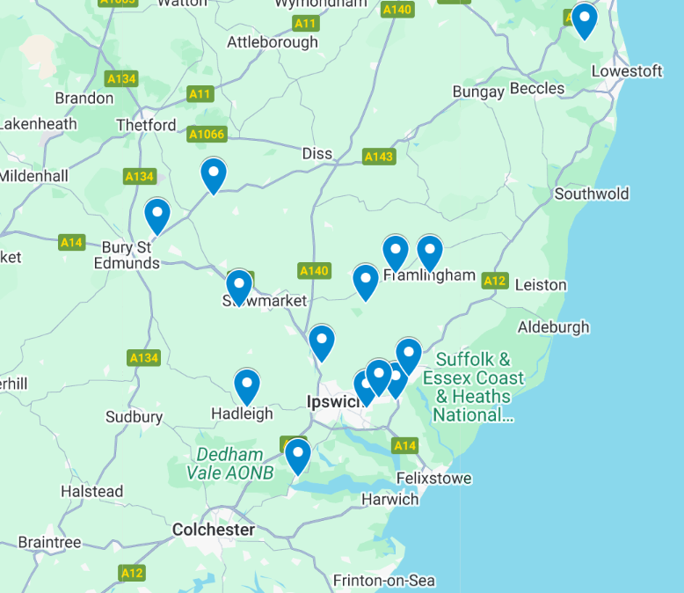



??
??
??
Notes:
Marc to add map and QR code

Slide 6

Introductions
On your tables:
Name, Role, School
Why are you here today?
Notes:
Beth

Slide 7

What are the similarities? Differences?
Which is the odd one out and why?
Notes:
1. Show the three images above and ask everyone to come up with as many similarities and differences as they can. If they get stuck, prompt them to think about:
appearance
what they do
where they might be found
2. Then, everyone needs to decide which one is the odd one out and why. Encourage a reason for every answer and there is no wrong answer!

Slide 8

















Our Schools, Our World Who is involved?
Brent | Devon | Bedfordshire | Leicester | Suffolk | Brighton and Hove
Notes:
Katie/Jonathan

Slide 9


Aims of Our Schools Our World
Develop an integrated environmental education curriculum gradually and systematically ‘greening’ the curriculum and supporting the development of green skills
Enable children and young people to develop a close connection with nature and our local biosphere
Create school organisational systems and practices which support sustainability and the school and regional Net Zero targets
Empower children and young people and their families to become changemakers both personally and collectively and inspire a strong sense of hope for the future

Slide 10

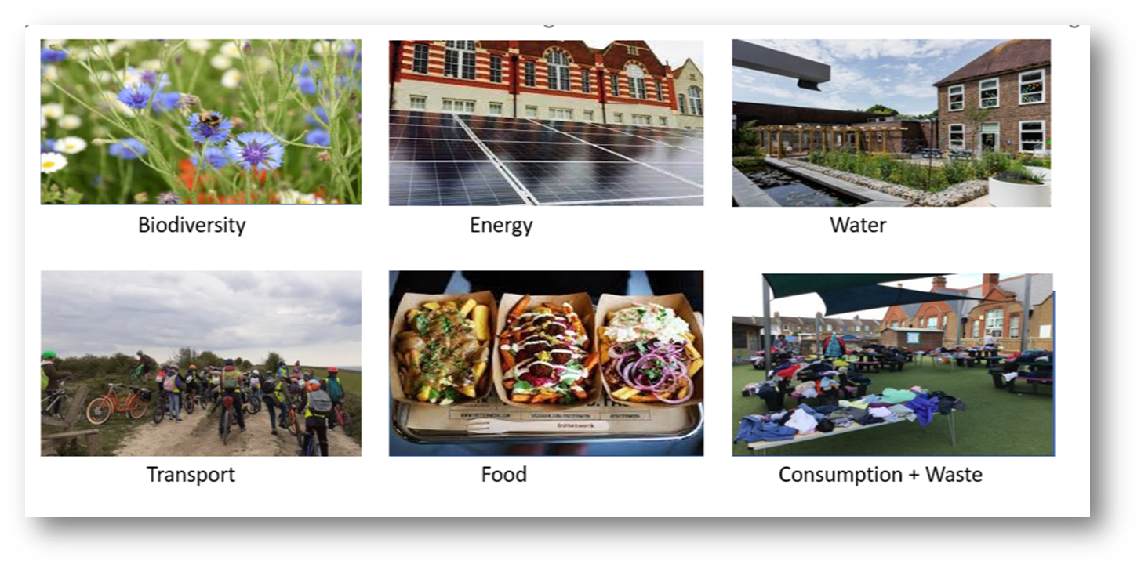
6 Themes

Slide 11

2 Year Rolling Programme
Curriculum
Concepts, Greening, Nature Connection
Theme 1
Assemblies
Actions
Theme 2
Assemblies
Actions
Theme 3
Assemblies
Actions
Theme 4
Assemblies
Actions
Theme 5
Assemblies
Actions
Theme 6
Assemblies
Actions
School Operations
Working towards Zero Carbon

Slide 12
The process
School Community
Training
Nature Connection
School
Surveys
Assemblies + Action
Local Authority
Local experts and organisations
Strategy Group
Net Zero Audits
Launch
Curriculum Review
Student and stakeholder voice

Slide 13
Strategy Group
Headteacher | Lead the vision and strategy Facilitate the delivery of OSOW
Governor | Ensure OSOW is on FGB and committee agendas Monitoring and evaluation
Senior Programme Lead | Lead and monitor the implementation of the framework alongside headteacher Coordinate training and establish links between the school, local organisations and Climate Action Advisors

Slide 14
Strategy Group
School Business Manager | Lead on the decarbonisation and procurement element of the Climate Action Plan and support work on biodiversity, adaptation and resilience Support the implementation of the framework through practical actions e.g. sending out surveys
School Site Manager | Provide practical support and advice to the School Business Manager around school operations, identify opportunities to reduce emissions and increase biodiversity in school buildings and grounds
Others e.g. parents, local community, local organisations, young people | Link schools, families and local communities Bring in expertise to enrich the strategy

Slide 15


Slide 16
Climate Change Basics
CAUSE
CONSEQUENCE
Human Activity
Greenhouse Gases
Greenhouse Effect
Climate Consequences
Impact on the Planet
Impact on Humans
Impact on Biodiversity
SOLUTIONS ?

Slide 17
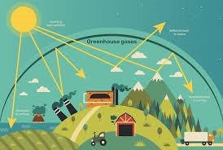
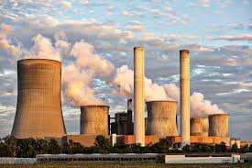
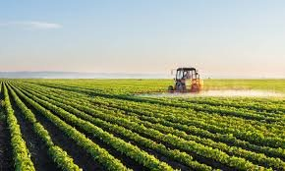
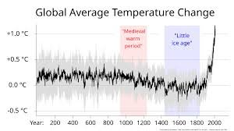


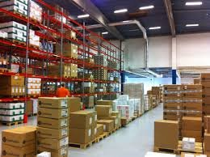
CAUSE
CONSEQUENCE
Human Activity
Greenhouse Gases
Greenhouse Effect
Impact on our Climate
Impact on the Planet
Impact on Humans
Impact on Biodiversity
SOLUTIONS ?

Slide 18

https://youtu.be/rWuKYuEOI9k

Slide 19
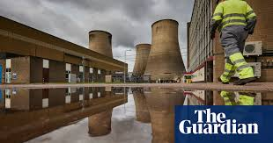
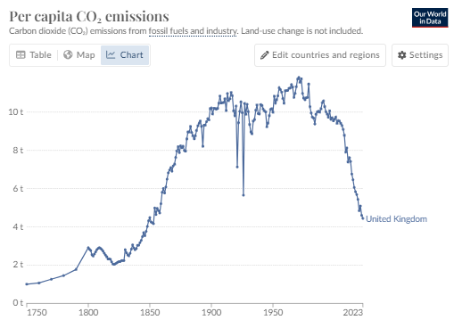
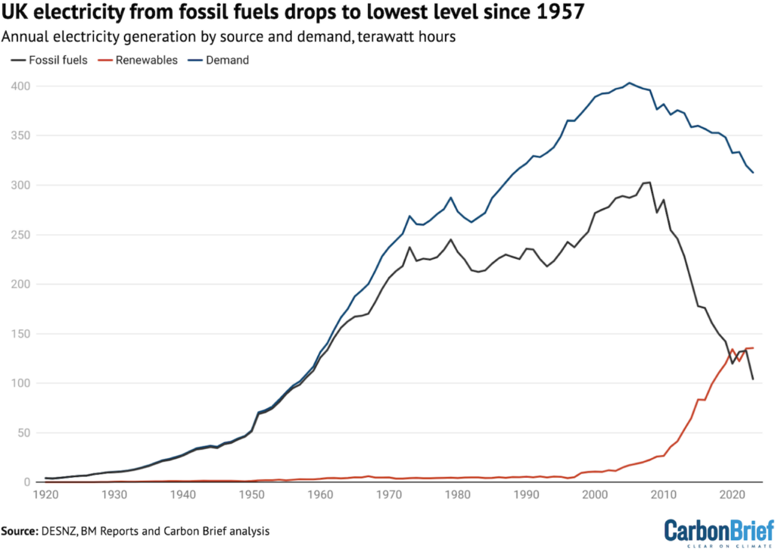
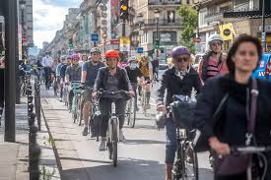
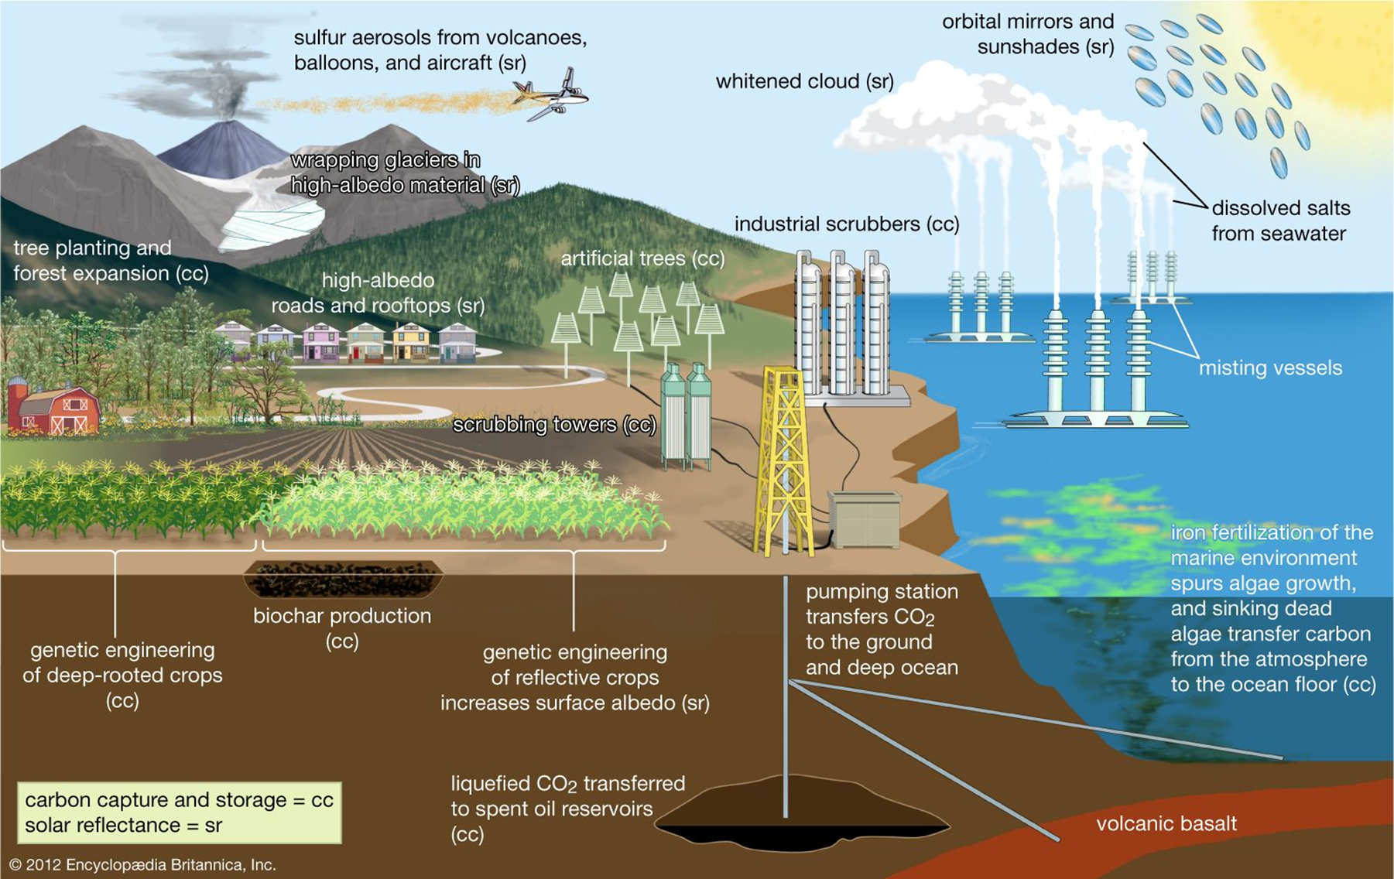

Reasons for optimism
Reasons for Optimism – nationally & globally

Slide 20
Our Schools, Our World
Decarbonisation – GHG emissions in INSERT

Slide 21
Local Net Zero Plan INSERT

Slide 22
Good news stories from INSERT

Slide 23

Positive action in our schools - sharing good news
Notes:
Adding to the rising number of community energy projects in the UK, Nayland Primary School has unveiled its 15.54kW solar installation in Suffolk. Made possible by the Green Energy Nayland scheme, the school will now benefit from free electricity and bill savings for over 25 years.

Slide 24
Planning for Effective Action
Set ‘smart’ targets – balance of impact and ease
Roles and responsibilities
Education and understanding
Campaigning
Audit / establish baselines
Cultural, behavioural and operational change evaluated
SMART
Specific
Measurable
Achievable
Relevant
Timetabled
Action

Slide 25

A New Vision
What if…
Energy
Consumption and Waste
Transport
What if…
Food
Water
Biodiversity

Slide 26

DfE Sustainability & Climate Change
Sustainability and Climate Change Strategy
By 2025:​
All education settings will have nominated a sustainability lead
​
All education settings will have put in place a climate action plan
decarbonisation
adaptation and resilience
biodiversity
climate education and green careers

Slide 27
DfE Sustainability & Climate Change
Sustainability and Climate Change Strategy
By 2025:​
All education settings will have nominated a sustainability lead
​
All education settings will have put in place a climate action plan
Decarbonisation – energy, transport, food, consumption & waste
adaptation and resilience
biodiversity
climate education and green careers

Slide 28
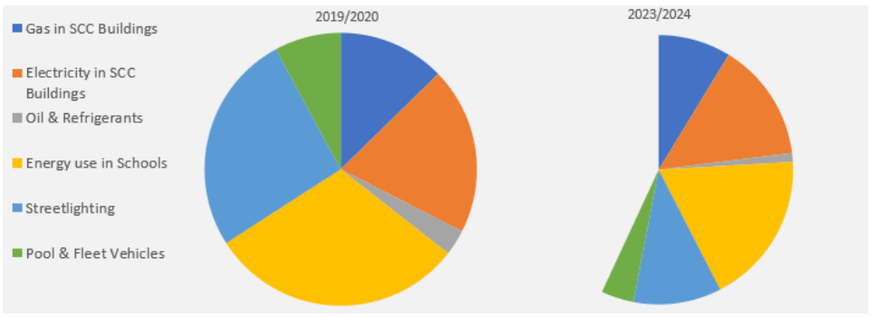
Decarbonisation – School Emissions in Suffolk

Slide 29
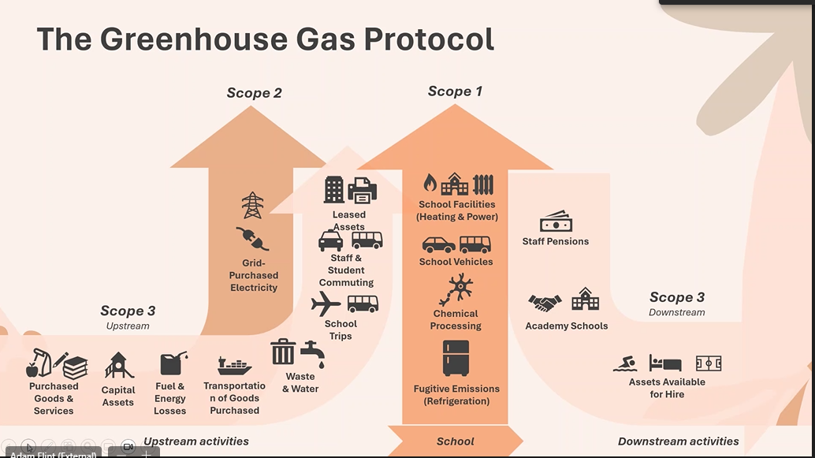
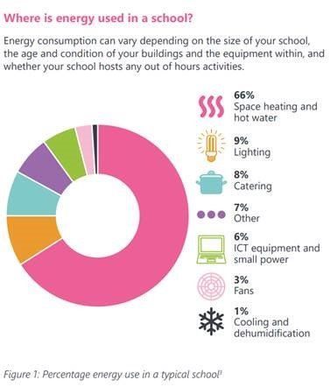
Decarbonisation – scope 1,2,3 emissions

Slide 30
Decarbonisation – School Emissions
Can you put the following in the correct order?
Transport
Food
Energy
Waste
Procurement
Lowest Emissions
Highest Emissions

Slide 31
Decarbonisation – School Emissions
Waste
Food
Energy
Transport
Procurement
1%
8%
23%
33%
36%
Lowest Emissions
Highest Emissions

Slide 32
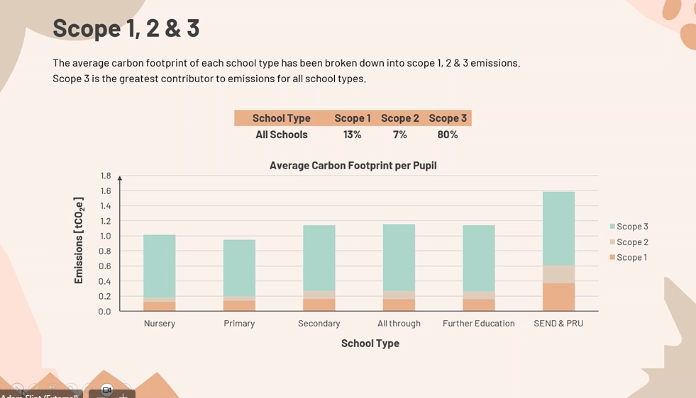
Scope 1,2 & 3 emissions

Slide 33
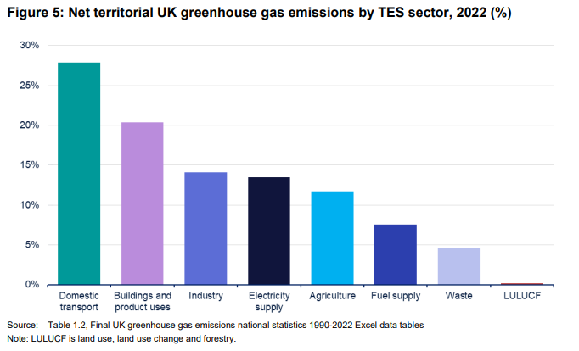
Decarbonisation - transport
INSERT local transport emission graph

Slide 34
Decarbonisation – transport + air quality
INSERT LOCAL AIR QUALITY MAP
Long-term exposure to poor air quality is responsible for up to 36,000 deaths per year in the UK
What responsibility do schools have for emissions caused by journeys to school?
What implications does this have for school trips?

Slide 35
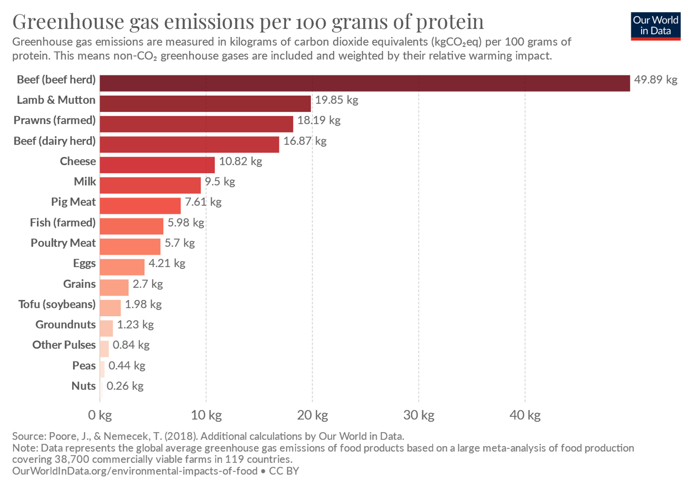
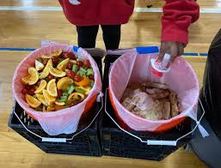
Decarbonisation - Food Considering the GHG emissions of red meat and food waste
60%+ of food GHG
10%+of all human induced GHG
What questions should we be asking about our school food provision?

Slide 36
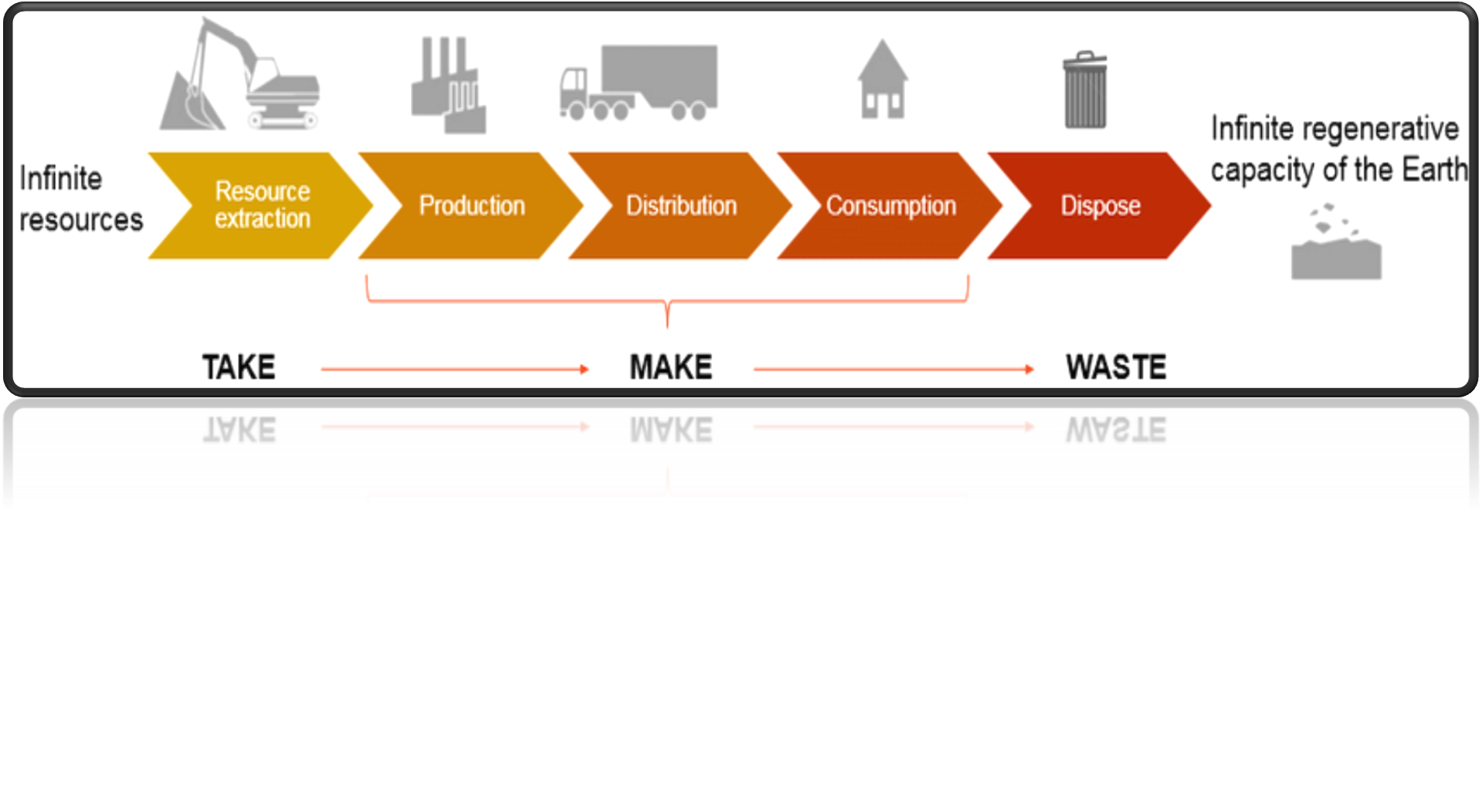



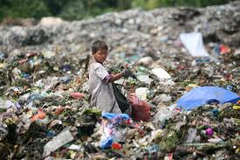
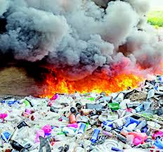
Resources

Slide 37
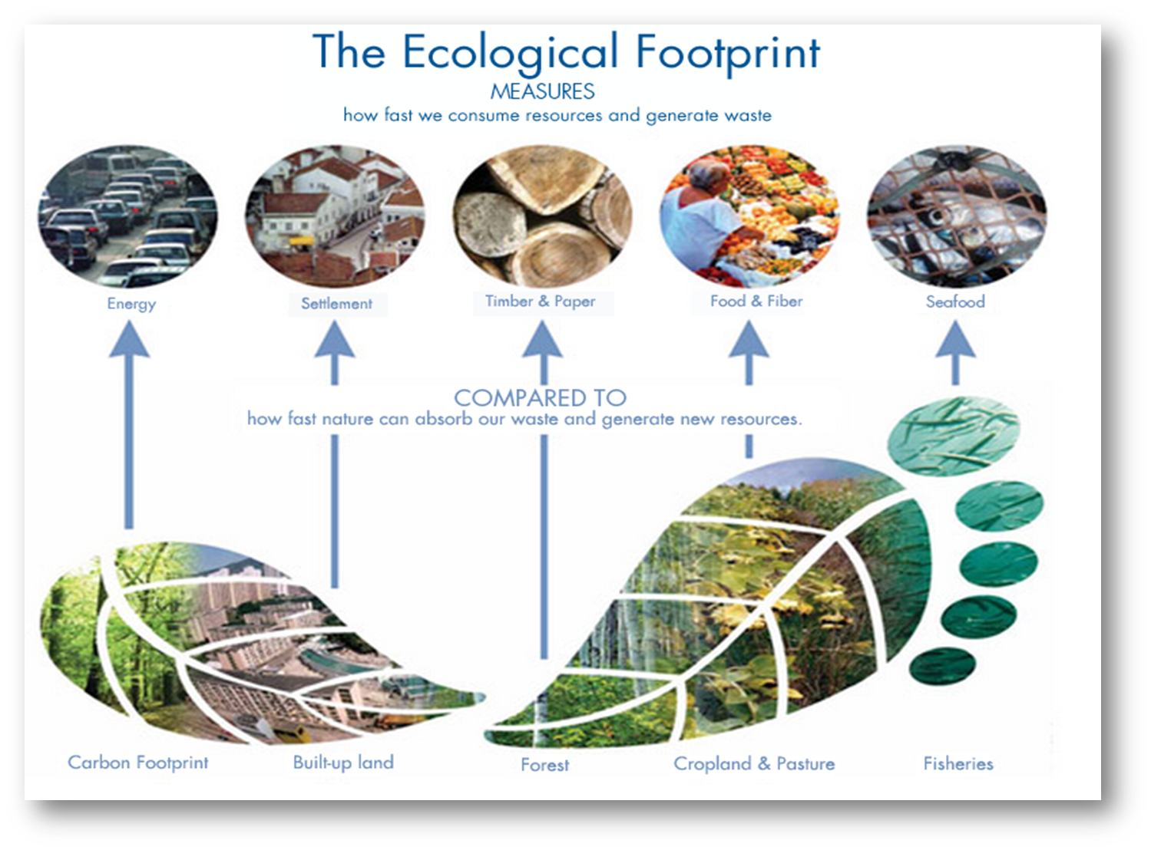
Procurement & Ecological Footprint

Slide 38
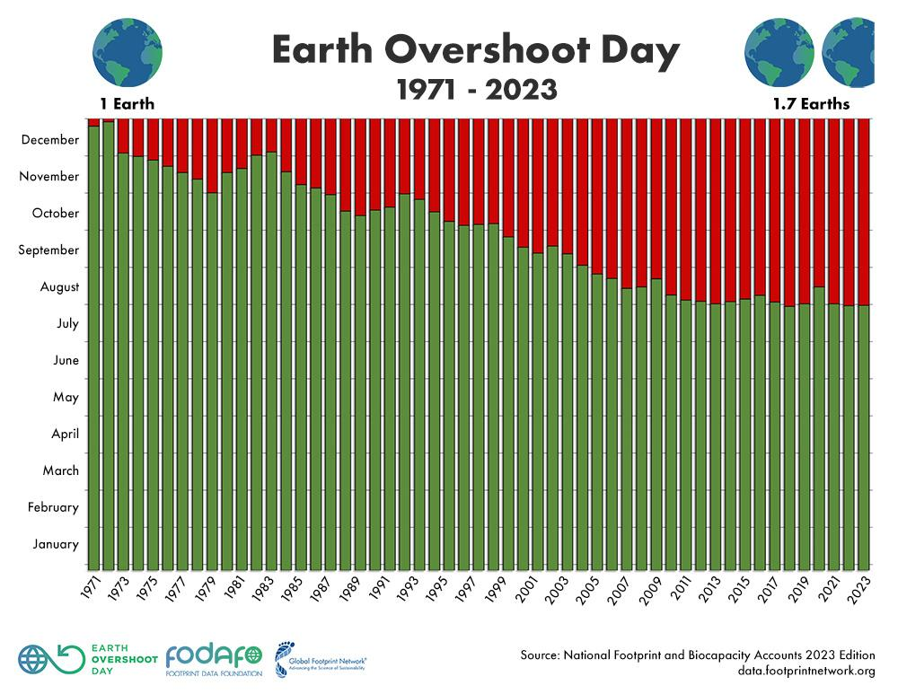
Earth Overshoot Day

Slide 39

A global perspective

Slide 40
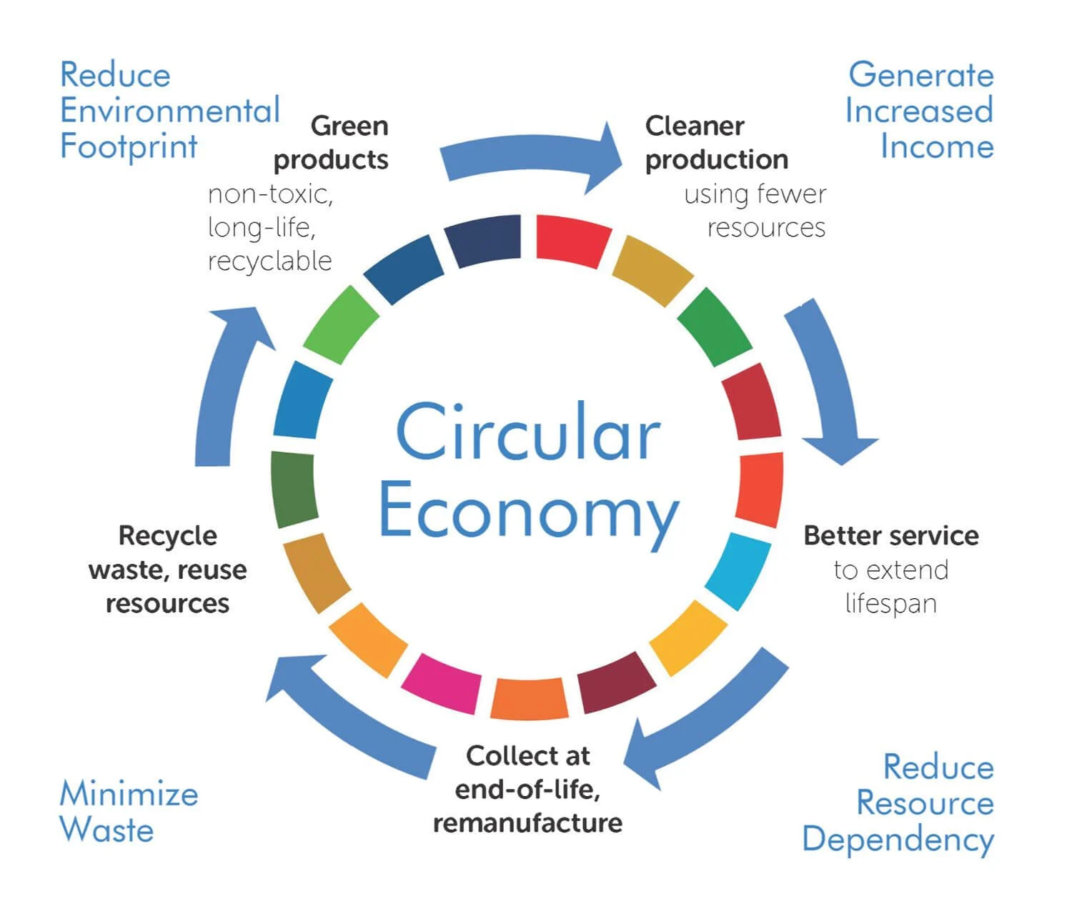
Circular Economy

Slide 41
Change Our Approach
1.REFUSE
2.REDUCE
3.REUSE
4.REPAIR
5.REPURPOSE
6.RECYCLE
7.RECOVER

Slide 42
Procurement
A good procurement decision
Initial cost
Greener product e.g. fair trade, energy efficient, recycled
Delivery
Running costs
Management/Servicing
Disposal
36-42% of school carbon emissions come from procurement

Slide 43
Procurement
Is your purchase necessary? What alternative solutions may be available?
Sharing equipment or services with another school
Taking from a local business
Working in a different ways
Reducing
Reducing waste
Reusing
Repairing
Repurposing
Amnesty
Extended warranties
Consider an audit e.g. a print audit
Could you gain from economies of scale by delaying short-term purchases where possible/sharing purchases with another school? Bundling together purchases from the same supplier can cut down delivery costs – less mileage means less fuel consumed to supply you.

Slide 44
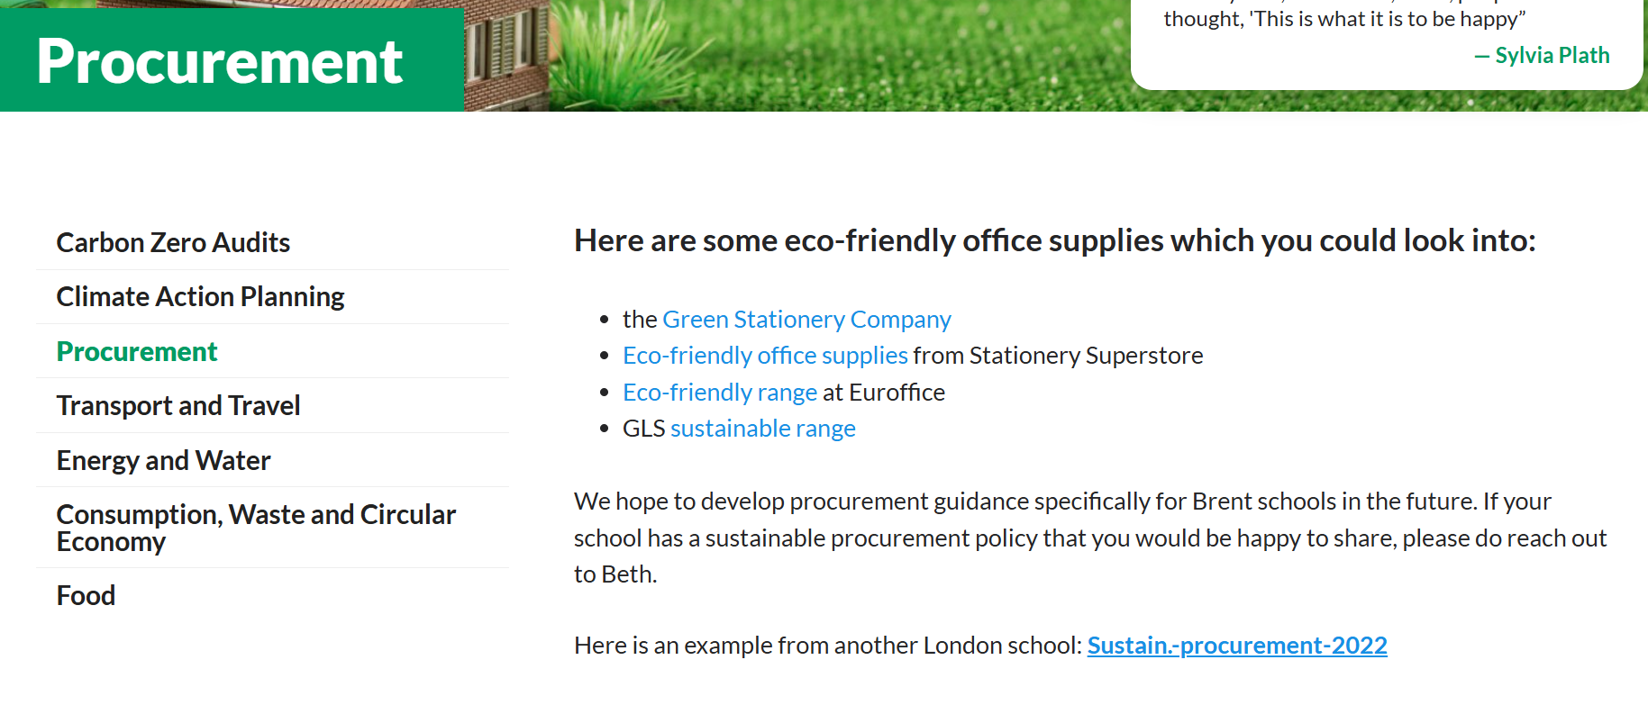
Procurement

Slide 45
DfE Sustainability & Climate Change
Sustainability and Climate Change Strategy
By 2025:​
All education settings will have nominated a sustainability lead
​
All education settings will have put in place a climate action plan
decarbonisation
adaptation and resilience - water
biodiversity
climate education and green careers

Slide 46
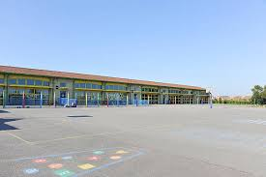
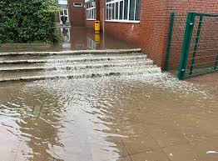
Adaptation & Resilience
Are our schools prepared for hotter summers and wetter winters?

Slide 47
Adaptation & Resilience
Are our schools prepared for hotter summers and wetter winters?
INSERT local flood / heat risk maps

Slide 48
Adaptation & Resilience
Are our schools prepared for hotter summers and wetter winters?

Slide 49
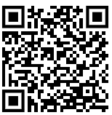
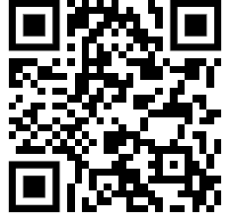
Adaptation and Resilience
Scan for UK Government flood risk map
Scan for UK Government heat risk map
Notes:
the long term flood risk for an area in England
the possible causes of flooding
how to manage flood risk

Slide 50
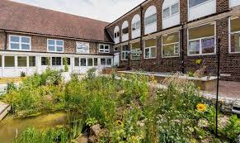
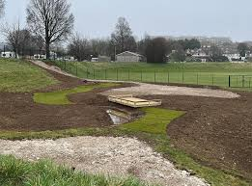
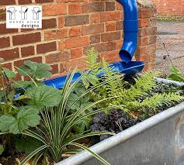
Adaptation & Resilience - Water
INSERT LOCAL EGS

Slide 51
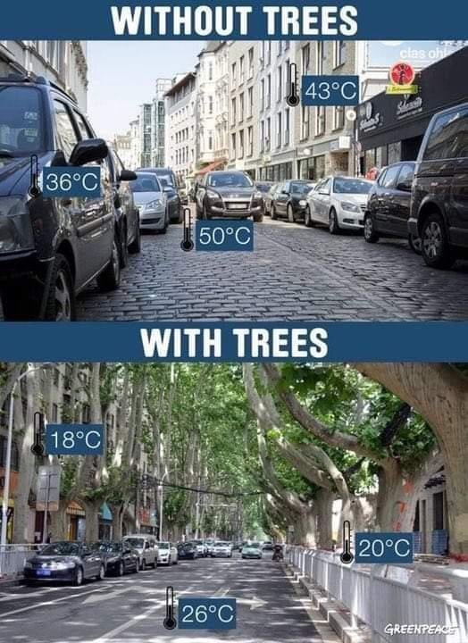
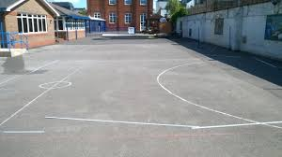
Adaptation & Resilience Nature Based Solutions

Slide 52
DfE Sustainability & Climate Change
Sustainability and Climate Change Strategy
By 2025:​
All education settings will have nominated a sustainability lead
​
All education settings will have put in place a climate action plan
decarbonisation
adaptation and resilience
biodiversity
climate education and green careers

Slide 53
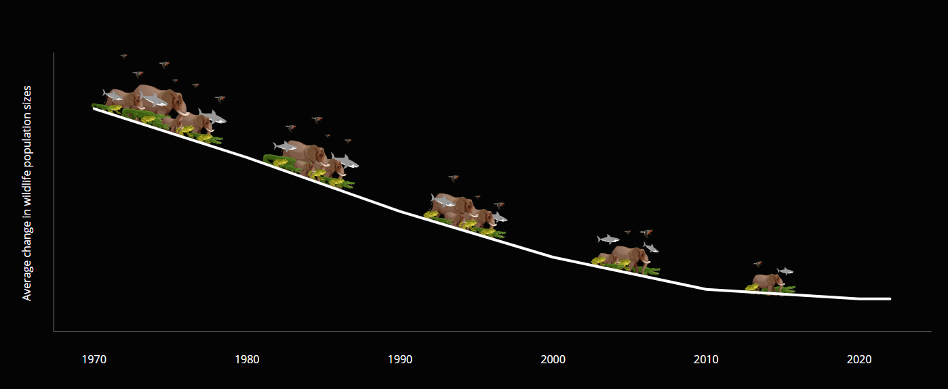

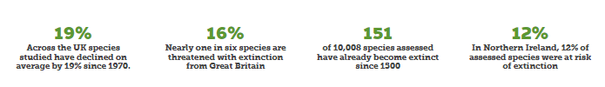
Biodiversity Loss – Living Planet Report 2024

Slide 54
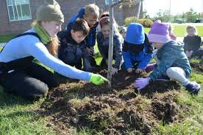
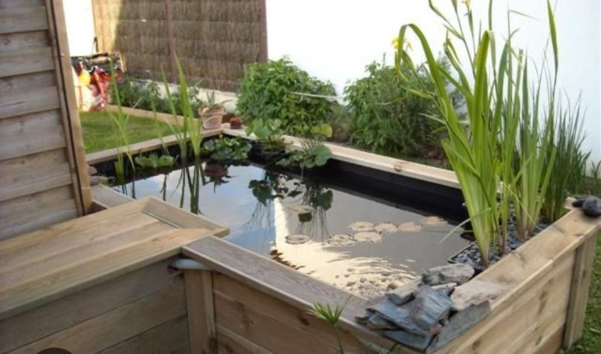
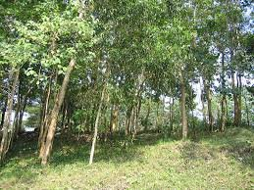
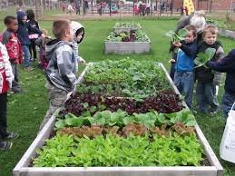
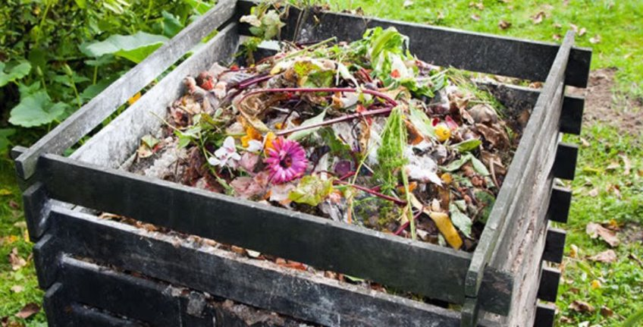
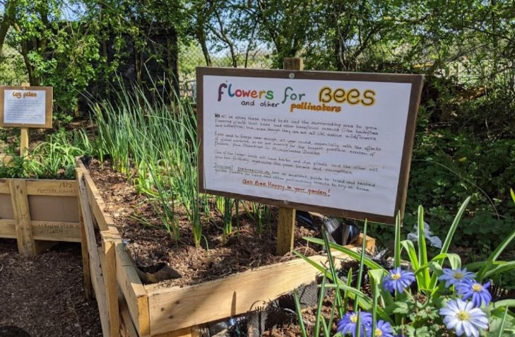
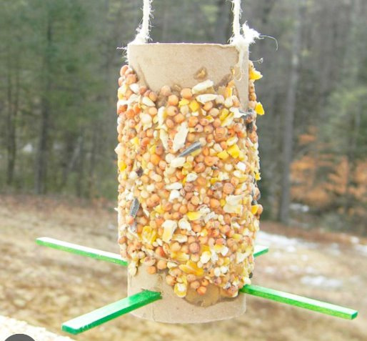
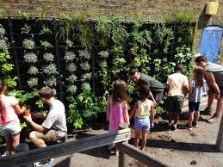
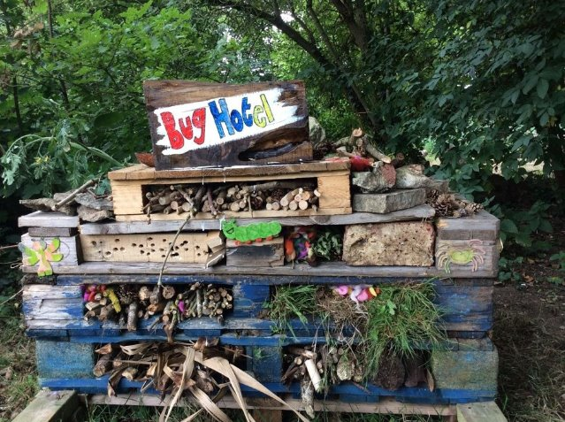
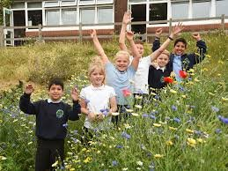
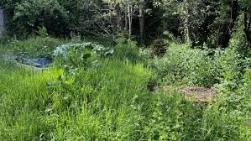
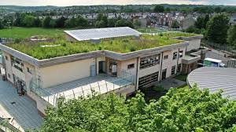

Slide 55
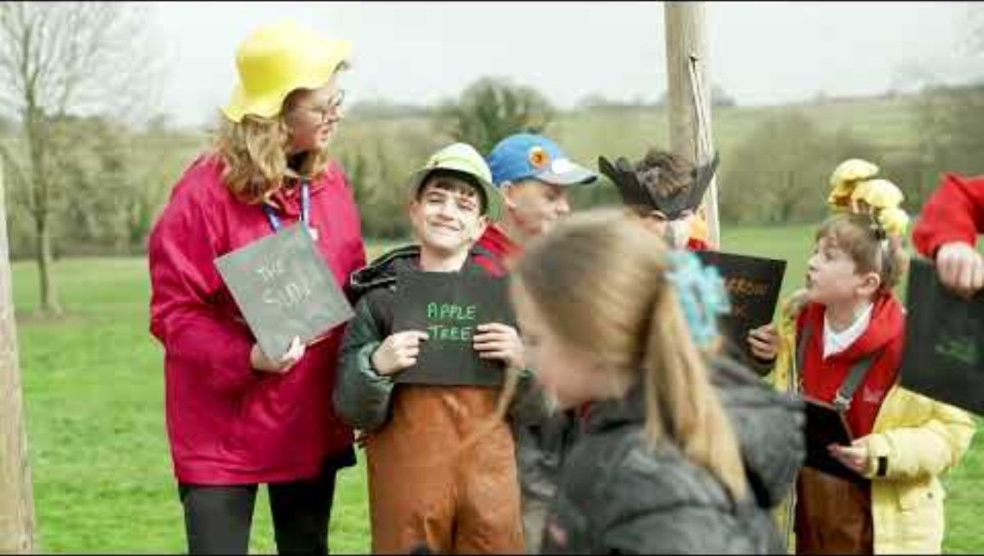
National Education Nature Park

Slide 56
DfE Sustainability & Climate Change
Sustainability and Climate Change Strategy
By 2025:​
All education settings will have nominated a sustainability lead
​
All education settings will have put in place a climate action plan
decarbonisation
adaptation and resilience
biodiversity
climate education and green careers

Slide 57

Climate Education & Green Careers
www.osow-suffolk.co.uk Climate999

Slide 58
Decarbonisation – opportunity for pledges?
Waste: Remove single use plastics from our classes, staffroom, catering operations and school events
Food: Promote a lower emissions menu, a greater plant-based offering and a significant reduction in food waste
Energy: Reduce carbon emissions from energy by 20%
Water: Reduce water use by 20%
Biodiversity: Increase the amount of land given over to supporting biodiversity by 10%
Transport: Reduce staff car travel to school by 20% (one day less a week)
Leadership: Sign up to Let's Go Zero & track carbon emissions using the Count Your Carbon tool

Slide 59
Let’s Go Zero
Support for Schools

Slide 60



Let’s Go Zero
The national campaign for all school colleges and nurseries to be zero carbon by 2030.
Over 5,000 schools, colleges and nurseries signed up to the campaign.
Representing over 2 million students.
Join the campaign now…
www.letsgozero.org/join

Slide 61

Climate Action Advisors
32 Climate Action Advisors across England, offering free and impartial advice to help schools develop their climate action plans and support to implement them.
Notes:
Our service is free and all our advice is impartial

Slide 62


The East of England Climate Action Advisor team
Luciana Almeida – Cambs, Suffolk & Essex
Nige’ Stannett – Norfolk, Suffolk & Cambs
Jeremy Williams – Beds, Herts & Essex
Register for free Climate Action Advisor
support:

Slide 63





























Let’s Go Zero works collaboratively
Our coalition
Our partners

Slide 64


“The Sisterhood” projects
“If you work with one of us, you work with all of us!”

Slide 65

Climate Ambassadors

Slide 66

National Education Nature Park

Slide 67

Sustainability Support for Education Hub

Slide 68

Energy Sparks
Energy Sparks works with schools to offer a unique, effective energy management tool, which monitors energy use and provides bespoke, simple low / no-cost recommendations, provided weekly.
Costs £545 a year - but the average primary school saves £3,000 per year (some free places)
Learning opportunities through interactive pupil dashboard and education programme, which includes a range of over 140 activities and resources including lesson plans.
Tailored induction webinars for range of school staff. Guidance on over 60 low and no-cost actions.
Set targets and track progress. Score points and compete with other schools.
Additional optional services such as energy audits and assemblies also available at additional cost.

Slide 69


£100 a week saving
£300 a week saving
£200 a week saving

Slide 70



Solar for Schools
Solar for Schools was set up with the aim of educating the next generation on energy and decarbonisation. Putting solar panels on school rooftops, and then using that solar - and the revenue from it - to enable that education, is the purpose behind Solar for Schools.
Energy Education
Viability Analysis
Grants and Funding
Project Development
Design and Procurement
Build Management
Asset Management
Funder Management

Slide 71

Greater South East Net Zero Hub
Support for public sector buildings including schools on:
Adding insulation
Installing more energy efficient lighting
Installing low carbon heating tech such as heat pumps
Connection or development of a heat network
Generation of renewable power.

Slide 72



Retrofit Action for Tomorrow (RAFT)
RAFT is committed to a vision of zero carbon, energy efficient, healthy and climate resilient schools, with deeply-engaged communities leading the way in a fair and just transition of society
School engagement workshops
Heat decarbonisation plans
Detailed retrofit design
Community engagement
Whole life carbon studies
Estate decarbonisation studies.

Slide 73

Historic England guide
Understanding the building
Whole building approach
Improving energy efficiency
Improving Climate resilience
Modifying Windows and doors
Installing insulation
Installing renewable technology
Maintenance and repair
Rainwater Goods

Slide 74




Water – Anglian Water
Range of free services for schools.
Self-led water audit
Water saving advice
Lesson plans and activities
Online sessions – book early
Notes:
school-water-audit.pdf (anglianwater.co.uk)

Slide 75

Scan here for Climate Action Advisor support:
Get started by completing our expression of interest form at letsgozero.org/climate-action-advisors
Let’s Go Zero is a campaign led by Ashden, and supported by Green Future Investments Ltd. All content © 2024 Ashden. Registered number: 05062574, Charity number: 1104153.
www.letsgozero.org
charity no: 1104153

Slide 76
Lunch
Please be back ready to start promptly at 1.15 :)

Slide 77

Climate Action Plans
Louise Robson – Keep Britain Tidy

Slide 78
Climate Actions
Cost - circle
Impact
High Impact
Low Impact
Ease
Easy
Difficult
Can you share any other actions?

Slide 79



Waste
INSERT LOCAL INFO
Simpler Recycling Regulations March 2025
Ensure identified waste streams are being separated and collected.
Includes food waste.
Pupil led project to reduce single use plastics in school.
Accreditation scheme.

Slide 80

Transport
Free support for schools to create active travel actions plans.
Accredited scheme.
STARS school travel award.
INSERT LOCAL INFO

Slide 81



Food - ProVeg
Provides free support to school caterers to make small changes to menus that can have a big impact on children’s health and the health of the planet.
Menu consultation and advice
Recipe guides
Impact assessment
Accreditation scheme
Collaboration with service providers
Lesson plans and activities

Slide 82
Funding sources
Everyday Energy competition - £5,000 poster competition.
Low Carbon Skills Fund – Phase 5 now closed, but funds decarbonisation plans in schools.
Public Sector Decarbonisation Fund – Phase 4 now closed
Condition improvement Fund – eligible schools only (should already have received invitation)
Local funding from renewable energy schemes like Galloper Wind Farm Fund, Sizewell C Community Fund if applicable.
OVO Foundation – nature improvements but can be used for nature based solutions to flooding and shading.
National Nature Education Park funding – selected schools only (will have received info).
National Lottery
Solar for Schools – different funding mechanisms for solar.

Slide 83
2 Year Rolling Programme
Curriculum
Concepts, Greening, Nature Connection
Theme 1
Assemblies
Actions
Theme 2
Assemblies
Actions
Theme 3
Assemblies
Actions
Theme 4
Assemblies
Actions
Theme 5
Assemblies
Actions
Theme 6
Assemblies
Actions
School Operations
Working towards Zero Carbon

Slide 84

www.osow-suffolk.co.uk Climate999

Slide 85

Climate Action Plans
Who from your school would lead on this action?​
What resources or support might be needed?​
What is your target and how might you measure your progress?

Slide 86

Climate Action Plans

Slide 87

Climate Action Plans

Slide 88

Climate Action Plans

Slide 89

Climate Action Plans

Slide 90
How many actions have you taken?
Pillar | Example Actions
Energy | Monitor energy use and take regular actions (Energy Sparks) | Ensure BMS has efficient timings and temperatures e.g. 6am-1pm at 18°C in classrooms. | Switch to 100% LED lighting and install motion sensors in corridors and toilets | Install solar panels (Solar for Schools) | Implement a 'Power Down Policy' including both pupils and staff
Transport | Carry out travel surveys and create an Active Travel Plan (Modeshift STARS) | Run an 'Active Travel’ week each term | Install sufficient amount of bike and scooter racks | Run cycle proficiency classes (Bikeability) | Install electric vehicle charge-points
Food | Have 1-2 plant-based days a week | Review menu to make more sustainable (Pro-Veg) | Food waste recycling in all areas where food is produced and consumed. | Measure and reduce food waste from canteen | Grow a wide range of food in a school garden.
Procurement | Reduce branding on uniform and school items. | Implement a ‘Sustainable Procurement Policy’ and consider environmentally ethical items and companies. | Switch to a 100% renewable energy supplier | Switch to a green ethical bank | Ban use of pesticides / herbicides and use eco-friendly cleaning products
Waste | Recycling bins in all classrooms and offices with clear signage. | Set up a permanent second-hand uniform scheme | Take part in waste-reducing initiatives and ban single-use plastic bottles (Plastic Free Schools) | Hold regular community swap events for clothes, books, toys. | Establish community recycling collections e.g. textiles, batteries, ink cartridges, (many generate funds / vouchers)

Slide 91

Operations
UKSSN Operations Group

Slide 92
Local Groups
Would this be useful?
What would work best for you?

Slide 93
1. Sign up to Let's Go Zero and contact Climate Action Advisor 2. Meet with SPL and headteacher to complete the OSOW framework 3. Liaise with SPL re review meeting
Our Schools, Our World
Next Steps

Slide 94


Evaluation
Thank you
We look forward to working with you again soon!

Slide 95

Our Schools Our World Operations

