Slide 1
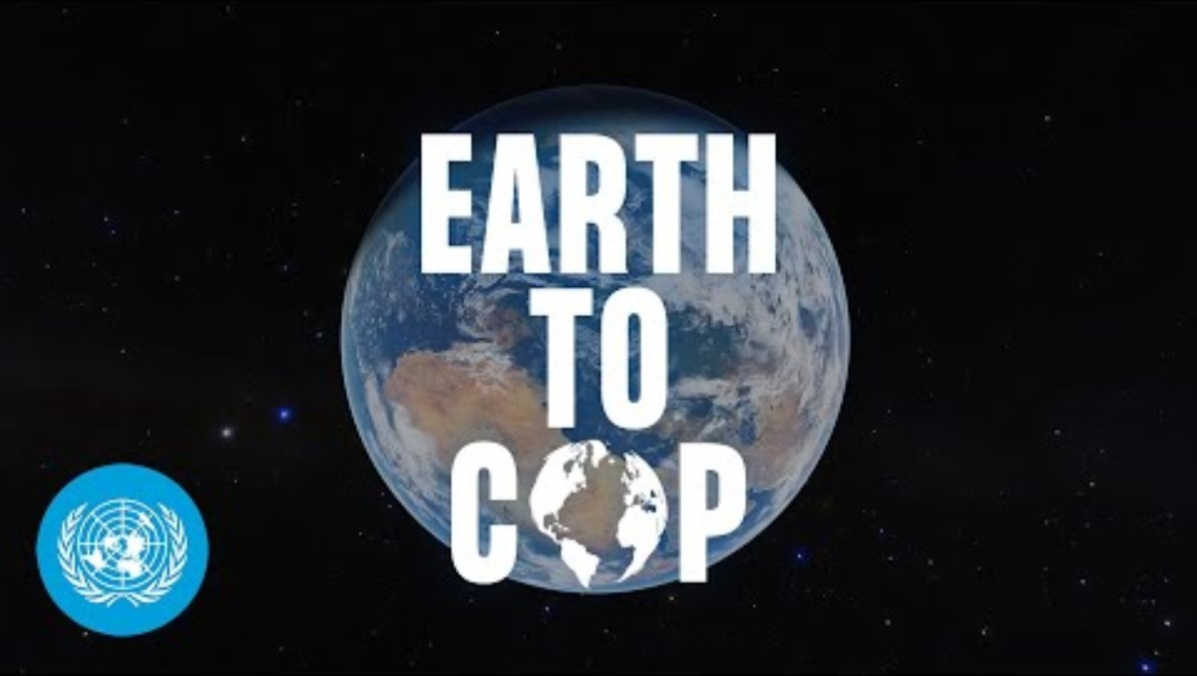

Slide 2


Slide 3

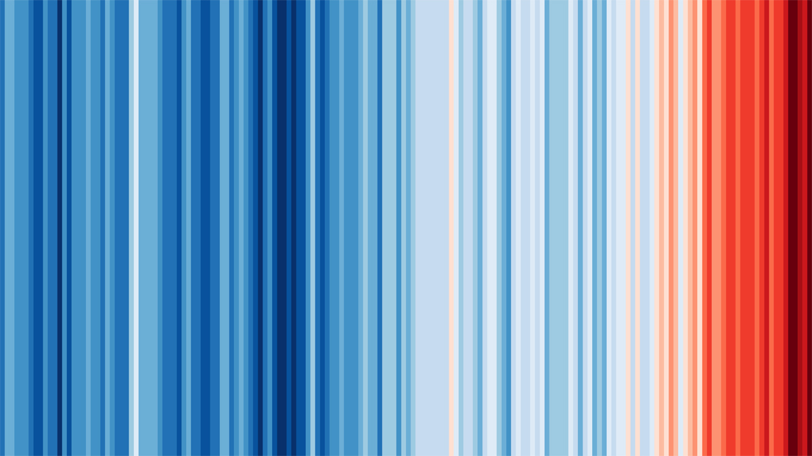
Climate Basics
1. It's warming
2. It's us
3. We're sure
4. It's bad
5. We can fix it

Slide 4
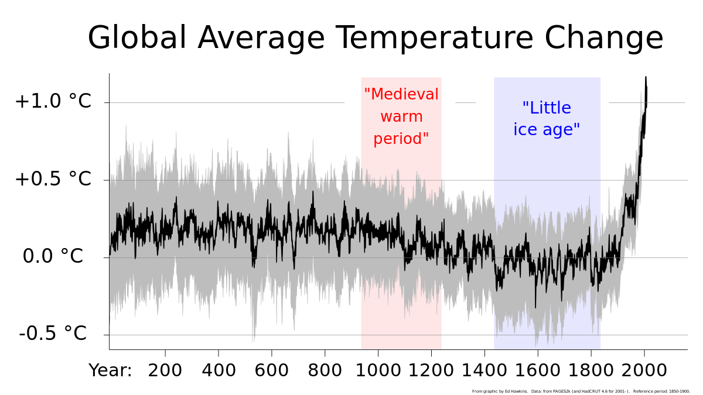
Climate Basics – it’s warming

Slide 5
This last year
INSERT WARMING STATS FROM MONTH / YEAR – the Met Office is a good source

Slide 6
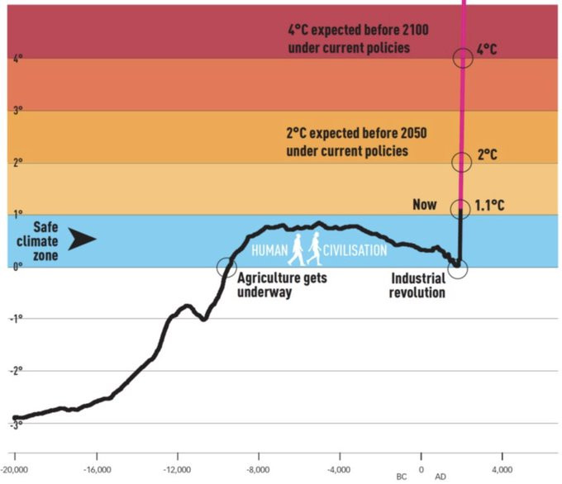
Our Schools Our World
Subtitle

Slide 7
Climate Basics
1. It's warming
2. It's us
3. We're sure
4. It's bad
5. We can fix it

Slide 8
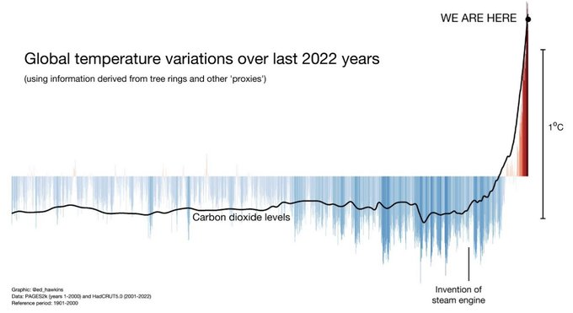
Climate Basics – It’s Us

Slide 9
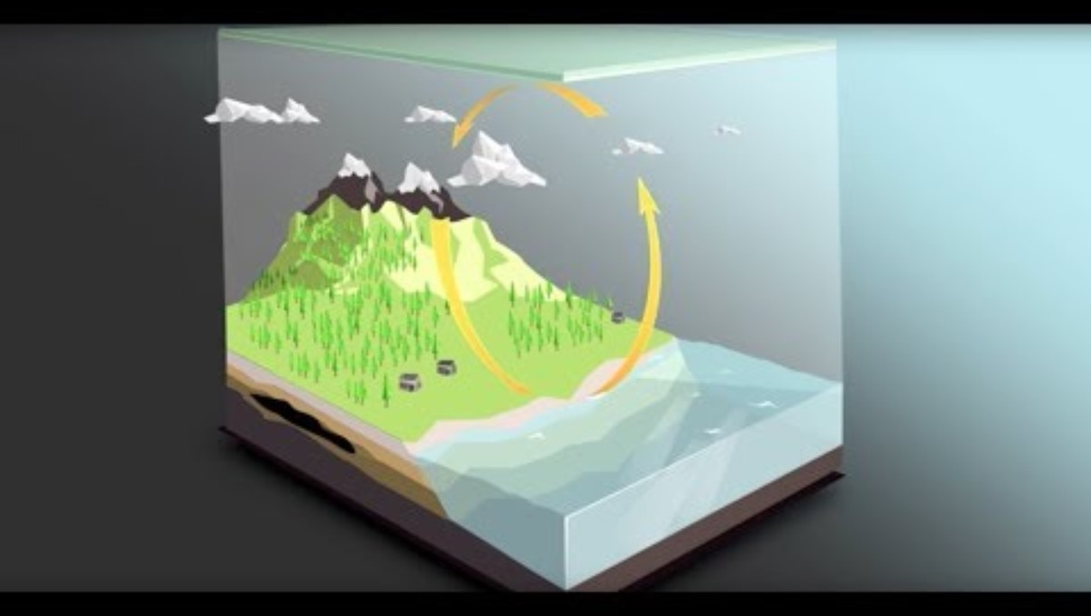

Slide 10
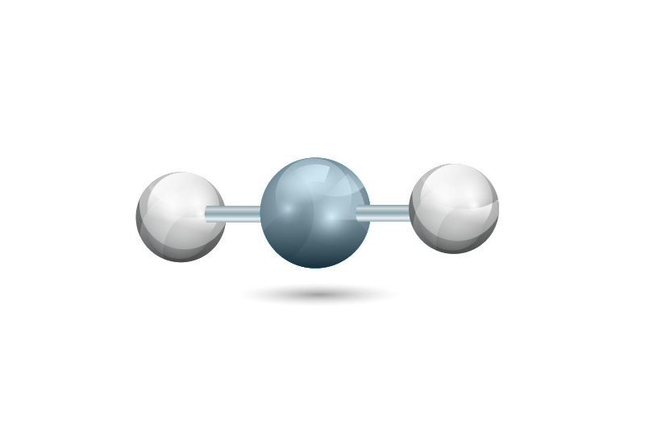

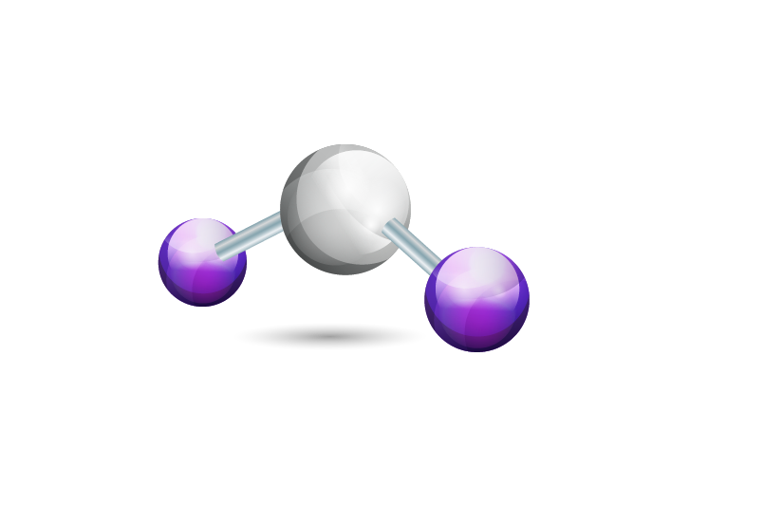

Climate Basics – Greenhouse Gases
Carbon Dioxide (CO₂)
Methane (CH₄)
Nitrous Oxide (N₂O)
F Gases (various)
1 28 265 10s-10,000s
Global warming potentials

Slide 11

Climate Basics – Tipping Points + Feedback Loops

Slide 12
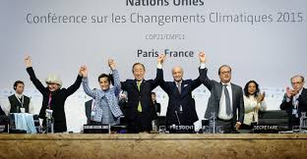
Climate Basics – Paris Agreement 2014
To "pursue efforts" to limit global temperature rises to 1.5C, and to keep them "well below" 2.0C above those recorded in pre-industrial times
To limit greenhouse gas emissions from human activity to the same levels that trees, soil and oceans can absorb naturally - known as net zero - between 2050 and 2100
Each country to set its own emission-reduction targets, reviewed every five years to raise ambitions
Richer countries to help poorer nations by providing funding, known as climate finance, to adapt to climate change and switch to renewable energy

Slide 13
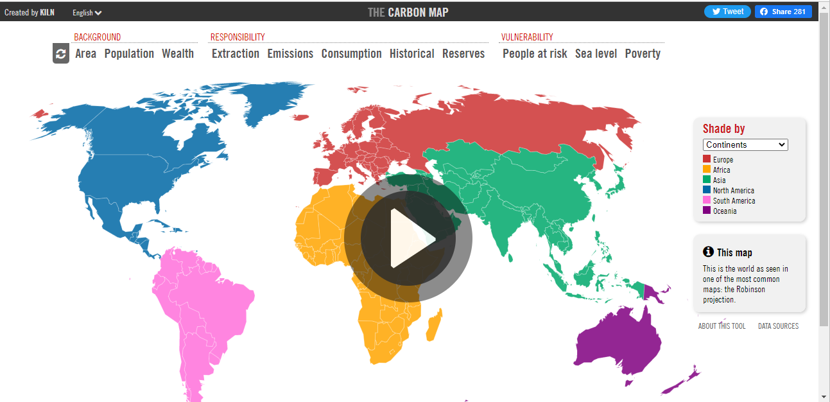
Climate Basics – Climate Justice
https://www.carbonmap.org/

Slide 14
Climate Basics
1. It's warming
2. It's us
3. We're sure
4. It's bad
5. We can fix it

Slide 15
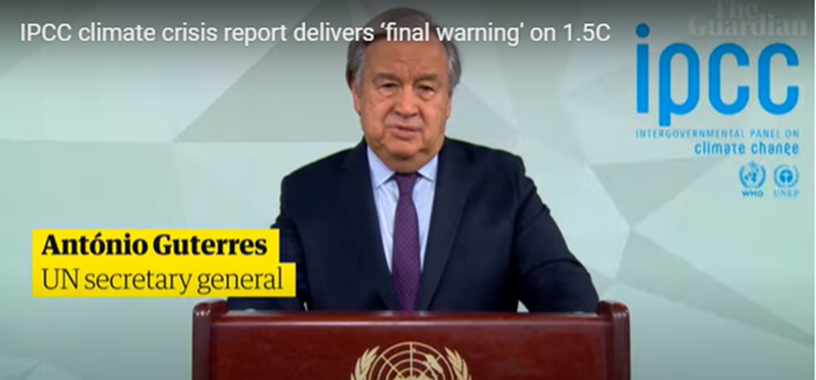
Climate Basics - IPCC
'Humanity is on thin ice' 'Time is running out. Irreversible climate tipping points lie alarmingly close'
'It is still possible to halt current climate change trends and secure a liveable future for all, but we must act now'

Slide 16
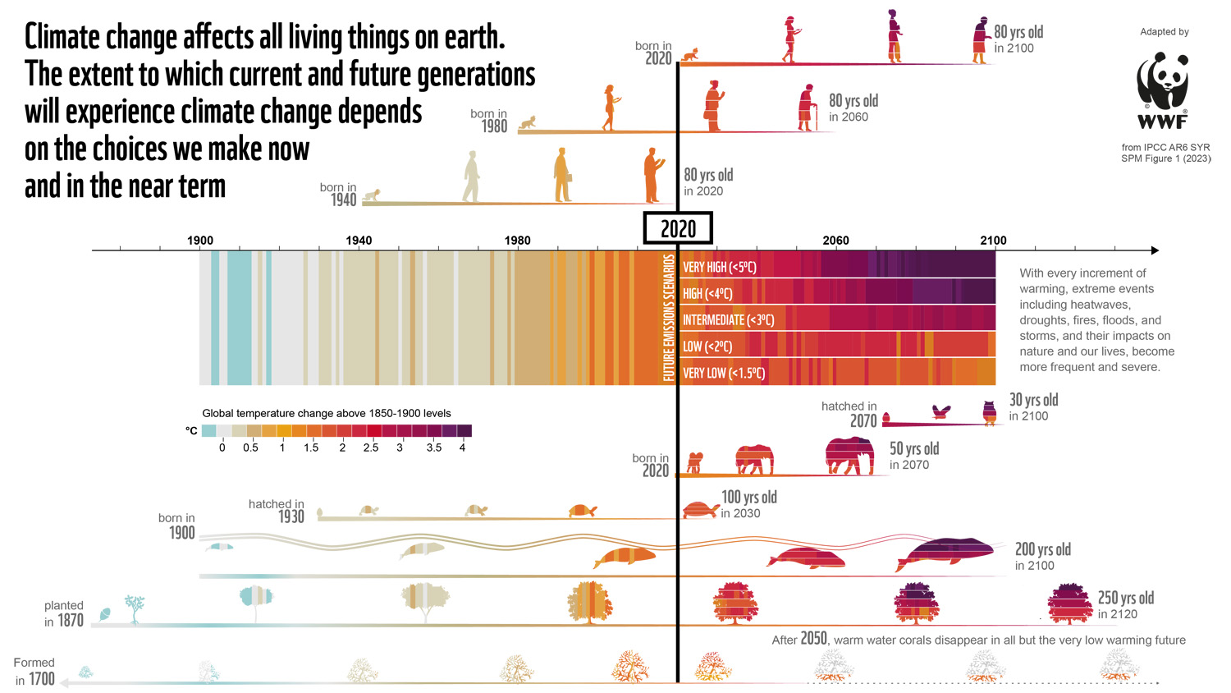


Slide 17
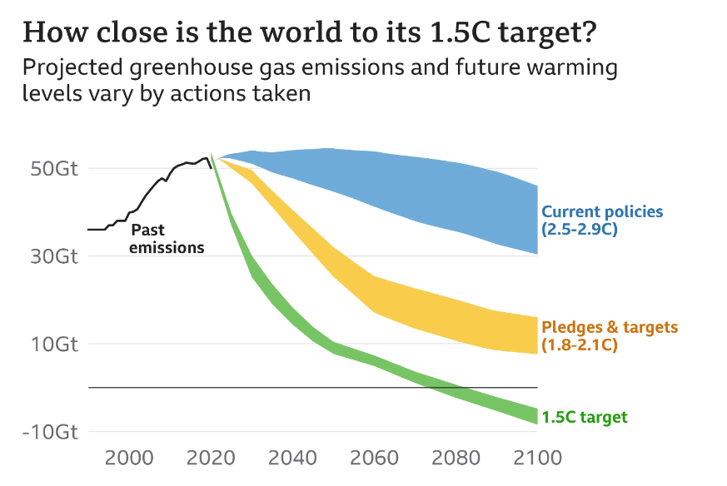
Subtitle

Slide 18
Climate Basics
1. It's warming
2. It's us
3. We're sure
4. It's bad
5. We can fix it

Slide 19
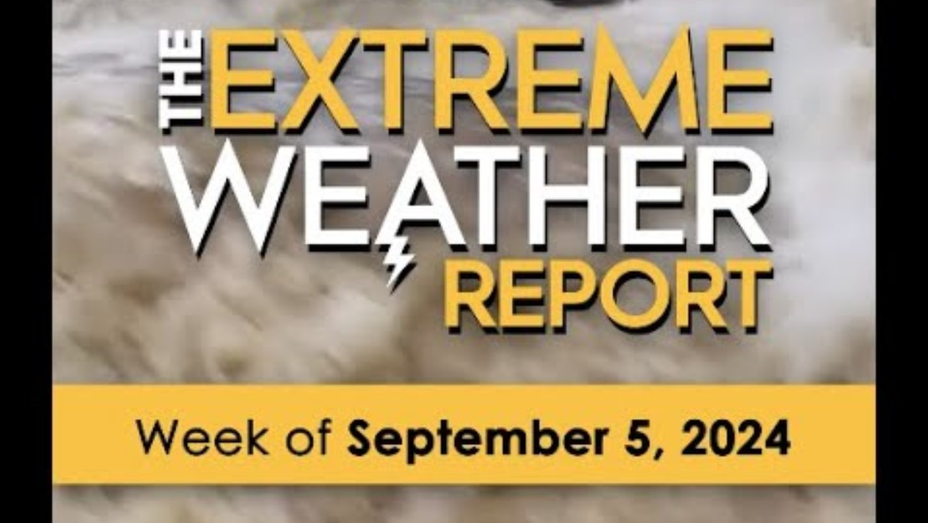
INSERT MORE RECENT REPORT FROM
June 26 | The Extreme Weather Report | Yellow Dot Studios

Slide 20
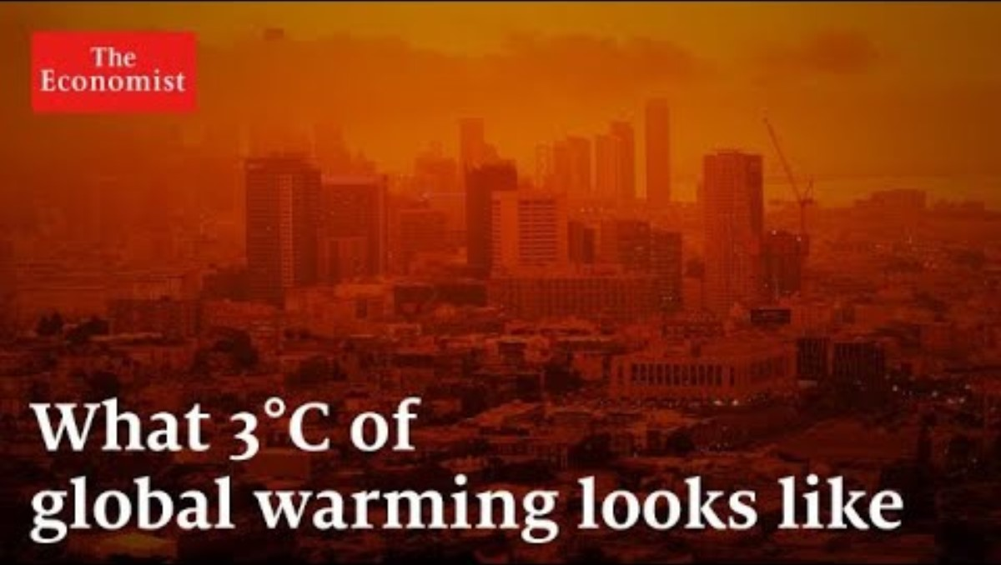

Slide 21
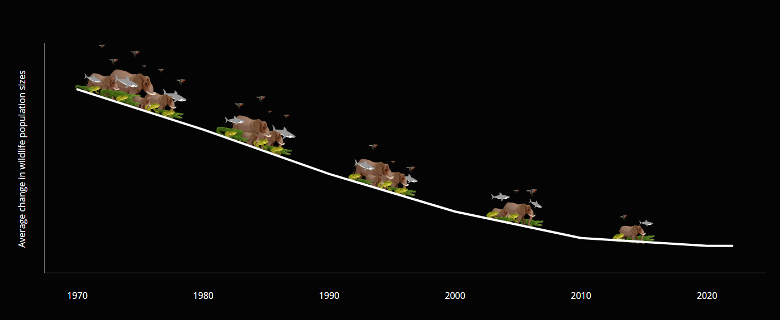

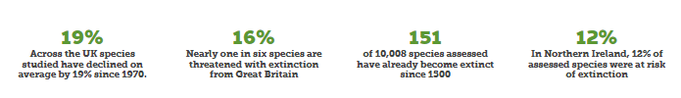
Biodiversity Loss – Living Planet Report 2024

Slide 22
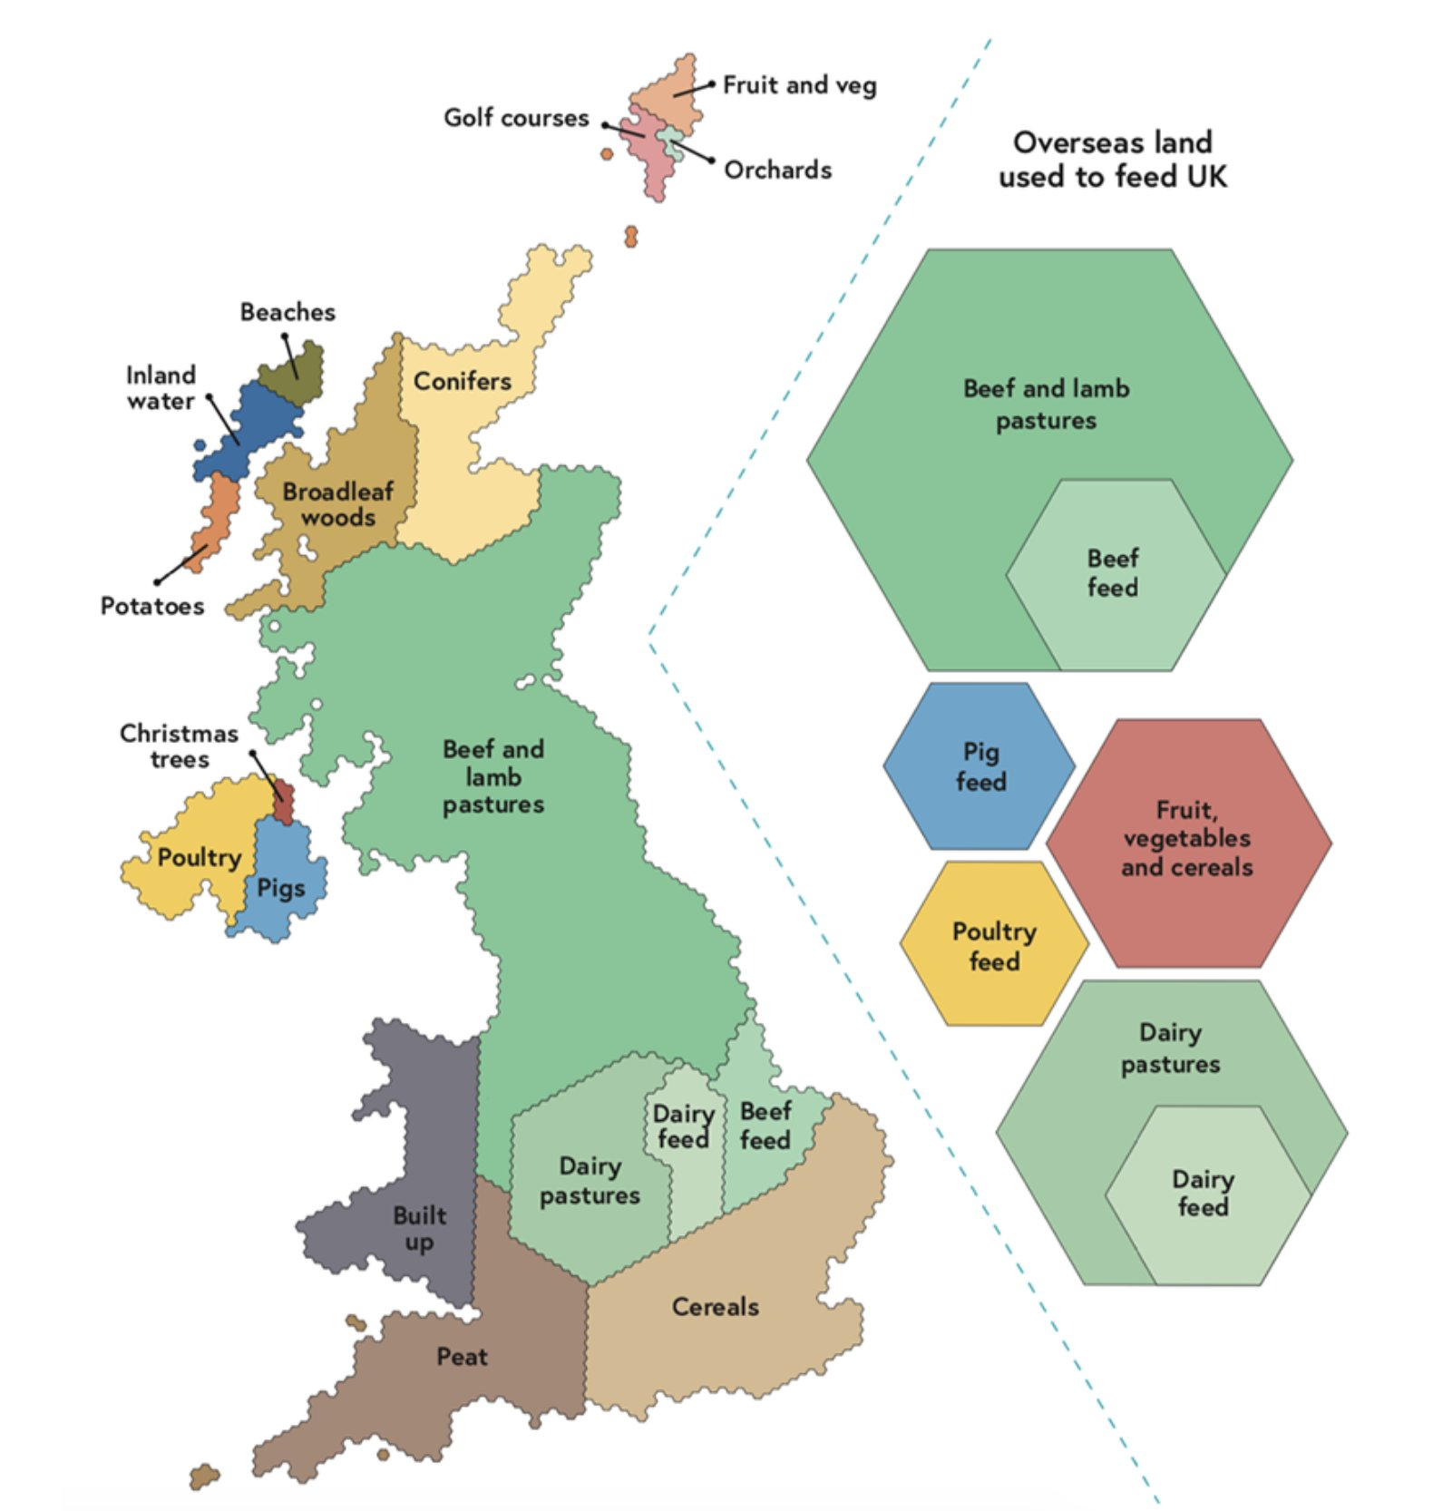
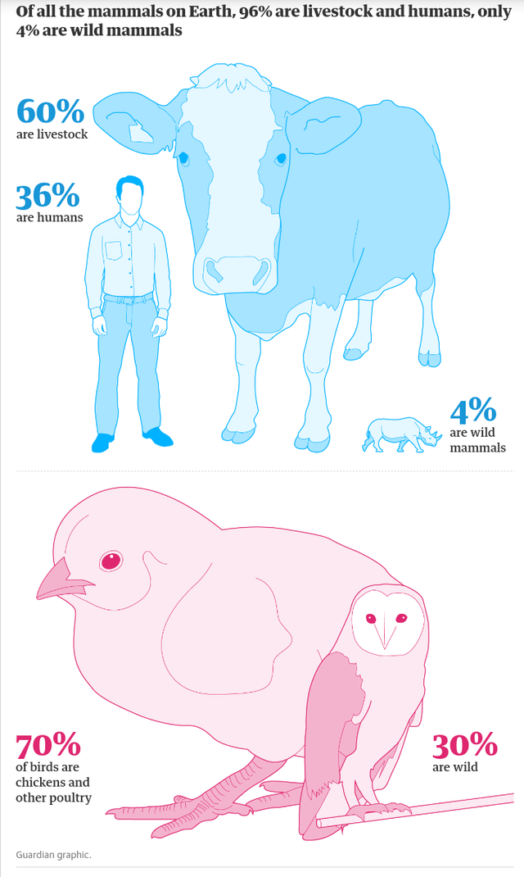
Biodiversity Loss, Food, Farming
Notes:
70% agriculture (mainly livestock and livestock feed and pasture)
Over half of total land use takes place overseas
Combined land area for rearing beef and lamb for UK consumption is larger than the UK itself
<1/10 of 1% of UK land is devoted to solar farms (sig. less than Christmas trees)

Slide 23
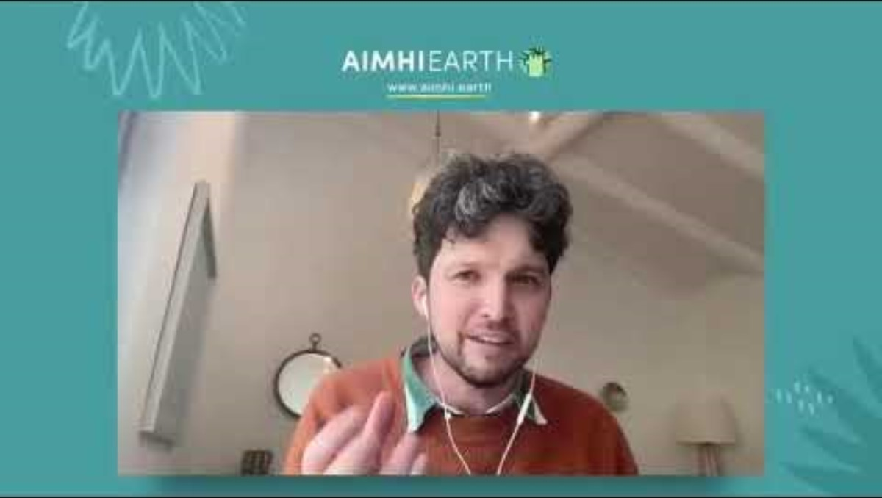
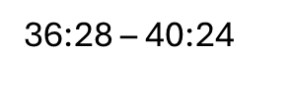
Biodiversity Loss, Food, Farming

Slide 24
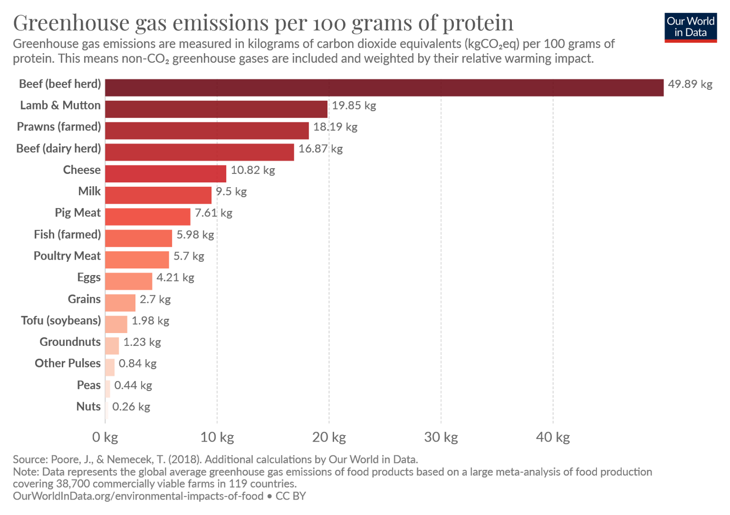
Climate Basics – thinking about school food

Slide 25
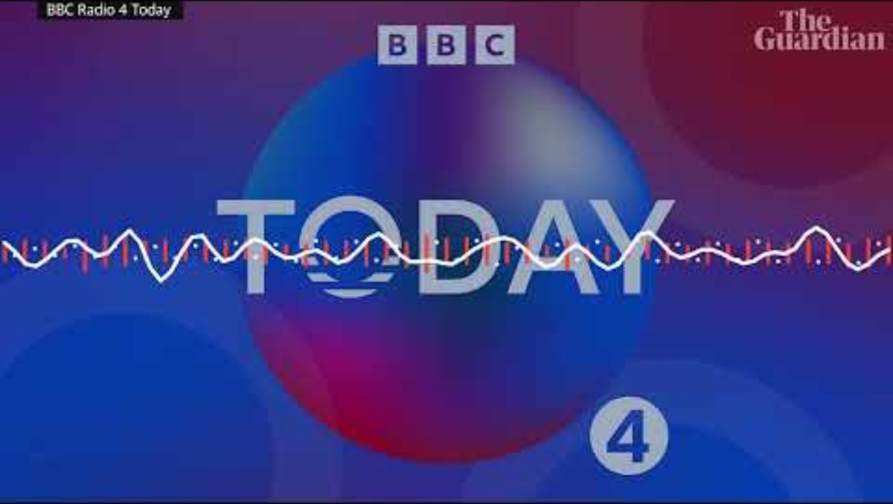
https://youtu.be/rWuKYuEOI9k

Slide 26
Climate Basics
1. It's warming
2. It's us
3. We're sure
4. It's bad
5. We can fix it

Slide 27
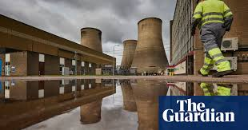
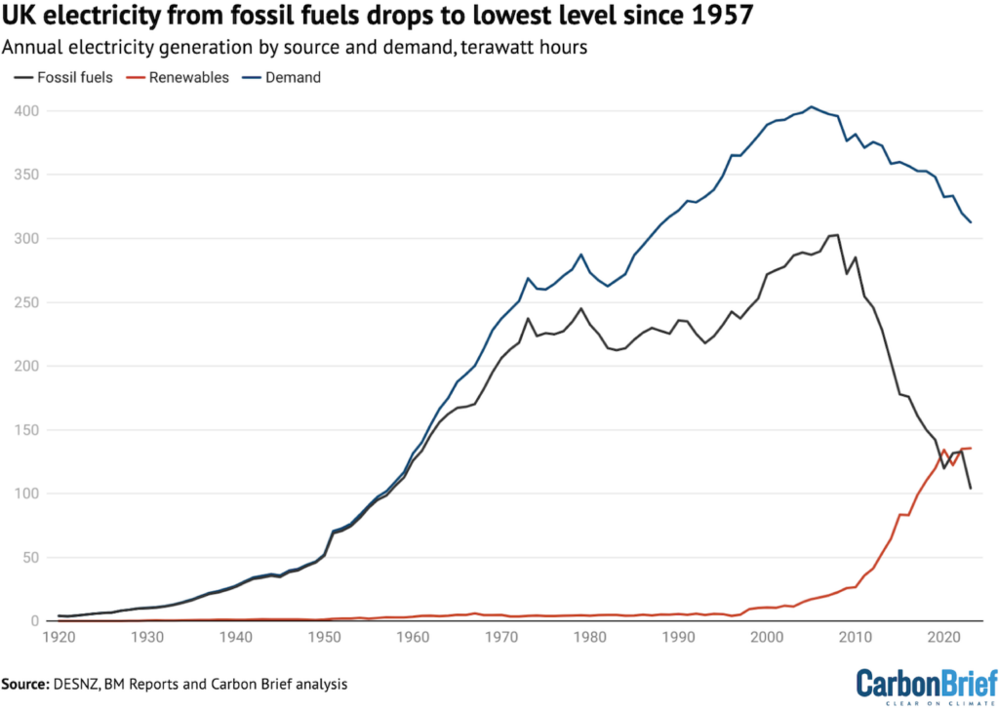
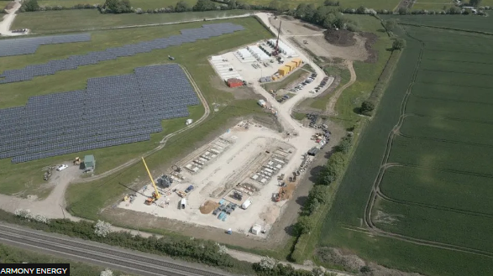
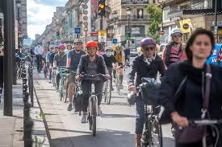
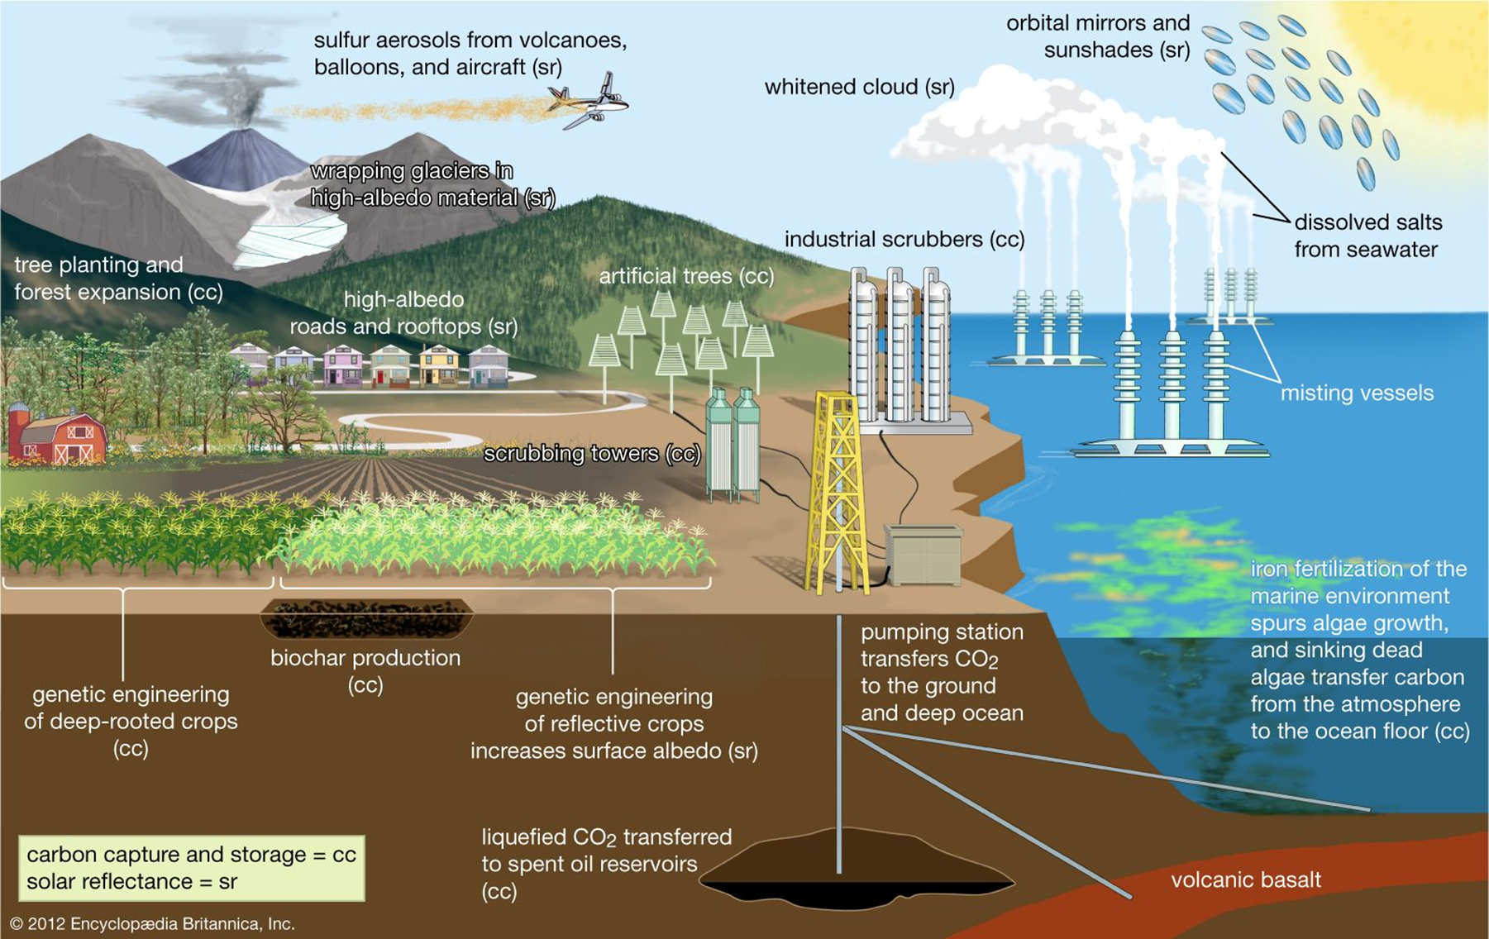
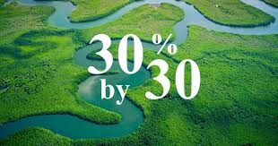
Reasons for optimism
Climate Basics – Reasons for Optimism

Slide 28
Good news stories in Brighton & Hove
Climate Basics – Reasons for Optimism – Brent
INSERT LOCAL GOOD NEWS STORIES

Slide 29

Climate Basics – Reasons for Optimism in Our Schools
Positive action in our schools
INSERT LOCAL SCHOOL GOOD NEWS STORIES

Slide 30
