Slide 1

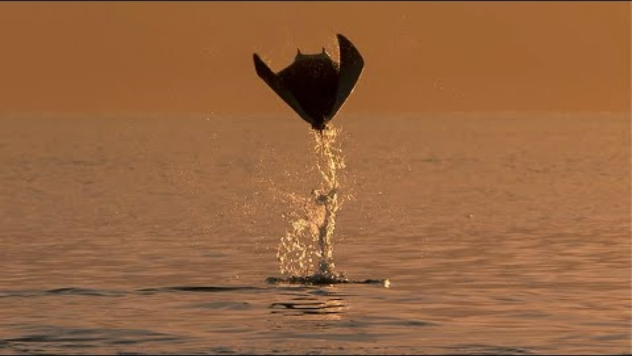
1. Biodiversity
A wonderful world
Notes:
Let's start todays assembly by thinking about some of the astonishing biodiversity on our planet

Slide 2
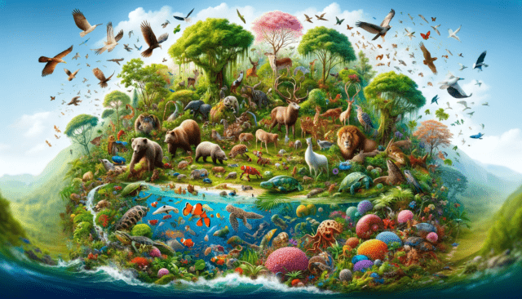
1. Biodiversity
Bio + Diversity = ?
What does biodiversity mean to you?
Why is biodiversity important to you?

Slide 3
1. Biodiversity
Local Biodiversity - habitats
insert pictures of locally important habitats

Slide 4
1. Biodiversity
Local Biodiversity - species
insert pictures of locally important species

Slide 5
1. Biodiversity
Local Biodiversity – school
insert pictures of any habitats and species you see in your school

Slide 6
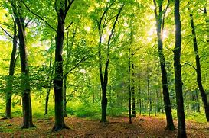
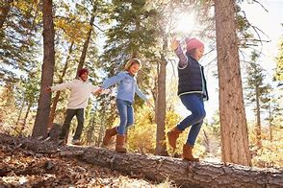
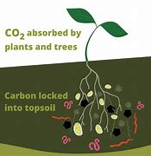
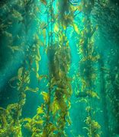
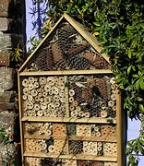
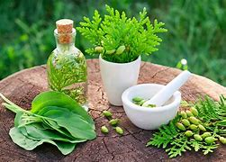
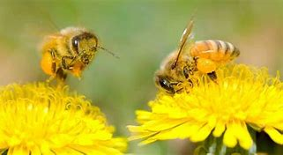
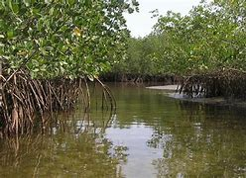
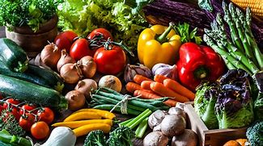
1. Biodiversity
Why does it matter?
Why is biodiversity important?
Notes:
Some ideas - Homes for plants and animals, Human well being walking and playing in nature, Food production, Future medicines
Locks in carbon – protects coastlines from wind and wave erosion (mangrove swamps, kelp forest etc)
Biome – a major regional ecological community with distinctive life-forms and a main plant or animal species e.g. rainforest, desert, tundra

Slide 7
Our Schools Our World
Celebrating Biodiversity
Before we meet again, take time to spot some of the following ….
Share your ideas and photos with your class and bring them along to our next assembly.
Clever Biodiversity
Unusual Biodiversity
Surprising Biodiversity
Beautiful Biodiversity

Slide 8
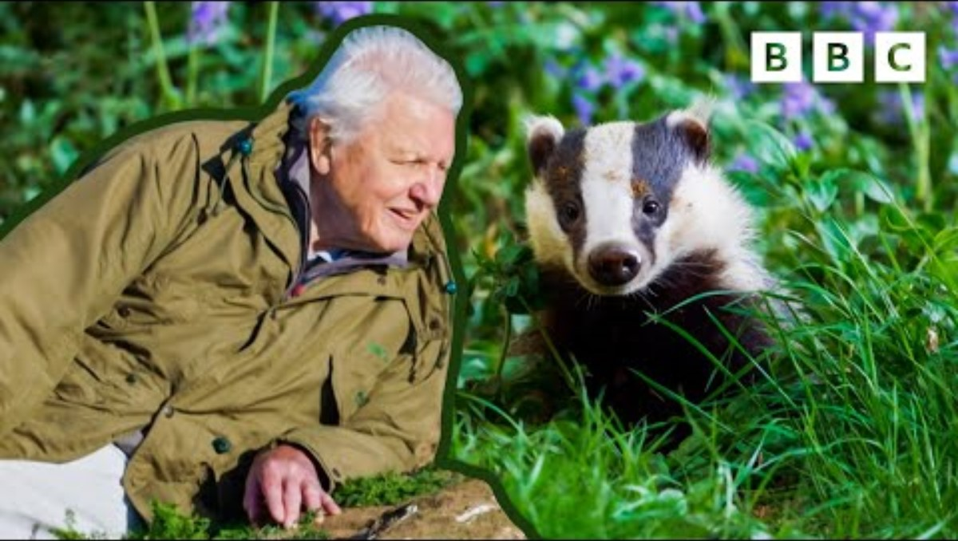
1. Biodiversity
Celebrating Biodiversity
While you are watching, count how many different plants and animal species you see.
Notes:
Lets finish by again looking at some of our amazing local biodiversity

Slide 9
Our Schools Our World
Celebrating Biodiversity
If time, watch again to wonder and enjoy the biodiversity.

Slide 10
2. Biodiversity
What are the issues around Biodiversity?
Did you spot any …?
Clever Biodiversity
Unusual Biodiversity
Surprising Biodiversity
Beautiful Biodiversity

Slide 11
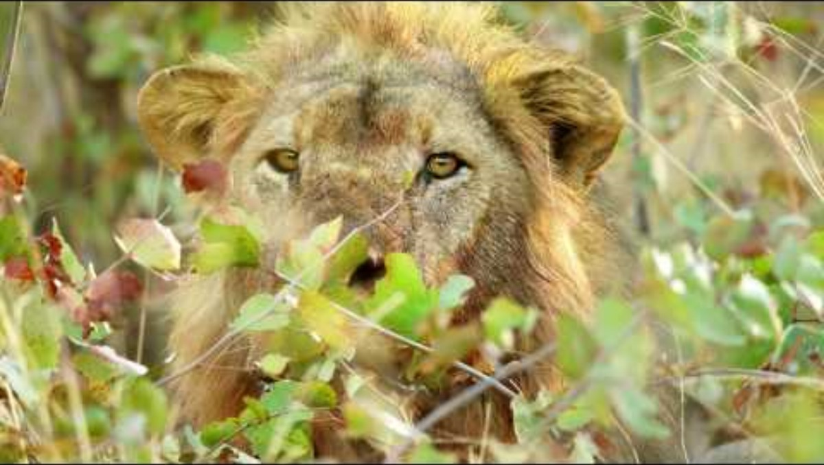
2. Biodiversity
What are the issues around Biodiversity?
What has happened to;
Lions?
Flying insects?
Tuna?
Notes:
In the last assembly, we learnt about biodiversity and its importance
This next video starts looking at the biodiversity loss and why this matters to us and our planet
Last 50 years – Around the world wildlife population has decreased by 60%
No. Lions in Africa decreased 65%, flying insects in Europe by 75% and Blue Fin tuna in Pacific by 95%
Eco Empathy motivates us to do something about this

Slide 12
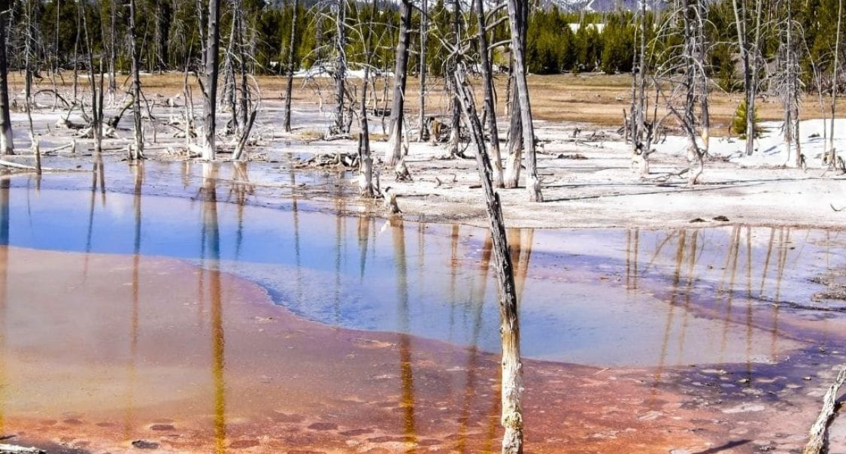
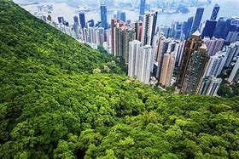
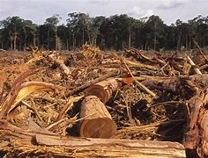
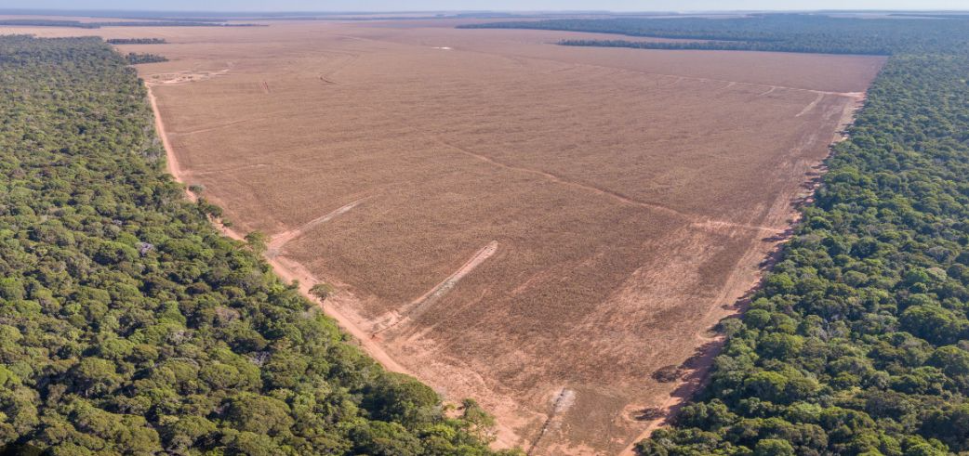
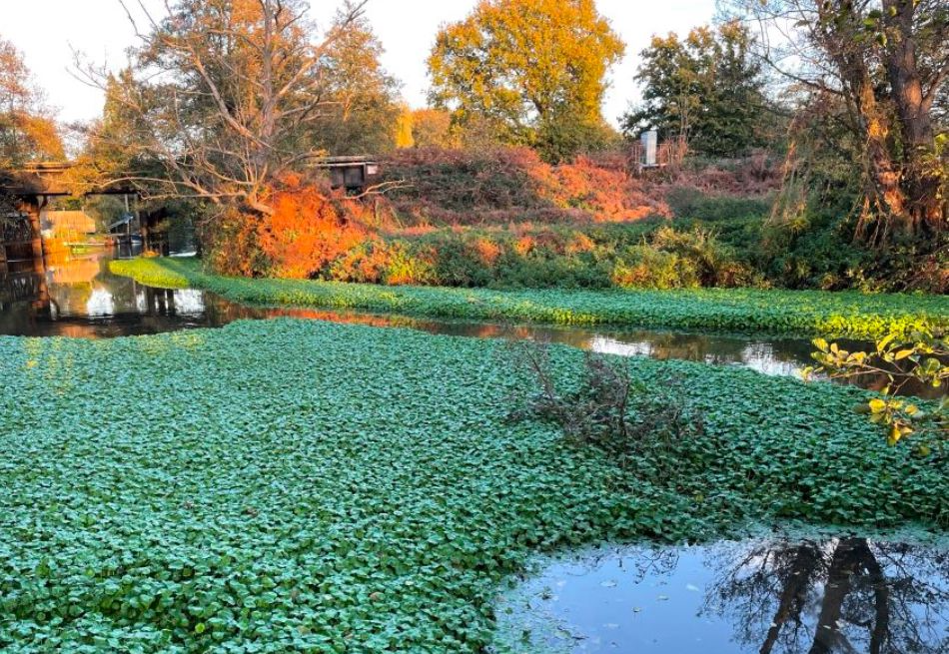
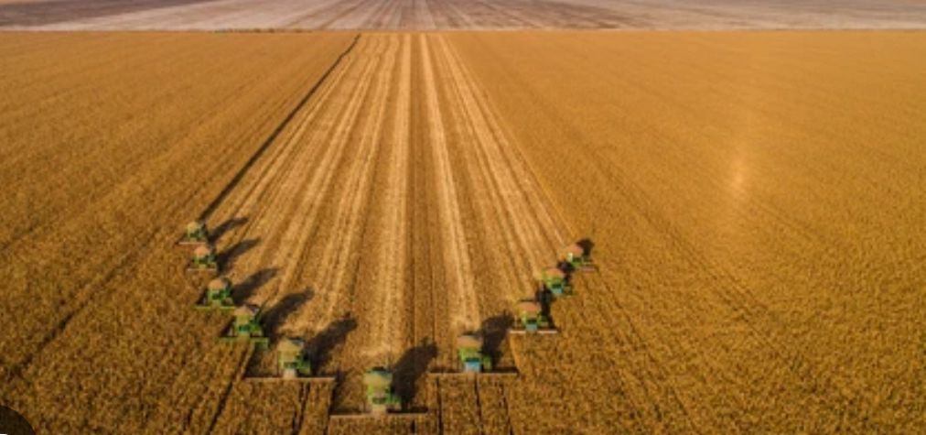
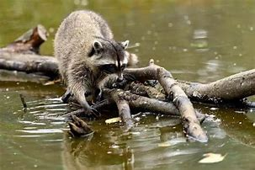
2. Biodiversity
What are the issues around Biodiversity?
Why is biodiversity declining around the world?
Notes:
Habitat loss through human activities like deforestation, urbanizations, intensive monoculture farming, over use of natural resources
Invasive species – non native species introduced to an environment. They have contributed to nearly 40% of animal extinctions since 17th Century
Pollution
Climate change

Slide 13
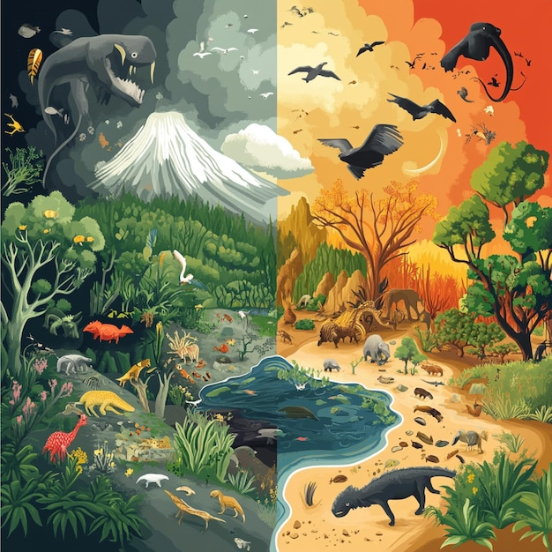
2. Biodiversity
How is Climate Change affecting Biodiversity?
Can species adapt to a changing climate?
Notes:
Think about:
Changing seasons – affects lifecycles and food available
Changing habitats – different plants etc need the right temperature and water conditions to survive. Loss of habitats through eg flooding
Species migration – might be necessary for survival
Invasive species – new species arriving may compete with native species

Slide 14
2. Biodiversity
What are the issues around Biodiversity?
Next time, we will be finding out about inspirational changemakers who are making a real difference.
Think about how we can be changemakers too.

Slide 15
3.Biodiversity
What are changemakers doing? Local
Insert example of local changemakers around biodiversity – individuals or projects or council / rangers / wildlife trust
Notes:
Change to a local initiative if you know of one.

Slide 16
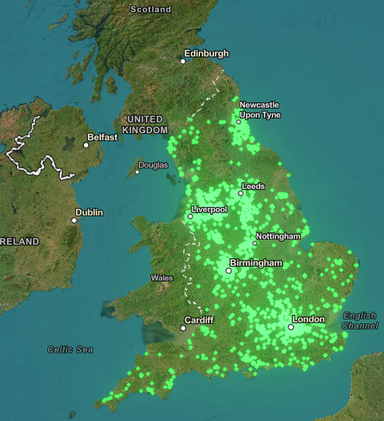
3.Biodiversity
What are changemakers doing? National
Schools all over England are working together for nature through the National Education Nature Park
If you put all school grounds in England together, the total amount of land which wildlife could thrive in is TWICE the size of Birmingham
Notes:
More info here - Home | Education Nature Park
Currently 1,800 schools have signed up to the NENP – this accounts for more than 3.5 million square meters of space.

Slide 17
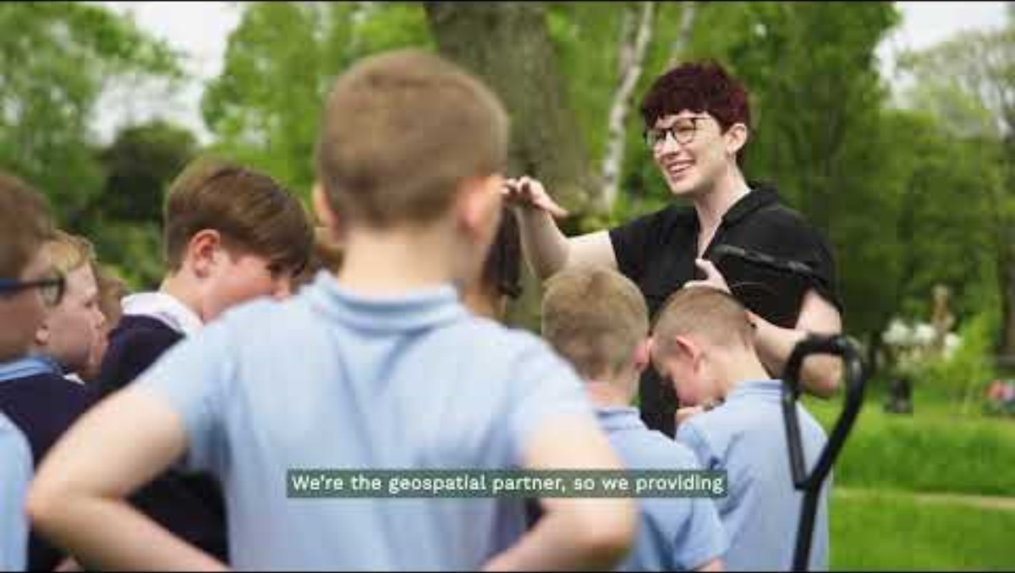
3.Biodiversity
What are changemakers doing? National
Is your school signed up to the National Education Nature Park? If not, why not?!
Notes:
Change to a local initiative if you know of one.

Slide 18
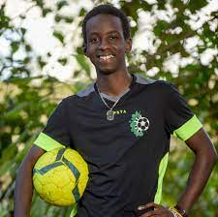
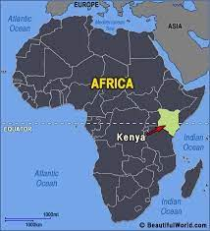
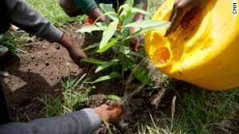
3.Biodiversity
What are changemakers doing? Global
Lesein Mutunkei is a teenager from Kenya. After learning about pollution and deforestation at school when he was 12 years old, he founded Tree4Goals
Lesein plants 11 trees every time he scores a goal in football. So far he has planted over 3000 trees and encouraged his friends, schools and football clubs all over the world to get involved.

Slide 19
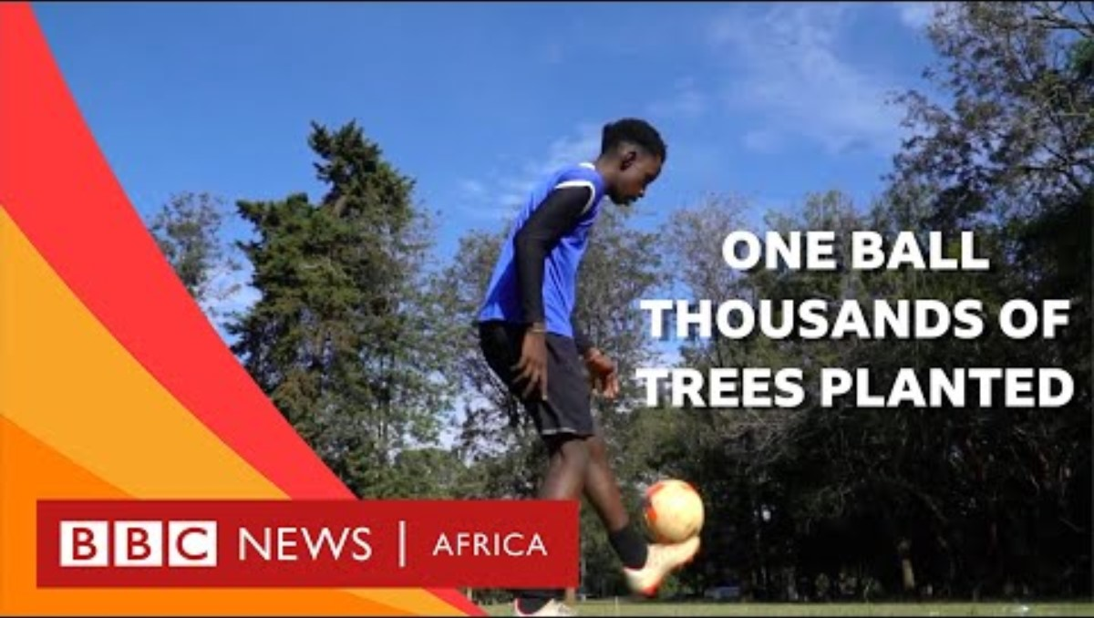
3.Biodiversity
What are changemakers doing? Global
Notes:
First video shows the importance of the kelp forest, changemakers coming up with a plan.
Second video – Glimmers of Hope shows that nature and biodiversity, when given a chance, is a able to come back.

Slide 20

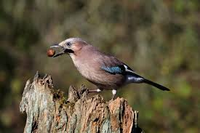
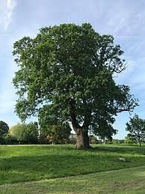
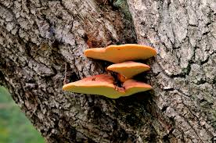
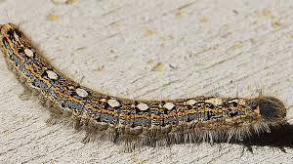
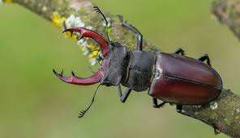
Our City Our World
4 -School Actions
How many different species can live in an oak tree?
2300 different species!

Slide 21
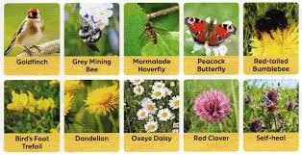
Our City Our World
4 -School Actions
Nearly 100!
different types
How many different types of pollinators were found on lawns that hadn't been mown?

Slide 22
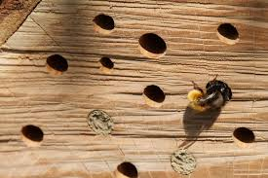
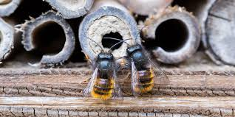
Our City Our World
4 -School Actions
Solitary bees like to live in small holes.
How many types of solitary bee are there in the UK?
250
different types!

Slide 23
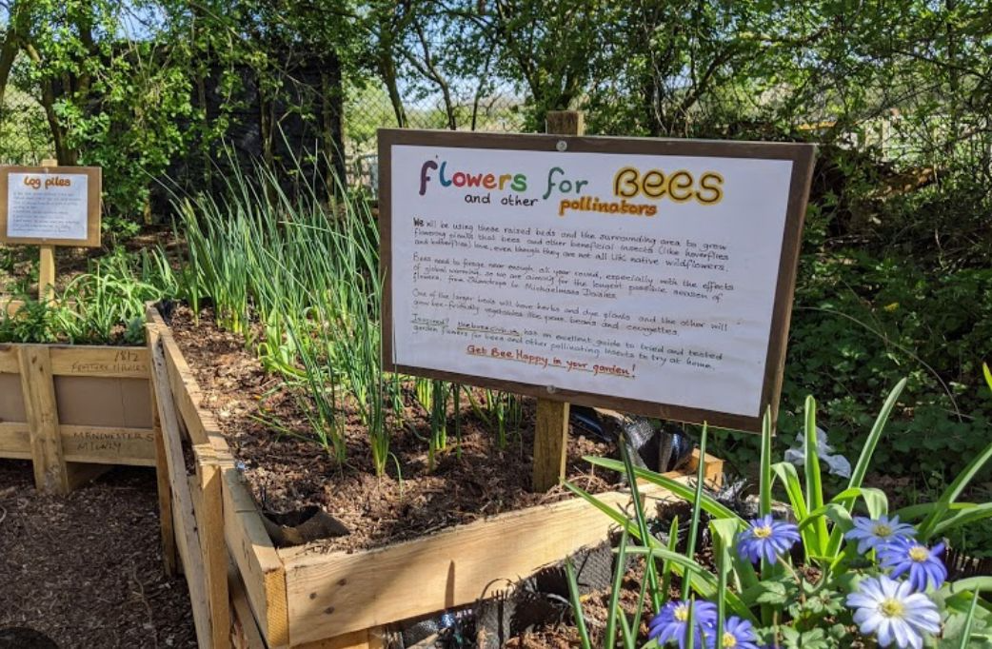
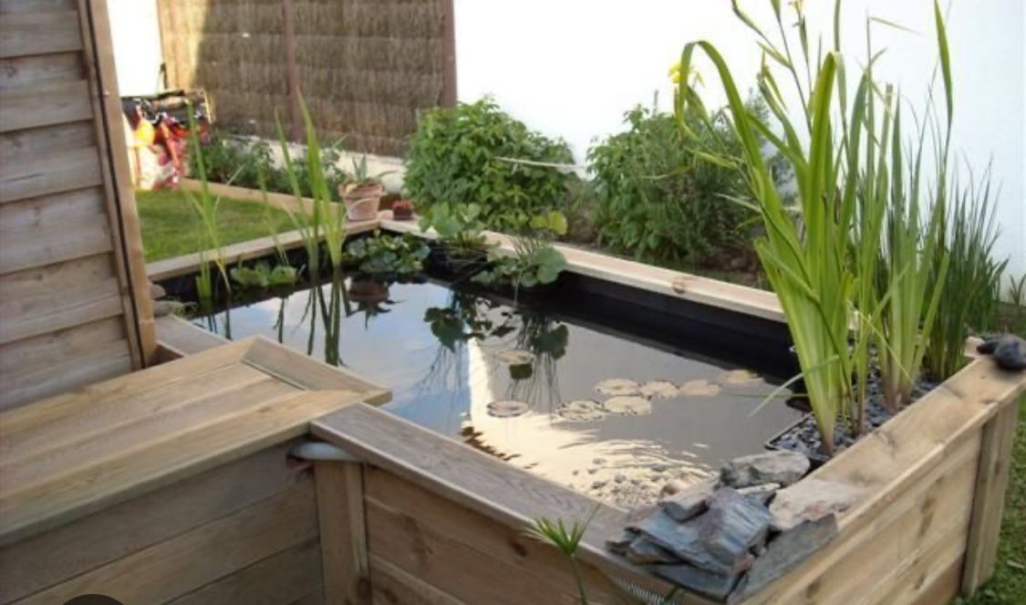
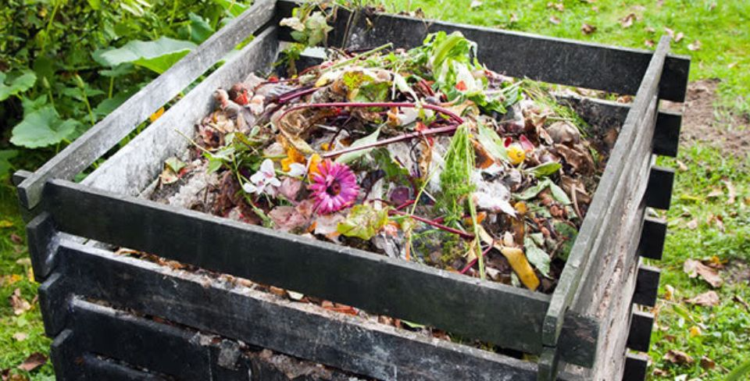
4. Biodiversity
School action – which of these do we have?
Flower beds Pond Compost bin
Could we have these?

Slide 24
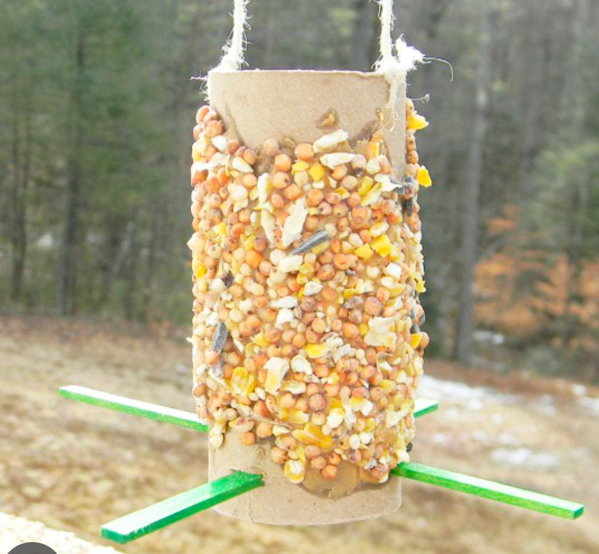
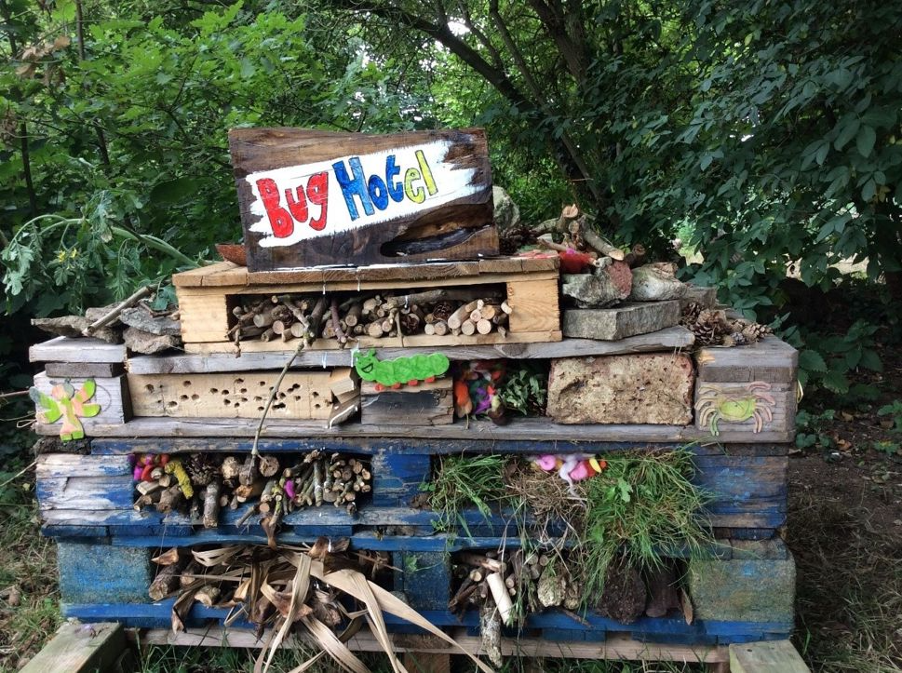
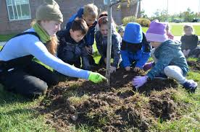
4. Biodiversity
School action – which of these do we have?
Bird feeders Bug hotels Trees and hedgerows
Could we have these?
Notes:
Explore nature grants from you local wildlife trusts
Another good organisation is Learning through Landscapes – Local School Nature Grant

Slide 25
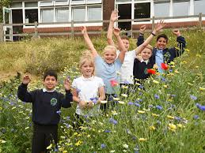
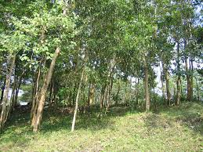
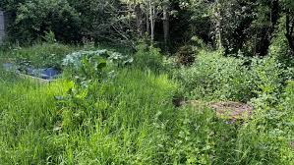
4. Biodiversity
School action – which of these do we have?
Meadow Mini-forest No-mow area
Could we have these?
Notes:
Explore nature grants from you local wildlife trusts
Another good organisation is Learning through Landscapes – Local School Nature Grant

Slide 26
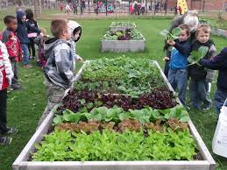
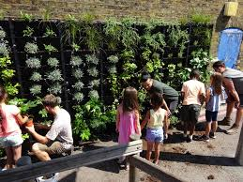
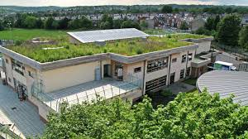
4. Biodiversity
School action – which of these do we have?
Vegetable area Green wall Green roof
Could we have these?

Slide 27
4. Biodiversity
School action
What could we do as a class to increase biodiversity?
What could we do as a school to increase biodiversity?

Slide 28
Week 4 - Biodiversity School Actions
What could we do as a whole school to increase biodiversity?
What could we do as classes to increase biodiversity?
Which of the adults in the school can help?
Talk to them!
Take some photos
of people helping nature at school!

Slide 29
5. Biodiversity
Individual and Family Actions
We can help wildlife by creating habitats, but also by getting outside and learning more about our local habitats and species.
Do you have any favourite spots for spotting wildlife or enjoying nature?
Can you share this with your friends and their families?

Slide 30
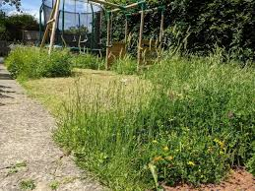
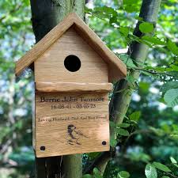
5. Biodiversity
Individual and Family Actions
Do you remember any of these ways to help wildlife from the last assembly?
Could you do any of these at home with your family?

Slide 31
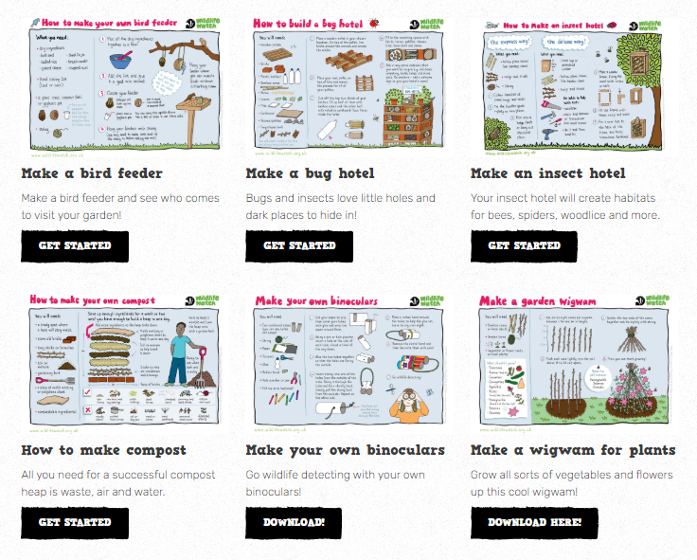
5. Biodiversity
Individual and Family Actions
There's lots of great ideas for families to help wildlife here on
the Wildlife Watch Website.

Slide 32
Week 5 - Biodiversity
Individual and Family Actions
How could learn more about the local wildlife and countryside?
What could you or your family do to help wildlife?
Which of the adults at home might want to help you?
Talk to them!
Take some photos of
you + your family helping or enjoying nature!

Slide 33
6. Biodiversity
Celebrating Our Actions
Insert images of the school helping biodiversity

Slide 34
6. Biodiversity
Celebrating Our Actions
Insert images of individuals, teachers and families helping biodiversity

Slide 35

6. Biodiversity
Celebrating Our Actions – let's keep going!

