Slide 1

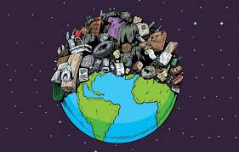
Week 1
Consumption & Waste
This term our whole school is thinking about Consumption & Waste
What do these word mean to you?
Notes:
This topic has two key behaviours, which are intrinsically linked, to think about. To make it more manageable, you might want to focus on consumption more with addressing issues of do we need it in school, how can we share resources, how do we buy more sustainable options etc. Second option to focus more on how we manage our waste in school and at home.

Slide 2
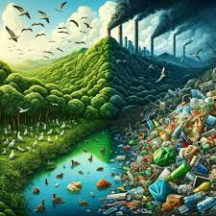
Week 1
Consumption & Waste
Where do you see too much
consumption
or
waste
at home or school?
Notes:
This topic has two key behaviours, which are intrinsically linked, to think about. To make it more manageable, you might want to focus on consumption more with addressing issues of do we need it in school, how can we share resources, how do we buy more sustainable options etc. Second option to focus more on how we manage our waste in school and at home.

Slide 3
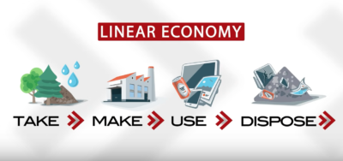
1 Consumption & Waste
The Linear Economy
consumption
waste
Where do 'take' most of our resources from?

Slide 4
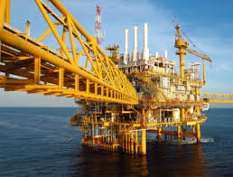
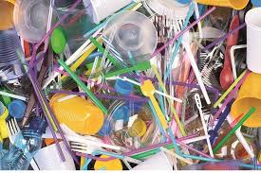
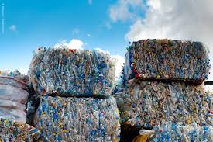
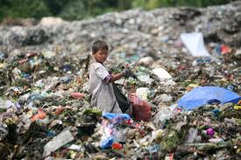
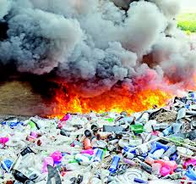
1 Consumption & Waste
The Linear Economy
Think about the journey of plastic
We take oil from the sea
And turn it into plastic which often we only use once
A small amount gets recycled
Lots gets sent to other countries to deal with
The rest gets buried or burnt
Notes:
This is the current main approach to consumption and waste.

Slide 5
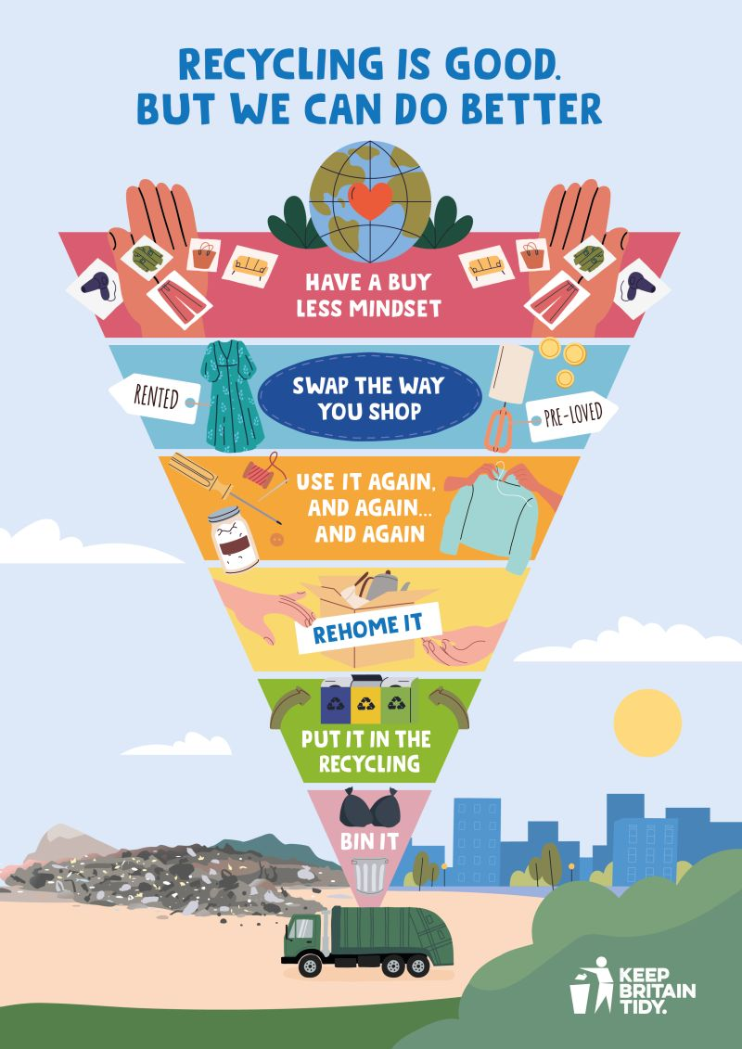
Week 1
Consumption & Waste
How does this idea help us?
Is recycling the best answer for waste?
What could be better?
Notes:
Many people think that if it can be recycled then this addresses the issue of waste. It needs to be continually stressed that there are all these stages before we recycle.

Slide 6
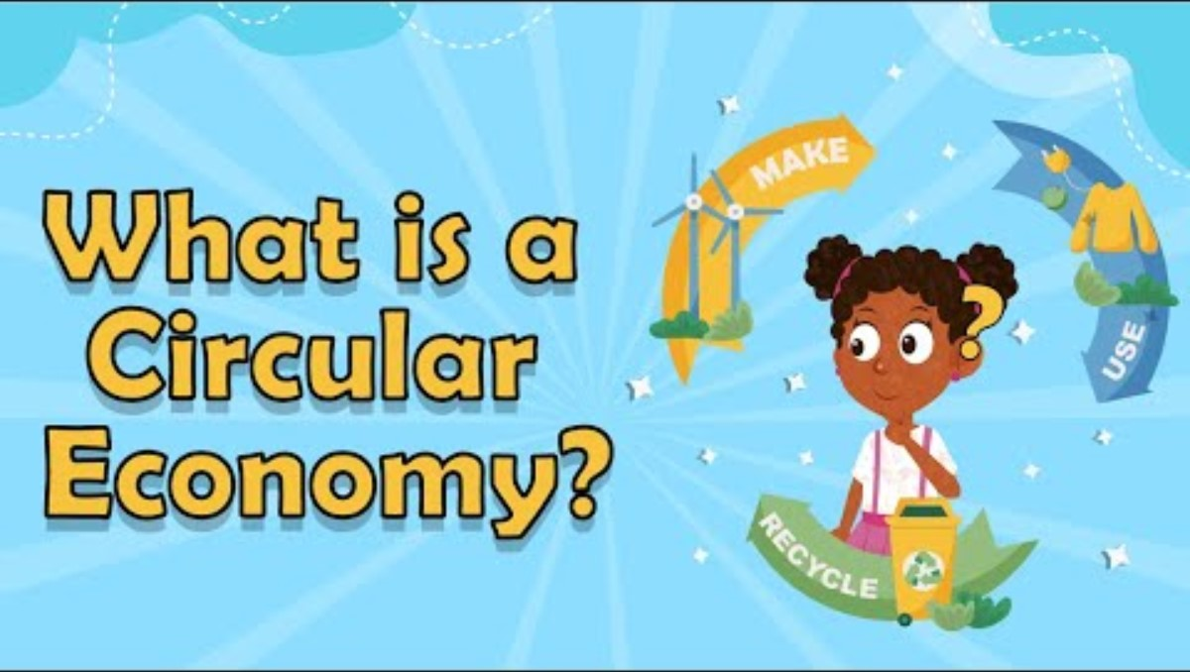
Week 1 Consumption & Waste
Or Even Better – try the Circular Economy!
Notes:
In school, at home and in all industries this approach should be a the centre of thinking.

Slide 7

Week 1 Consumption & Waste
Next time, we will be thinking about what are the problems that come with too much consumption and the waste at the end of it.
Notes:
This term we will thinking about water in our assemblies.

Slide 8
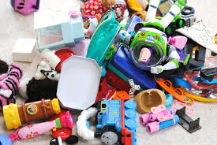
2. Consumption & Waste
Main issues around Consumption & Waste
Let's think about toys
How many toys have you had in your life?
What happens when you grow out of a toy?

Slide 9
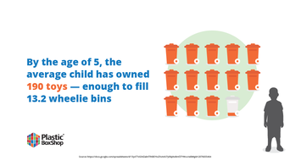
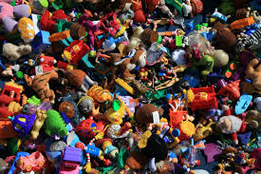
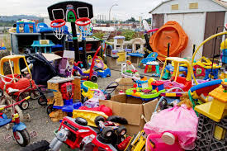
2. Consumption & Waste
Main issues around Consumption & Waste
This is over consumption.

Slide 10

2. Consumption & Waste
Main issues around Consumption & Waste
Now let's think about fashion.
What issues did you spot?
Notes:
100 billion items produced globally each year. 3 out of 5 items end up in landfill within 12 months

Slide 11
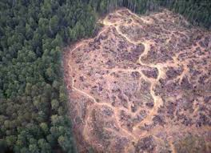
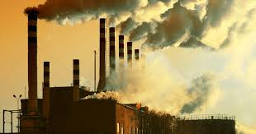
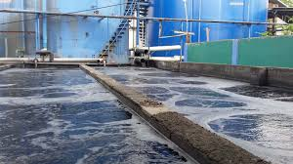
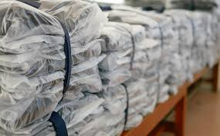

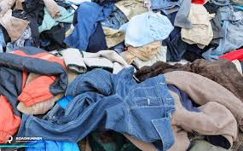
2. Consumption & Waste
Main issues around Consumption & Waste
Habitat destruction Pollution Water and Energy used
Packaging Transport Waste

Slide 12
2. Consumption & Waste
We need to Change Our Approach
Key questions
Do we need it?
Do we want it?
or
Think 'The 7 Rs'
1.REFUSE
2.REDUCE
3.REUSE
4.REPAIR
5.REPURPOSE
6.RECYCLE
7.RECOVER
Recover means we burn it to create energy

Slide 13

2. Consumption & Waste
We need to Change Our Approach

Slide 14
Week 2
Main issues around Consumption & Waste
Next week we'll look at ​
​
Changemakers​
​
who are helping rethink our consumption
and manage our waste

Slide 15
3. Consumption & Waste
Local changemakers
Insert info about local changemakers eg local waste café / circular economy project
Notes:
This is an idea of an organisation that may operate in your area. This is a suggestion and you may well know of great examples of your own.

Slide 16
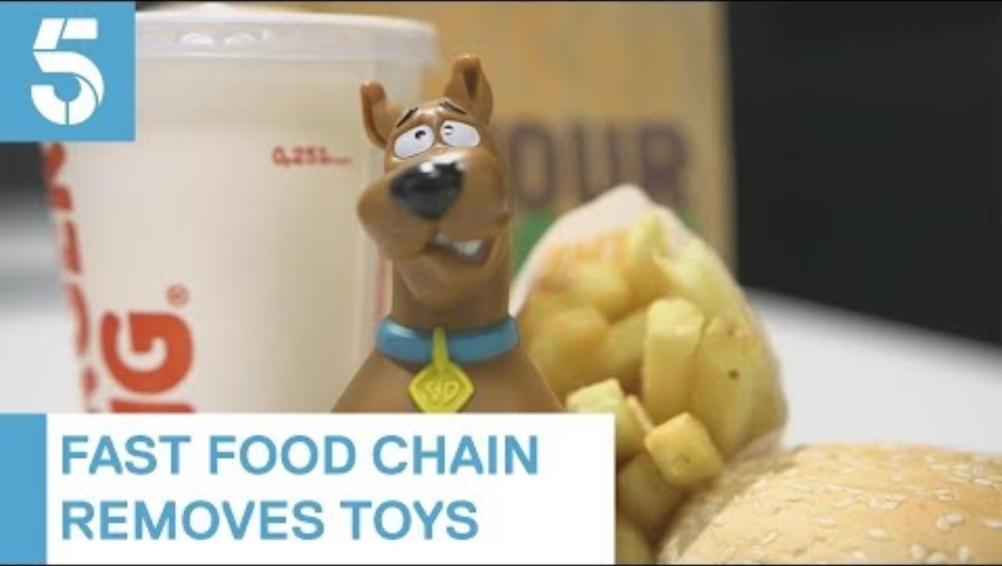
3. Consumption & Waste
National changemakers – Ellen & Caitlin

Slide 17
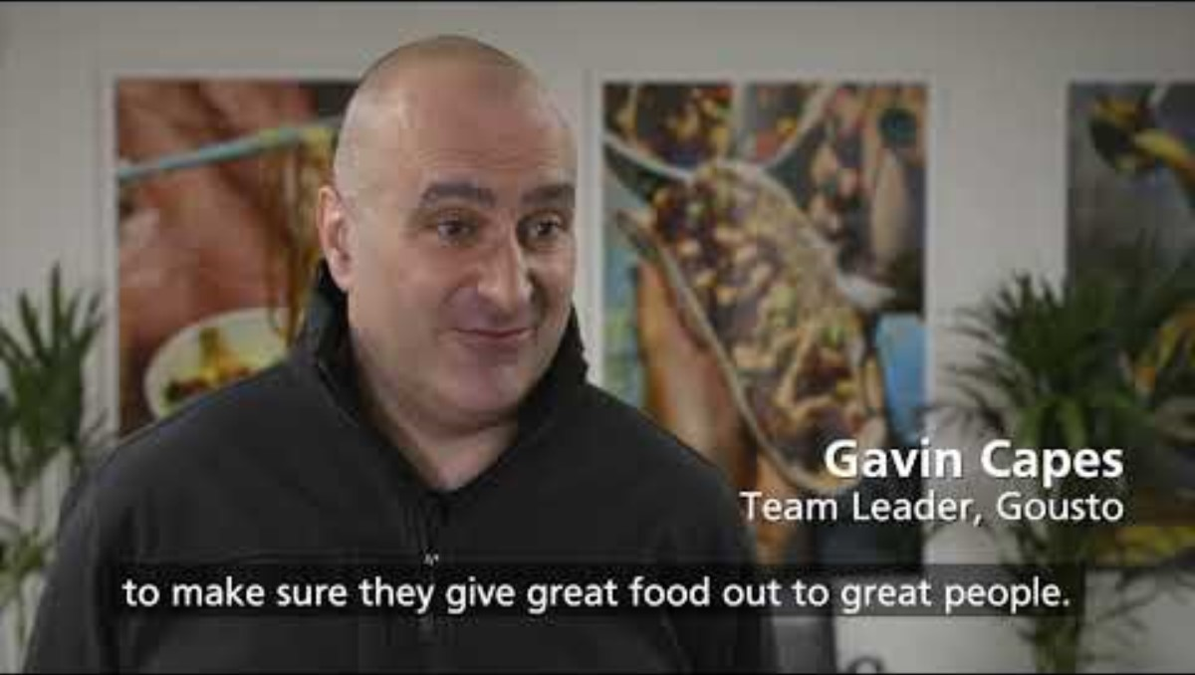
3. Consumption & Waste
National changemakers - Fareshare

Slide 18
3. Consumption & Waste
Changemakers
Next time we'll look at how
YOU
can be a changemaker at school and at home

Slide 19
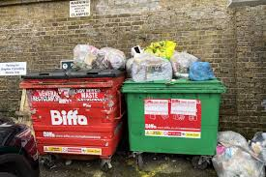
4. Consumption & Waste
School Actions
Where do you see over-consumption
or waste;
in your classes?
in other areas of the schools?
Notes:
Reuse paper trays in classrooms, by photocopiers and in offices; refillable glue pots and brushes; clothes and books swap; use the library for topic book loans; carry out food waste audit in canteen and with packed lunches

Slide 20
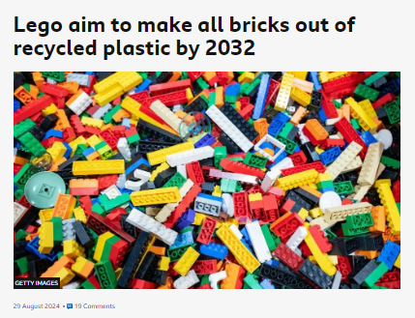
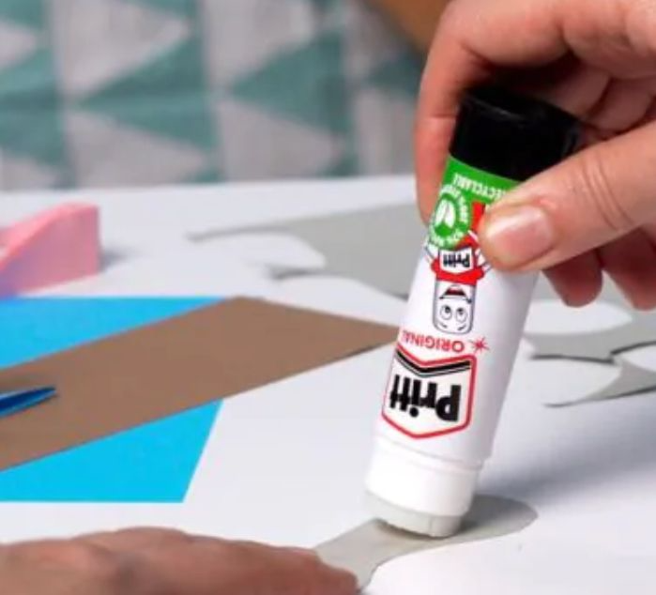
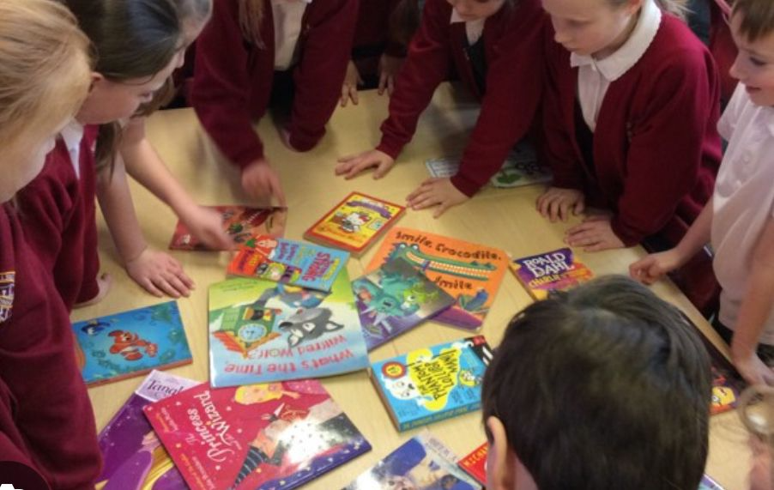
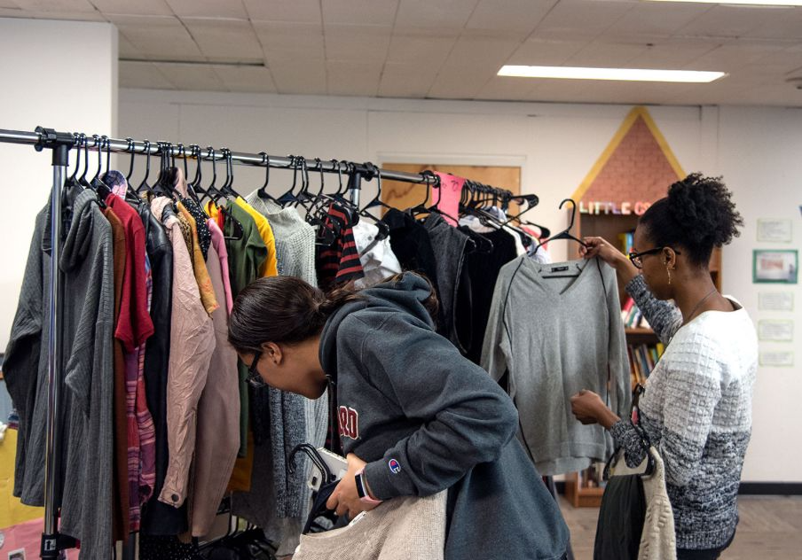
4. Consumption & Waste
School Actions
What could we do about this?
Re-use?
Share?
Swap?
Buy recycled?
Refuse?
Repair?
Recycle?
Borrow?
Notes:
Reuse paper trays in classrooms, by photocopiers and in offices; refillable glue pots and brushes; clothes and books swap; use the library for topic book loans; carry out food waste audit in canteen and with packed lunches

Slide 21
4. Consumption and Waste
School Actions
What could we change in other areas of the school?
What could we change in our classes?
Which of the adults in the school can help?
Talk to them!
Take some photos
of people preventing waste at school!

Slide 22
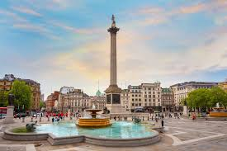
5. Consumption & Waste
Individual and Family Actions
Did you know?
Each day the UK produces enough rubbish to fill Tragalgar Square to the height of Nelson's column.
Notes:
5 L is around about the number of litres in a large can

Slide 23

5. Consumption & Waste
Individual and Family Actions
Did you know?
Most people in the UK produce more than 1kg of waste every day of the year.
That the same weight as a big bag of sugar.
Notes:
5 L is around about the number of litres in a large can

Slide 24
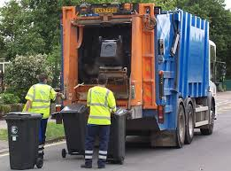
4. Consumption & Waste
Individual and Family Actions
Where do you see over-consumption
or waste at home?
Notes:
Reuse paper trays in classrooms, by photocopiers and in offices; refillable glue pots and brushes; clothes and books swap; use the library for topic book loans; carry out food waste audit in canteen and with packed lunches

Slide 25

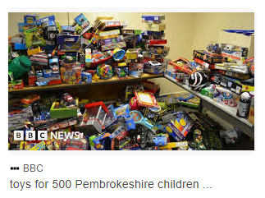
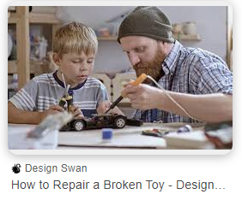
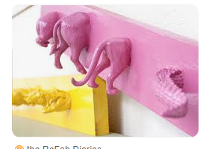

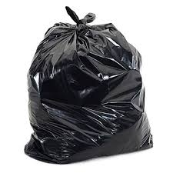

5. Individual and Family Actions
How can you and your family reduce consumption and waste at home.
Think 'The 7 Rs'
1.REFUSE
2.REDUCE
3.REUSE
4.REPAIR
5.REPURPOSE
6.RECYCLE
7.RECOVER

Slide 26
4. Consumption and Waste
Individual and Family Actions
What could your family do to reduce waste at home?
What could you do to reduce waste at home?
Where can you get help?
Talk to your family!
Take some photos
of you and your family saving waste at home.

Slide 27
Week 6
Celebrating Our Actions
Let's remember some of the things we've talked about in assembly this term around the theme of Consumption & Waste.

Slide 28
6. Consumption & Waste
Celebrating Our Actions – class actions
INSERT PICTURES OF CLASSES TAKING ACTION IN THIS AREA
Over the last x weeks, we have reduced our waste (or similar) by kg through class actions.

Slide 29
6. Consumption & Waste
Celebrating Our Actions – whole school actions
INSERT PICTURES OF CONSUMPTION OR WASTE REDUCTION AT SCHOOL and people involved
Over the last x weeks, we have saved ….. kg of ….... through whole school actions.

Slide 30
6. Consumption & Waste
Celebrating Our Actions – family actions
INSERT PICTURES OF FAMILIES REDUCING CONSUMPTION OR WASTE
Over the last x weeks, our families have saved ….. kg of waste. (or similar)

Slide 31

6. Consumption & Waste
Celebrating Our Actions
Close your eyes and imagine a world without waste.
What would it look and sound and smell like?
How would it differ from our world?
Notes:
A chance to reflect about the importance of water and it's role in the natural world.

