Slide 1

Week 1 Energy
This term our whole school is thinking about Energy
How do you use energy at home and at school?
Notes:
This term we will thinking about water in our assemblies.

Slide 2

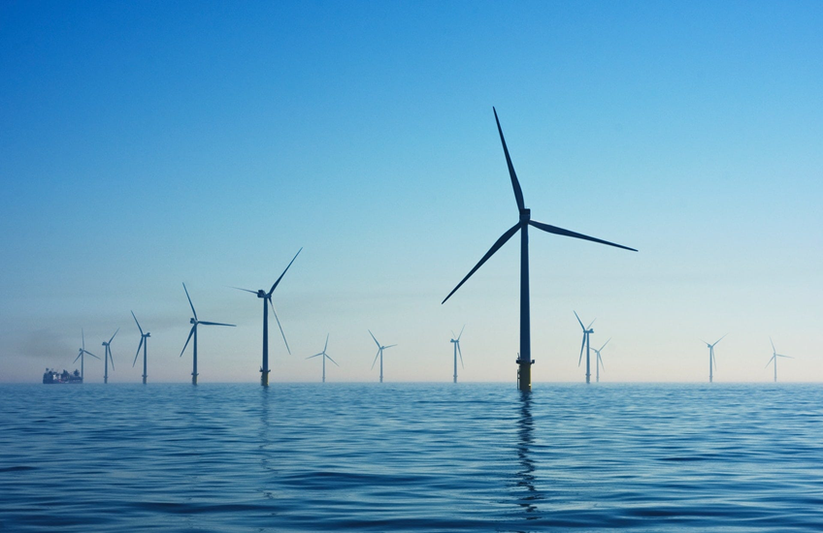
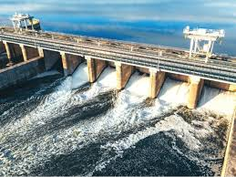
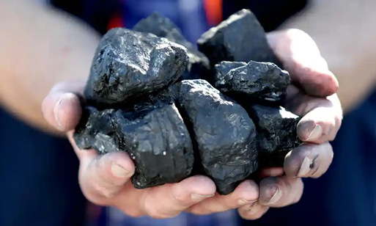
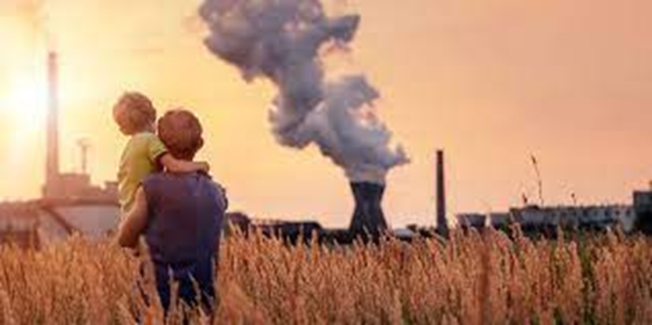
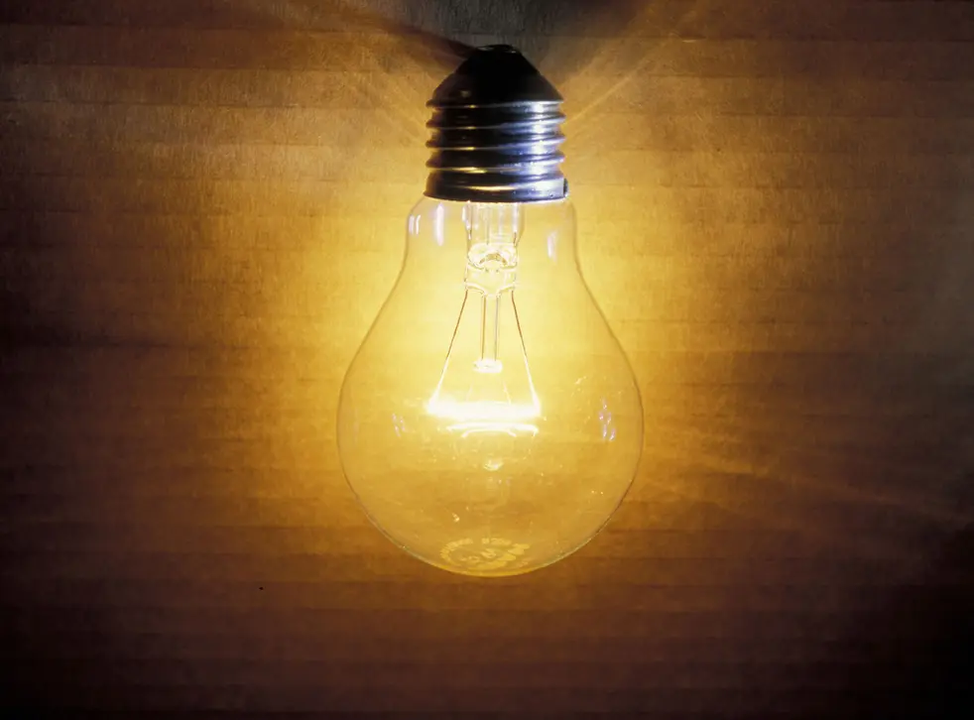
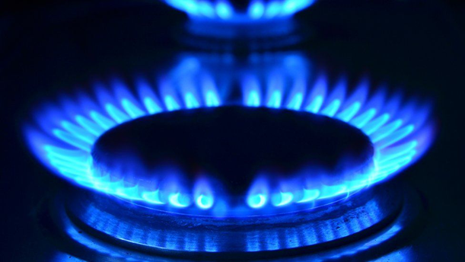
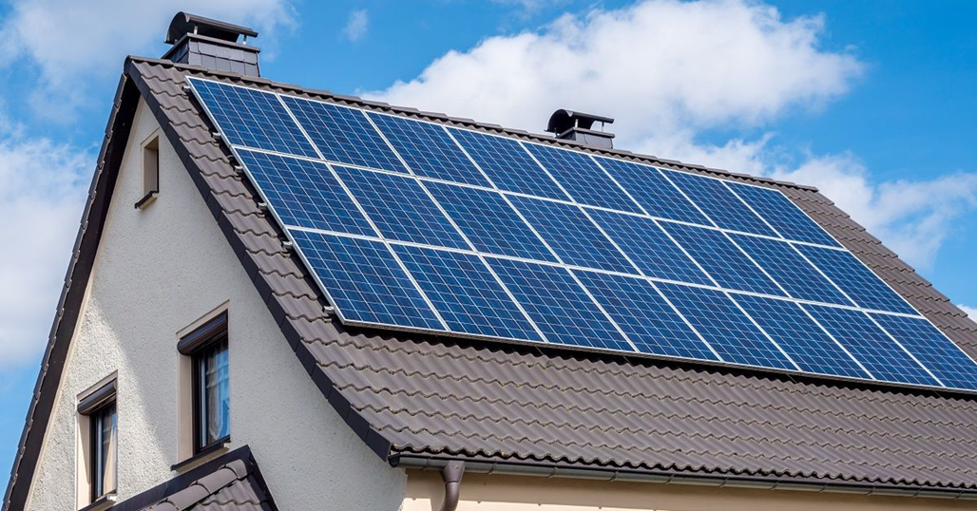
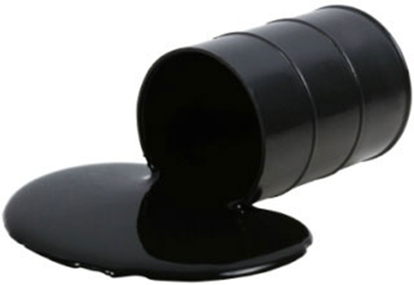
Week 1 - Energy Sources of Energy
How are these pictures linked?
Notes:
All forms of energy production

Slide 3
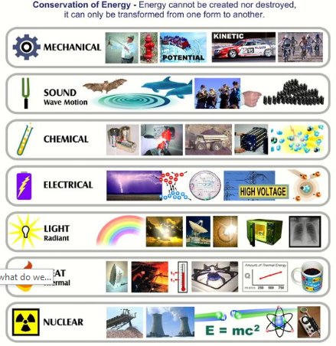
Week 1 - Energy Energy use
What do you use energy for at school and at home?

Slide 4
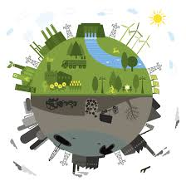
Week 1 - Energy Renewable or non-renewable?
Notes:
Can they think of egs of renewable and non-renewable energy?
Introduce term 'Fossil Fuels' - a natural fuel formed many many years ago from living organisms

Slide 5
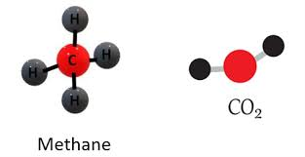
Week 1 – Energy Fossil fuels
Fossil fuels were formed in the earth millions of years ago
Coal was formed from ancient forests and plants
Gas and oil were formed from tiny decayed sea creatures
Fossil fuels are burnt to release ENERGY, but they also release greenhouse gases that contribute to climate change
Notes:
This term we will thinking about water in our assemblies.

Slide 6
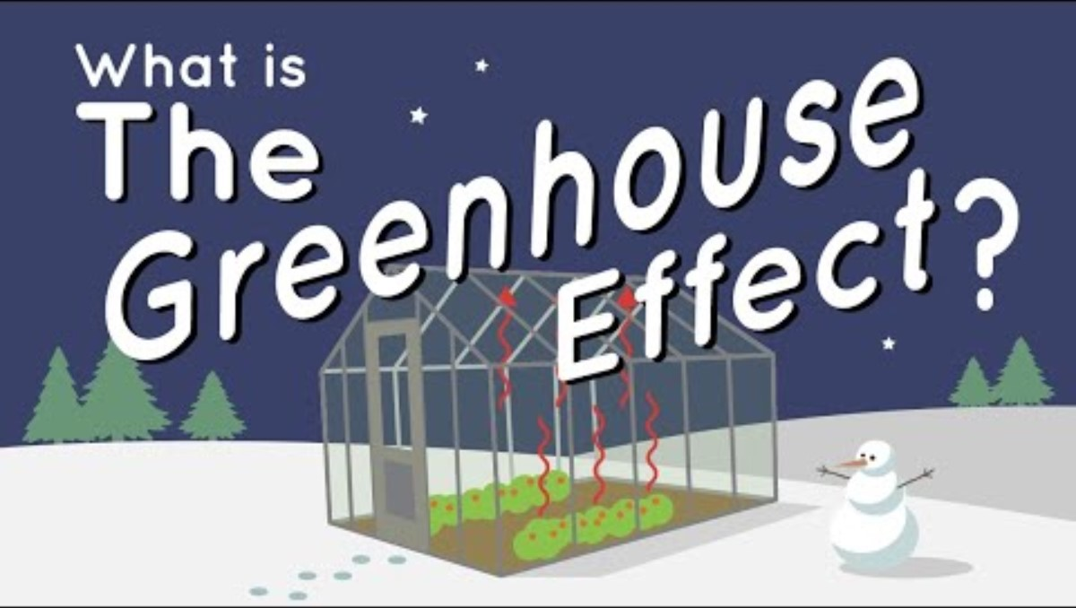
Week 1 - Energy Climate change
Notes:
Up to 1:42

Slide 7
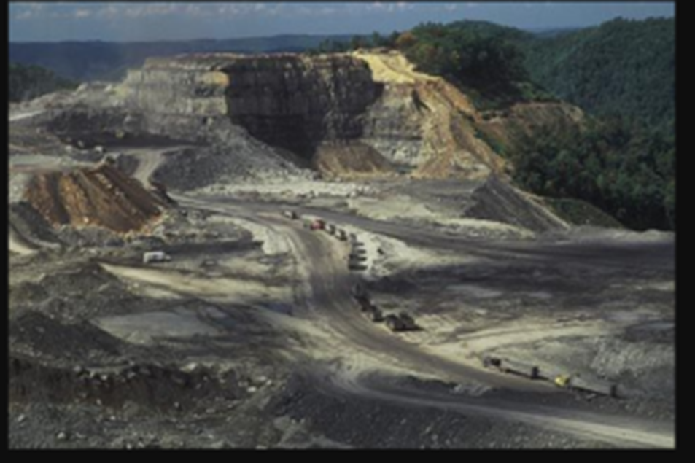
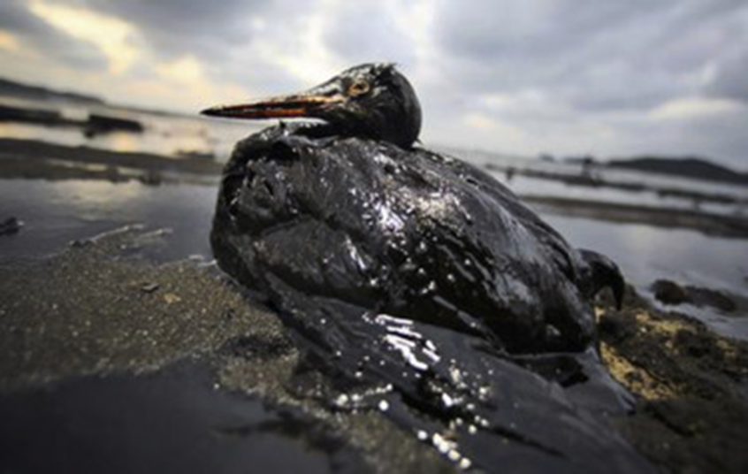

Week 1 - Energy Issues around energy
Notes:
Impact of extracting and burning fossil fuels including:
Increasing greenhouse gases
Destroying land through quarrying
Water pollution – oil spillages and harming wildlife
Air pollution
Acid rain

Slide 8
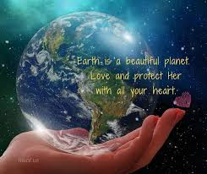
Week 1- Energy Protecting our planet
The less energy we use, the fewer fossils fuels we need and the more our planet is protected
Notes:
This term we will thinking about water in our assemblies.

Slide 9
Week 1 - Energy
Next time:
We'll think about Renewable Energy
Notes:
This term we will thinking about water in our assemblies.

Slide 10
Week 2 Energy - Introduction
Last week we looked at some of the problems around energy production.
Today we'll be thinking about cleaner renewable energy.

Slide 11

Week 2 - Energy Renewable energy - solar
If we collected and stored all the energy we got from the sun in 1 minute, it would be enough to power the whole earth for 1 year
Notes:
Solar energy is plentiful, free and renewable.
It doesn’t create carbon dioxide or greenhouse gases.
It can be used in places where the grid can't reach.

Slide 12
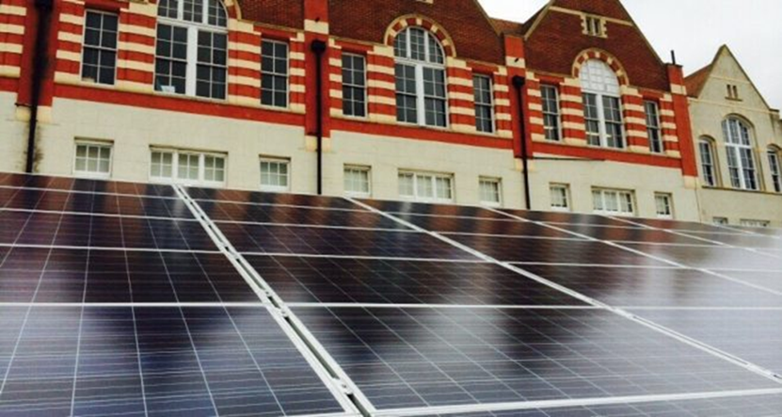
Week 2 - Energy Renewable Energy – Solar on Schools
INSERT INFORMATION AND PICTURE OF YOUR SCHOOL SOLAR PANELS IF YOU HAVE THEM AND HOW MUICH ENERGY IS PRODUCED

Slide 13
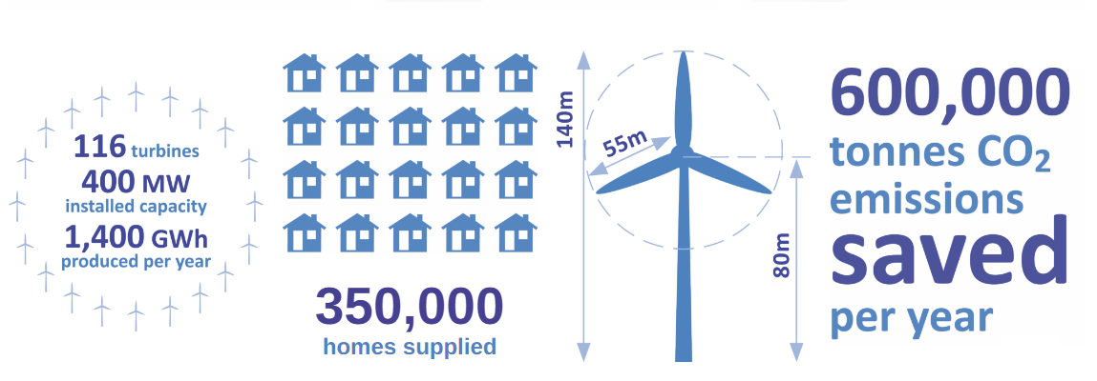
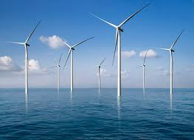

Week 2 - Energy Renewable energy - wind
Notes:
OSOW schools – substitute for a local wind / energy story
Picture is of Rampion Wind Farm that now produce clean, renewable energy for half the houses in Sussex.
Wind is free
As one of the windiest countries in Europe, it is perfect for our climate.
Wind turbines can be used to supply energy in remote places.
There is no need to dig underground or drill for the resource; therefore there is less pollution of the soil or the sea

Slide 14
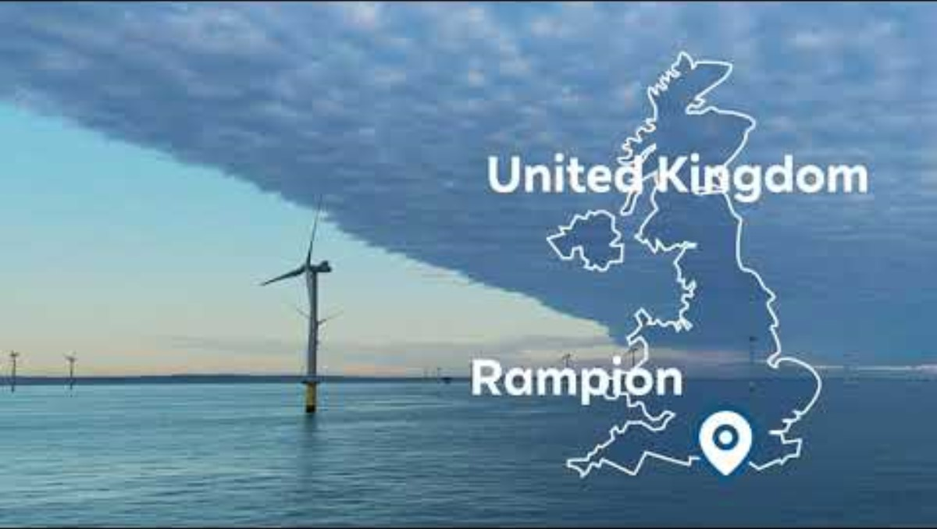
Week 2 - Energy Renewable energy – xxxxx
REPLACE WITH LOCAL EG?

Slide 15
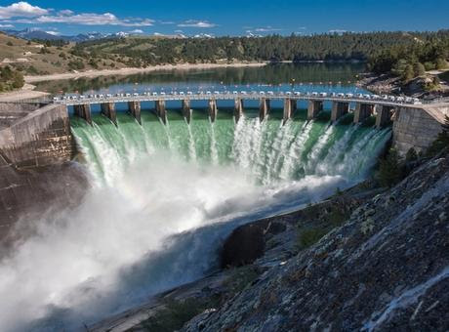
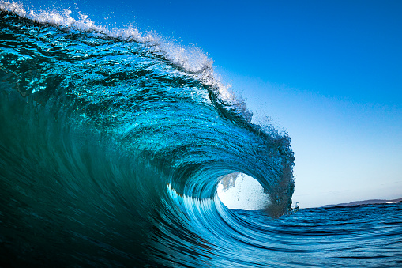
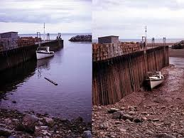
Week 2 - Energy
Renewable energy - water
There are three main ways we can generate electricity from water.
Hydro-electric
Waves
Tides
https://www.youtube.com/watch?v=gcStpg3i5V8

Slide 16
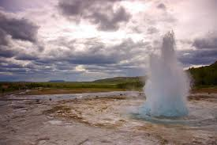
Week 2 - Energy Renewable energy - geothermal
The centre of the Earth is extremely hot – around 6000oC.
Some of this heat rises up to heat rocks nearer the surface. We can use this heat to make electricity.
Notes:
Geothermal plants can be found wherever very hot rocks can be found near the surface, for example in the United States, New Zealand, Iceland and Japan. There is one small geothermal power plant in the UK, in Southampton.
It is a renewable source of energy, which means that it will not run out!
Once built, geothermal plants do not produce air pollution and do not contribute to the greenhouse effect.

Slide 17

Week 2 - Energy A world without fossil fuels
Notes:
Can they imagine what the world would be like if we only used renewable energy?
Play (some of?) video til approx

Slide 18
Week 2 Energy
Next week we'll look at ​
​
Changemakers​
​
who are helping reduce waste

Slide 19
Week 3 - Energy Energy Changemakers

Slide 20
Week 3 - Energy Local change maker
Who is an Energy Changemaker in your area – insert info
Notes:
Katie Scanlan talks about sustainable energy produced by Rampion

Slide 21
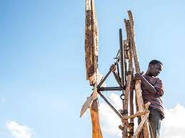
Week 3 - Energy Global changemakers
William Kamkwamba, from Malawi, was 14 years old when his parents couldn't afford for him to go to school.
He went to the library and taught himself how to build a wind generator out of wood, a bicycle frame, an old tractor fan and other materials.
He used it to pump out water from the ground, helping his local community survive during a drought.

Slide 22
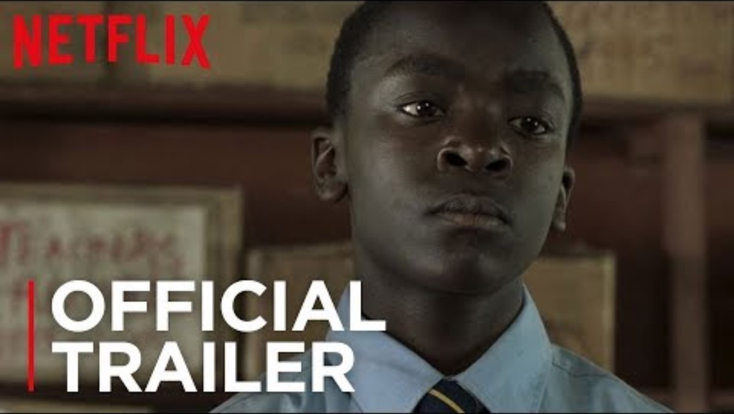
Week 3 - Energy Changemaker – William Kamkwamba

Slide 23
Week 3 - Energy Changemakers
Next time we'll look at how
YOU
can be a changemaker at school and at home

Slide 24

Week 4 - Energy School Actions
This week we'll be thinking of ways we can reduce energy use in school.

Slide 25
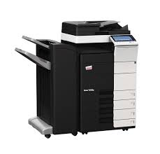
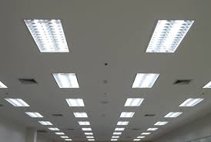
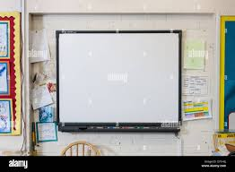
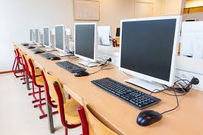
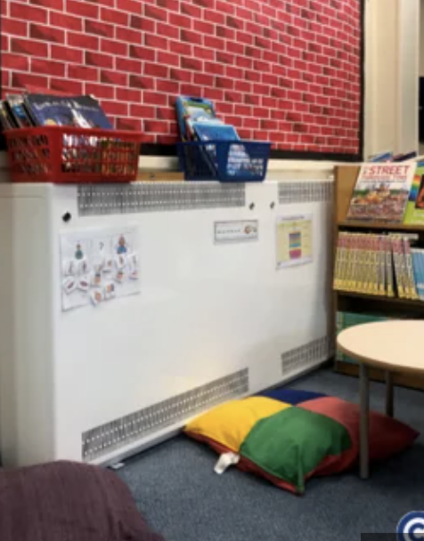
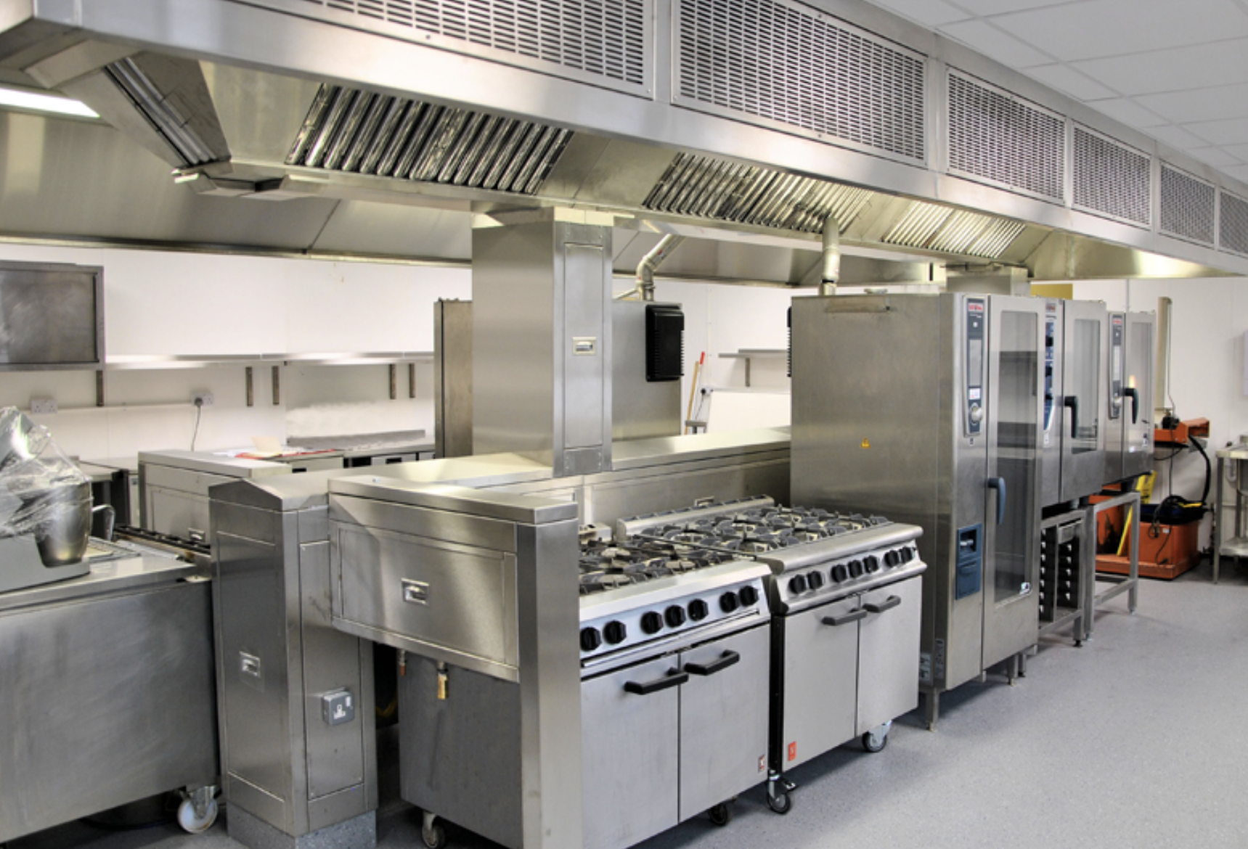
Week 4 - Energy School Actions
How could you reduce energy use in each of these?
Heating – gas/electricity / other
Freezer, Oven. Hob

Slide 26
Week 4 - Energy School Actions
How much electricity does a light like this use for 10 hours?
It takes about 5 watts to charge a phone and 50 watts to watch tv an hour
Older style incandescent bulb: 600 watts
Newer LED lights: 90-120 watts
Do we have LED in our school?

Slide 27
Week 4 - Energy School Actions
Does our school use energy at night time?
What still might be using energy?
No
Maybe
Yes –why?

Slide 28
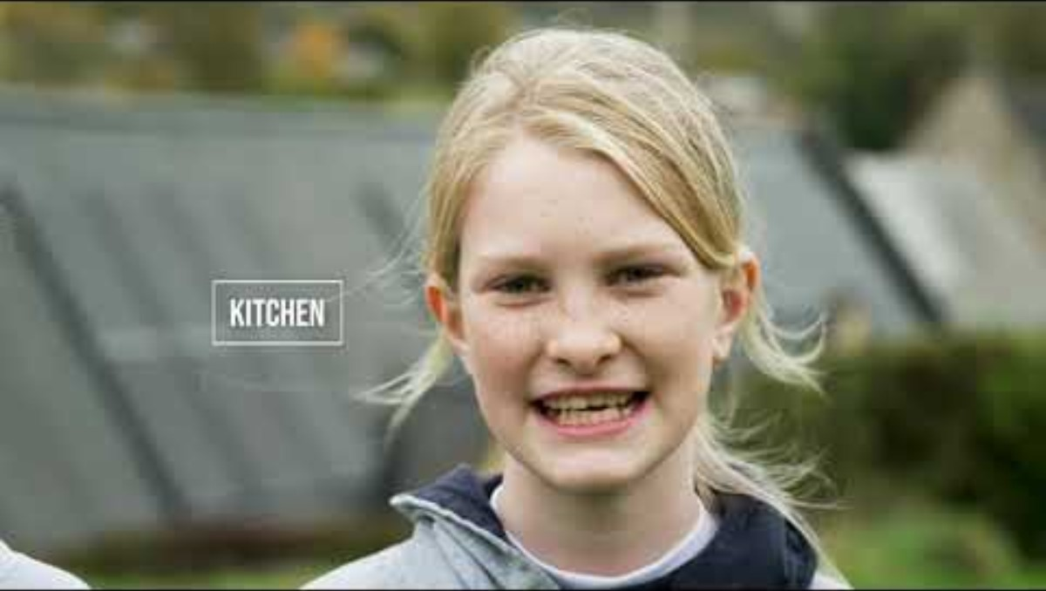
Week 4 - Energy School Actions
Can you think of any ways to monitor and save energy (electricity and gas) at school?
Energy Sparks in action at Freshford Church School
Choose which parts you want to watch.

Slide 29
Week 4 - Energy School Actions
Which of the adults in the school can help?
Talk to them!
What needs to change at school?
Take some photos
of people saving energy at school!

Slide 30
Week 4 - Energy School Actions
Our class action will be ….
Our school action will be …

Slide 31
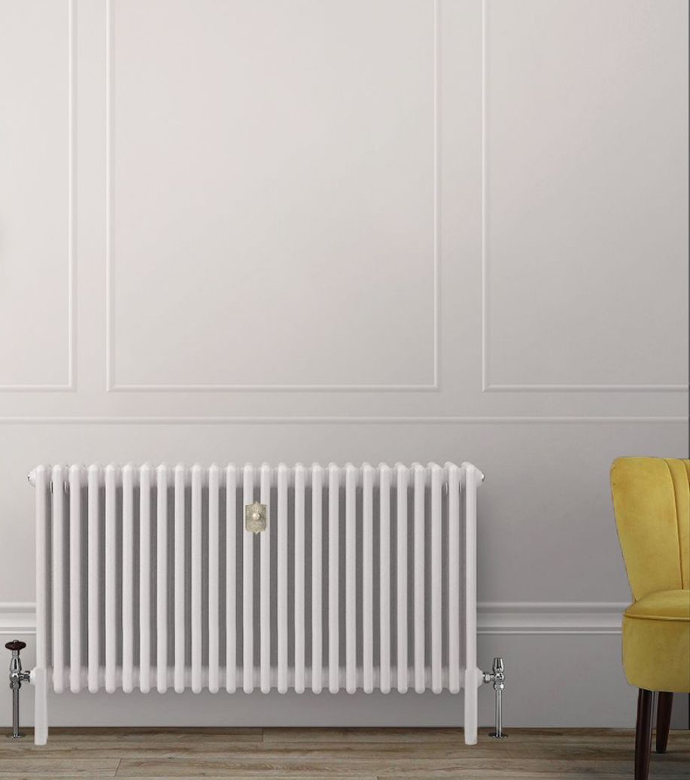
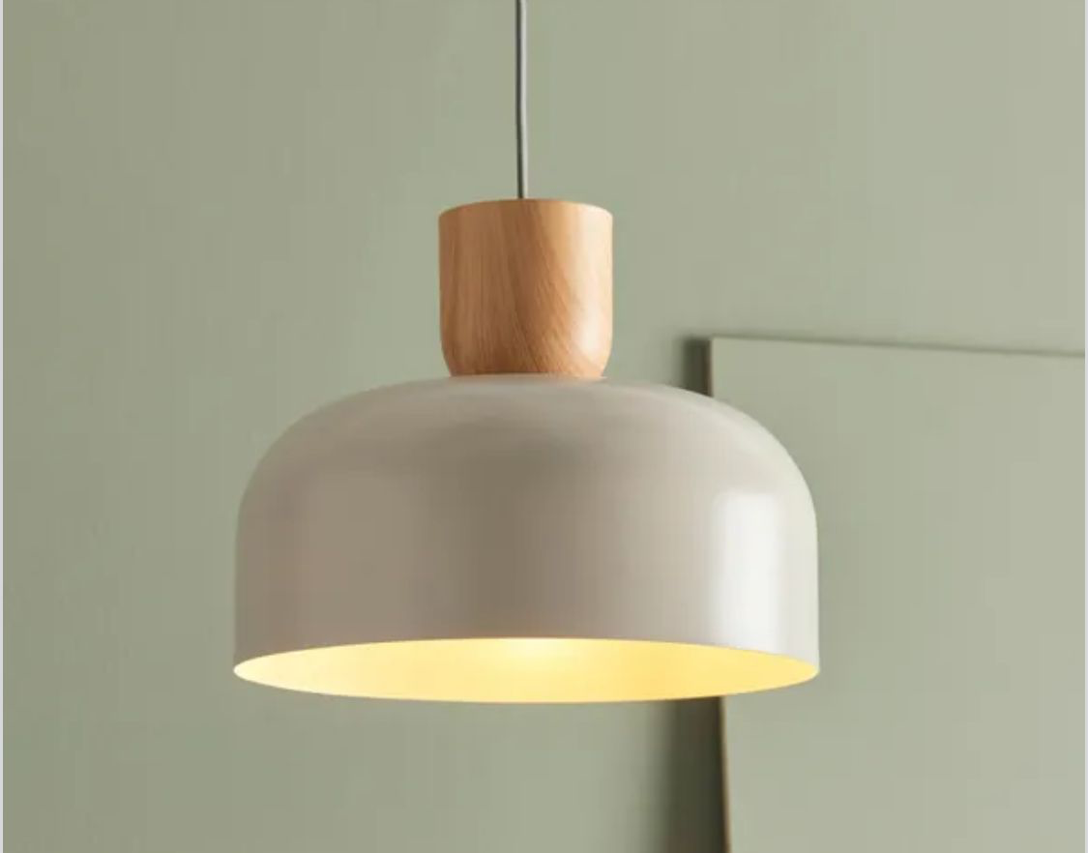
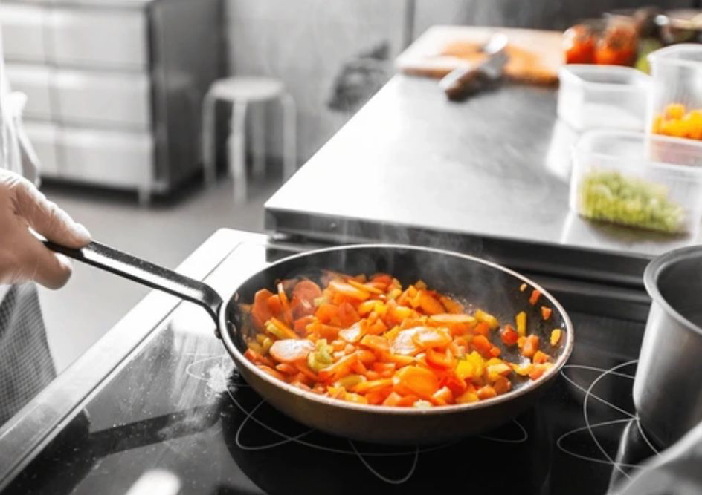
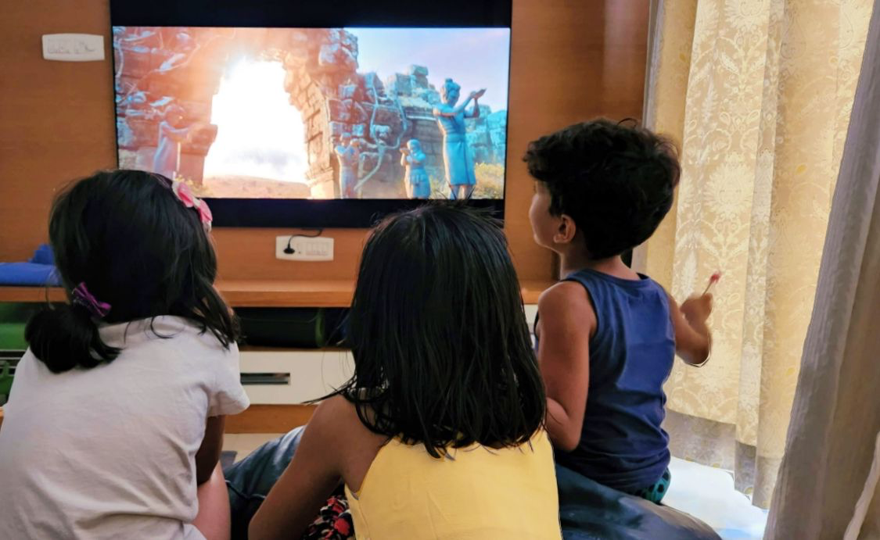
Week 5 - Energy Individual and Family Actions
This week we'll be thinking of ways we can reduce energy use at home.
Look at these pictures.
Which ones use gas in your home? What ones use electricity?
Do you use any other types of energy in your home? Renewable?

Slide 32
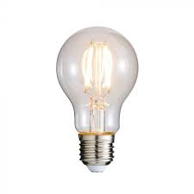
Week 5 Energy - Individual and Family Actions
How much ?
Around...
1 day ?
2.5 days?
2 hours?
Leaving a 40W bulb on for one extra hour when you're not in the room uses 0.04 kW.
How many days of riding a bike would it take to recreate that energy?
Riding a bike can be fun, but it sounds like you can save a lot of energy and reduce greenhouse gases by simply turning off the lights!
Notes:
2.5 days to recreate this energy

Slide 33
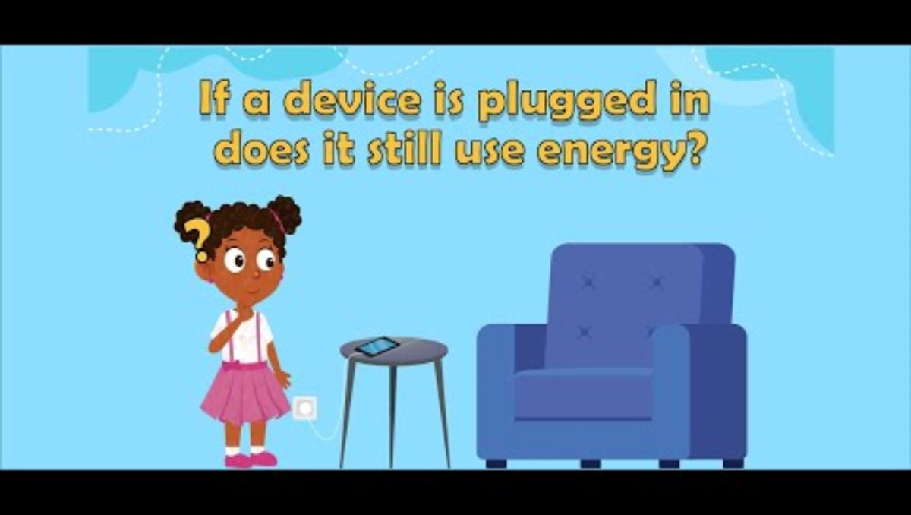
Week 5 - Energy Individual and Family Actions
What is phantom energy use?

Slide 34
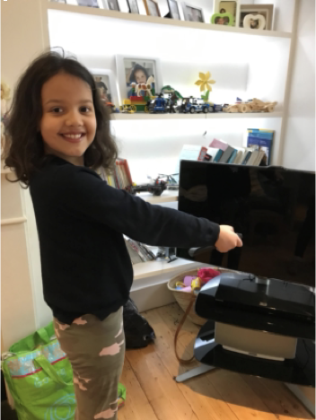
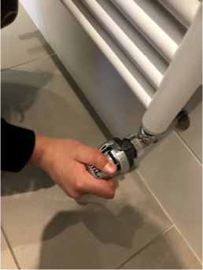
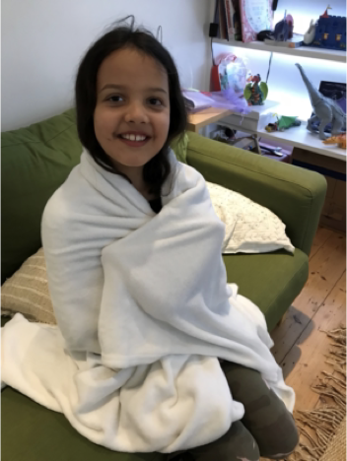
Week 5 - Energy Individual and Family Actions
How is this person saving energy?

Slide 35
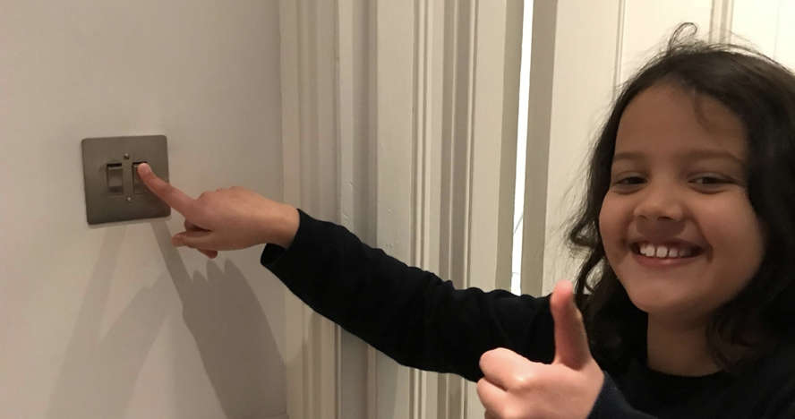
Week 5 - Energy Individual and Family Actions
Take some photos
of you ….at home
saving energy.
Send them in to school
to share and inspire others.

Slide 36
Week 6 - Energy Celebrating Our Actions
Let's remember some of the things we've talked about in assembly this term around the theme of energy

Slide 37
Week 6 Energy Celebrating Our Actions – class actions
INSERT PICTURES OF CLASSES TAKING ACTION IN THIS AREA
Over the last x weeks, we have reduced our energy(or similar) by kW or £ through class actions.

Slide 38
Week 6 - Energy Celebrating whole school actions
INSERT PICTURES OF energy use / saving AT SCHOOL and people involved
Over the last x weeks, we have saved …..kW of ….... through whole school actions.

Slide 39
Week 6 - Energy Celebrating family actions
INSERT PICTURES OF FAMILIES REDUCING CONSUMPTION OR WASTE
Over the last x weeks, our families have saved ….. kg of waste. (or similar)

Slide 40

Week 6 - Energy Celebrating Our Actions
Notes:
A chance to reflect about the importance of water and it's role in the natural world.

