Slide 1

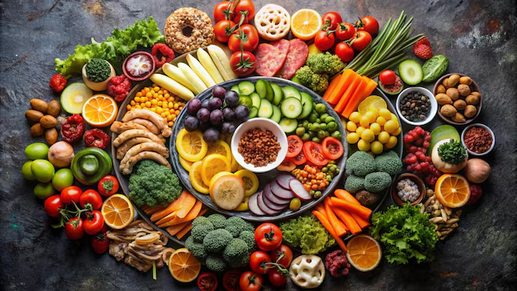
Week 1 Food Food
This term our whole school is thinking about Food
Notes:
This term we will thinking about food in our assemblies.

Slide 2
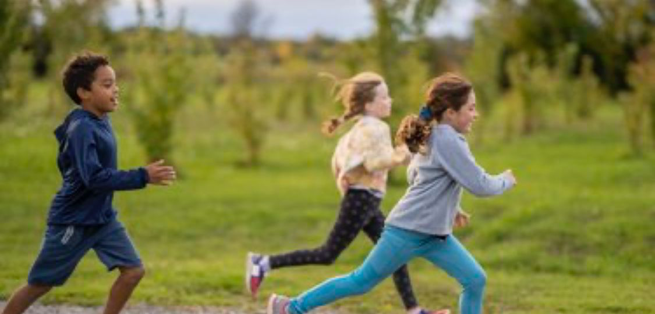
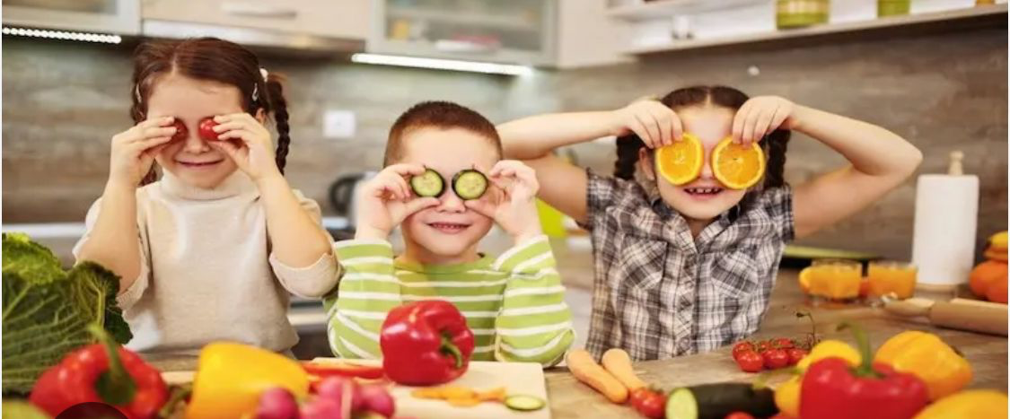
Week 1 Food Why do we need food?
To give us energy
To make new body cells and grow
To fight infection and to protect us from disease
What's your favourite food?
Notes:
Every living thing needs food for life.
Our food gives us the energy we need to live and the carbohydrates, fats, protein, vitamins and minerals that we need to stay healthy.
The food we eat also links us to our family and friends who we share food with and the farmers who produce food in the UK and around the world.

Slide 3
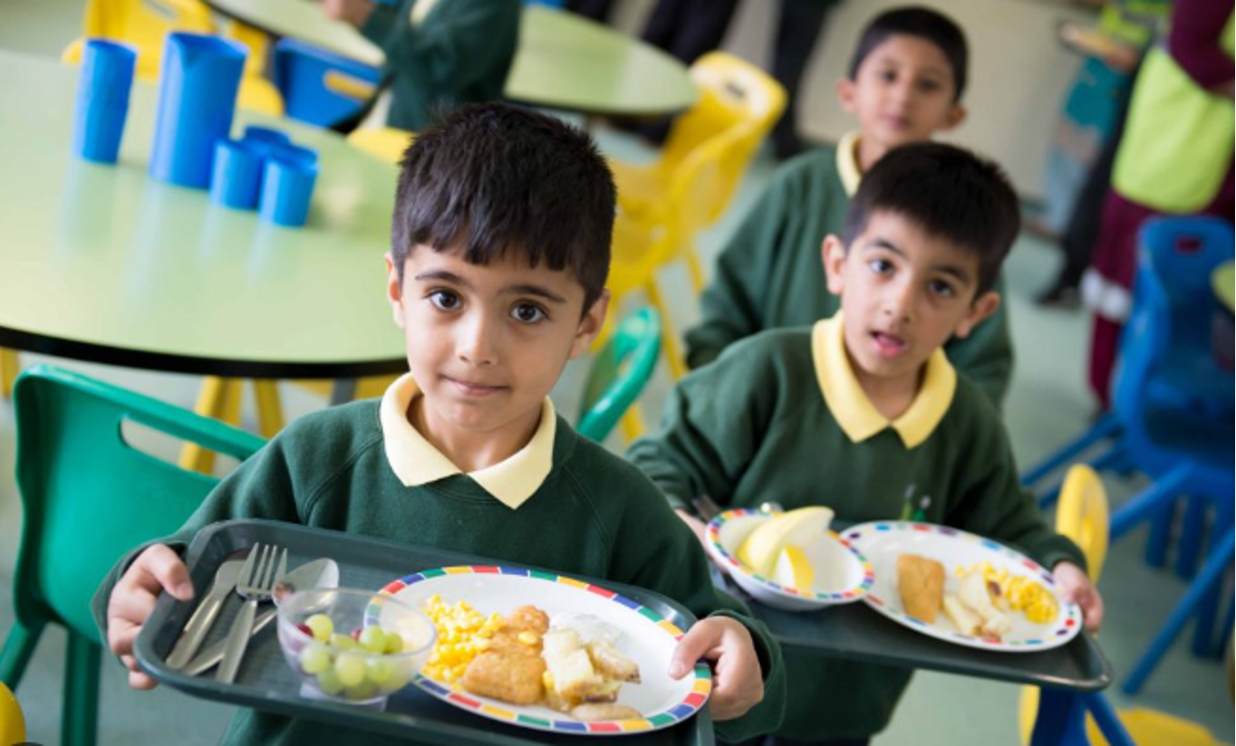
Week 1 Food Where does our food come from?
What do we already know?

Slide 4
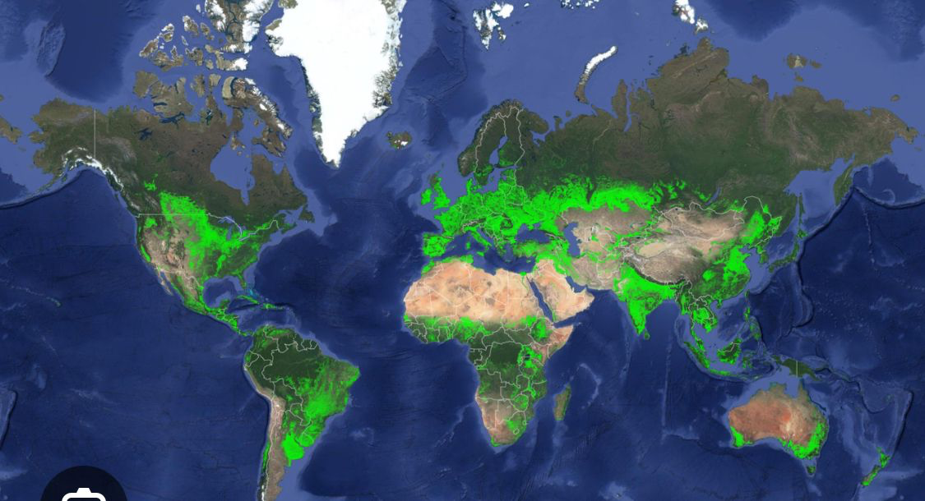
Week 1 Food Where is our food grown?
Our planet has to feed 8.2 billion people.
The green places are croplands where food is grown.
What might they be growing?

Slide 5
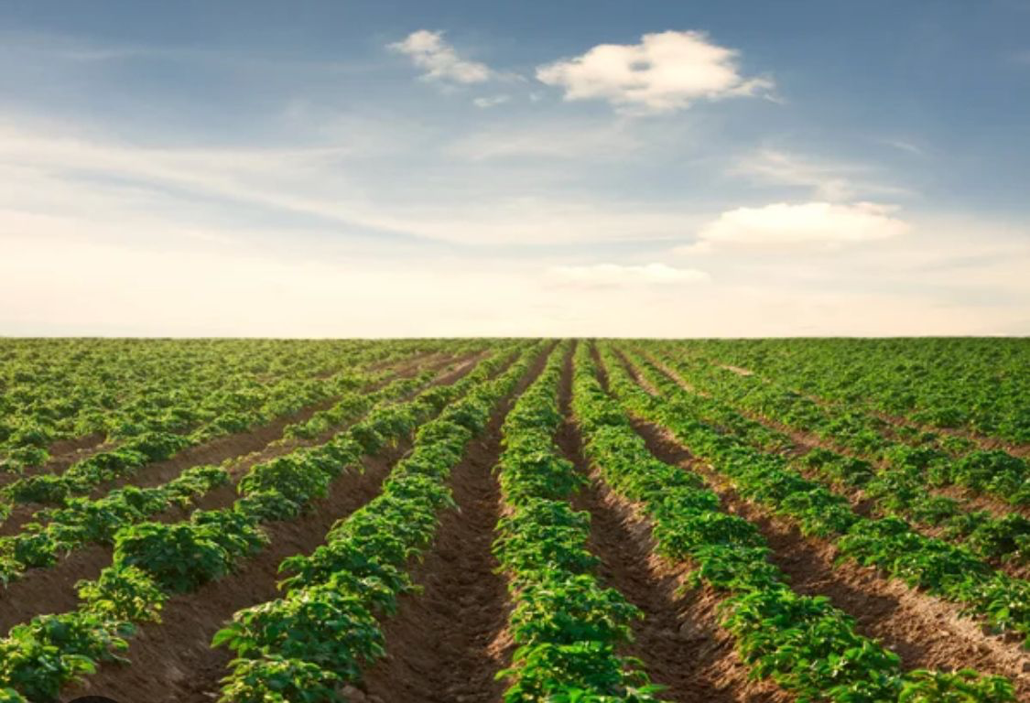
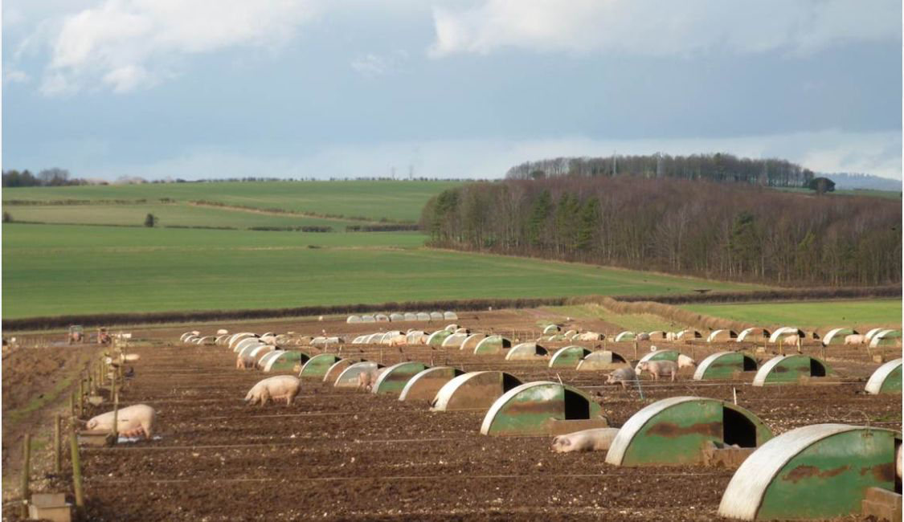
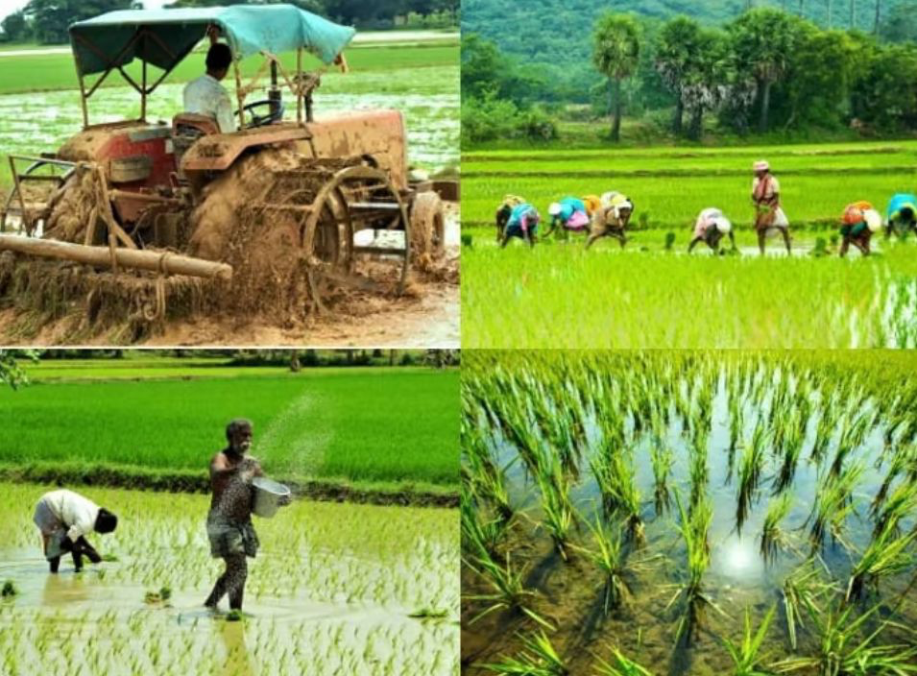
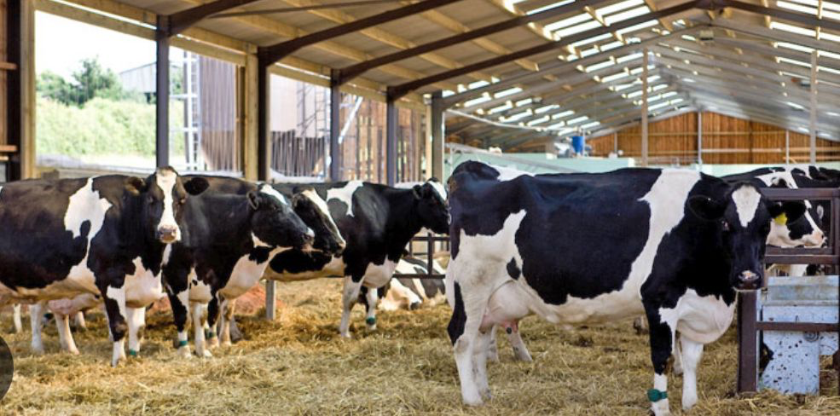
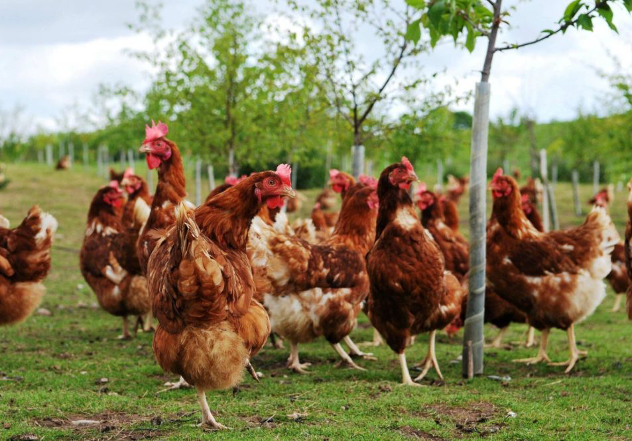
Week 1 Food Food Production: how do farmers use the land?
Grow plants for people to eat
Grow plants to feed animals

Slide 6
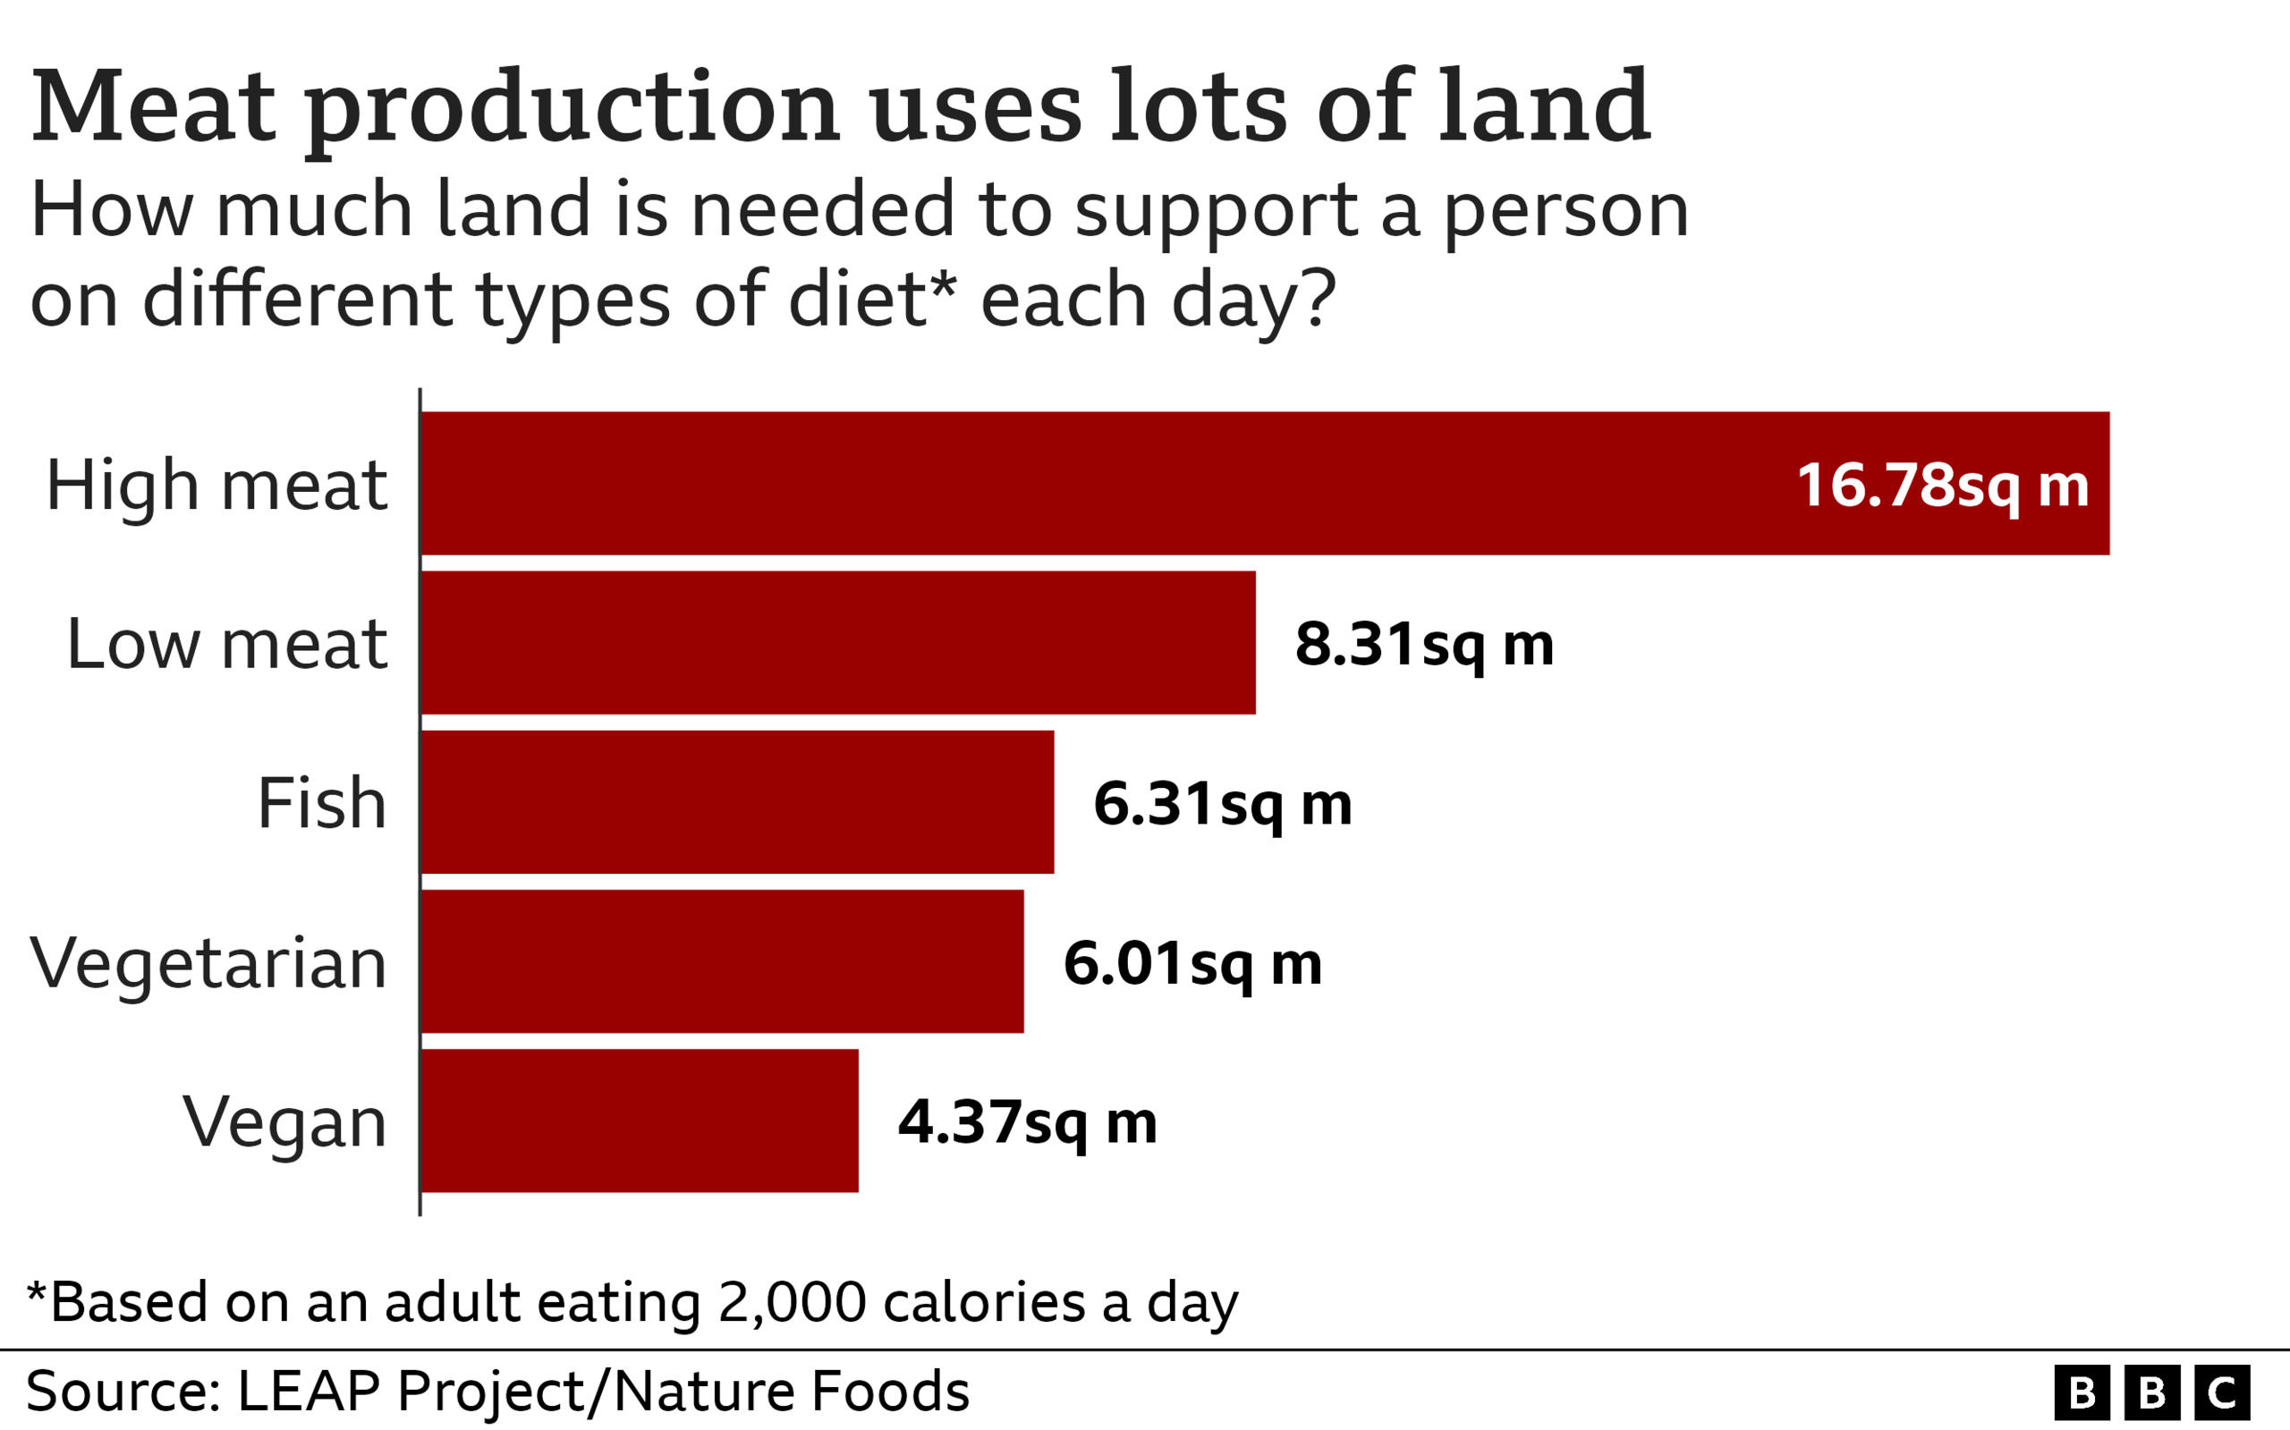
Week 1 Food Food Production – how is land used?
What does this graph tell us about meat and crop production?
Why might eating less meat be good for the planet?

Slide 7
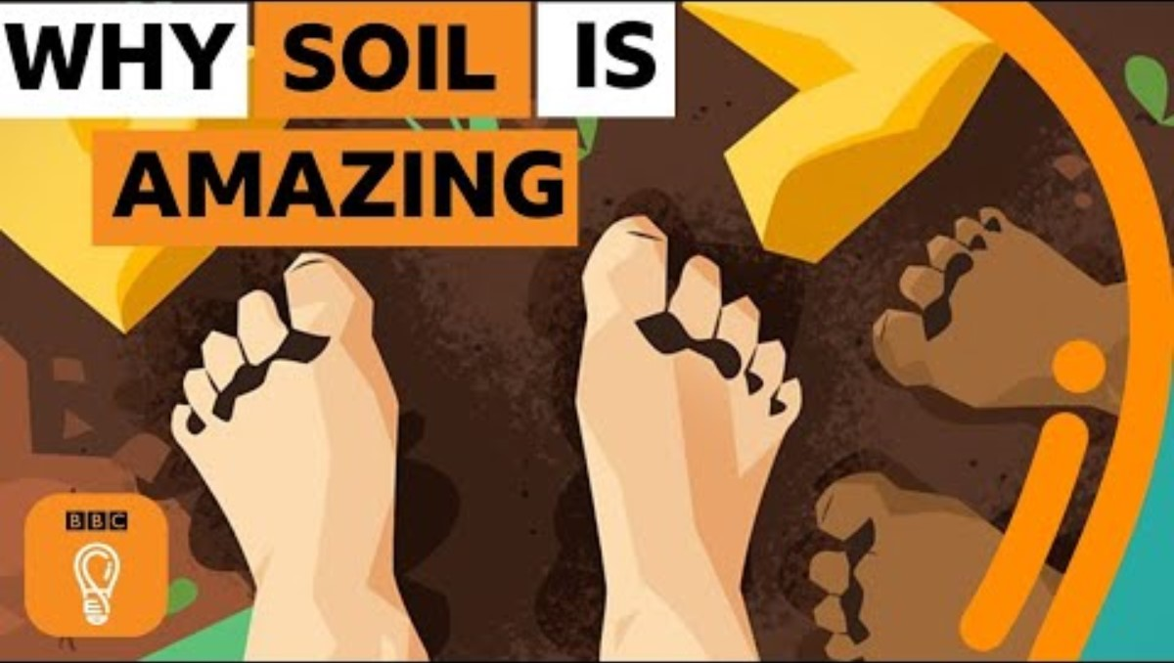
Week 1 Food Soil
Farmers work hard to protect the soil
Notes:
https://www.youtube.com/watch?v=MmJUj4Aa2kM&t=6s

Slide 8
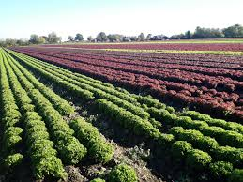
Week 1 Food Next time
Next time:
We'll think more about the main issues around food and farming

Slide 9
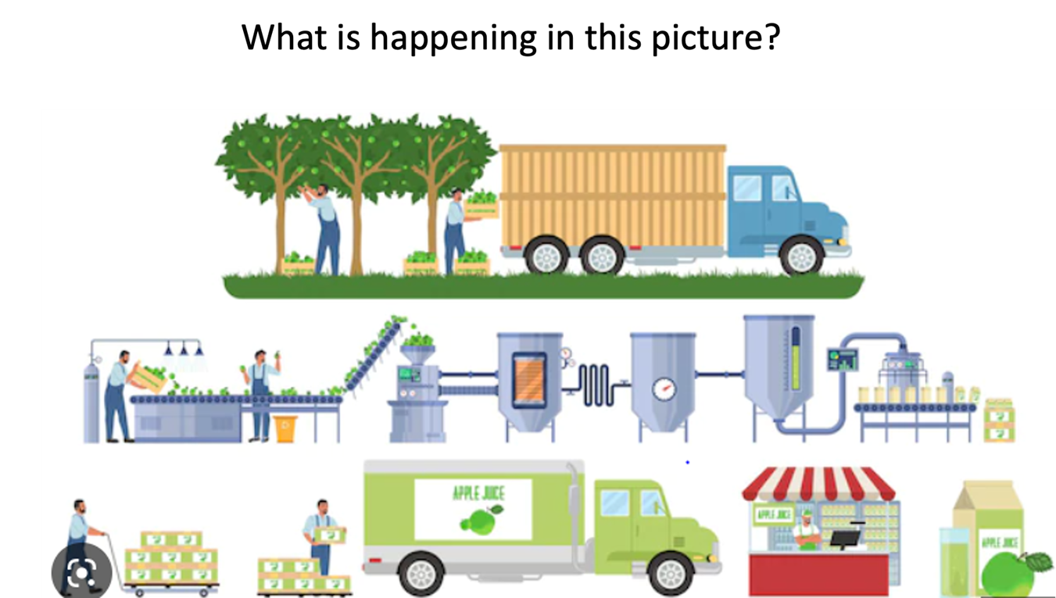
Week 2 Food What are the main issues around food?
Good quality food is important for everyone.
But we do need to think about how food production impacts our planet.
What ways can you think of that food production affects our planet?

Slide 10
Week 2 Food What are the main issues around food?
Let’s explore these issues:
Deforestation & Habitat Loss
Fertilizers, Pesticides & Herbicides
Transportation
Food Waste

Slide 11
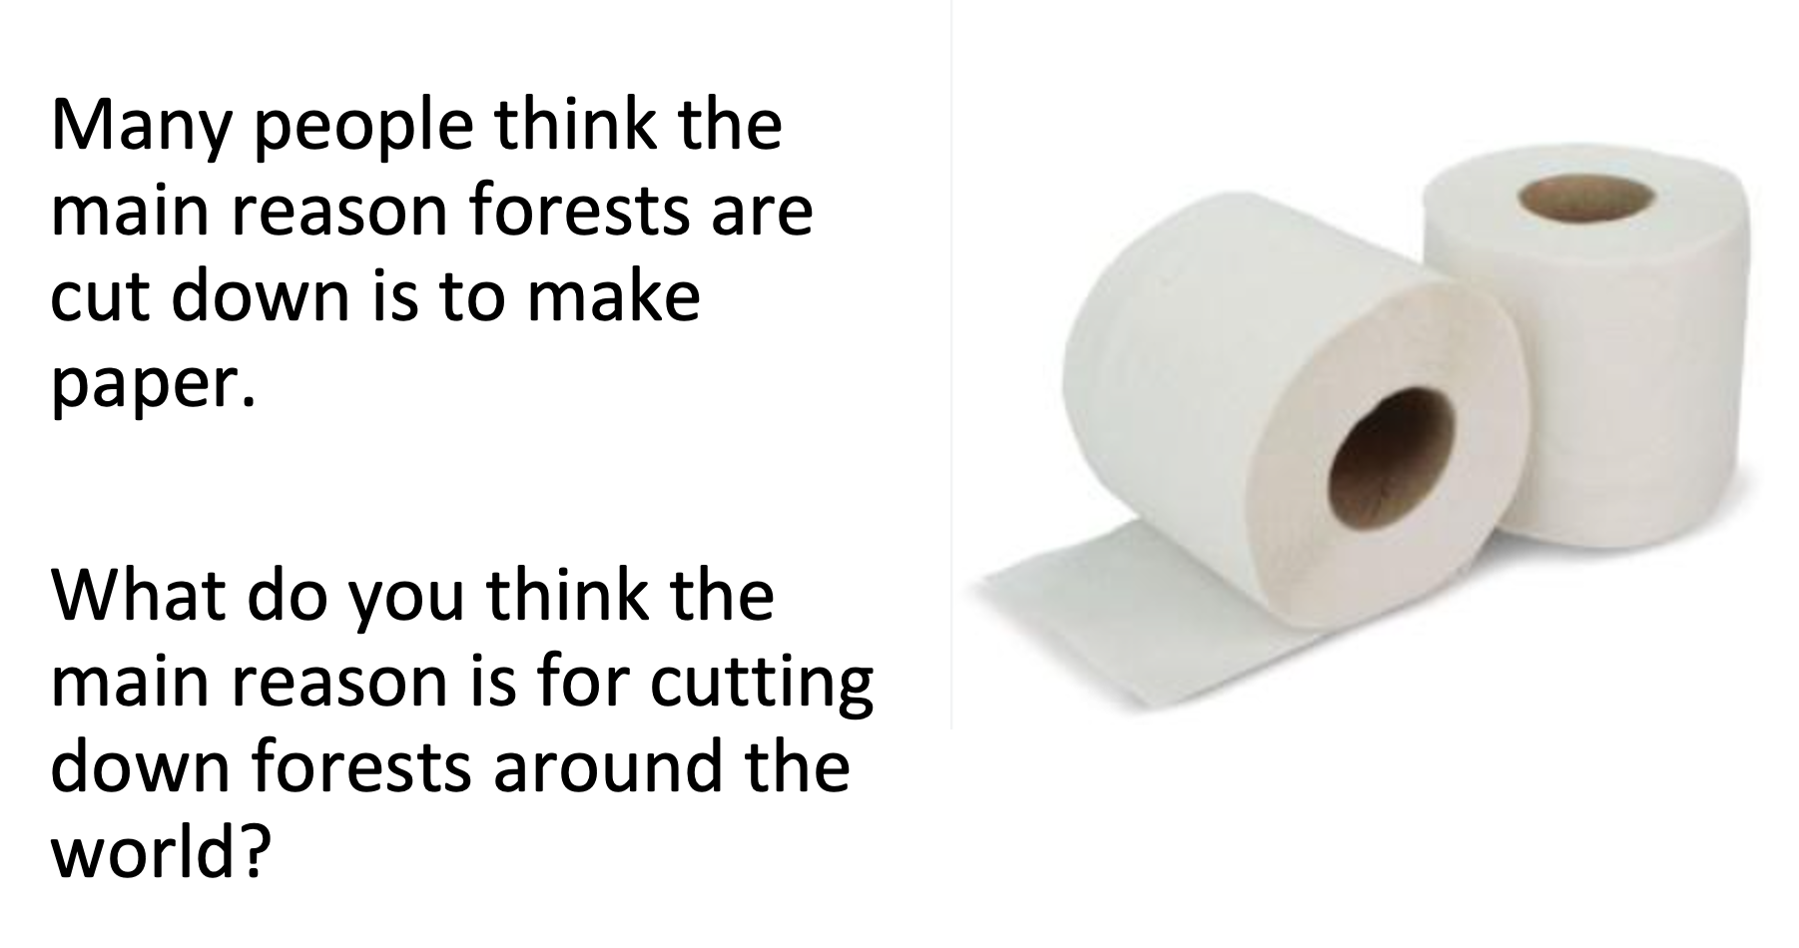
Week 2 Food Deforestation

Slide 12
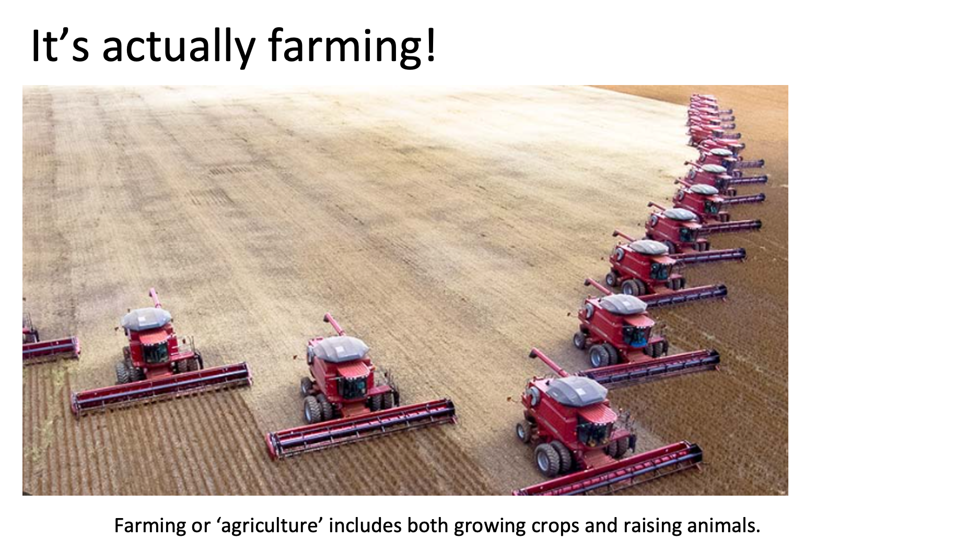
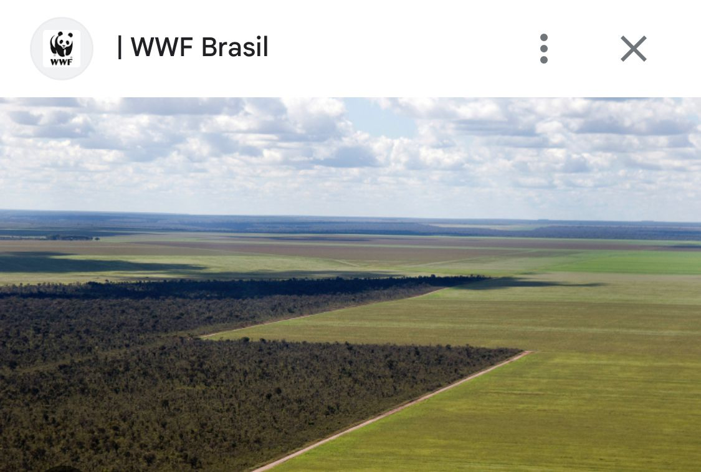
Week 2 Food Deforestation
Globally, beef and soy are the leading reasons for tropical deforestation.

Slide 13
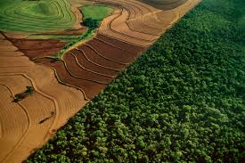
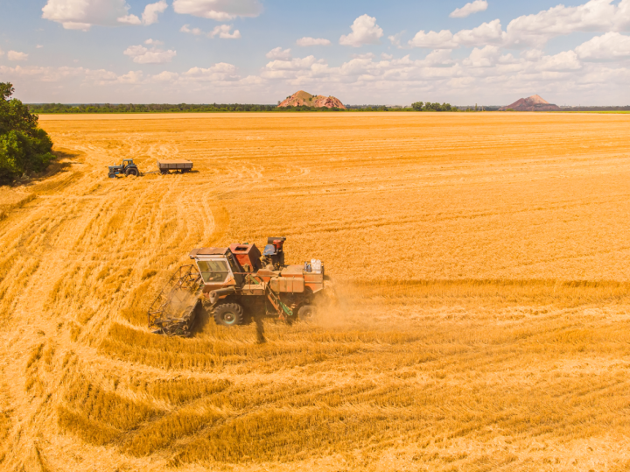
Week 2 Food Habitat loss
Do you know what ‘mono-culture’ means?
What impact is this farming having on biodiversity / wildlife?

Slide 14
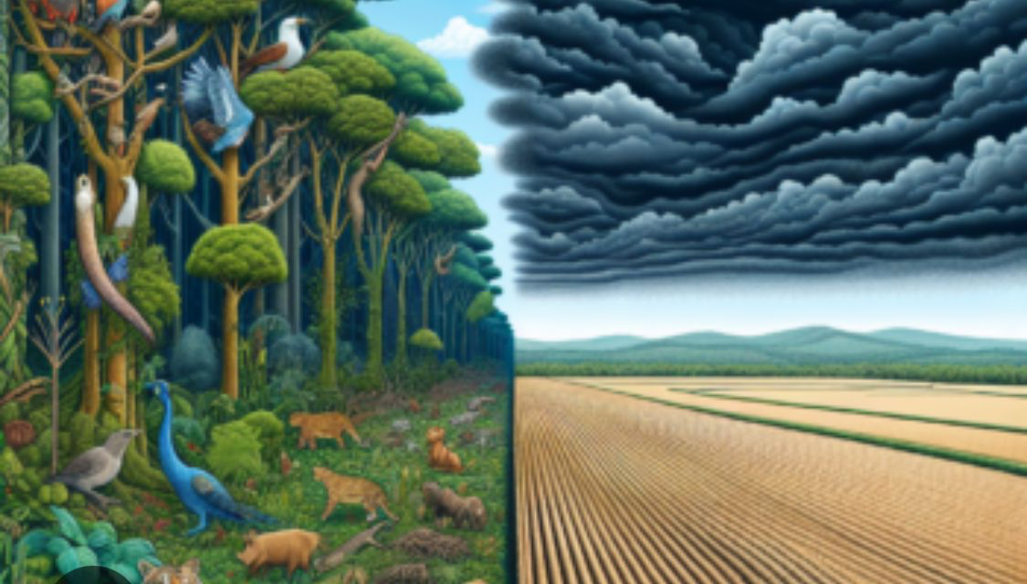
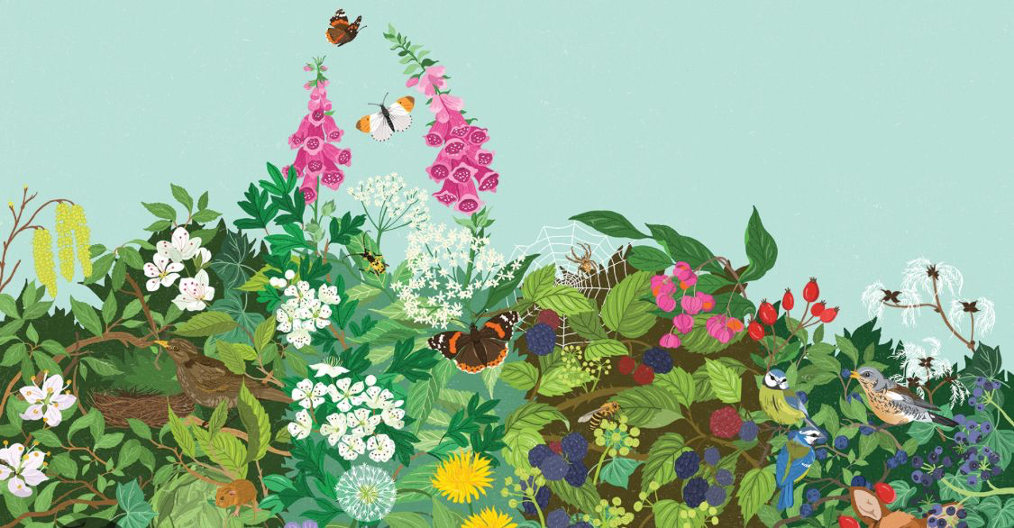
Week 2 Food Habitat loss + biodiversity
Habitats can be destroyed with some modern farming methods.
If the rainforests are cut down to grow beef, soy and palm oil, the animals that live there lose their homes.
What animals and plants are losing their homes?
If hedgerows are cut down for bigger and bigger fields, the animals that live there lose their habitats.
In the last 75 years the UK has lost 50% (half) of its hedgerows.
What animals and plants are losing their homes?

Slide 15
Week 2 Food Fertilizers and Pesticides
Fertilisers, pesticides and herbicides
Why are these helpful?
Why might some people not be keen on them?
Plants
Animals
Notes:
Fertilizers contain nutrients which plants need to grow.
They can be organic (poo and compost) or synthetic (human-made)
Adding fertiliser to the soil where plants are growing can make them stronger and bigger.
Pesticides and herbicides

Slide 16
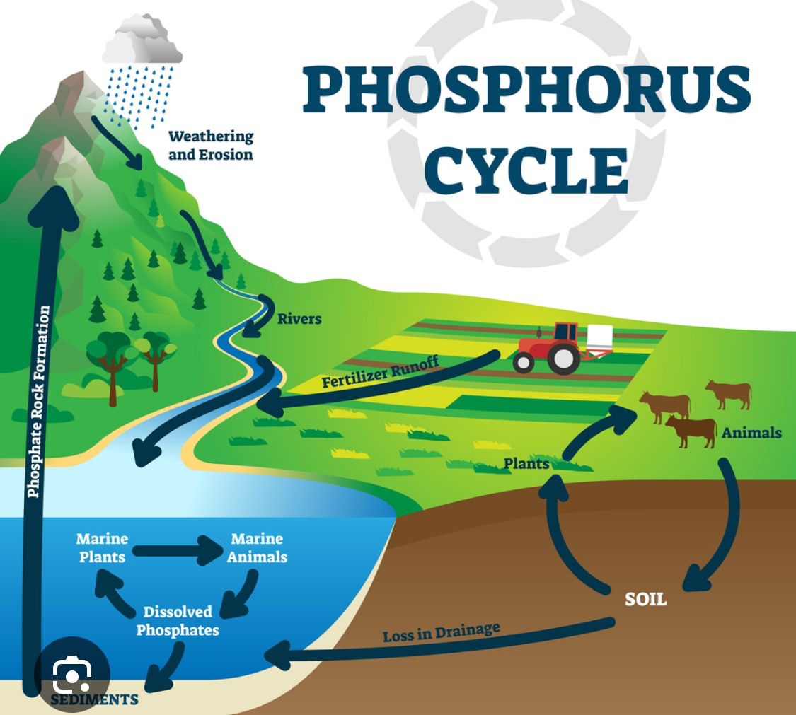
Week 2 Food Fertilizers and Pesticides
Pesticides and fertilizers can run off fields into our water and rivers.
Do we have any problems with our local rivers or lakes?
Who can find out for us?
Notes:
https://www.youtube.com/watch?v=6Hfb9R5G-C4

Slide 17

Week 2 Food Fertilizers and Pesticides
Do you recognise this sign?
What does it mean?
Why is organic food good for the environment?

Slide 18
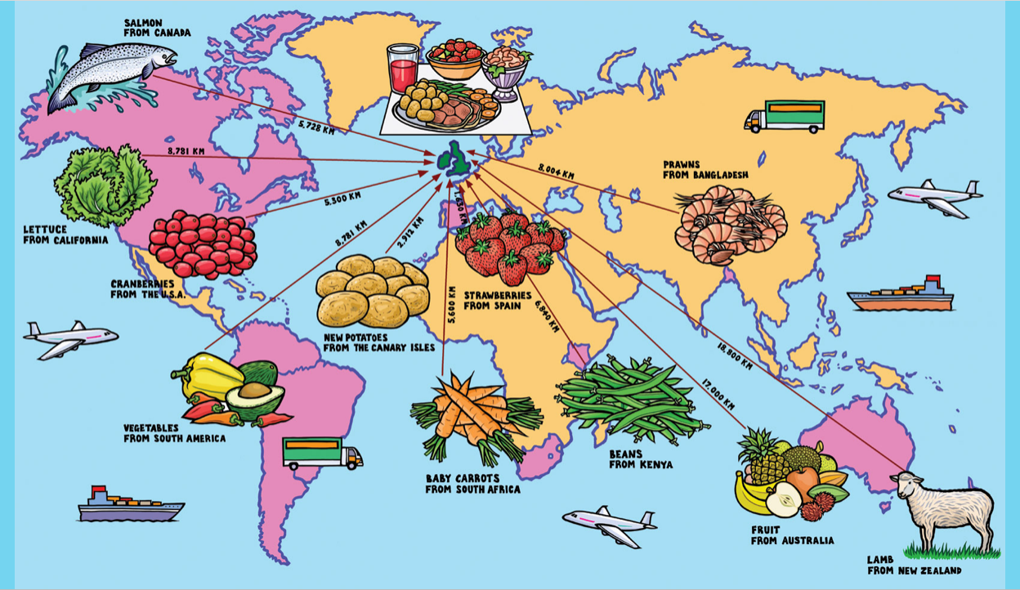
Week 2 Food Transportation & Food Miles
Notes:
This term we will thinking about water in our assemblies.

Slide 19

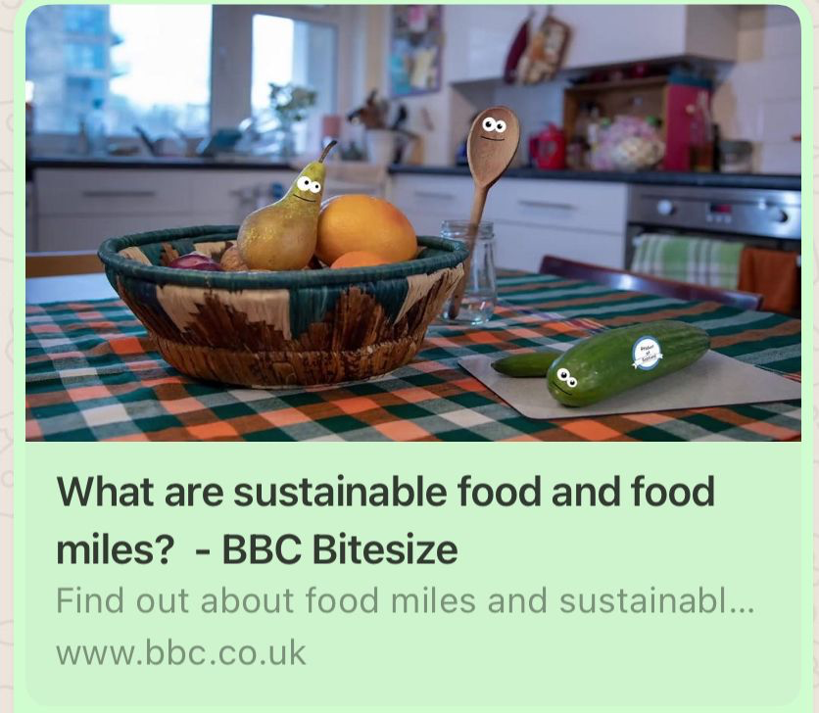
Week 2 Food Transportation & Food Miles
https://www.bbc.co.uk/bitesize/topics/zfmpb9q/articles/zs9gsk7#zkhhvj6
Notes:
https://www.bbc.co.uk/bitesize/topics/zfmpb9q/articles/zs9gsk7#zkhhvj6

Slide 20
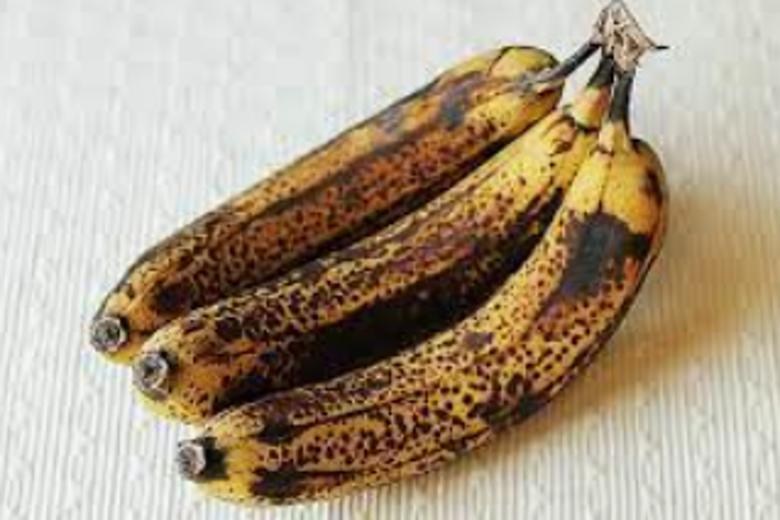
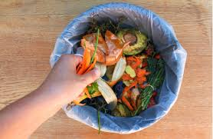
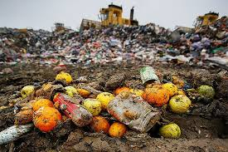
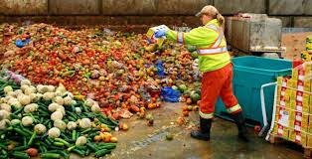
Week 2 Food Food Waste
Where do you see food being wasted?
How does this harm our planet?

Slide 21
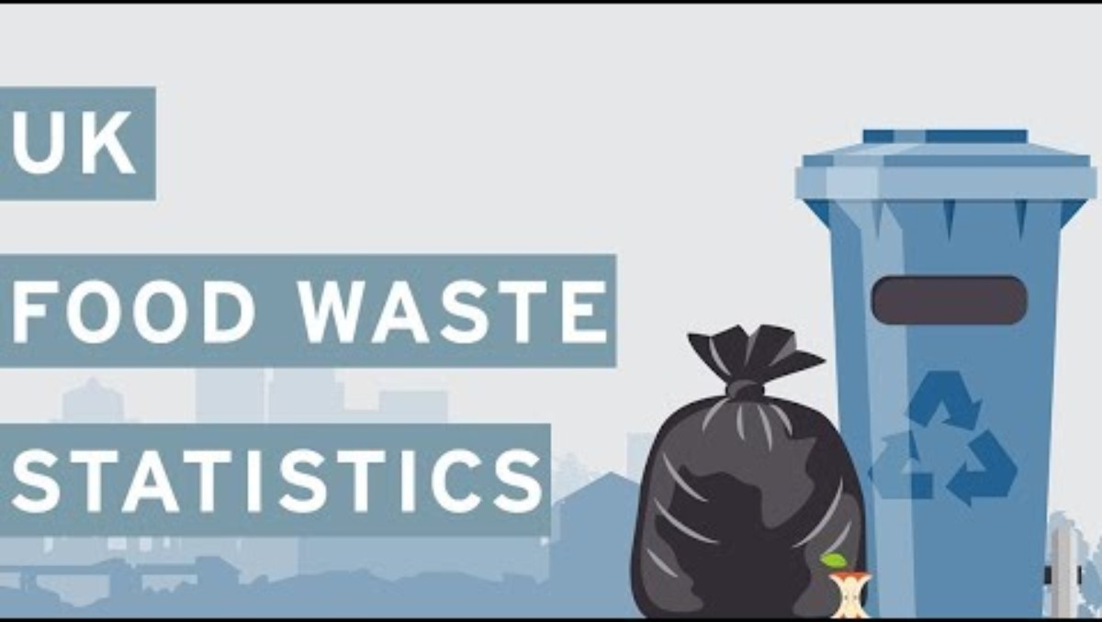
Week 2 Main issues around Food
Notes:
https://www.youtube.com/watch?time_continue=8&v=89w-g-XmIOU&embeds_euri=https%3A%2F%2Fwww.ourcity
ourworld.co.uk%2F&feature=emb_logo

Slide 22
Week 2 Main issues around Food
Next week we'll look at ​
​
Changemakers​
who are helping us improve Food Production and look after the environment. You could find out about some to share next time.

Slide 23
Week 3 Local changemakers – Real Junk Food Project
INSERT INFO ABOUT LOCAL FOOD CHANGEMAKER

Slide 24
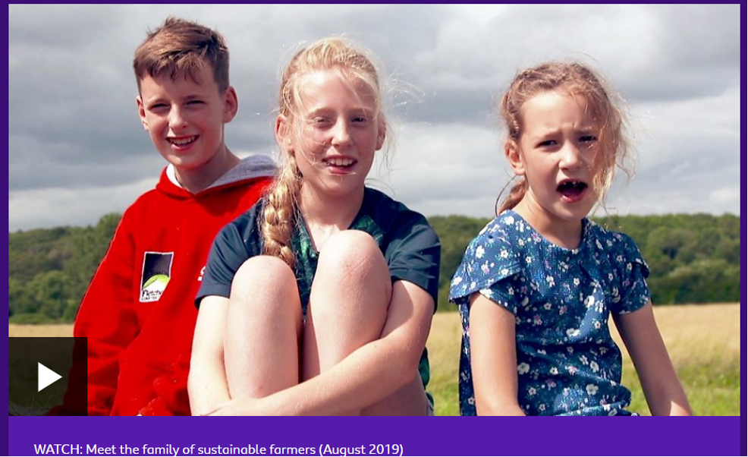
Week 3 National changemakers
Many farmers are doing great work making sure their farming is sustainable and helping wildlife.
Climate change: What's it got to do with farming? - CBBC Newsround
Notes:
https://www.youtube.com/watch?v=LKLupMzNUdE
https://www.bbc.co.uk/newsround/49371062

Slide 25
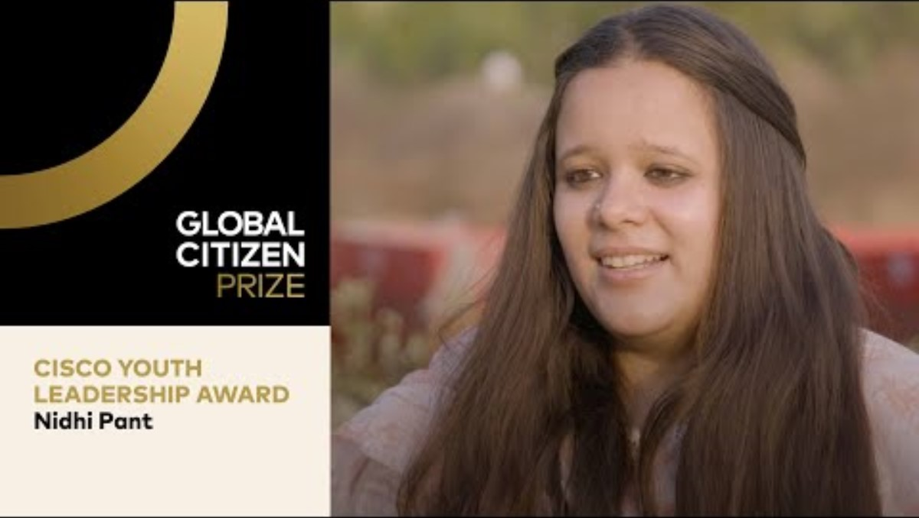
Week 3 Global changemakers
Meet Nidhi Pant from India. She won an award for her work helping women find jobs on farms and produce local food. They process any excess food so it can be used throughout the year.

Slide 26
Week 3 Changemakers
Next time we'll look at how
YOU
can be a changemaker at school and at home

Slide 27
Week 4 School Actions
What’s on the menu at school today?
Which ingredients can be found locally?
Which ingredients have had to travel the furthest?
INSERT CUTTING OF SCHOOL MENU
Who could we talk to in school about using more local or organic food?

Slide 28
Week 4 School Actions
Look at a picture of our school food waste from yesterday.
Why might you leave food at school?
Which foods get thrown away most often at school?
INSERT PICTURE OF RECENT SCHOOL FOOD COLECTION
What could we do to reduce food waste at school?
Who could we talk to help?

Slide 29
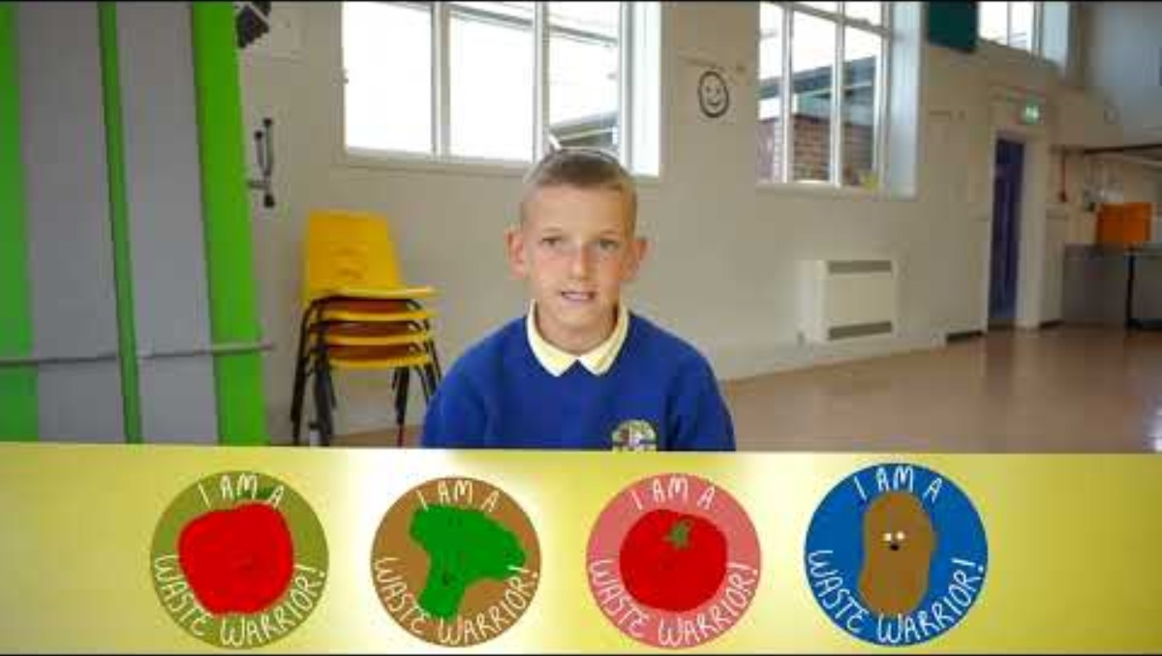
Week 4 School Actions
Watch how another school has reduced food waste.
Would this work in our school?
Notes:
https://www.youtube.com/watch?v=MxGGab_Y04E

Slide 30
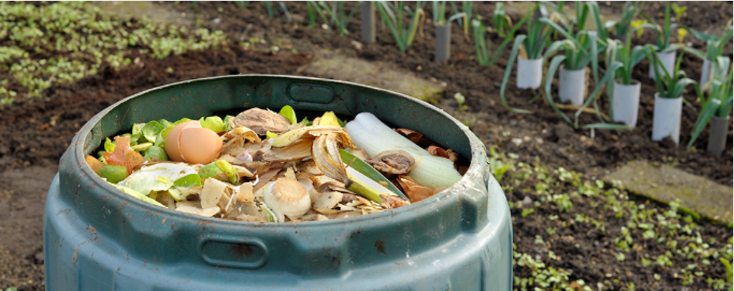
Week 4 School Actions
Composting is a great way of disposing of fruit and vegetable peelings. Compost also helps keep our soils healthy.
Could we create our own compost at school?

Slide 31
Week 4 School Actions
Which of the adults in the school can help?
Talk to them!
What needs to change at school?
Take some photos
of people taking action for food at school!

Slide 32
Week 4 School Actions
Our class action will be ….
Our school action will be …
Take some photos of your class being changemakers about food
Talk to others in the school

Slide 33
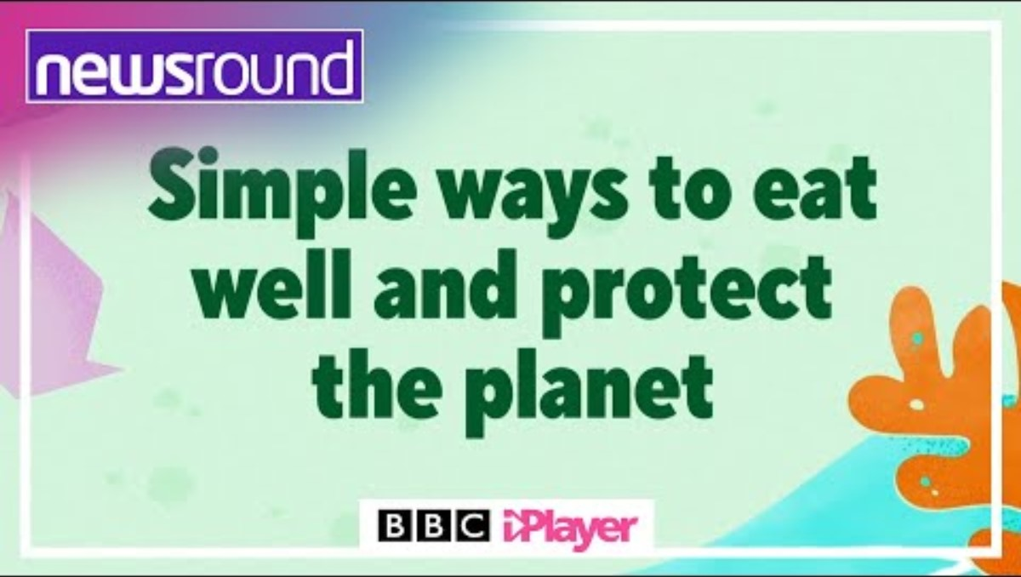
Week 5 Individual and Family Actions
This week we'll be thinking of ways we can make good environmental choices about food at home.

Slide 34

Week 5 Individual and Family Actions
How many tonnes of food waste from each house each year in U.K. 2018?
500 tonnes
1 million tonnes
7 million tonnes
Notes:
7 million tonnes

Slide 35
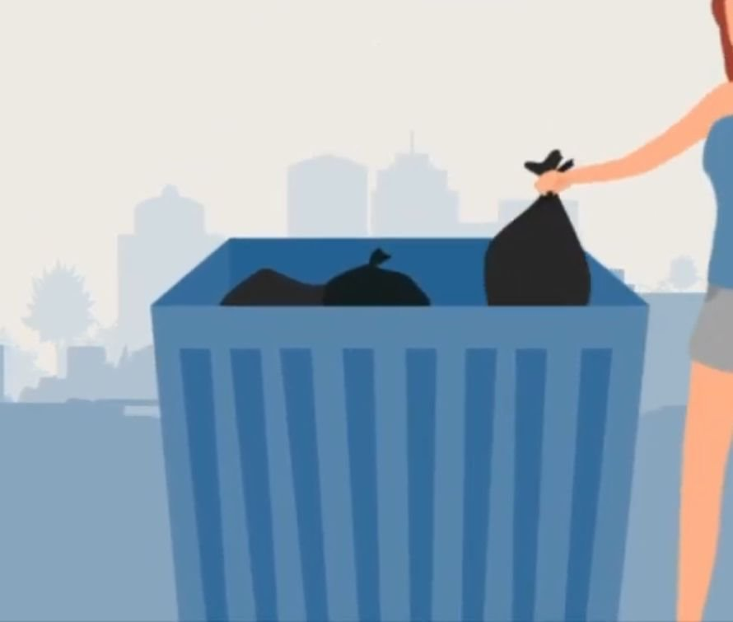
Week 5 Individual and Family Actions
What is estimated cost of this food waste?
£500
​
£2 million
​
£7.5 Billion
​
other
Notes:
7.5 Billion

Slide 36
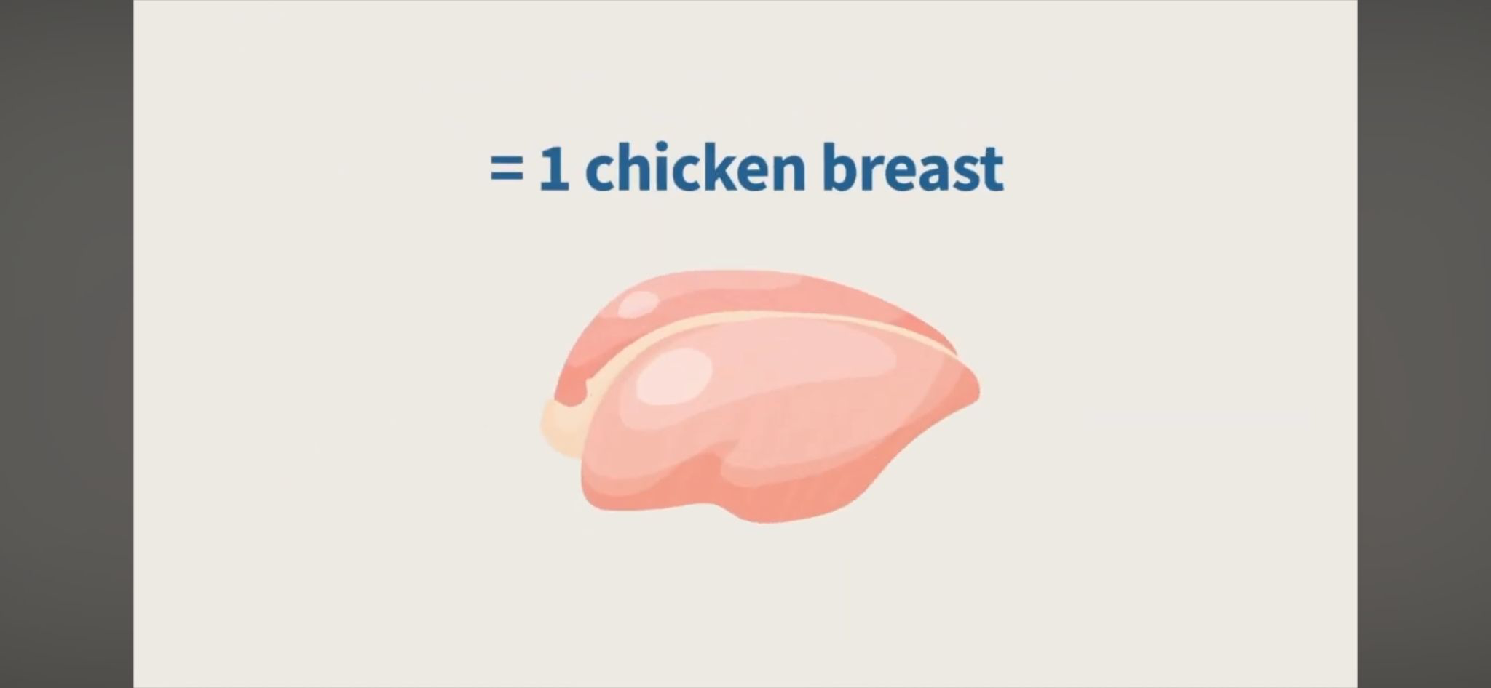
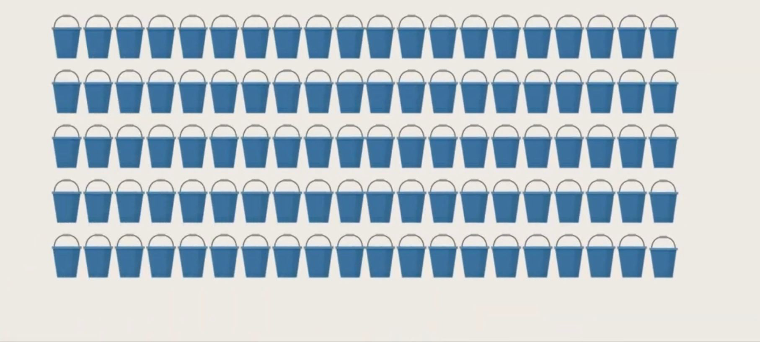
Week 5 Individual and Family Actions
2 bucket of water
​
54 buckets
​
100 buckets
​
other
How many buckets of water to produce a chicken breast…...
Notes:
54 buckets – to grow grain to feed them and then water for the live birds

Slide 37
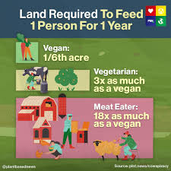
Week 5 Individual and Family Actions
How much land is required to feed 1 person for 1 year?
Can you match the area to the type of diet?
Vegan 3 acres
Vegetarian 1/6 acre
Meat Eater ½ acre
How could eating more plant based food help the planet?
Notes:
Vegan -1/6 acre
Vegetarian – ½ acre
Meat eater – 3 acres

Slide 38
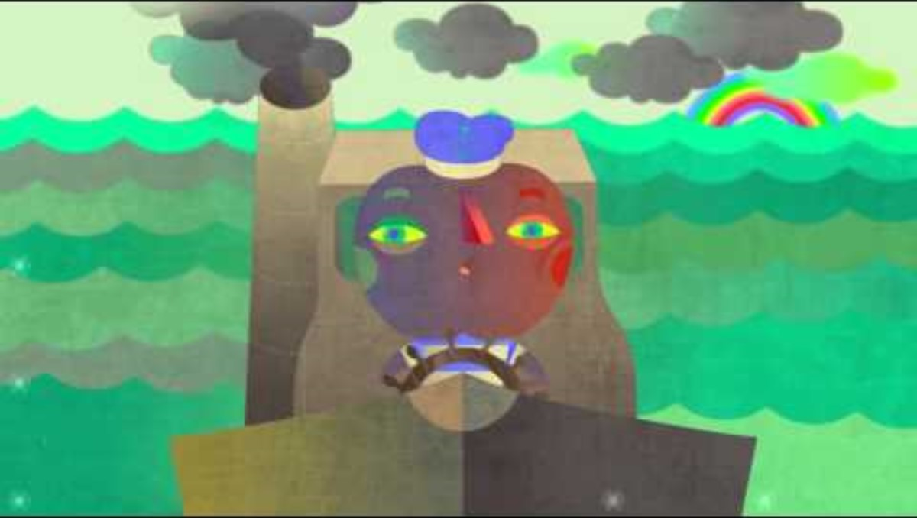
Week 5 Individual and Family Actions
Why is it better to buy local food where you can?
How could you eat more local food at home?

Slide 39
Week 5 Individual and Family Actions
Can you think of ways you can reduce the impact of your food at home?
Take some photos of you taking action around food at home
Some ideas
Shopping local
Cutting down on food waste
If you can, grow your own organic food
Eat less meat

Slide 40
Week 6 Celebrating Our Actions
Let's remember some of the things we've talked about in assembly this term around the theme of Food

Slide 41
Week 6 Celebrating Our Actions – class actions
INSERT PICTURES OF CLASSES TAKING ACTION IN THIS AREA
Over the last x weeks, we have ….........(or similar) by kg through class actions.

Slide 42
Week 6 Celebrating Our Actions – whole school actions
INSERT PICTURES OF positive food choices for the environment AT SCHOOL and people involved
Over the last x weeks, we have saved ….. kg of ….... through whole school actions (or similar data).

Slide 43
Week 6 Celebrating Our Actions – family actions
INSERT PICTURES OF FAMILIES making positive food choices for the environment
Over the last x weeks, our families have saved ….. kg of waste. (or similar)

Slide 44
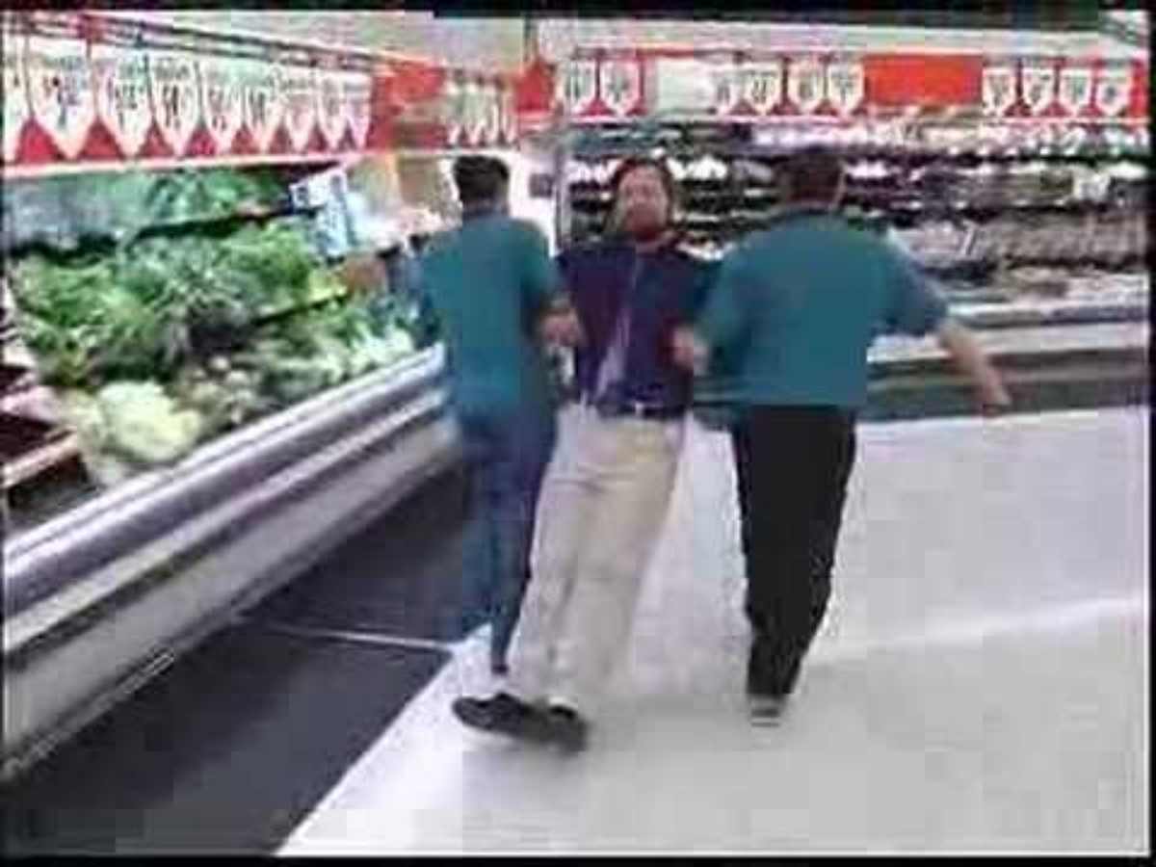
Week 6 Celebrating Our Actions
Going Crazy About Vegetables
What Vegetables are YOU Crazy About?!

