Slide 1

1 Travel & Transport
What do we know about travel & transport?
This term our whole school is thinking about Travel & Transport
Notes:
This term we will thinking about water in our assemblies.

Slide 2

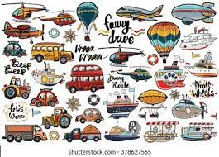
1 Travel & Transport
What do we know about travel & transport?
How many different forms of transport can you think of?
Transport is very useful, but ....................
Notes:
This term we will thinking about water in our assemblies.

Slide 3
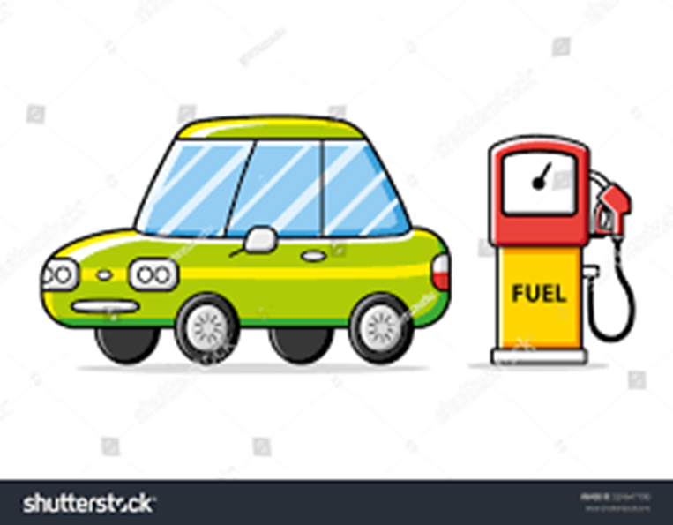


1 Travel & Transport
What do we know about travel & transport?
Most cars, buses, planes and trains still run on fossil fuels like petrol or diesel.
And when these fuels are used, engines produce harmful gases, dust and smoke
Notes:
This term we will thinking about water in our assemblies.

Slide 4
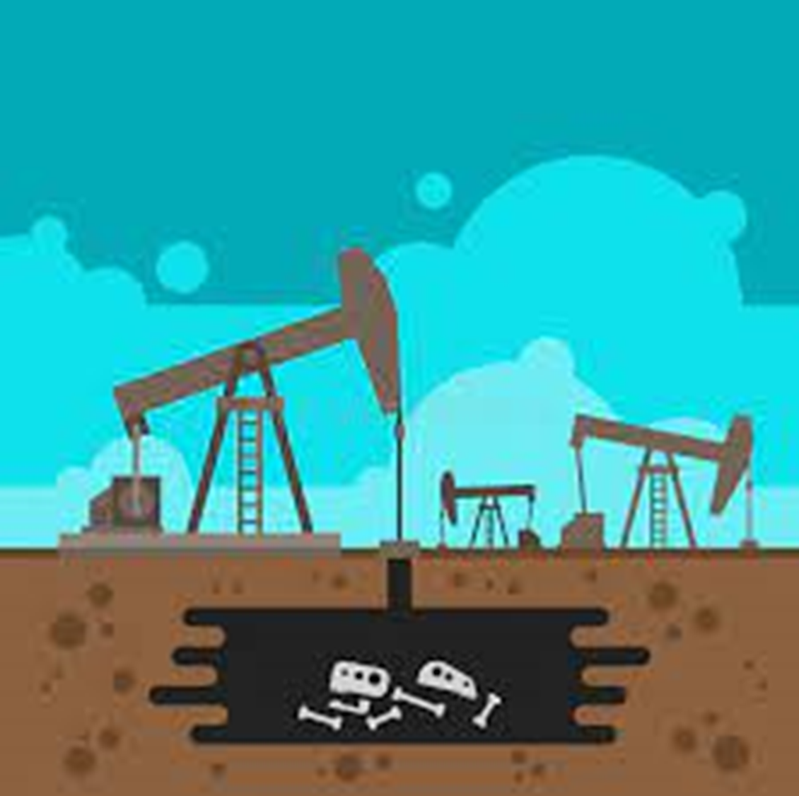

1 Travel & Transport
What do we know about travel & transport?
Petrol and diesel come from oil which is made from organisms that lived and died millions of years ago.
When we remove oil from the ground and use it as fuel, carbon dioxide is released. This contributes to global warming.
Notes:
This term we will thinking about water in our assemblies.

Slide 5
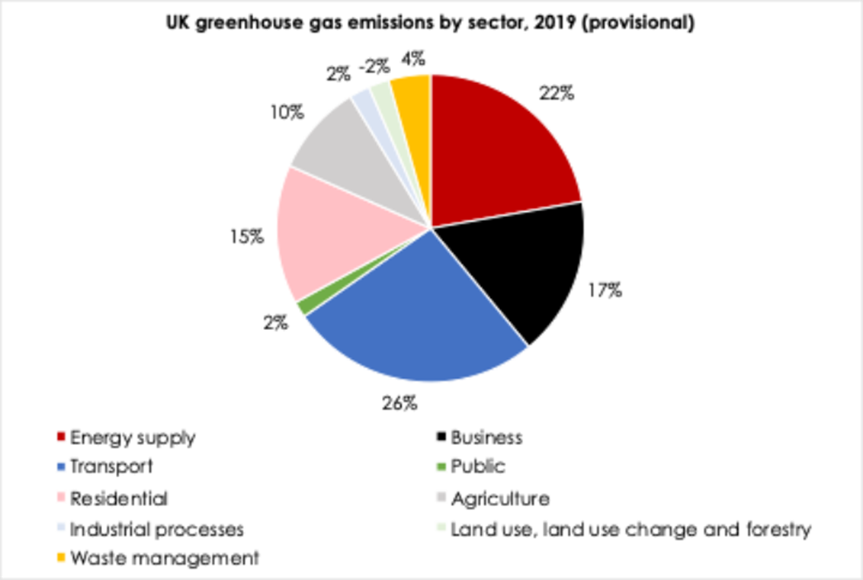
1 Travel & Transport
What do we know about travel & transport?
How much of the UKs greenhouse gases are produce by transport?
Notes:
This term we will thinking about water in our assemblies.

Slide 6
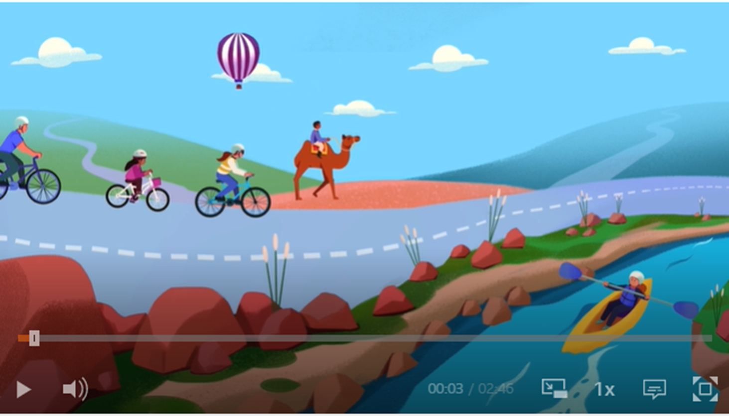
1 Travel & Transport
What do we know about travel & transport?
Let's find out more about transport and climate change here.
Notes:
This term we will thinking about water in our assemblies.

Slide 7

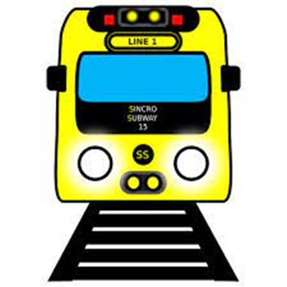
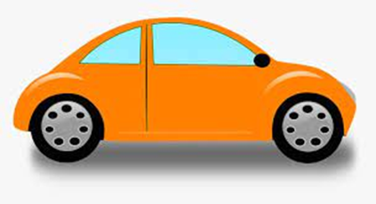


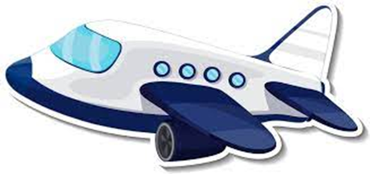
1 Travel & Transport
What do we know about travel & transport?
Which form of transport produces the most emissions per passenger / km?
Notes:
This term we will thinking about water in our assemblies.

Slide 8
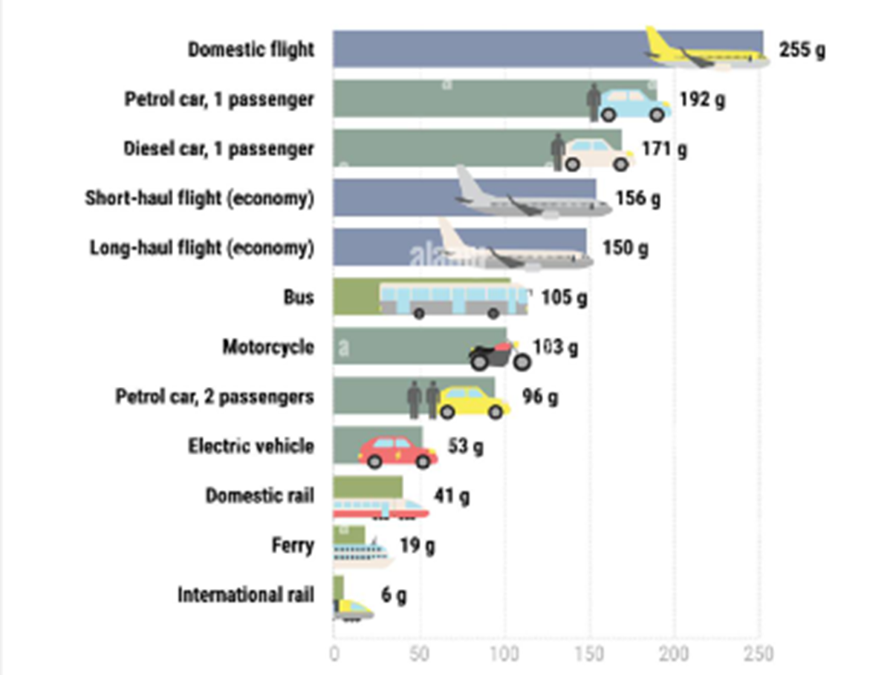
1 Travel & Transport
What do we know about travel & transport?
G / CO2 / passenger / kg
What does this show?
Notes:
This term we will thinking about water in our assemblies.

Slide 9
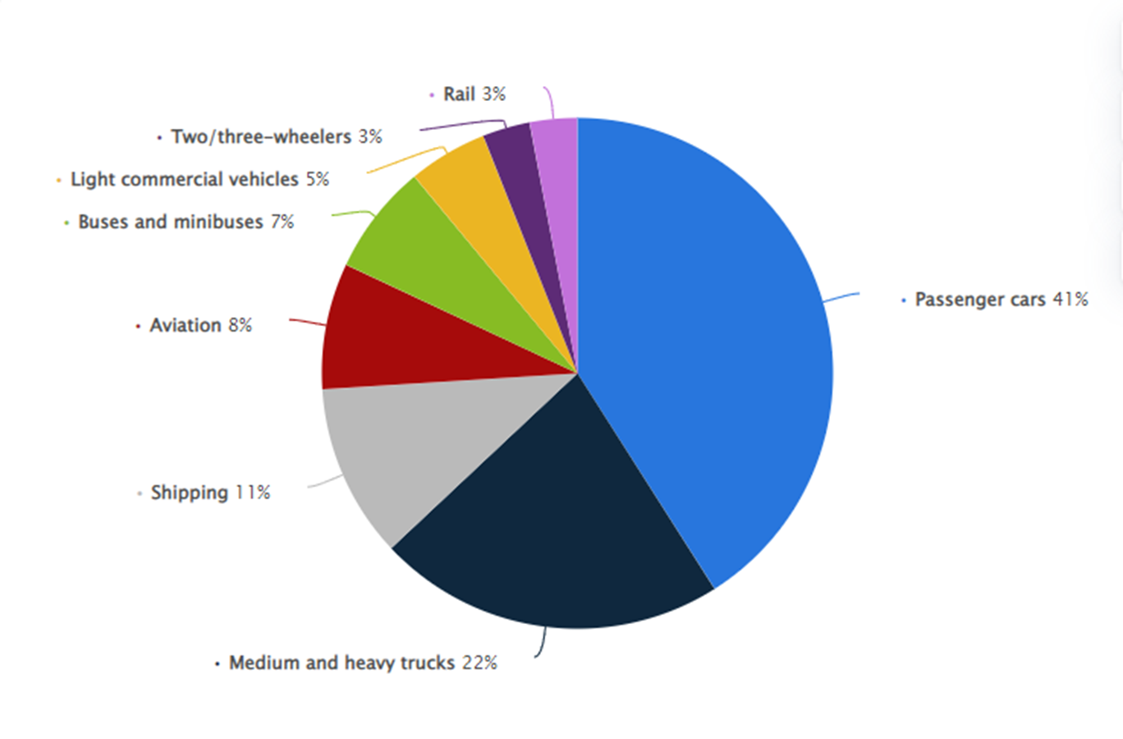
1 Travel & Transport
Global emissions from different types of transport
What do you notice?
Passenger cards create the greatest emissions.
In the UK, 4/10 journeys made by car are less than 3 miles long.
How could trucks and shipping be connected to your school?
Notes:
This term we will thinking about water in our assemblies.

Slide 10

1 Travel & Transport
What do we know about travel & transport?
In our next assembly, we'll be asking:
What do you know about air pollution and how we can make our
air cleaner?
Notes:
This term we will thinking about water in our assemblies.

Slide 11
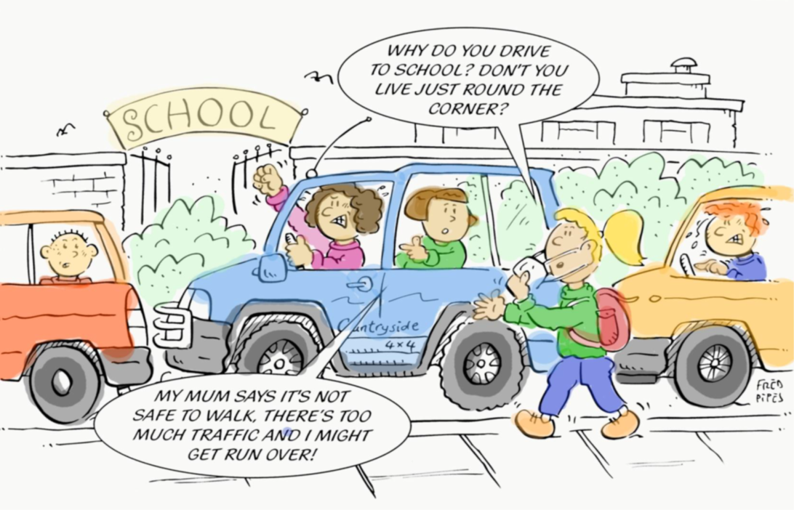
2. Travel & Transport
Travelling to School
How did you get to school today?
How did children from primary schools in xxxxxxxx insert region get to school last year?
Walk – xx %
Car – xx %
Bike – xx %
Bus – xx %
Let's now look at how children across the world get to school.

Slide 12
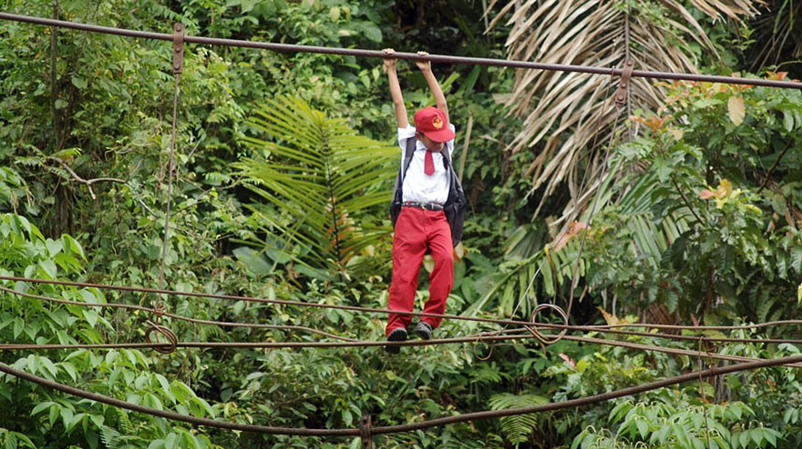
10 meters above a river
Padang, Sumatra, Indonesia

Slide 13
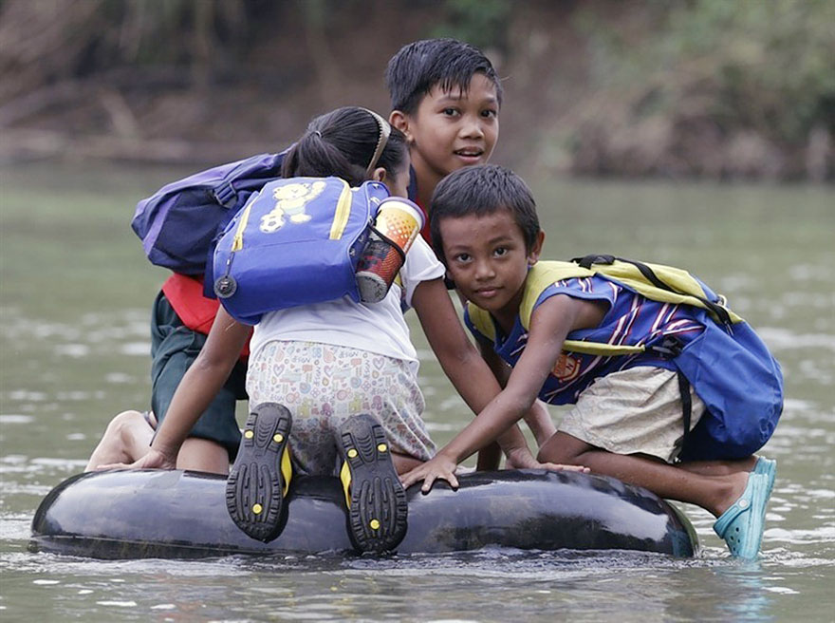
Crossing a river
Rizal Province, Philippines

Slide 14
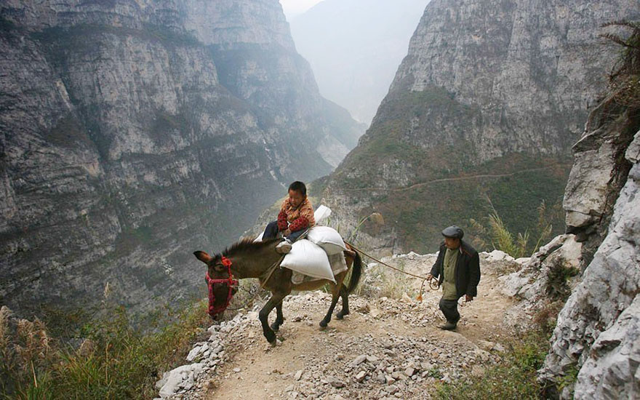
5-hour journey
Gulu, China

Slide 15
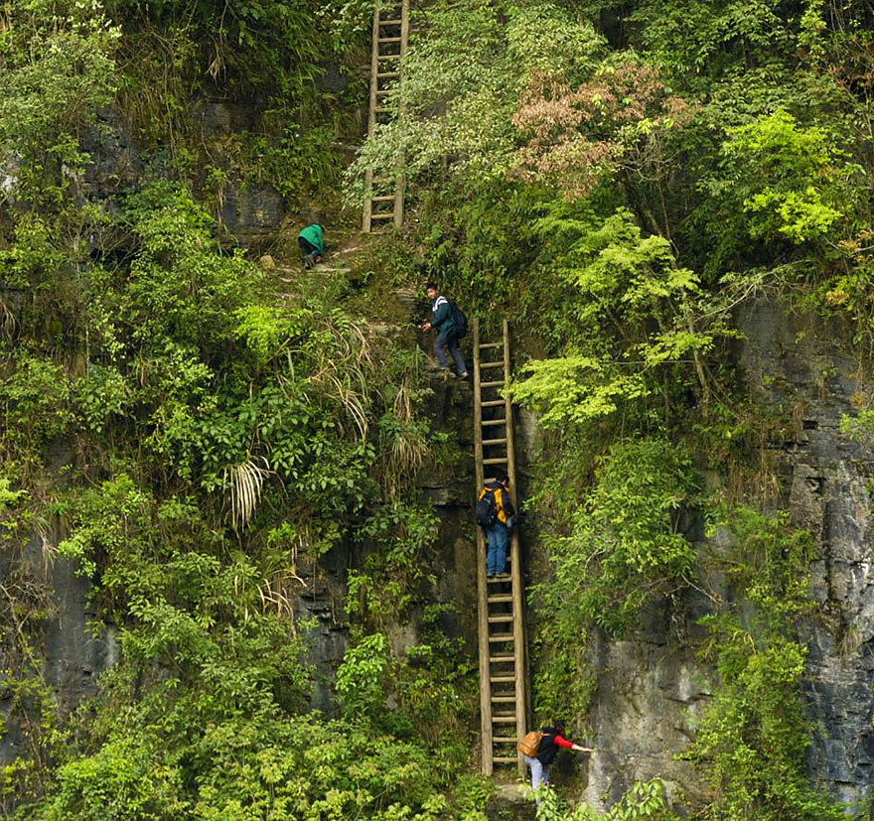
Zhang Jiawan Village, Southern China

Slide 16
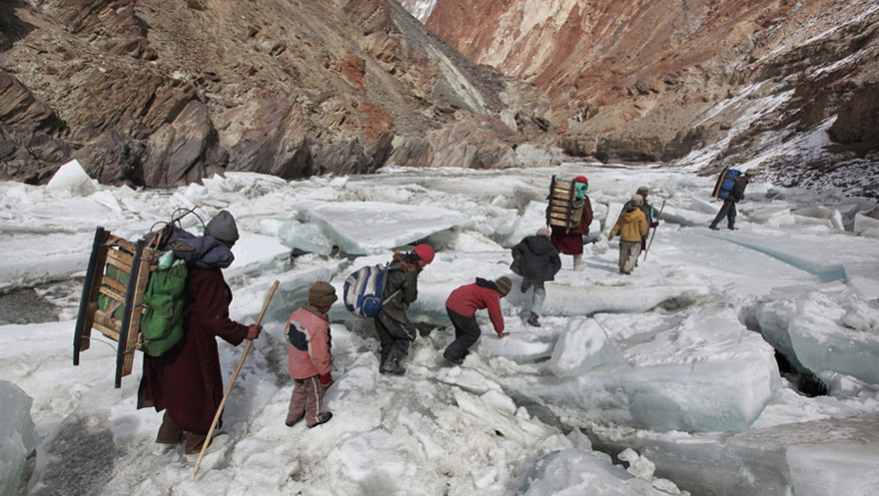
Traveling to a boarding school
Zanskar, Indian Himalayas

Slide 17
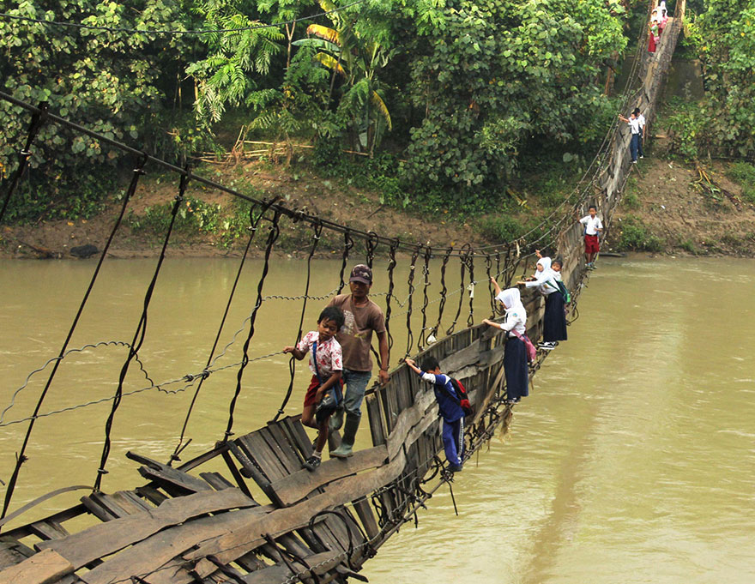
Pupils Crossing A Damaged Suspension Bridge, Lebak, Indonesia
Lebak, Indonesia

Slide 18
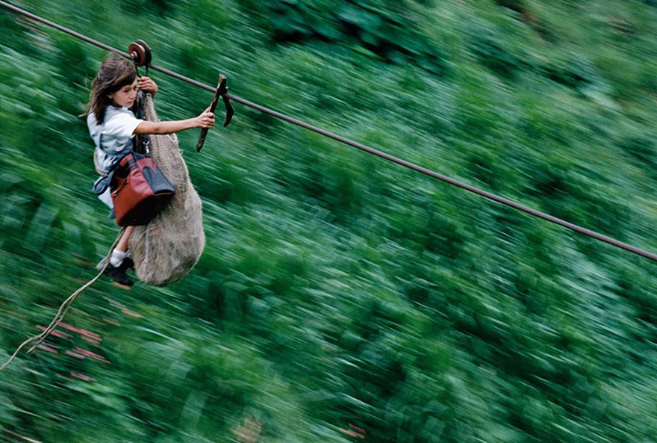
Kids Flying 800m On A Steel Cable 400m Above The Rio Negro River, Colombia
Flying 800m 400m above the Rio Negro River.
Colombia

Slide 19
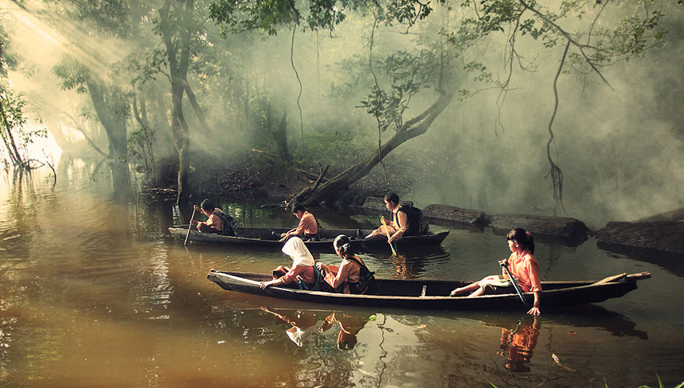
Pupils Canoeing To School, Riau, Indonesia
Riau, Indonesia

Slide 20
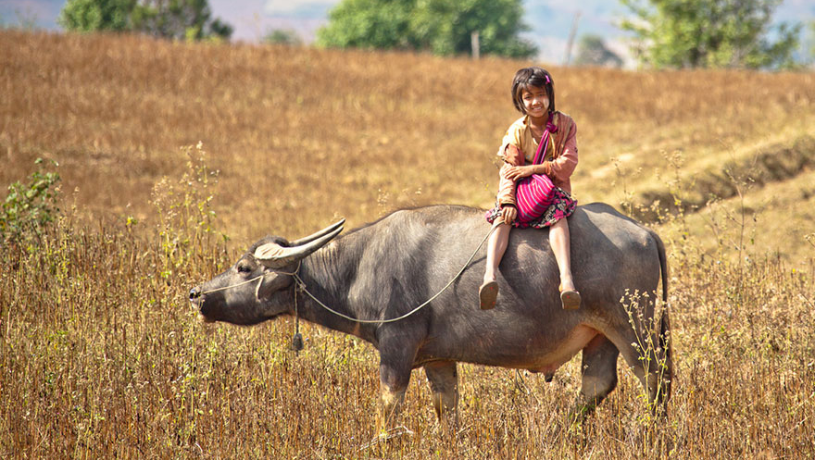
Myanmar

Slide 21
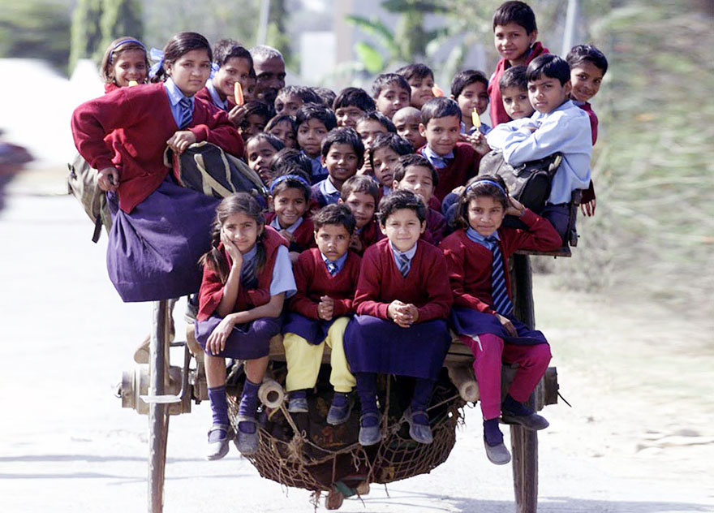
Delhi, India

Slide 22
2. Travel & Transport
Travelling to School
Think about these children's journeys to school
Do you think they enjoyed it?
Did they travel with friends or family?
Were there any dangers?
How did they overcome them?
Was their journey sustainable?
Think about your journey to school
Did you enjoy it?
Did you travel with friends or family?
Were there any dangers?
How did you overcome them?
Was your journey sustainable?
Could it be more sustainable?

Slide 23
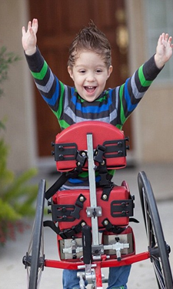
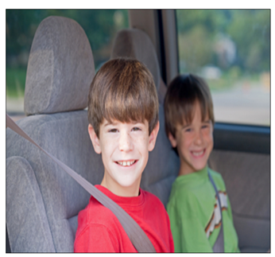
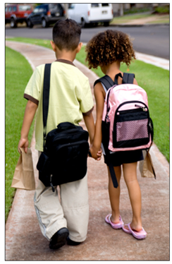
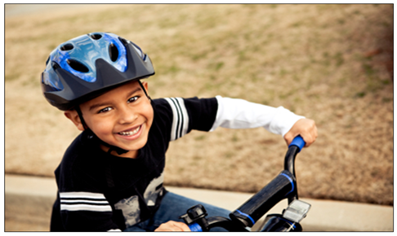
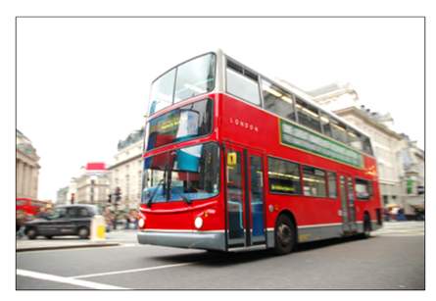
2. Travel & Transport
Travelling to School
What does sustainable mean?
Which of these are sustainable forms of transport?
Why is sustainable travel sometimes called 'active' travel?
Let's now look at how children across the world get to school.

Slide 24
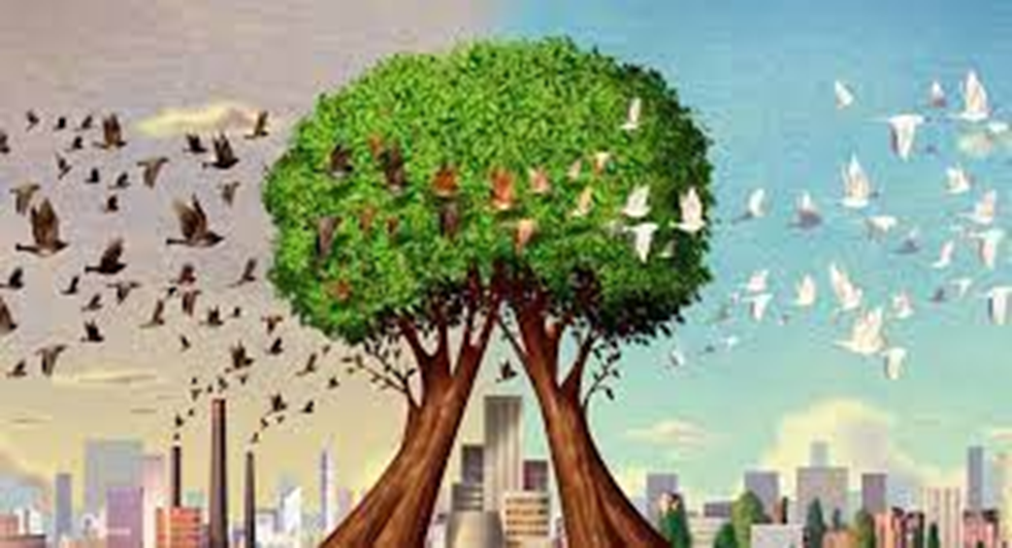
2. Travel & Transport
Transport & Air Quality
Fumes from cars can create air pollution.
Walking to school also helps improve air quality.
How clean is the air around your school?
Find out here (or try www.addresspollution.org)
NOTE TO SCHOOLS - Be wary of showing this information in airs of poor air quality

Slide 25
2. Travel & Transport
Next week we'll look at ​
​
Changemakers​
​
who are helping reduce emissions from transport

Slide 26
4. Transport
Changemakers - local
Insert info about local transport changemakers eg electric buses, cargo bike delivery, School streets, walking bus etc
Notes:
This is an idea of an organisation that may operate in your area. This is a suggestion and you may well know of great examples of your own.

Slide 27
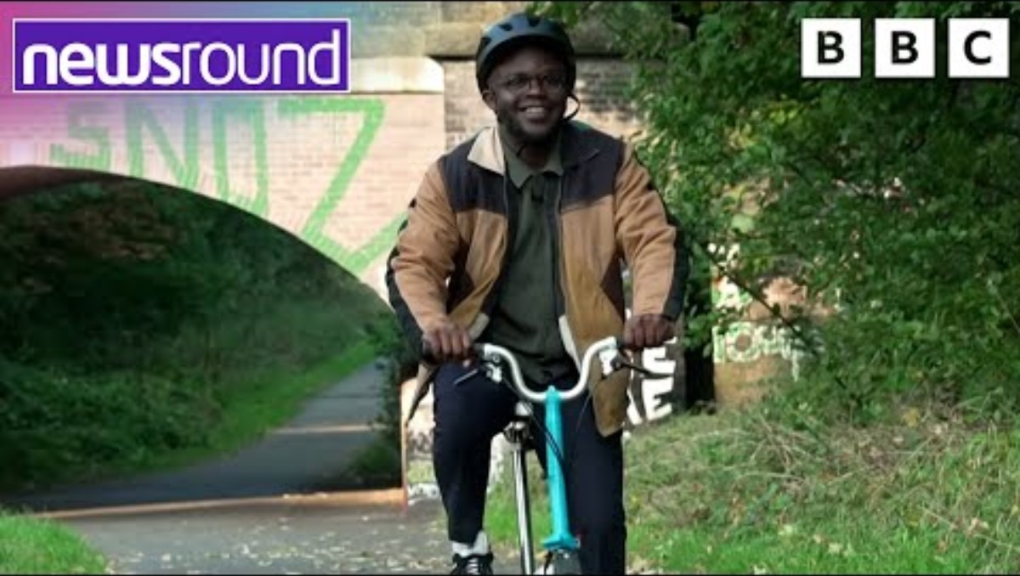
4. Transport
Changemakers - national
Hear from people making it easier for pupils to cycle safely to school
Notes:
This is an idea of an organisation that may operate in your area. This is a suggestion and you may well know of great examples of your own.

Slide 28
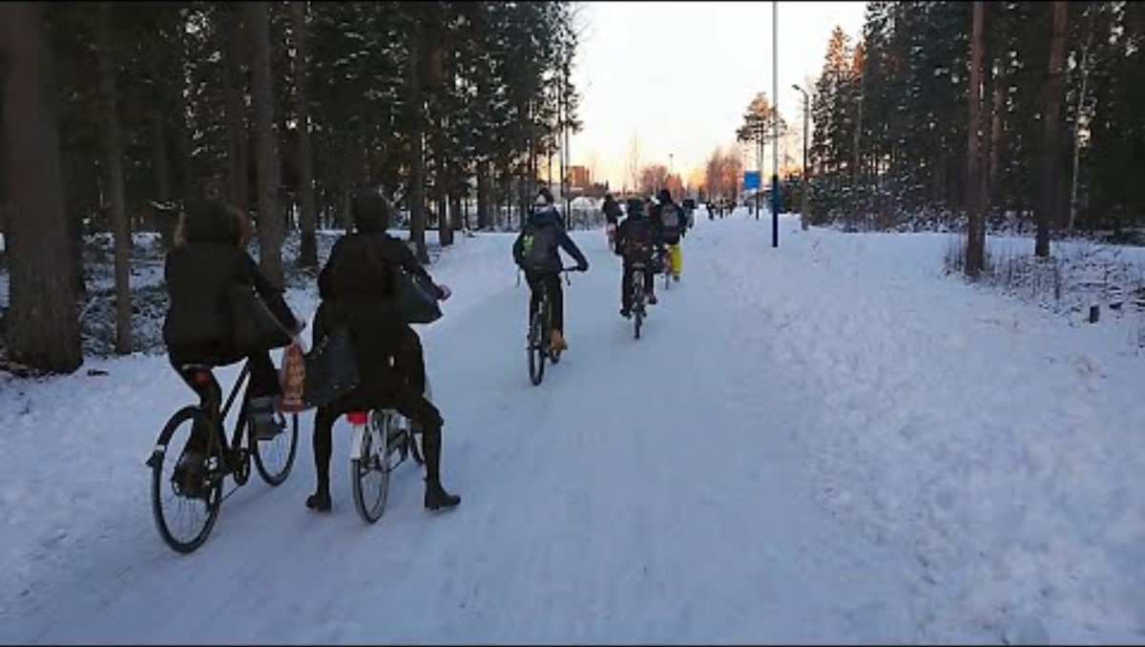
4. Transport
Changemakers – Global, Oulu, Finland
It's very cold and snowy in Finland for 5 months of the year. In this school 1000 out of 1200 children cycle to school – others sledge, walk or ski every day.
Have a look!
Notes:
This is an idea of an organisation that may operate in your area. This is a suggestion and you may well know of great examples of your own.

Slide 29
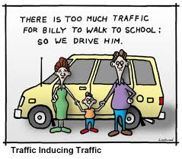
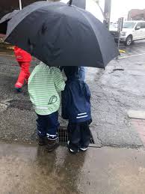
4. Transport
School Actions
What puts you off walking or cycling to school?​
What could the school do to help you this?
Notes:
Reuse paper trays in classrooms, by photocopiers and in offices; refillable glue pots and brushes; clothes and books swap; use the library for topic book loans; carry out food waste audit in canteen and with packed lunches

Slide 30

2. Travel & Transport
Walk to School Week 2025
How could we celebrate this at our school?

Slide 31


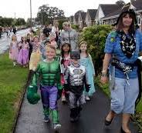
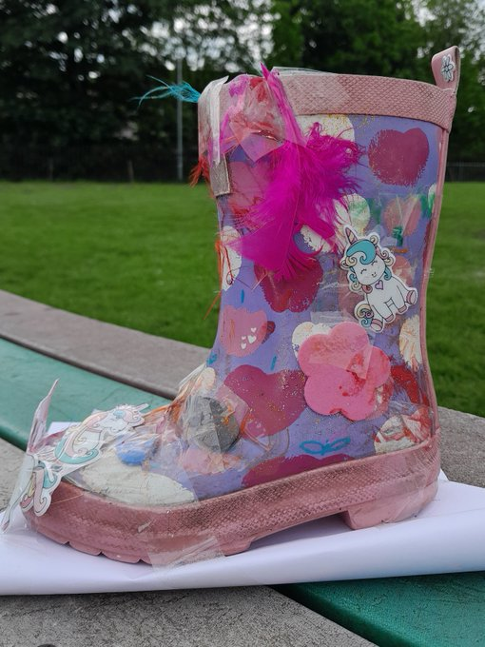
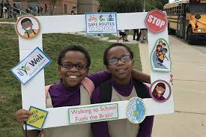
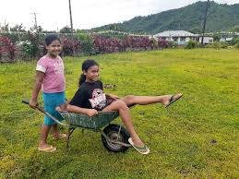
2. Travel & Transport
School Action - Walk to School – How about.....
A walking bus Park & Stride
Magic shoes Photo booth Most unusual way Fancy dress

Slide 32
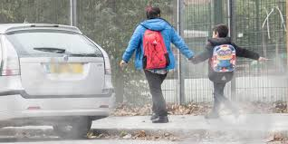
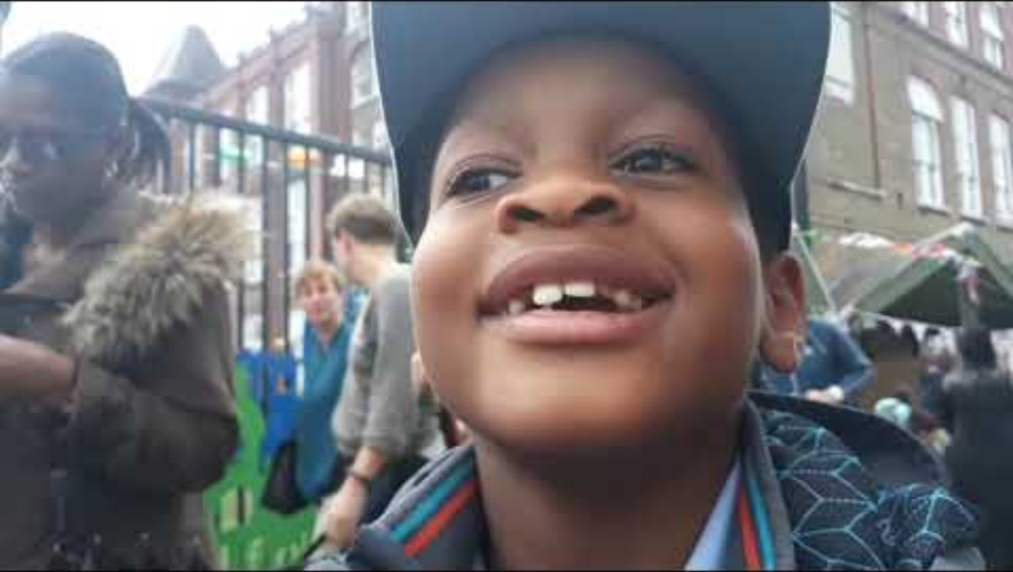
4. Transport
School Actions
How could we improve the air quality around our school?
Find out about 'School Streets' - who could help you?
Notes:
Reuse paper trays in classrooms, by photocopiers and in offices; refillable glue pots and brushes; clothes and books swap; use the library for topic book loans; carry out food waste audit in canteen and with packed lunches

Slide 33
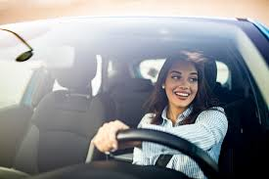
4. Transport
School Actions
Find out how your teachers travel to school?​
Can you suggest how what would make it easier for them to travel sustainably?
Notes:
Reuse paper trays in classrooms, by photocopiers and in offices; refillable glue pots and brushes; clothes and books swap; use the library for topic book loans; carry out food waste audit in canteen and with packed lunches

Slide 34
4. Consumption and Waste
School Actions
How could teachers travel more sustainably to school?
How could you travel more sustainably to school?
How could the school encourage sustainable travel?
Take some photos
of people travelling sustainably to school!

Slide 35
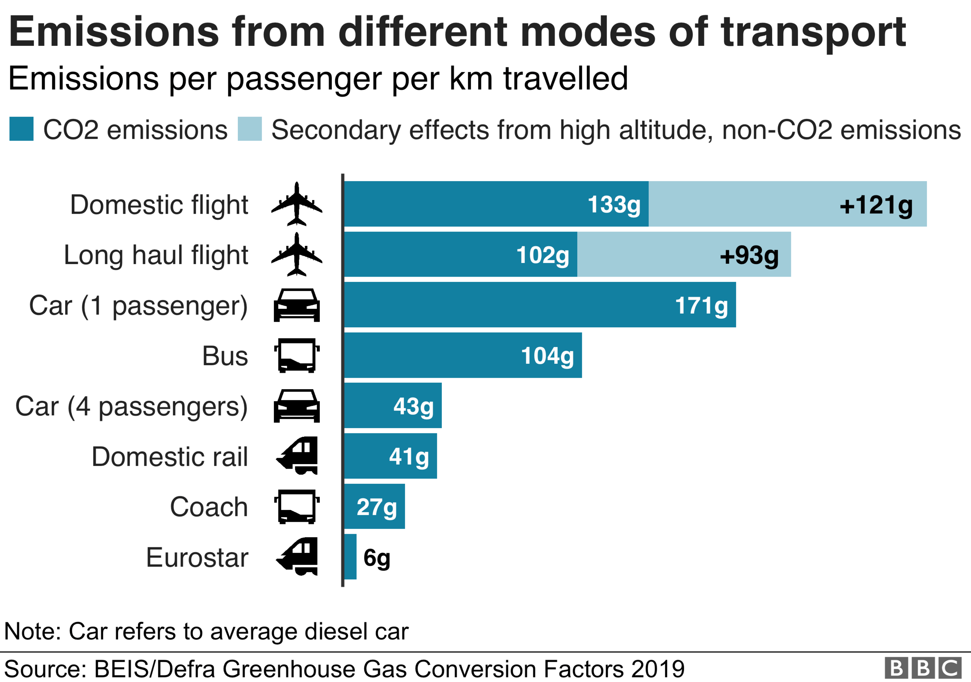
5. Travel & Transport
Individual and Family Actions
What does this bar chart show us?

Slide 36
5. Travel & Transport
Individual and Family Actions
Think about how you and your family travel?
It's not always possible, but are there times where you could travel more sustainably?
Take some pictures of you travelling sustainably at home.
Notes:
5 L is around about the number of litres in a large can

Slide 37
6. Travel & Transport
Celebrating Our Actions
Let's remember some of the things we've talked about in assembly this term around the theme of travel and transport.

Slide 38
6. Travel & Transport
Celebrating Our Actions
INSERT PICTURES OF CLASSES TAKING ACTION IN THIS AREA

Slide 39
6. Travel & Transport
Celebrating Our Actions
INSERT PICTURES OF ACTIONS THE TEACHERS HAVE TAKEN IN THIS AREA

Slide 40
6. Travel & Transport
Celebrating Our Actions
INSERT PICTURES OF ACTIONS THE SCHOOL HAS TAKEN IN THIS AREA

Slide 41
6. Travel & Transport
Celebrating Our Actions – family actions
INSERT PICTURES OF FAMILIES TAKING ACTION IN THIS AREA

Slide 42
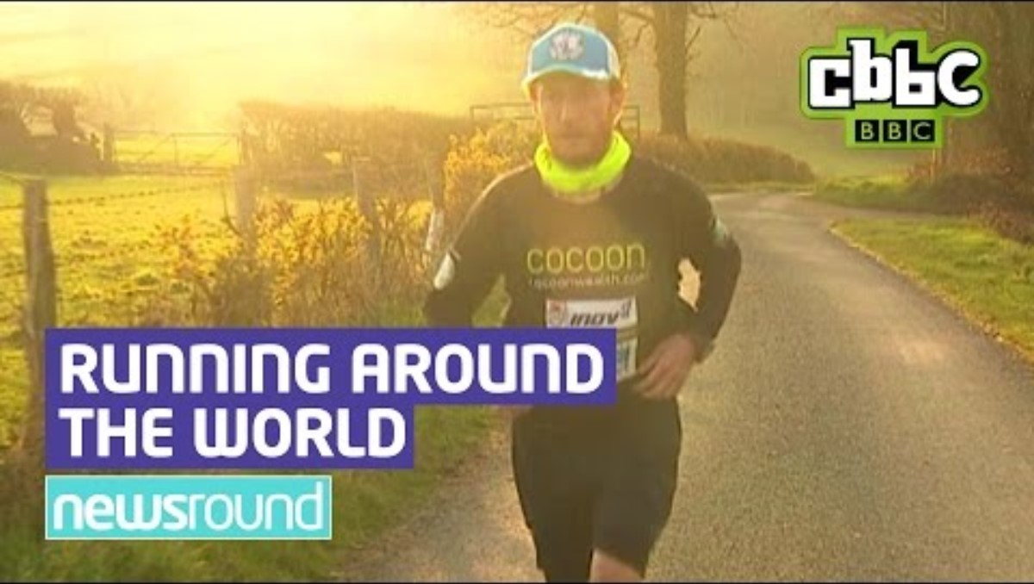
6. Travel & Transport
Celebrating Our Actions
Let's finish by watching how one man travelled sustainably around the world.

