Slide 1

Our City Our World
Week 1 - Celebrating Water
Notes:
This term we will thinking about water in our assemblies.

Slide 2

Our Schools Our World
1 - Celebrating Water
Notes:
This term we will thinking about water in our assemblies.

Slide 3
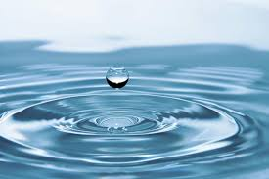
Our Schools Our World
1 - Celebrating Water
Why is water important to you?
How does it make you feel?

Slide 4
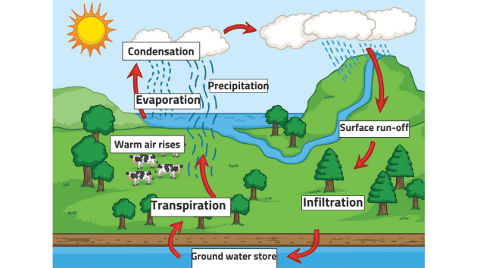
Our Schools Our World
1 - Celebrating Water
Where does our water come from?
Notes:
Ensure pupils understand water cycle. Include impact of Surface run-off

Slide 5
You may need to replace the slides about the aquifer to reflect where your local area gets it's water from

Slide 6
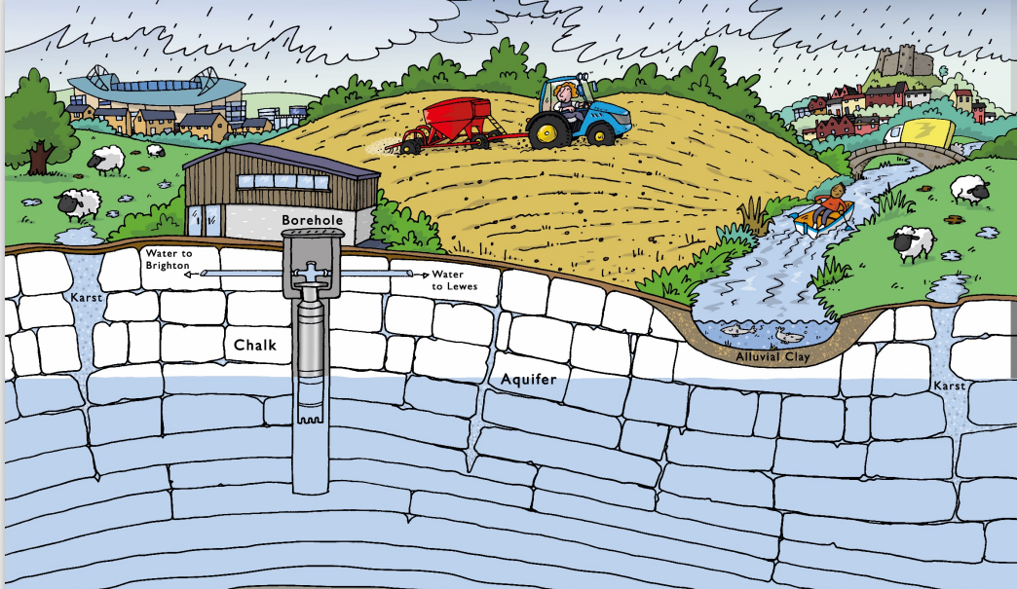
Our Schools Our World
1 - Celebrating Water
In xxxxx ALL our drinking water comes from the Aquifer.
Notes:
Do they know what an aquifer is?
The next film will explain more.

Slide 7
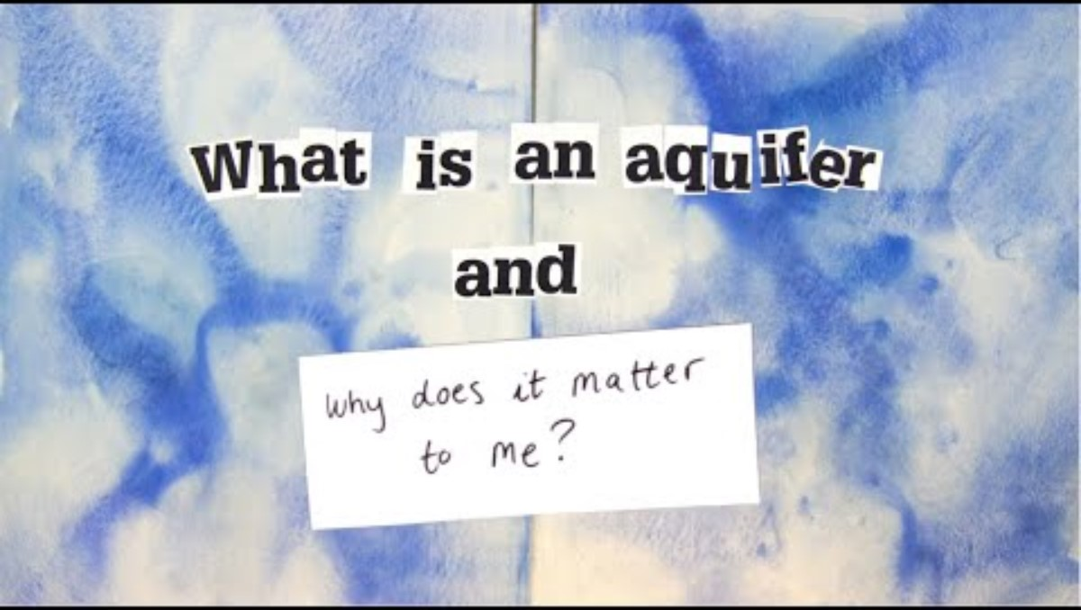
Our Schools Our World
1 - Celebrating Water

Slide 8
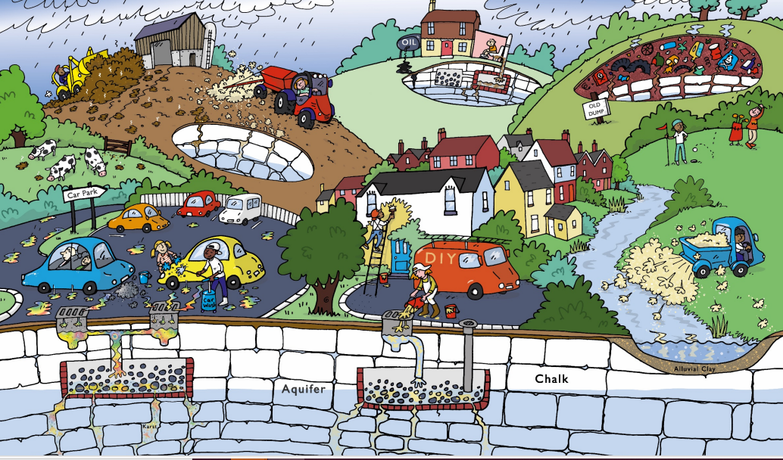
Our Schools Our World
1 - Celebrating Water
Next time:
We'll think about water pollution and how this impacts our aquifer and the sea

Slide 9
Our Schools Our World
Week 2 - What are the issues around Water?

Slide 10
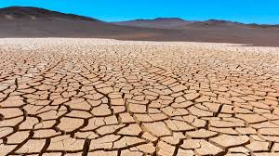
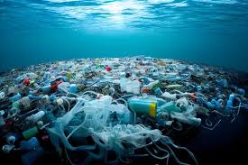
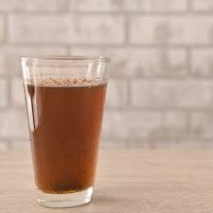
Our Schools Our World
2 -What are the issues around Water?

Slide 11
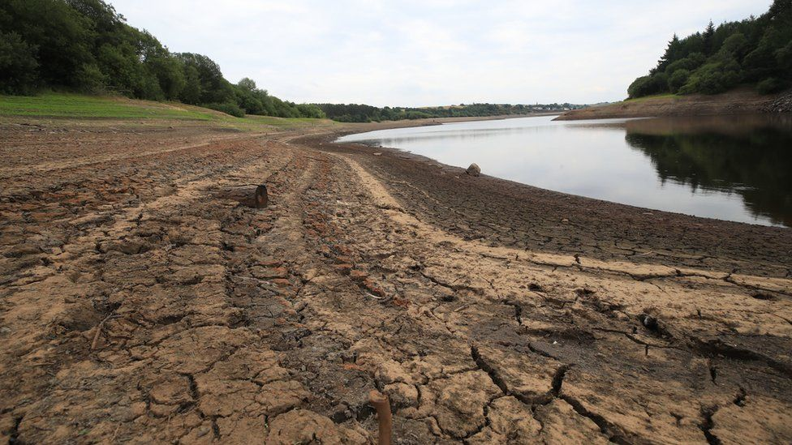
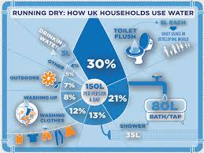
Our Schools Our World
2 - What are the issues around Water?
The average British person uses 140L of water a day
Notes:
Climate change along with a growing population and also use of water by industry are all contributing towards water shortages.
This is more extreme in many parts of the world, where poorer communities often they use their water supply to produce goods for richer nations.

Slide 12
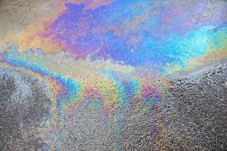
Our Schools Our World
2 - What are the issues around Water?
Drainbows
Have you ever seen one?
Do you like them?
Notes:
Drainbows are when the oil from cars mix with rainwater on the roads.
The oil is then washed down the drain where is can impact our water quality.

Slide 13
Replace next slide with one that reflects your local situation

Slide 14
Our Schools Our World
2 - What are the issues around Water?
Notes:
Last week we talked about the Aquifer and how all our drinking water comes from the aquifer.
We need to protect the aquifer if we want clean drinking water.
Have a look at the picture - what activities can you spot that might affect our drinking water quality?
Include:
Run off from cars, farming,
Leisure – eg golf courses using pesticides to keep weeds back running into aquifer
Agriculture - pesticides and manure leaking into aquifer
Landfill - leaking of chemicals into aquifer
Home - sewage, chemicals (eg paint) and fuel leaking into aquifer

Slide 15
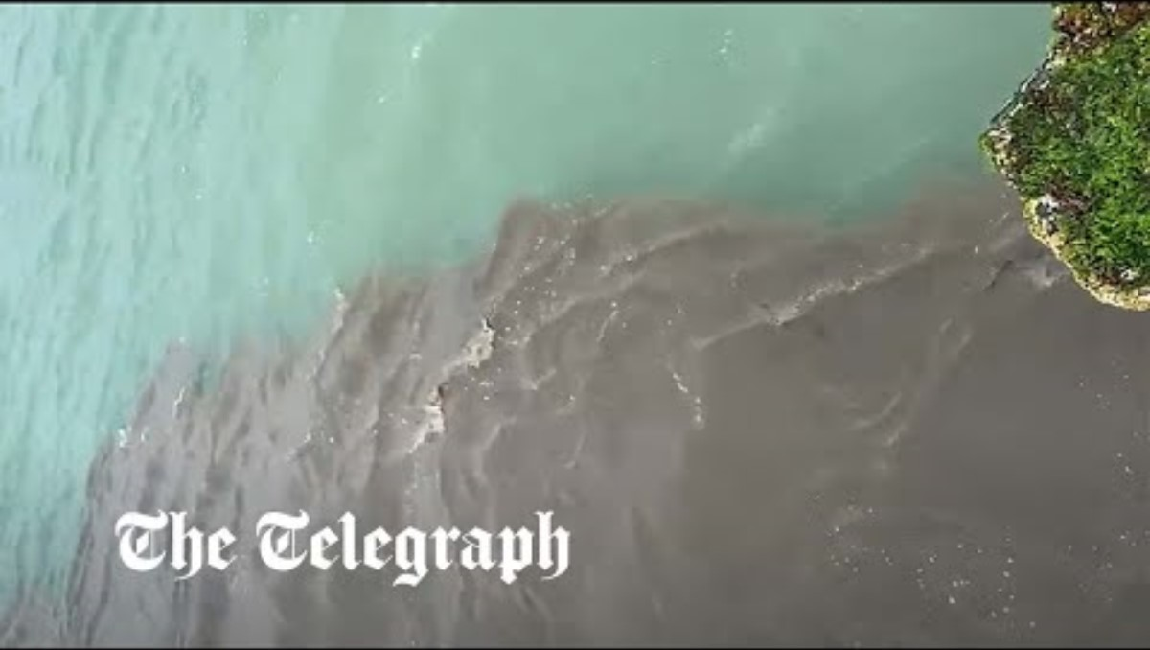
Our Schools Our World
2 - What are the issues around Water?
Notes:
You've probably heard about how sewage is polluting our seas.

Slide 16
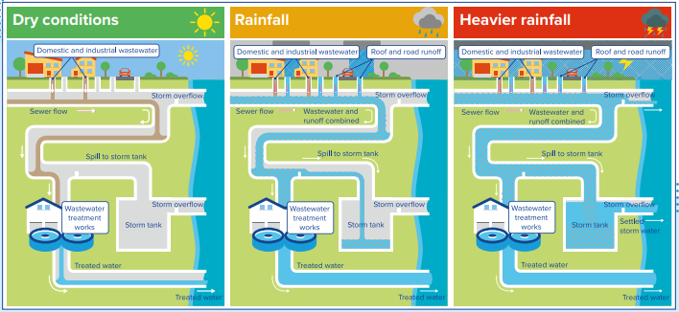
Our Schools Our World
2 - What are the issues around Water?
Notes:
Why does sewage end up in the sea.
Under dry conditions – wastewater is treated in a treatment works before clean water is discharged into the sea.
When it rains, the extra rainfall is stored in a storm tank under the ground. After the rain this water can be pumped back into the treatment works.
Our sewage system was built in the Victorian era when there were much less people living in the city. The sewage system is not sufficient for our bigger city. In heavy rain, the amount of water cannot be stored in the storm tank and so overflows into the sea.
We need a new, better sewage system but this costs a lot of money to build.

Slide 17
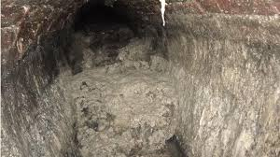
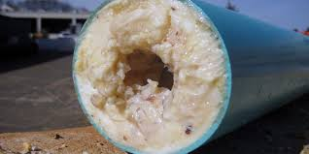
Our Schools Our World
2 - What are the issues around Water?
Notes:
What's in the picture?!
It's a fat-berg.
The fats and oils we use to cook and clean with collect inside our sewers. Over time, they harden to a concrete-like material and restrict the flow of wastewater in the pipes.
These blockages can cause wastewater to back up through toilets and sinks into homes and businesses – or escape through manholes into streets and rivers.
As well as causing blockages leading to flooding, a build-up of fat, oils and grease can also put our wastewater pumping stations out of action, causing pollution in local streams and bathing waters.
Every year 20,000 blockages occur in our sewers because of fats, oils and grease.
To stop this we need to ensure that we put fats, oils and grease from our cooking and our plates into the bin, not down the drain.
We also need to ensure that only poo and pee is flushed down our toilets. Cotton buds and wipes should be throw in the bin not put down the drain.

Slide 18
Our Schools Our World
2- What are the issues around Water?
Next week we'll look at
Change Makers
around the theme of water

Slide 19
Our Schools Our World
3 - Changemakers across the country
Week 3
A look at changemakers working to improve our water quality

Slide 20
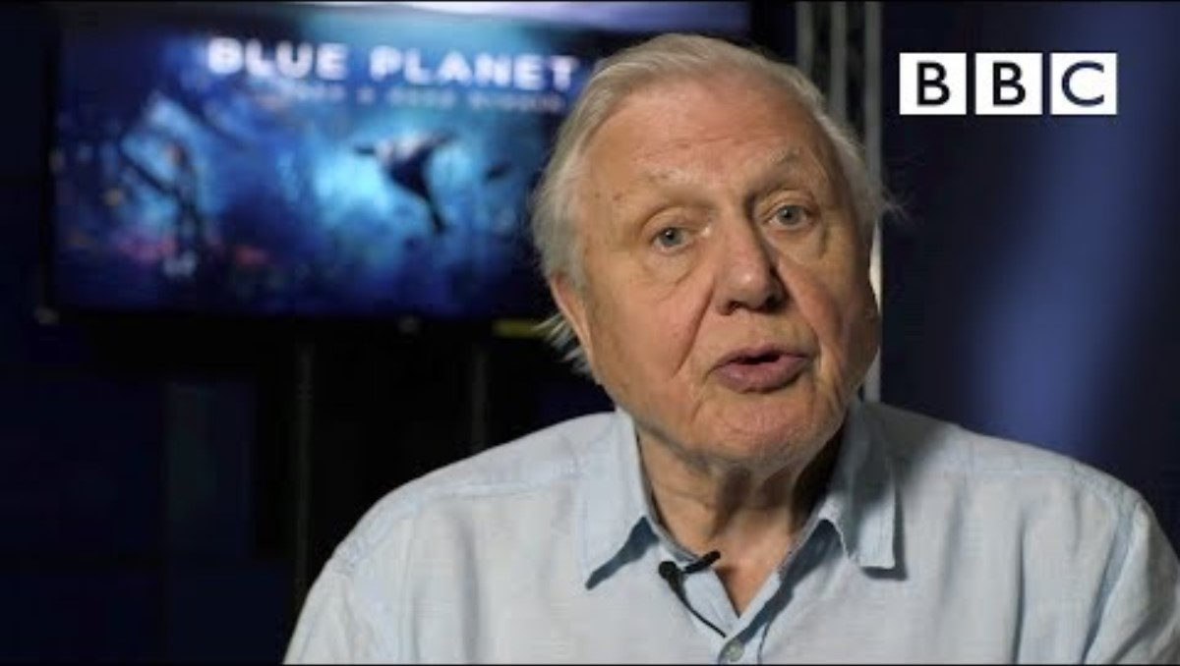
Our Schools Our World
3 - Changemakers across the country
Notes:
This clip shows the impact of Blue Planet 2 and how this has inspired changemakers across the country

Slide 21

Local Water Changemaker
Claire Potter
Our Schools Our World
3 - Local Water Changemaker – Claire Potter
Insert info about local water changemaker
Notes:
Substitute with other local changemakers

Slide 22
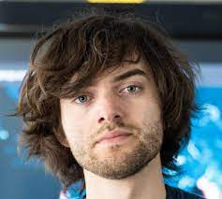
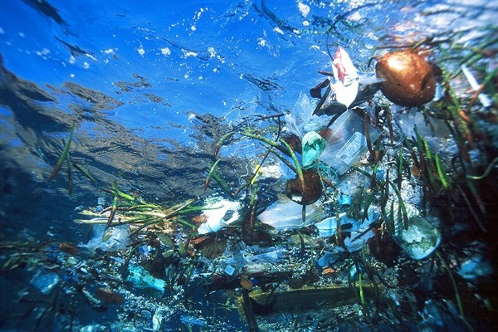
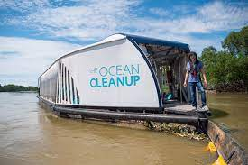
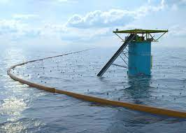
Our Schools Our World
3 - Global Water Changemaker – Boyan Slat
The Ocean Clean-Up
Notes:
Boyan Slat is a Dutch inventor who’s passionate about creating megaprojects to address planetary problems.
He started the company The Ocean Cleanup which aims to rid the world's oceans of plastic.
His invention consists of a giant tube made of durable plastic and a nylon screen, so fish don't get caught.
It uses ocean currents to collect and trap rubbish as small as 1cm.

Slide 23
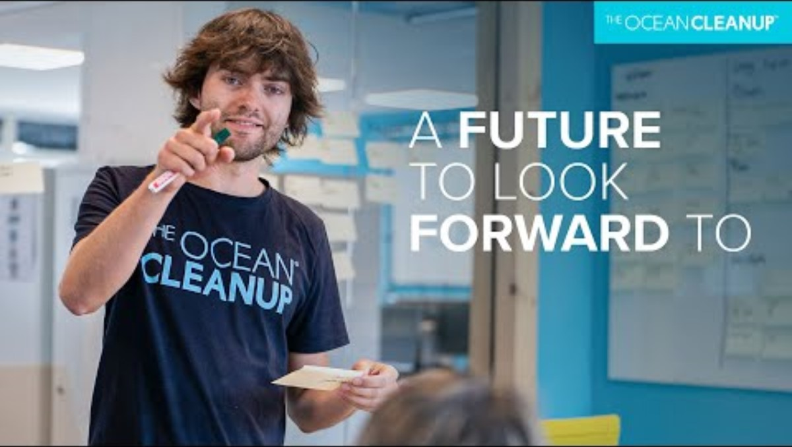
Our Schools Our World
3 - Global Water Changemaker – Boyan Slat

Slide 24
Our Schools Our World
3 - Global Water Changemaker – Boyan Slat
Next time we'll look at how
YOU
can be a changemaker at school and at home

Slide 25
Our Schools Our World
4 - School Actions
Week 4
Considering what actions we can take at school

Slide 26
Our Schools Our World
4 -School Actions
Insert info about what local schools have been doing around water – eg SuDS, ponds, water audits

Slide 27
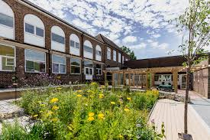
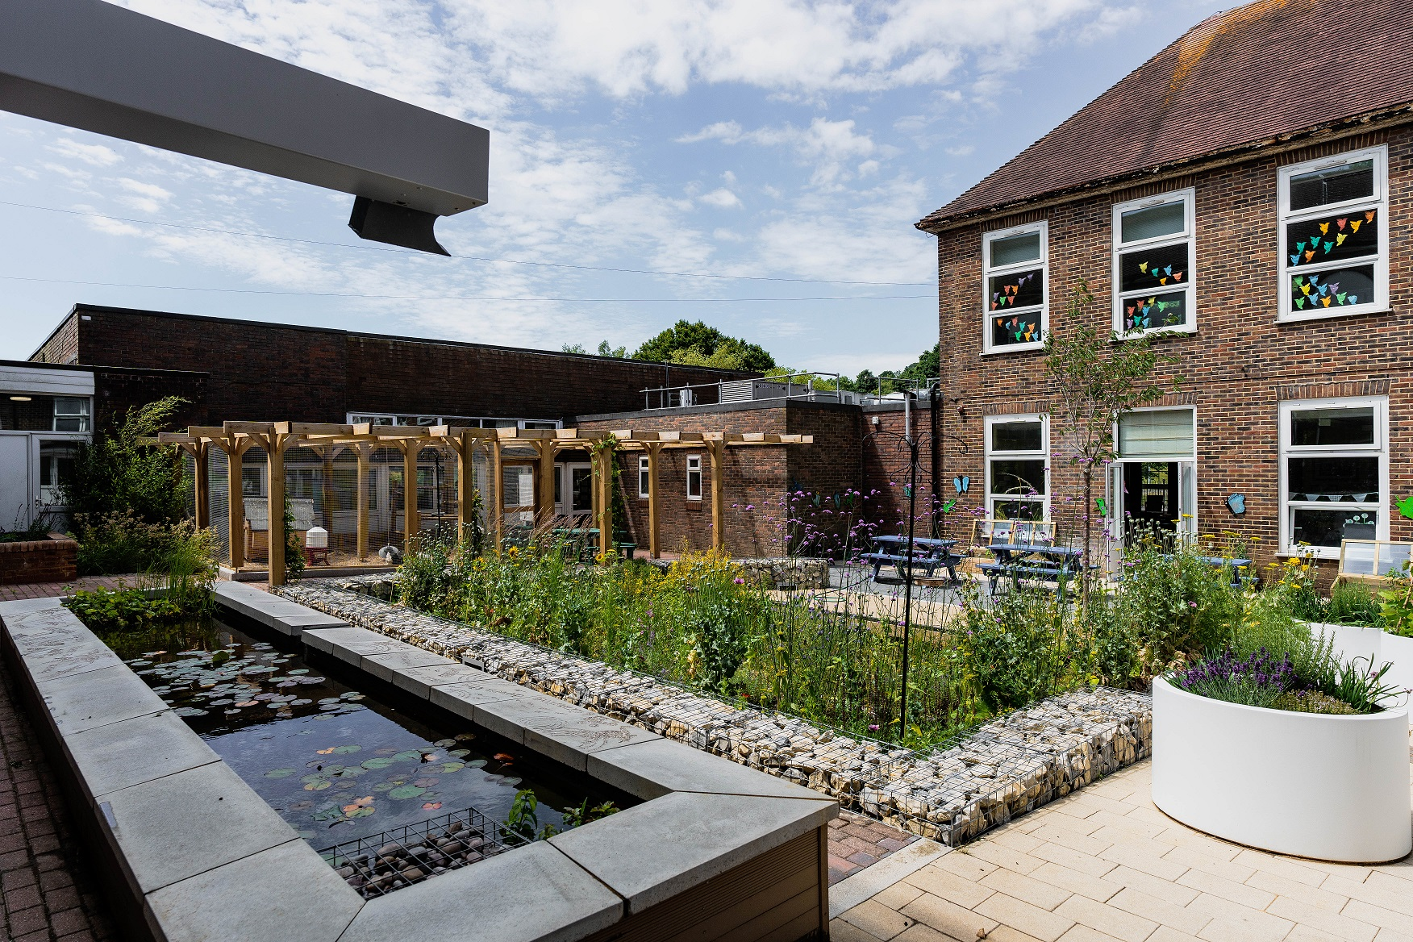
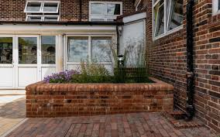
Our Schools Our World
4 -School Actions these are B&H examples
Notes:
Eg of a raingarden at Moulsecoomb Primary
Rain from the drainpipes is diverted directly into raised beds and into ponds.
The plants, animals and micro-organisms in the pond filter any pollution and ensure that the water is clean before it filters down into the ground.

Slide 28
Our Schools Our World
4 -School Actions
Here's a quick water quiz!

Slide 29
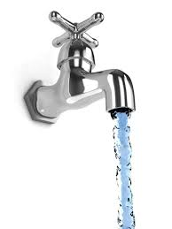
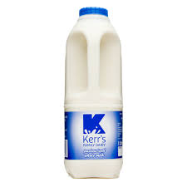
Our Schools Our World
4 -School Actions
How much water does
a running
tap waste
per minute?
6
litres
x6

Slide 30
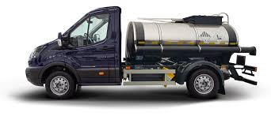
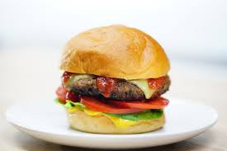
Our Schools Our World
4 - School Actions
How much water does it take to produce
a beef burger?
4000+
litres

Slide 31
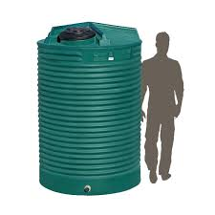
Our Schools Our World
4 - School Actions
How much water does it take to produce
a t-shirt?
2700
litres

Slide 32
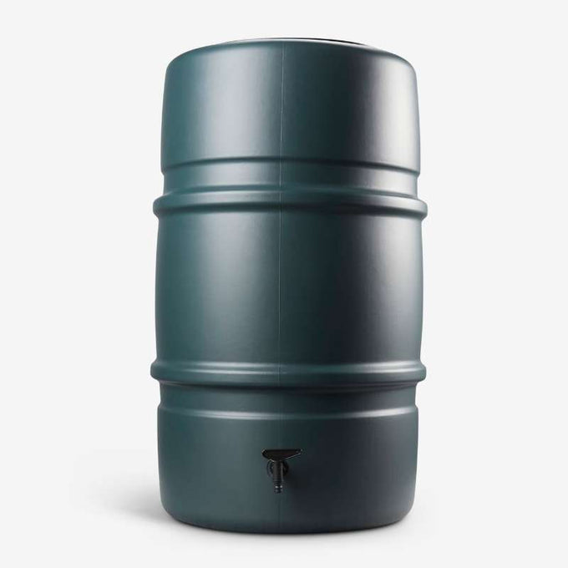
Our Schools Our World
4 - School Actions
Can you think of any ways to monitor and save water at school?
Which of the adults in the school can help save water?
Talk to them!
Take some photos of people saving water at school.

Slide 33
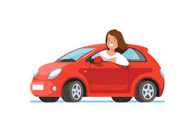
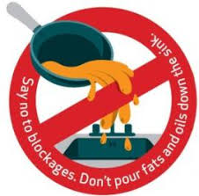
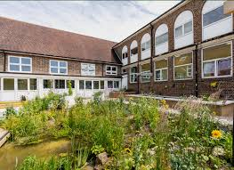
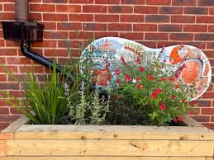
Our Schools Our World
4 - School Actions
Think about ways our school can help protect water quality?

Slide 34
Our Schools Our World
4 - School Actions
Our class action will be ….
Our school action will be …
Take some photos of your class saving or monitoring water.
Talk to others in the school

Slide 35
Our Schools Our World
5 - Family Actions
Week 5
Considering what actions we can take at home

Slide 36
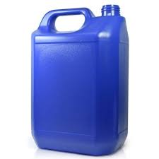
Our Schools Our World
5 - Family Actions
How much water do most people use brushing their teeth?
Around 5
litres
Notes:
5 L is around about the number of litres in a large can

Slide 37
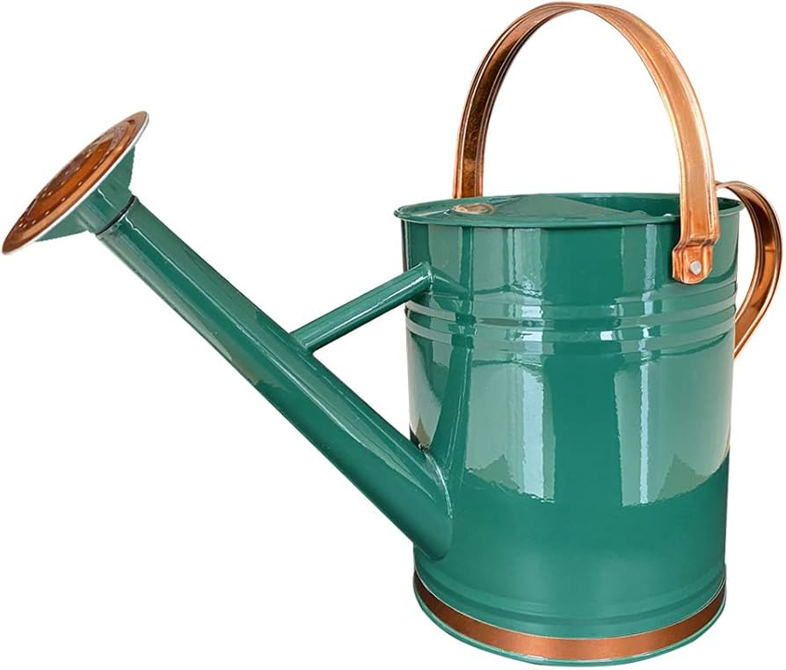
Our Schools Our World
5 - Family Actions
How much water does it take to water a garden?
Around 5
litres for
every watering
can
used

Slide 38
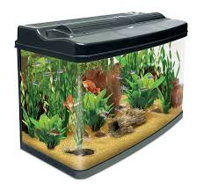
Our Schools Our World
Family Actions
How much water does a 5 minute shower use?
120
litres
Notes:
120 L is approximately the amount of water in a large fish tank

Slide 39
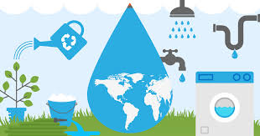
Our Schools Our World
Family Actions
Can you think of ways you can save water at home?
Take some photos of you saving water at home

Slide 40
Our Schools Our World
Celebrating Water
Week 6
Review of water assemblies and celebration of actions achieved at school and home

Slide 41
Our Schools Our World
Celebrating Water
Notes:
Over the last 6 assemblies, we've been considering issues and solutions around water.
What can you remember about why it's so important, what dangers it faces and what people can do to protect it?
Let's share some of the impact we have had a school community.

Slide 42
Our Schools Our World
6 - Celebrating Water – in our classes
INSERT PICTURES OF CLASSES SAVING WATER
Over the last x weeks, we have saved ….. litres of water through class actions.

Slide 43
Our Schools Our World
6 - Celebrating Water – at school
INSERT PICTURES OF WATER SAVING AT SCHOOL and people involved
Over the last x weeks, we have saved ….. litres of water through whole school actions.

Slide 44
Our Schools Our World
6 - Celebrating Water – at home
INSERT PICTURES OF FAMILIES SAVING WATER
Over the last x weeks, we have saved ….. litres of water in our families

Slide 45
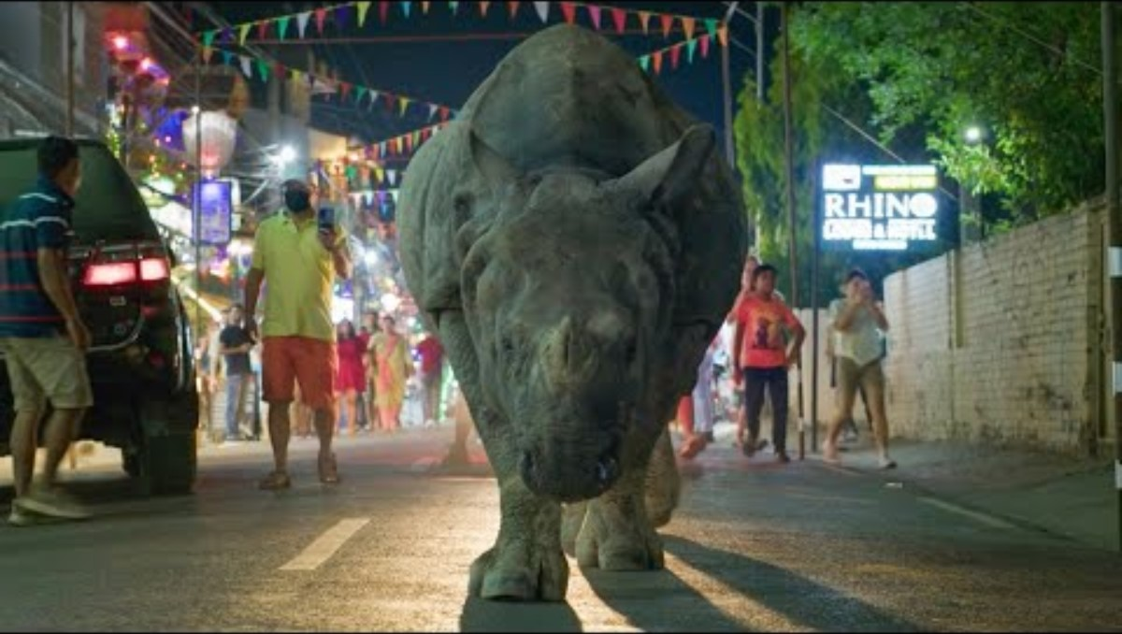
Our Schools Our World
Celebrating Water and the Natural World
Notes:
A chance to reflect about the importance of water and it's role in the natural world.

