Slide 1
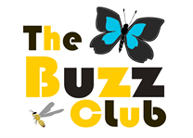
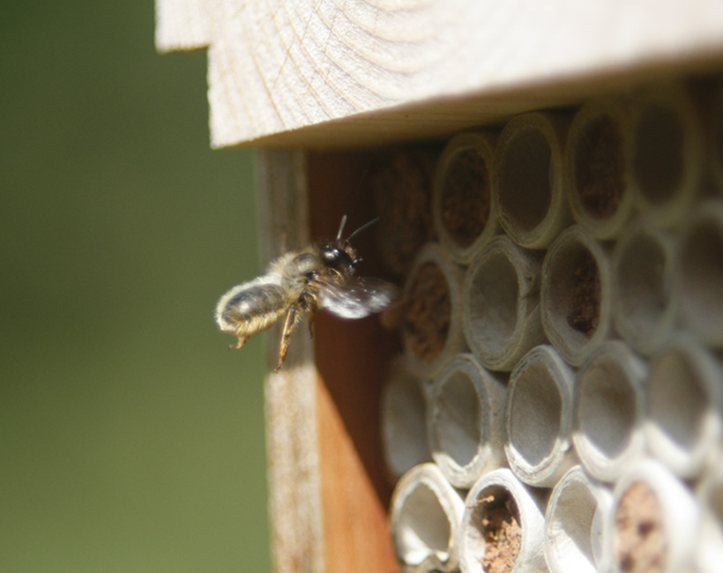

The Big Bee Hotel Experiment
Thanks for choosing
the Big Bee Hotel Experiment
as a SSFSF project, to work on across the city’s secondary schools.
By taking part in this project, you will be contributing to real science and will help to conserve bee species across the UK. You will also be encouraging more pollinators to visit your school and increasing its ecological value.

Slide 2
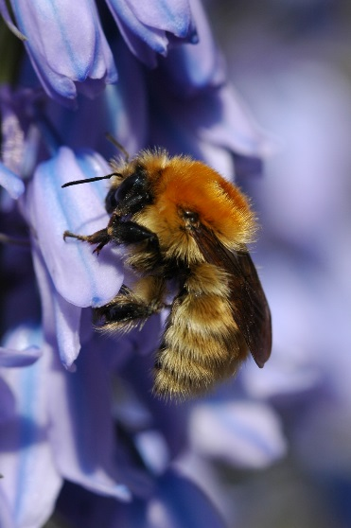
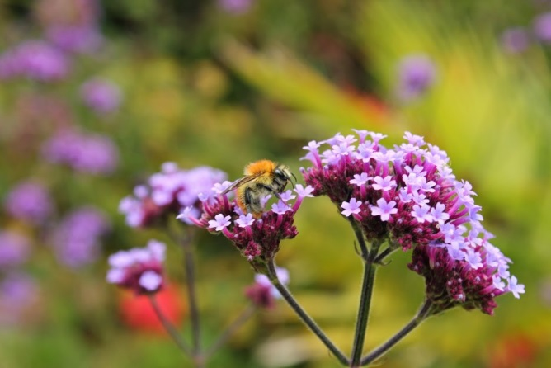
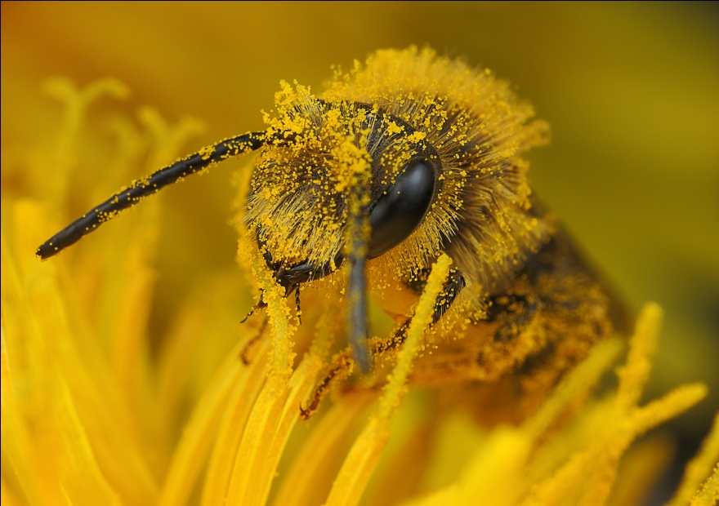
Did you know?
Bees pollinate 30% of the worlds crops and 90% of wild flowers
It would cost farmers about £1.8 billion to pollinate crops without bees
There are around 270 different species of bee in the UK
13 species of UK bee are already extinct and 35 species at risk
2024 recorded the lowest number of bumble bees since records began

Slide 3
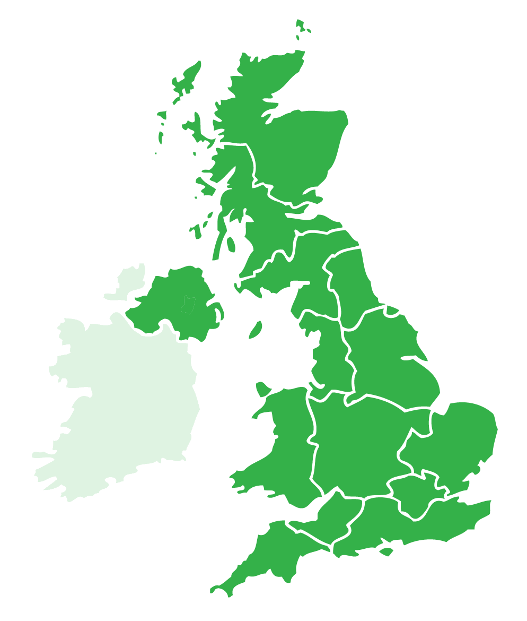
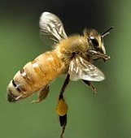
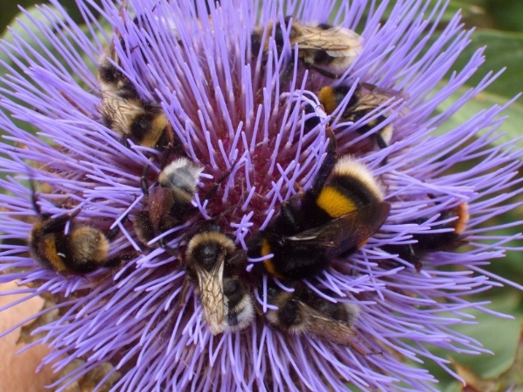
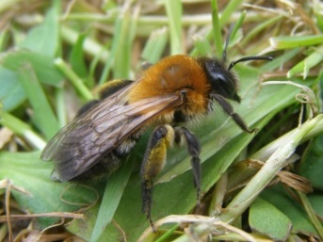
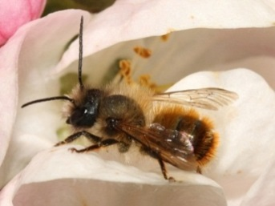
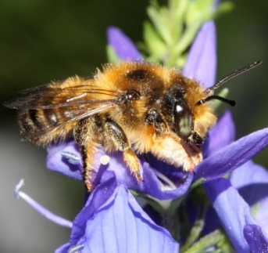
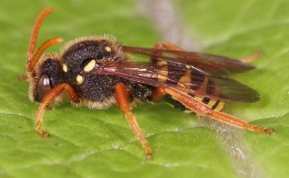
What bees can we find in the UK?
Honeybee (1 species) Bumblebees (~27 species) Solitary & Other bees (~250 species)

Slide 4

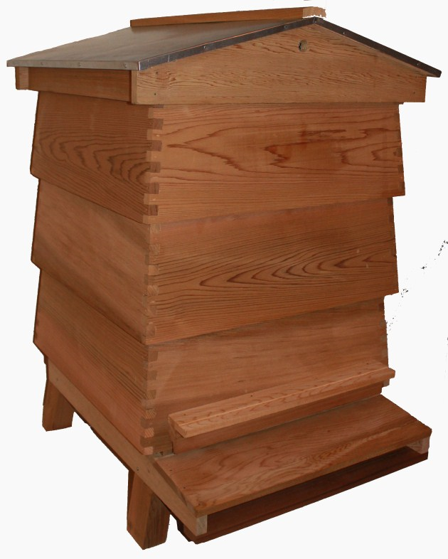
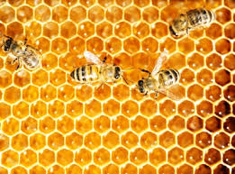
Honey bee
Live in hives (one queen, a few hundred drones, and thousands of worker bees)
Make honey
Die after stinging
Notes:
Smaller and thinner than bumblebees
Shorter tongues – need open flowers to reach nectar
Up to 60,000 bees can live in a hive
Queen and daughters live in hive all year – queen can live for 3-4 years
Use a waggle dance to communicate – showing other bees where they can find flowers

Slide 5
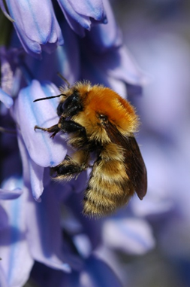
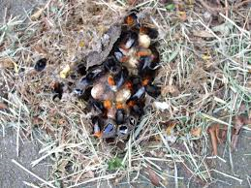
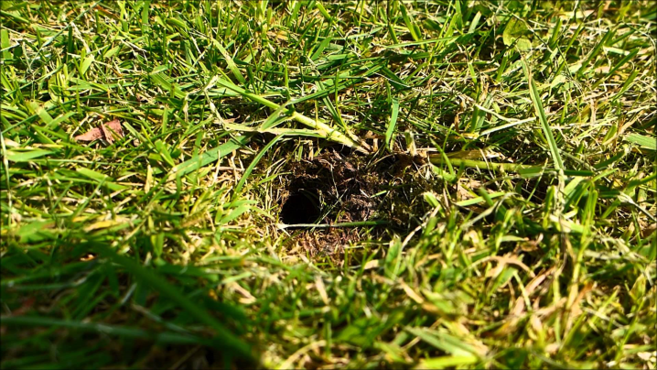
Bumble bee
Rarely sting
Live in nests - often underground
Notes:
Fat and furry
Their stings are not barbed, so they don’t die when they sting, and can sting more than once
Use disused burrows made by small rodents eg mice and voles. The queen will use dry grass and moss to create insulation for her own nest. She incubates her eggs until the larvae hatch. They are fed on both pollen (for protein) and nectar (for energy)
Some bumblebees will nest above the ground in piles of dead leaves, long grass or old birds nests
Bumblebee colony formed of between 50-200 individuals. Comprised of a queen (large female) and workers (her offspring, smaller and female). The workers collect pollen and nectar and maintain wax cells and look after the young. Colony starts to decline after 2-3 months – workers, males and old queen will die. New queens will hibernate over winter and will emerge in spring / early summer.

Slide 6
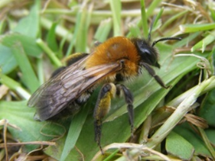


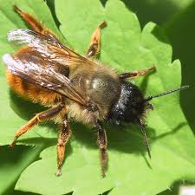

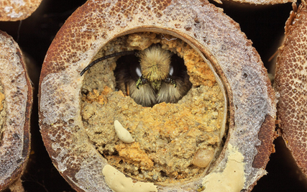
Solitary bee
Don’t sting
Live as individuals, not in colonies
Most likely to see the Red Mason Bee
Notes:
Lots of different sizes, shapes and colours
Don’t sting
Important for pollination
Lay eggs in cells constructed in underground tunnels, old stone walls or within dead wood
Live as individuals – no workers, but can often nest communally or in large groups
In your garden, most likely to see the Red Mason Bee – nests in all kinds of holes and cavities, constructs nest cells from mud

Slide 7
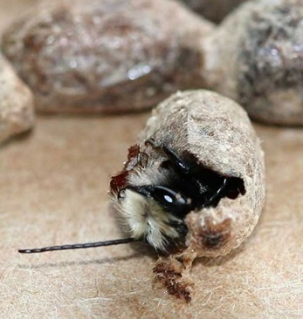
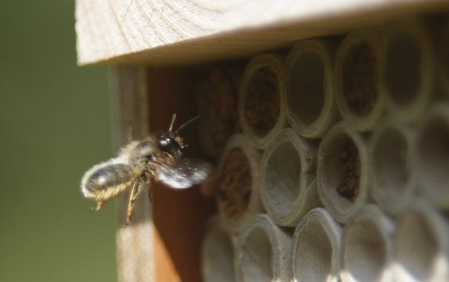
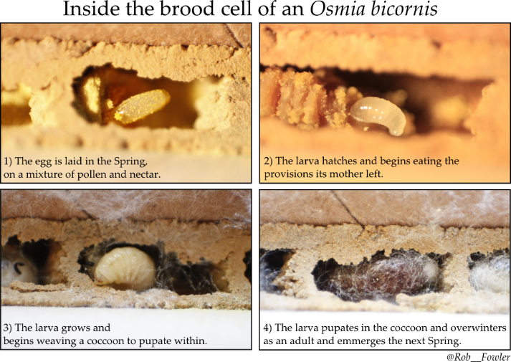
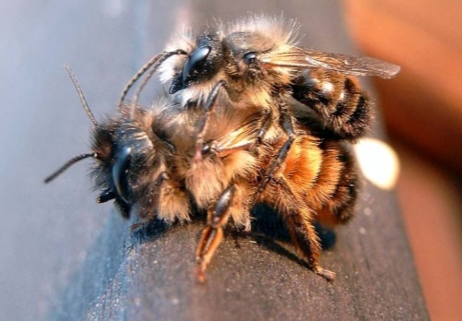
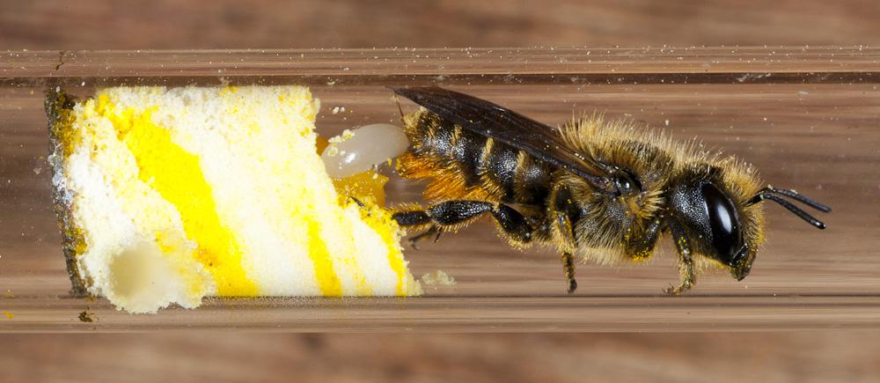
Solitary bee life-cycle
March-April
April - May
June – November
Overwinter
Notes:
March-April – Red Mason bees will being to emerge from cocoons they have overwintered in once the weather begins to turn more spring-like and the temperature increases. Males will emerge first and ‘hand around’ whilst females emerge about a week or two later. Males and females will mate. Males then usually die off after a month, as their main role is to mate with the female bees.
April-May – This is the most active time for Red Mason bees. The females will start looking for suitable nesting locations to lay their offspring. This is typically some type of empty tube or hole in masonry. In the wild, they will try to find the dead stems of trees/shrubs, or use holes in rock faces or dead wood. However artificial holes such as bamboo, cardboard tubes or drilled holes in wood are very attractive for these bees as they are perfectly suited for their needs. Once a nesting site is found, the female will forage for pollen and nectar in the local area. She will collect pollen and attach it to the underside of her abdomen where specially adapted/toughened hairs will keep it in place after she has added nectar to make it sticky. She’ll take this pollen back to her nest and place it in a clump at the end of the tube. Once she decides it is big enough, she will lay an egg on the ‘pollen ball’ and close off the ‘brood cell’ using mud she has mixed with water. This will protect her offspring from parasites. She will continue to do this all the way down the tube until it is full of offspring.
June-November – Most information is on the picture. Once the egg is laid, it will hatch in a few days the larva will start to eat the pollen and nectar left by its mother. The pollen contains essential nutrients for the bee to grow into an adult, including protein, carbohydrates and lipids. As the larva grows, it will start to resemble and large grub. Once it reaches a certain size or eats all of its pollen, it will begin to make a cocoon surrounding itself in a protective layer. This will give it protection against the cold temperatures over the winter. Once the cocoon is complete, roughly around the end of summer, the larva starts to pupate and change into an adult bee. Once it is an adult, it remains in the cocoon until spring when the temperature starts to rise again. Then, it emerges, completing the life cycle.

Slide 8
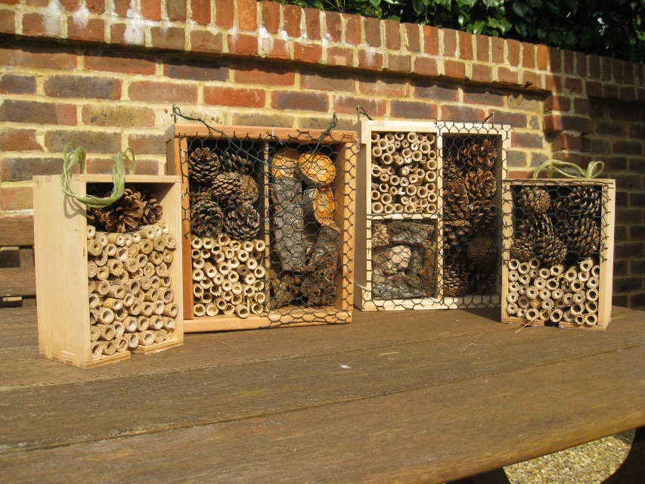

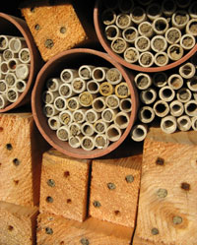
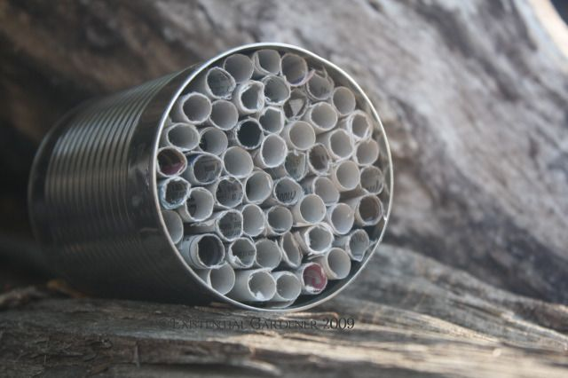
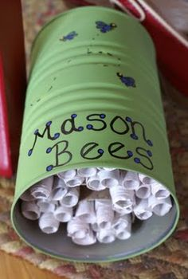
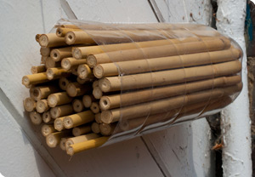
Bee Hotels
Bee hotels help provide vital habitats for bees to lay their eggs and overwinter.
Ideal hole size is around 8mm in diameter.
The Big Bee Hotel Experiment is looking at what design features bees like best in a hotel and where they like them placed.

Slide 9
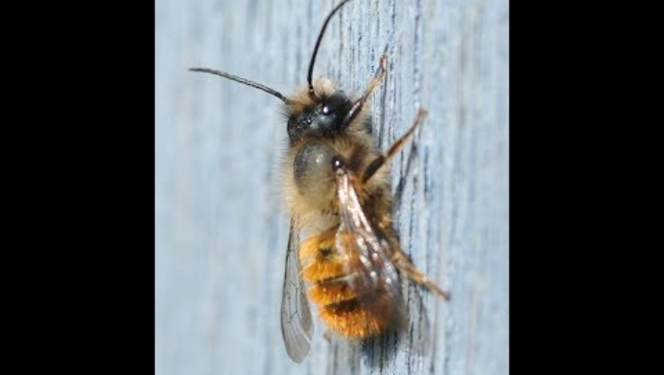
Notes:
Ideas for Making a Bee Home – from 58 seconds in

Slide 10
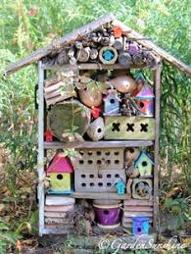
Bee Creative
Bees have a lot to see and distinguish between when flying around – they have to;
spot flowers at speed
learn where the best pollen and nectar sources are
find available nesting sites
remember how to find their nests when they leave and return from a foraging trip.
Can colour help them to better spot their hole in a bee hotel?
This project asks you to decorate your bee hotel with a non-toxic marker/paint, clearly differentiating between available holes.

Slide 11

Next Steps
Sign up
Make a colourful bee hotel
Register your bee hotel on www.thebuzzclub.uk
Send the Buzz Club a photo of the hotel every month to buzzclub.uk@gmail.com so they can research which type of hotels are the most popular and whether colour makes a difference.

