Slide 1
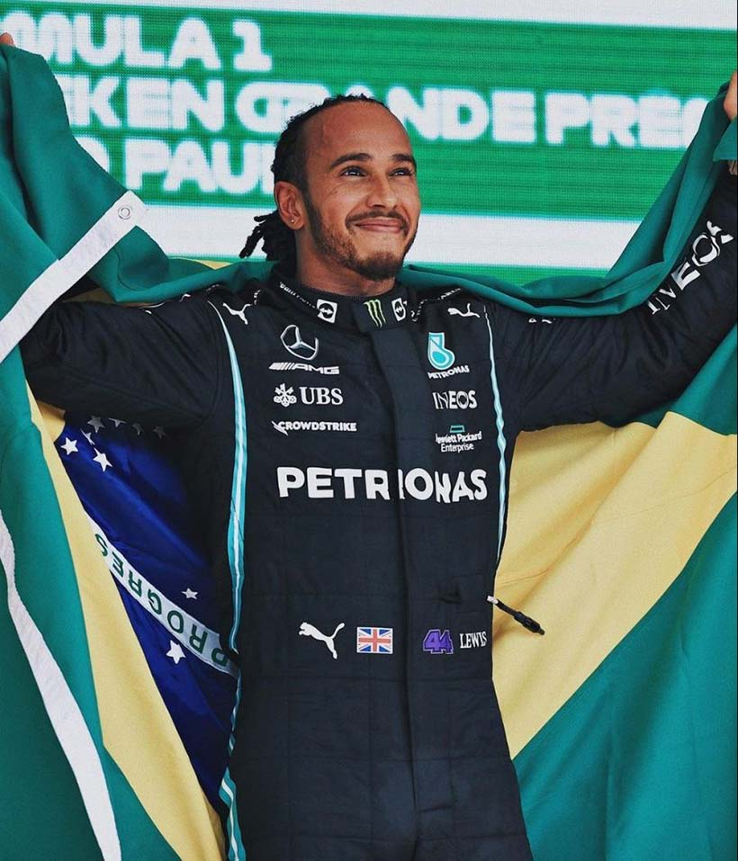
“I have more energy; I’m so much more productive. I wake up feeling way better, clearer in thought and fresher in my body.”
(Since going plant-based) “I recover quicker; I sleep better. My skin cleared up. I have fewer allergies. There are just so many impacts.”
“I’m physically in better shape than I’ve ever been, and I’m more successful than ever right now, and my plant-based programme has played such a big role in that.” Lewis Hamilton
Hamilton is an outspoken supporter of animal rights, having made the plant-based switch in 2017 after watching the Netflix documentary What the Health. He credits his vegan diet as the reason for his sporting success and changing his energy levels for the better.

Slide 2
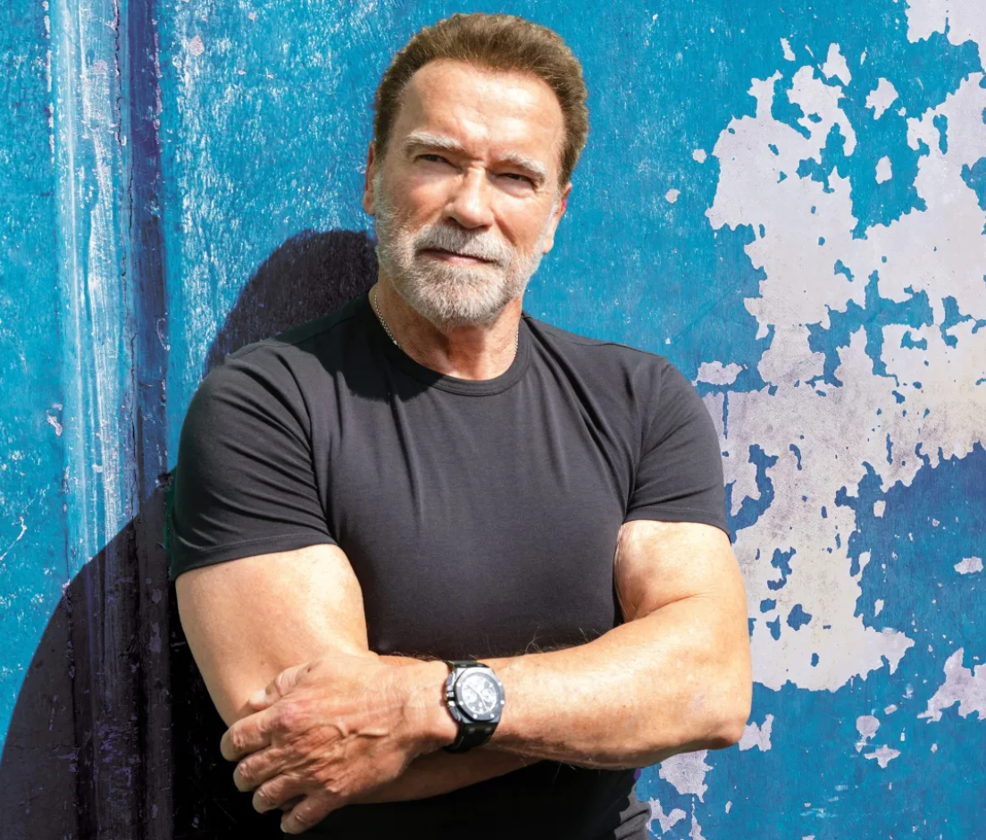
“I’m getting off meat and I’ll tell you, I feel fantastic.
Meat is a great source of protein but it’s not the only one. Your muscles won’t know the difference.
Bill Pearl was a vegetarian and he’s one of the greatest body builders ever.
You can be a body builder and care about something that’s bigger than your own muscles”
Arnold Schwarzenegger
Arnold Schwarzenegger (“Arnie”) has been a body builder, Hollywood actor and politician and has embraced a mostly plant-based diet, consuming about 80% vegan foods, and attributes it to improvements in his health and overall well-being

Slide 3
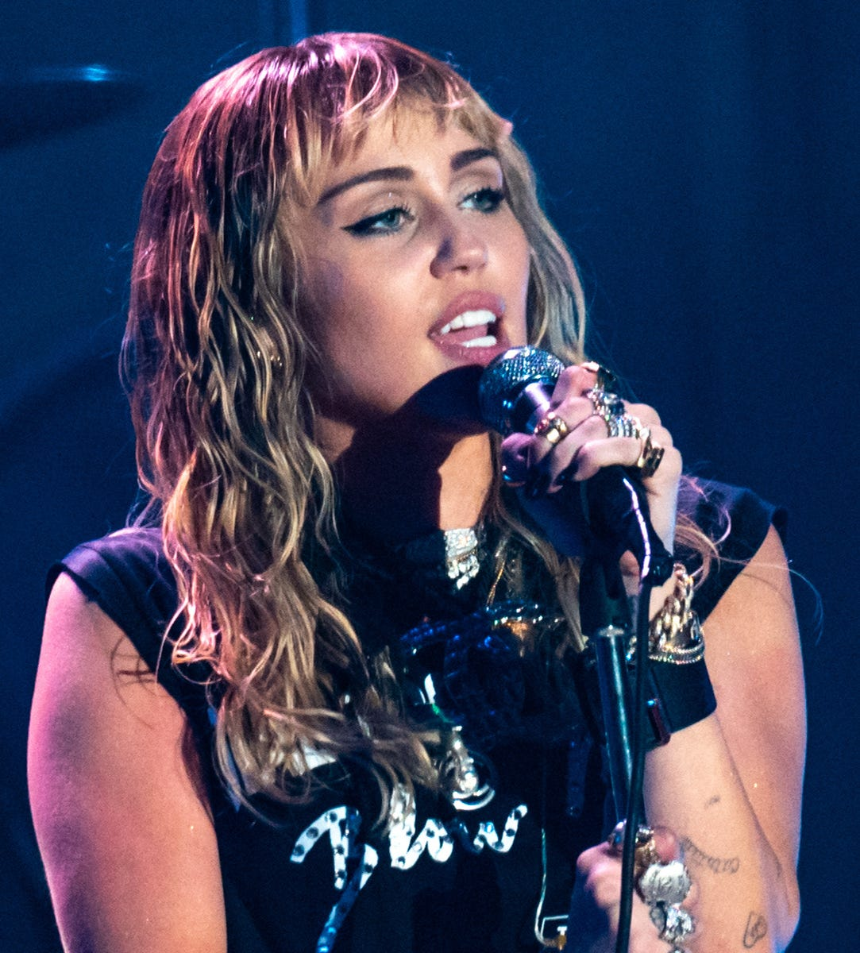
“I’m so proud to call myself vegan.
By not consuming animal products over the years, I have protected myself from preventable diseases and saved the lives of animals that would be turned into breakfast/lunch/dinner.
Think before you eat. Go vegan!”
Miley Cyrus
Miley Ray Cyrus is a American pop icon, singer, songwriter, and actress and became a vegan and stopped eating animal products in 2014

Slide 4
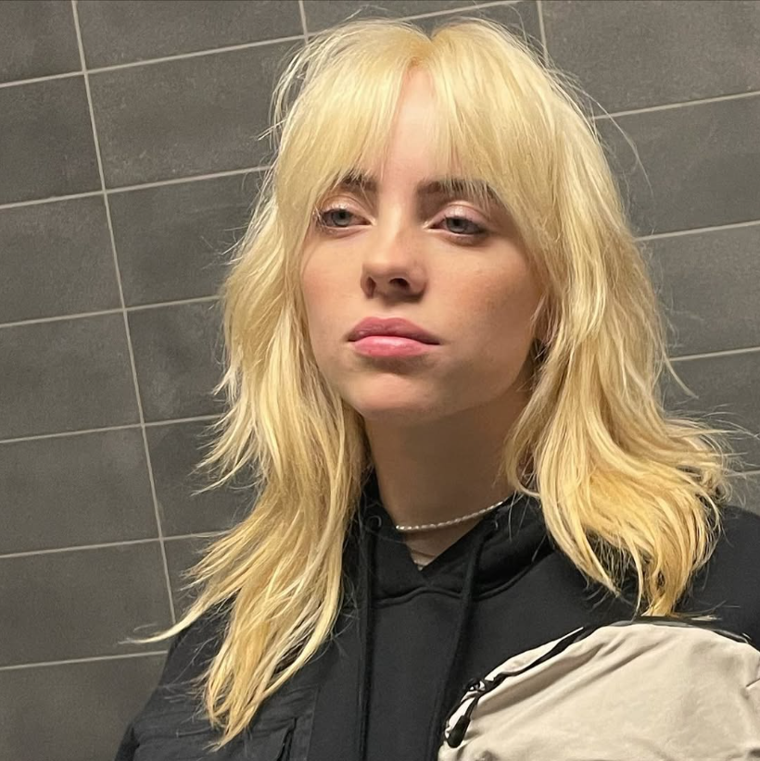
“Climate change is a huge threat facing all of us. Shifting our diets towards more plant-based foods can have a major impact on climate change. “
Billie Eilish
Music artist Billie Eilish was raised vegetarian and chose to stop eating all animal products when she was 12.

Slide 5
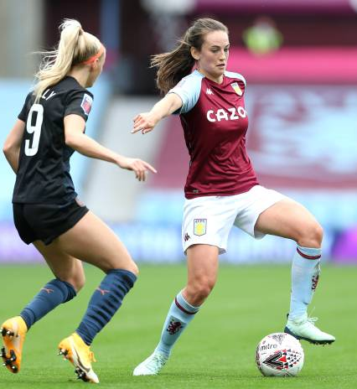
“I feel better in myself and recover better as an athlete”
“There are not really any downsides to it… I feel better for doing it [going vegan]. I would recommend it to anyone,”
Chloe Arthur
Chloe Susan Arthur is a Scottish footballer who plays as a midfielder for Crystal Palace in the Women's Super League and the Scotland national team.

Slide 6
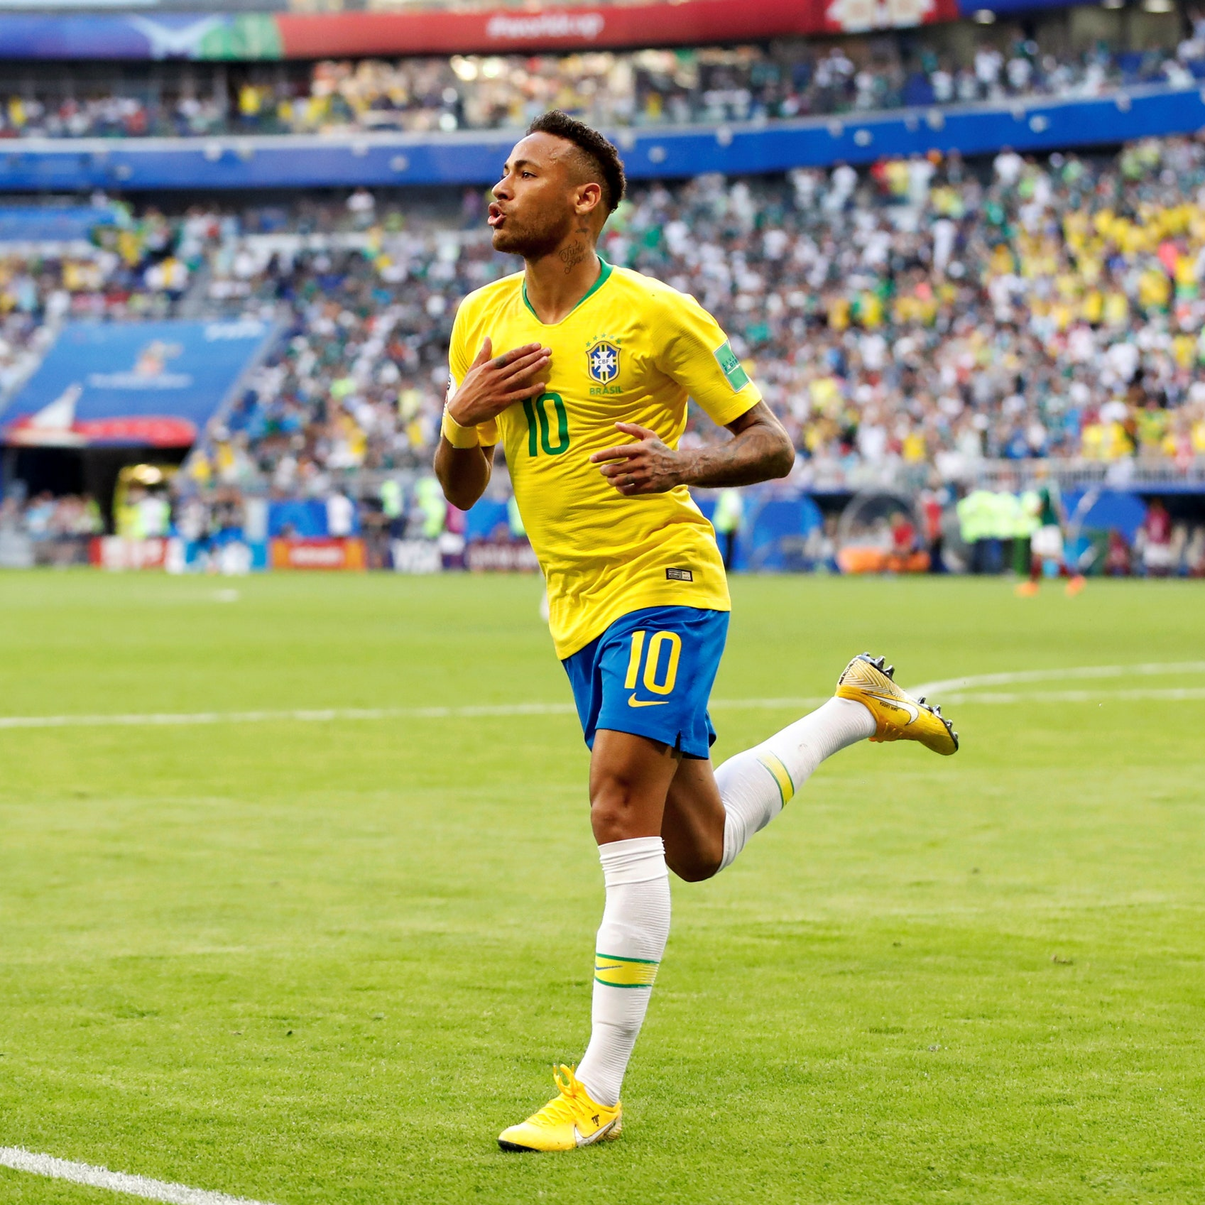
“At the moment I'm enjoying [a plant-based diet], I'm feeling well.
I had conversations with friends, watched documentaries.
I just want to give it a try”
Neymar Júnior
Neymar is a Brazilian professional footballer who plays for and captains Brasilian team Santos and the Brazil national team

Slide 7
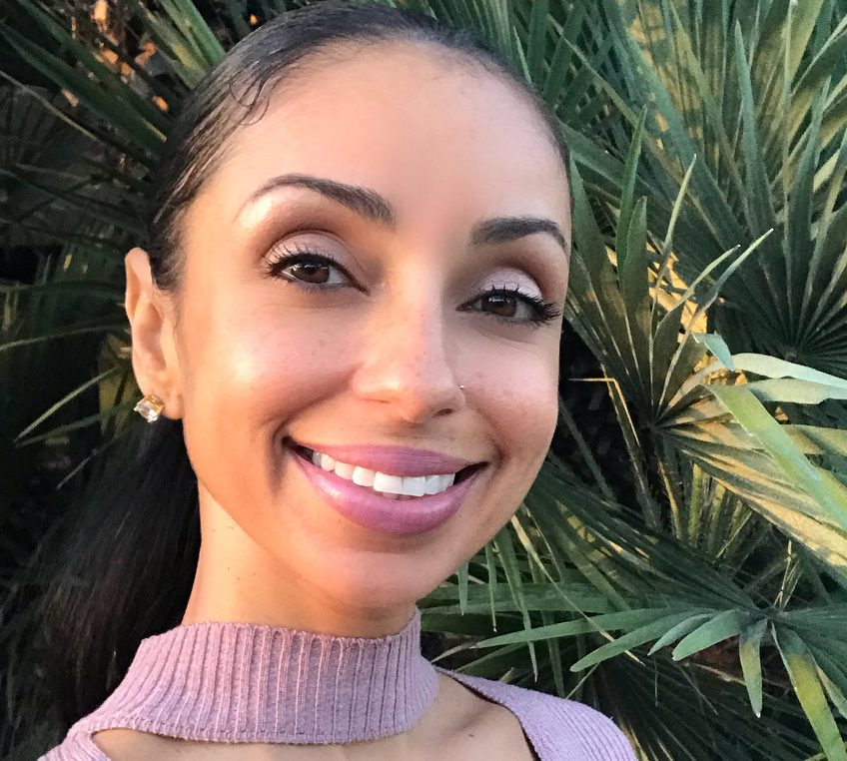
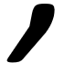
“Veganism has truly improved my overall health, well being, spirituality, creativity, and connection to all life. Ultimately, I have been able to see the bigger picture and align myself with the divine, the natural way, the Vegan Way”
Mya
Mýa, is an American singer, songwriter, dancer, record producer, and actress

Slide 8
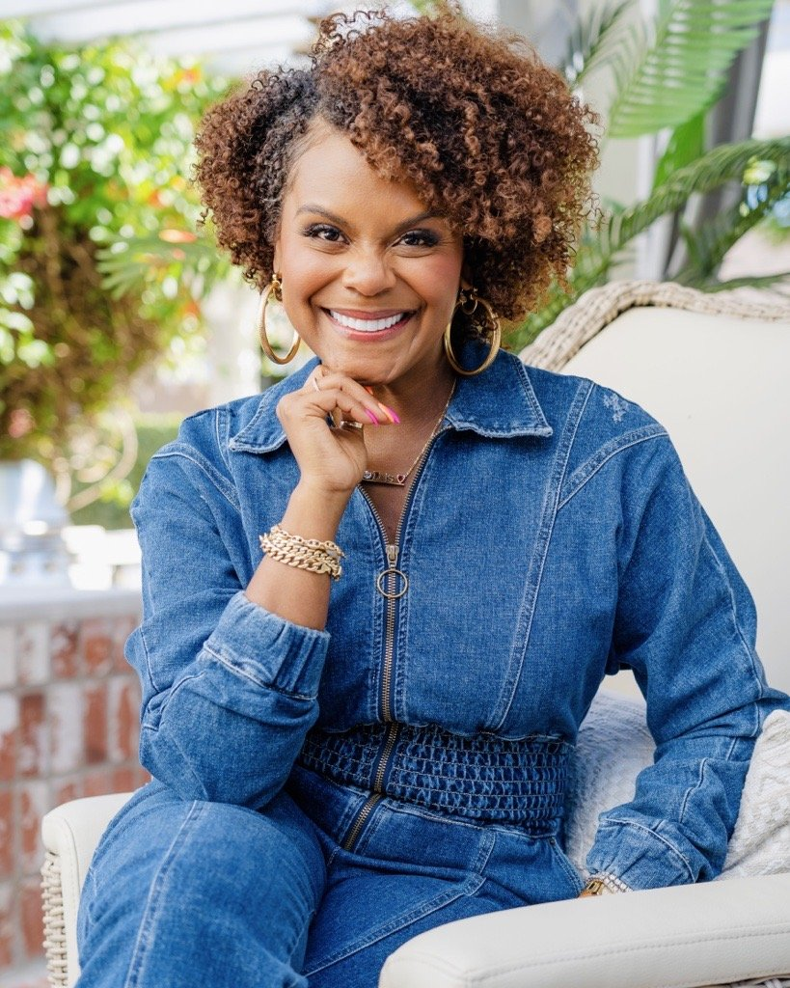
“I hope that people try veganism for their health, the animals and the planet. Even one meal a day can make a difference.
Start with adding something new, not taking something away”
Tabitha Brown
Tabitha Brown is an American actress, Emmy winning host, social media personality, entrepreneur, & author with millions of social media followers

Slide 9
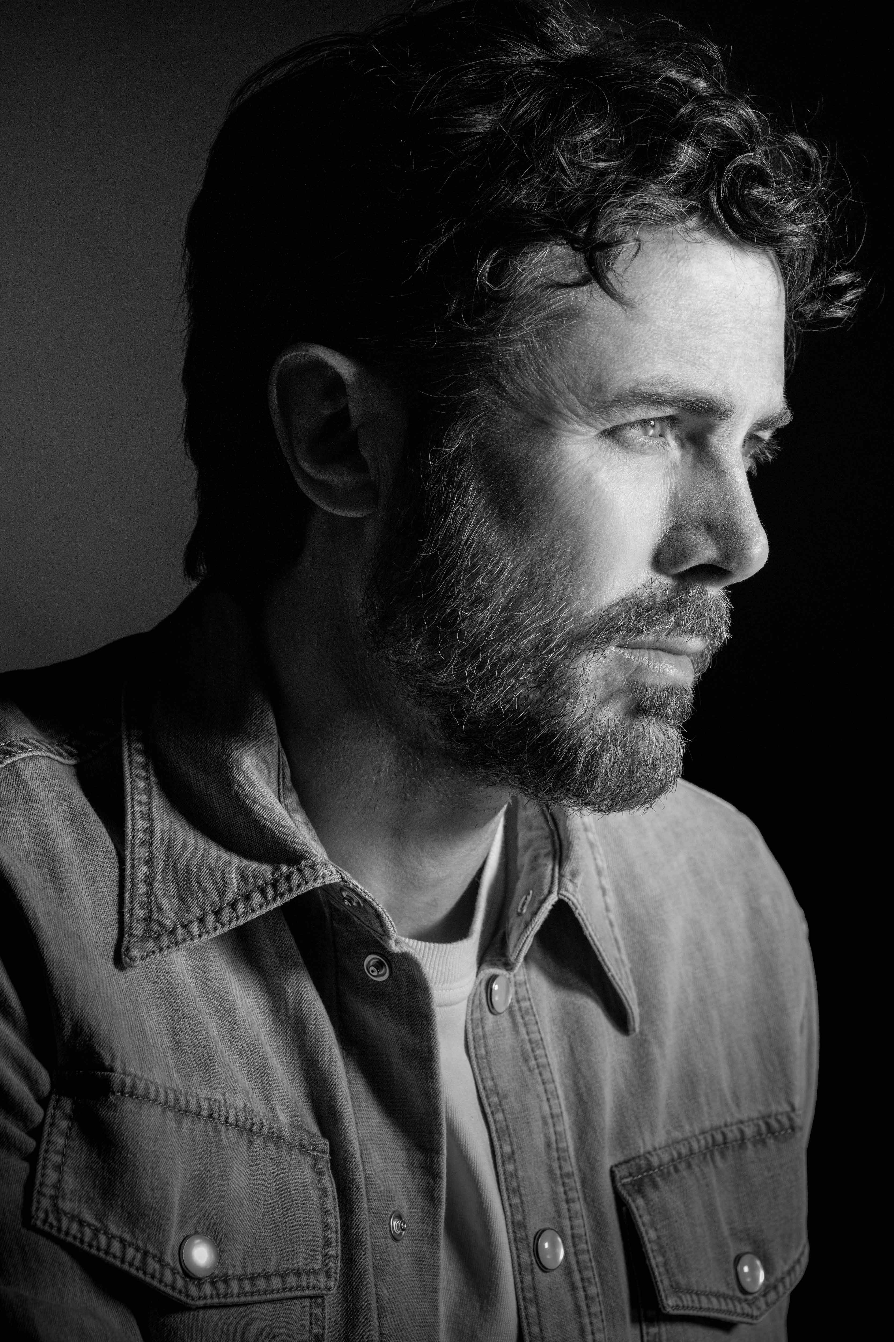
“When people ask me why I don’t eat meat, I say, ‘Because they are unhealthy and the product of a violent and inhumane industry’”
Casey Affleck
Casey Affleck is an Oscar, BAFTA and Golden globe winning actor

Slide 10
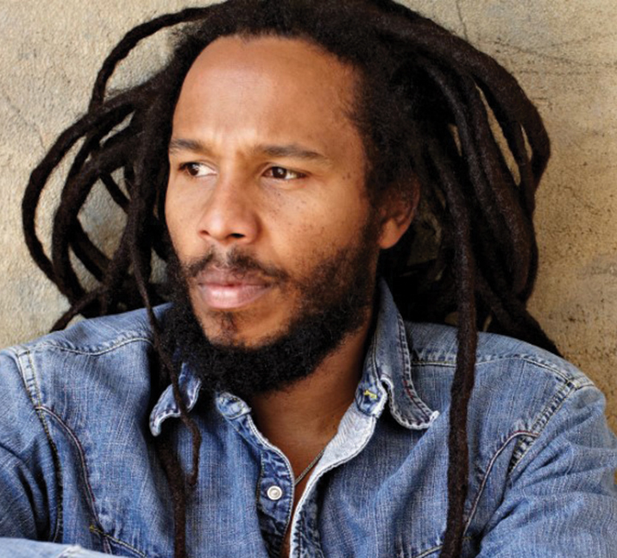
"The more red meat and blood we eat, the more bloodthirsty we get, the more violent we get. The more vegetarian food we eat, the more peace is taken into us."
Ziggy Marley
Musician Ziggy Marley, son of Bob Marley grew up in a Rastafarian community where many people ate a vegetarian or vegan diet.

