Slide 1

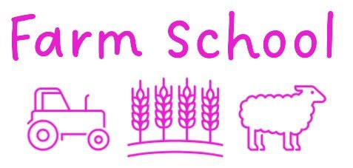
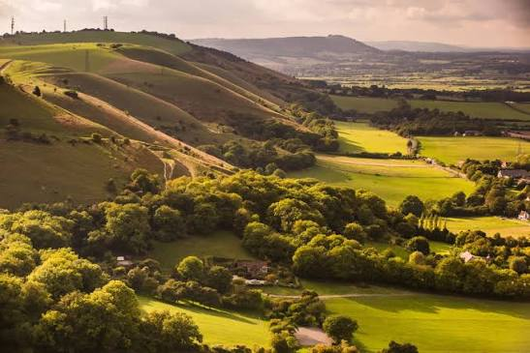
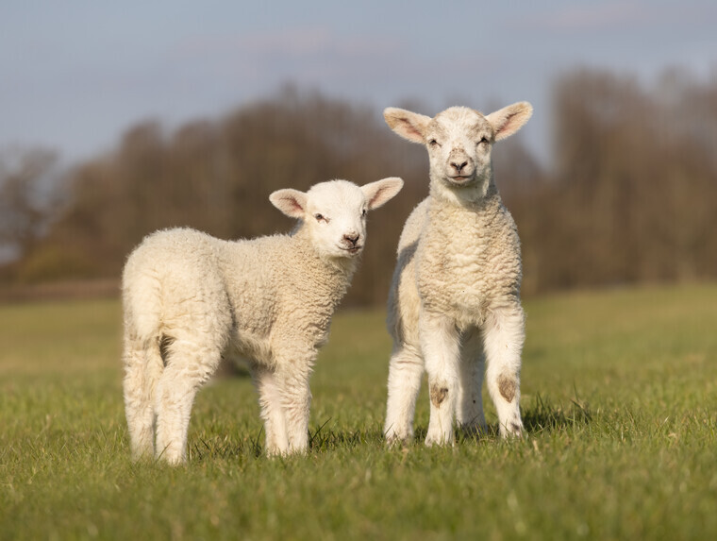
Our City , Our World and Farm School are teaming up to run two interactive EYFS and KS1 friendly webinars around farming, nature and sustainability.
To register for a place for your class, please click on the link below. Places are limited so register early.
14th
April
A day in a life of a local farmer.
Meet two local farmers who live and work on the South Downs.
Find out more about what a farmer does all day, what do they love about their job and what parts they don't.
What can we do to help farmers?
Wednesday 14th April 11.00am-11.30am.
Register here.
Register here
28th
April
Live Lamb Feeding at Truleigh Hill
Join Hannah, from Farm School, and Farmer Emma as they introduce you to four new arrivals at Truleigh Centre on the South Downs.
Thursday 28th April 11.00am-11.30am.
Register here
Register here

