Slide 1

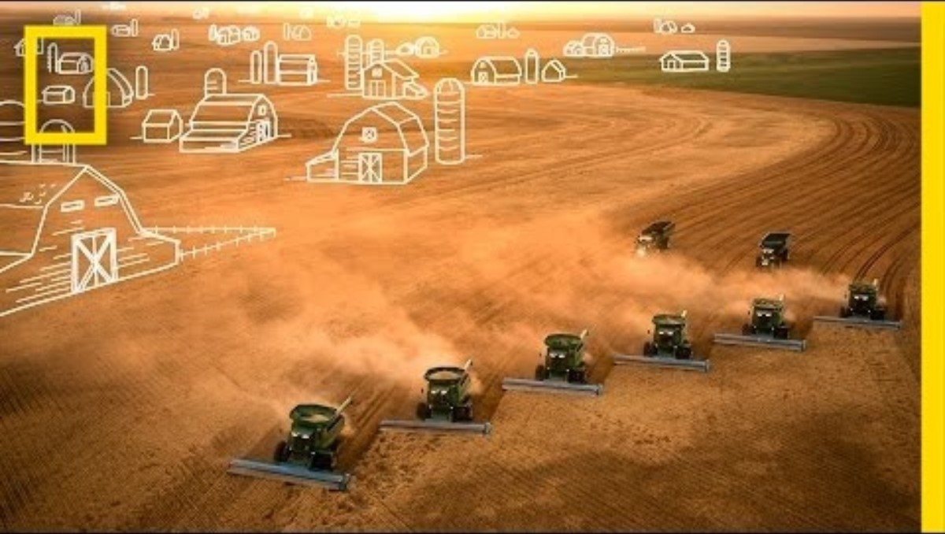
Food –Discussion 1
Food production

Slide 2
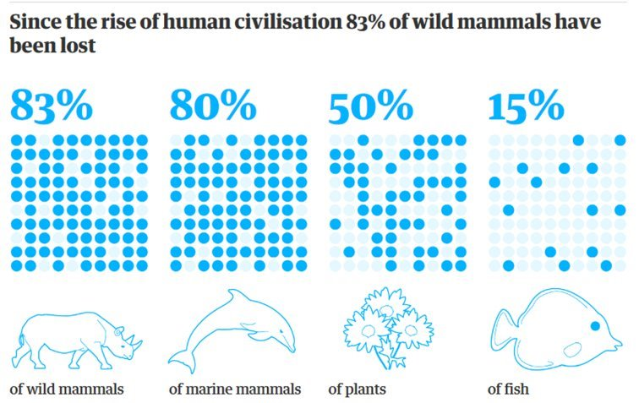
Food –Discussion 1
Food production
Nearly half of the habitable land on the planet is given over to agriculture and 80% of this is taken up for livestock, yet it only supplies 17% of our food energy.
Taking all this land for our food supply has been devastating for wildlife.

Slide 3
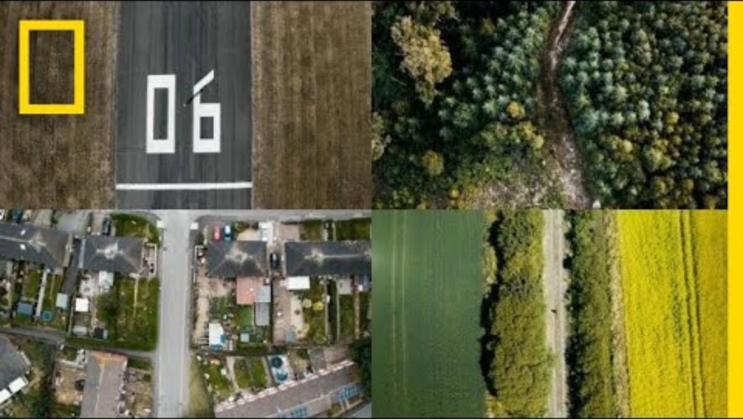
Topic –Food
Discussion 1 – Food production
https://youtu.be/LUSK2CxsLMk

Slide 4
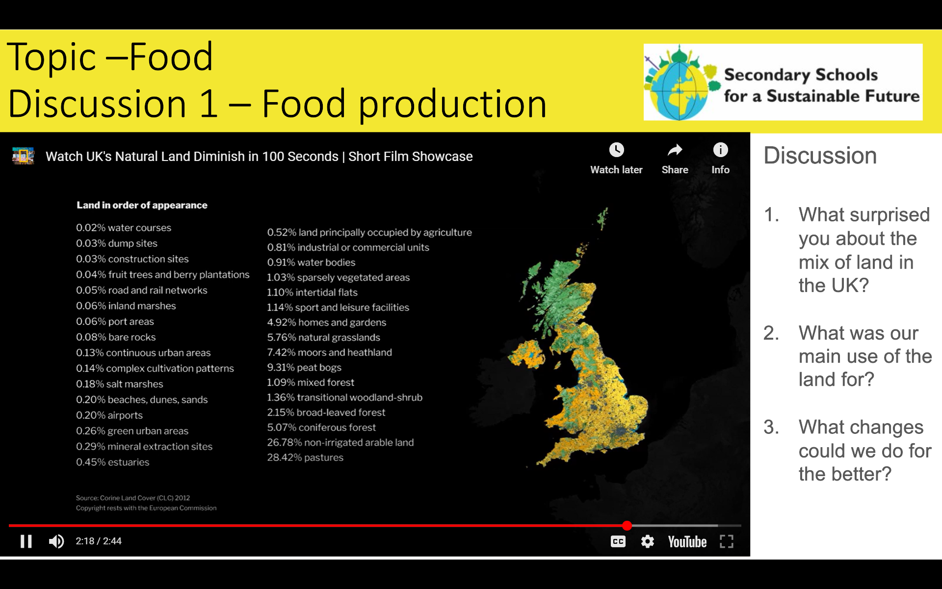
Topic –Food
Discussion 1 – Food production
Discussion
What surprised you about the mix of land in the UK?
What was our main use of the land for?
What changes could we do for the better?

Slide 5
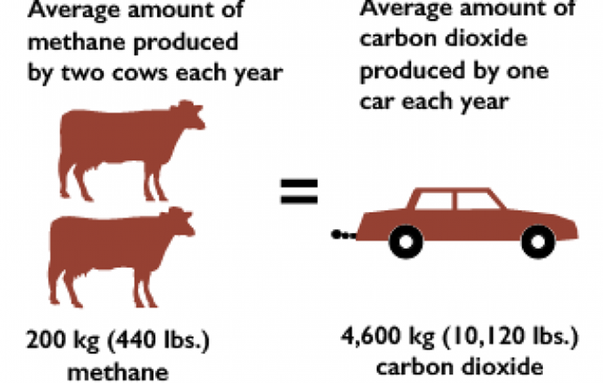
Food – Discussion 2
Impacts of Food Production – Greenhouse Gases
Methane is about 23 times more powerful as a greenhouse gas than Carbon Dioxide.
It is estimated that there are 1.6 billion cows on the planet.

Slide 6
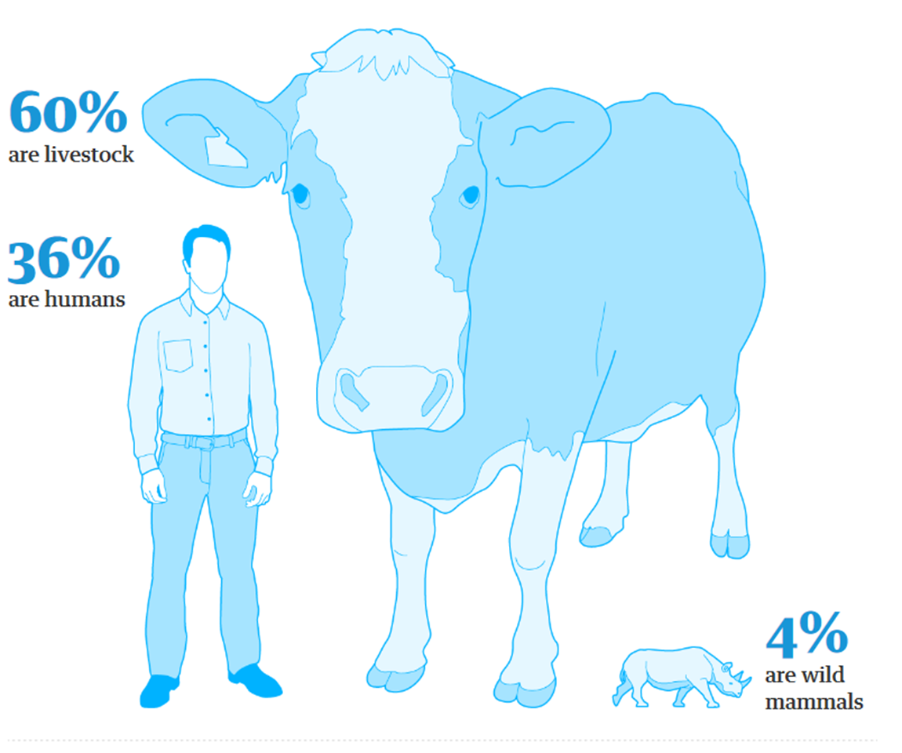
Food – Discussion 2
Impacts of Food Production – Biodiversity loss
The total biomass weight of all mammals on the planet
What percent of mammals (by weight) on Earth are wild?
6%? 60%? 96%?

Slide 7
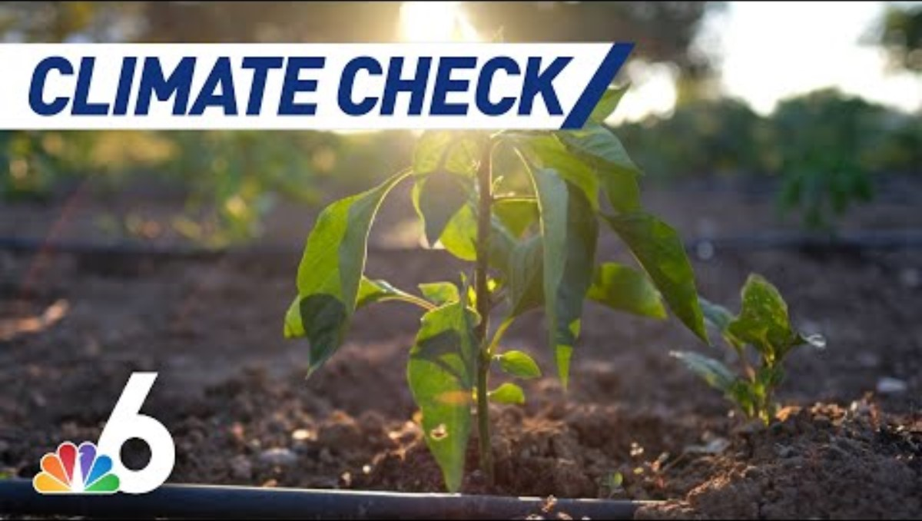
Food – Discussion 2
Impacts of Food Production
Discussion
What surprised you in this video?
What things do you to know more about?

Slide 8
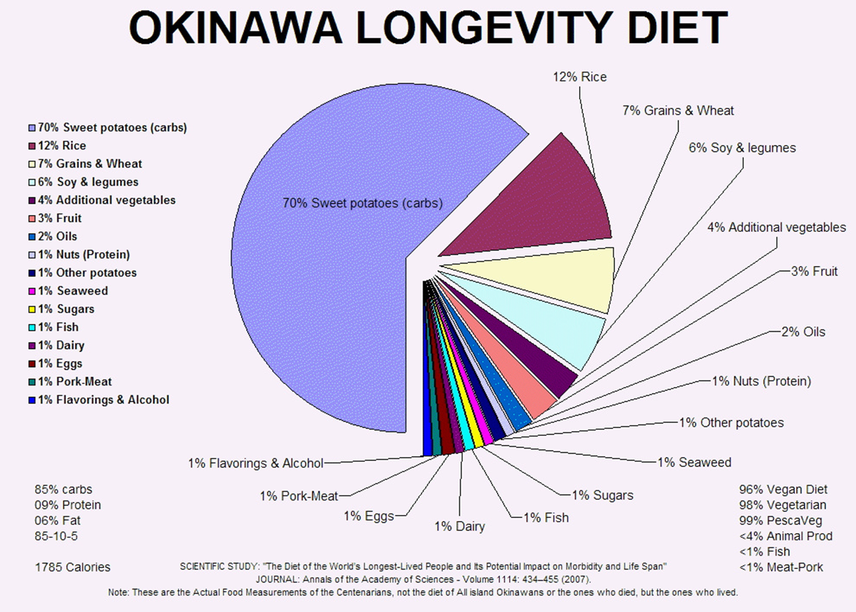
Food – Discussion 3
Nutrition
Until 2000 people living in Okinawa, Japan had some of the longest life spans in the world, many reaching 100 years old. This was thought mainly due to their diet. They ate 1% Meat, 1% Fish, 1%Dairy and a staggering 70% sweet potatoes. They were 8 times less likely to die from a heart attack/disease, 7 times less likely to get prostate cancer and 6 times less likely to get breast cancer.
However, in recent years their diet has changed with far more meat, fatty foods and processed sugars and the result has been a drop in life expectancy and a rise in cancers.

Slide 9
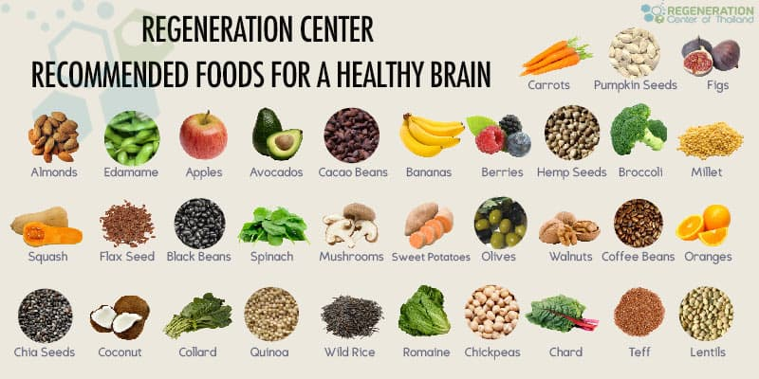
Food – Discussion 3
Nutrition
Every week there is more and more research coming out about how what we eat has a major impact on our health both physically and mentally.
The food industry has taken advantage of our bodies hard wired desires for sweet/fatty foods high in calories. This stems from when we were living in caves and had very few natural sources of sugar.
What we know now is that a diverse mixture of food stuffs can improve our health and increase our brain function.

Slide 10

Food – Discussion 3
Nutrition
Watch this video about all these body builders that moved away from eating meat.
Questions/Discussion
What surprised you about this video?
Who in society is sending us the messages that we must eat lots of meat?
Has this video made you think about changing anything in your own diet? What? Why?

Slide 11
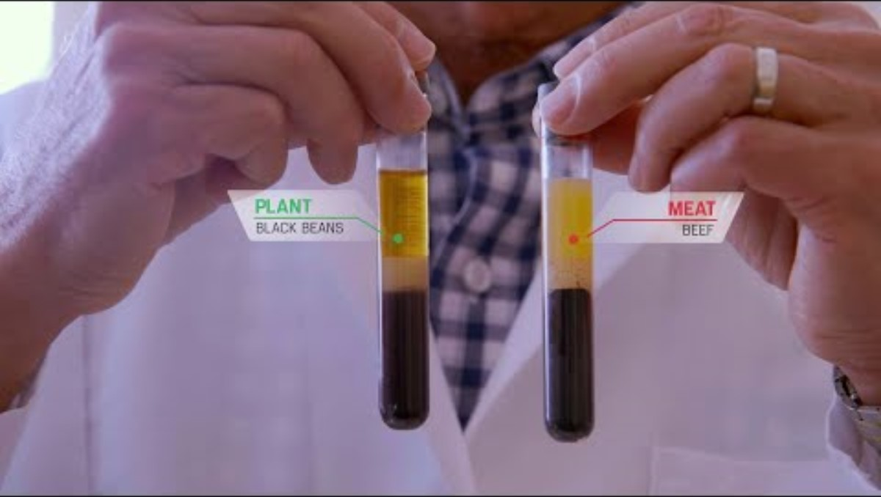
Food – Discussion 3
Nutrition – extension resources
Watch this video about the science in the Game Changers movie.
Questions/Discussion
What surprised you about this video?
Who in society is sending us the messages that we must eat lots of meat?
Has this video made you think about changing anything in your own diet? What? Why?

Slide 12


Food – Discussion 4
Food waste and packaging in schools.
We are the only species to create waste that nature cannot break down.
First, we destroy habitats digging minerals out of the ground or cut down forests or clear habitats to grow things that we use.
Second, we pollute air and water making things in factories using chemicals that nature is unable to break down and can be poisonous.
Thirdly, we pollute more with packaging and driving the goods around and driving to go and buy this stuff.
Finally, we end up throwing this stuff away polluting the environment further. Recycling doesn't solve the problem.
LINEAR PROCESS - WASTE IS JUST WASTE!

Slide 13
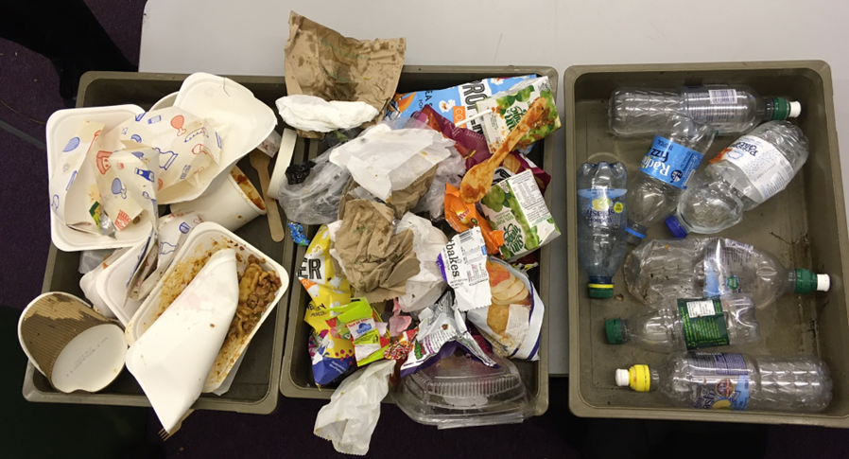
Food – Discussion 4
Packaging in schools
Different school canteens offer different types of food packaging which results in a range of different wastes.
Questions/Discussion
In your school what do you think makes up the most waste?
What changes do you think they could do to reduce this waste?
What changes could you make to reduce the amount of waste?

Slide 14
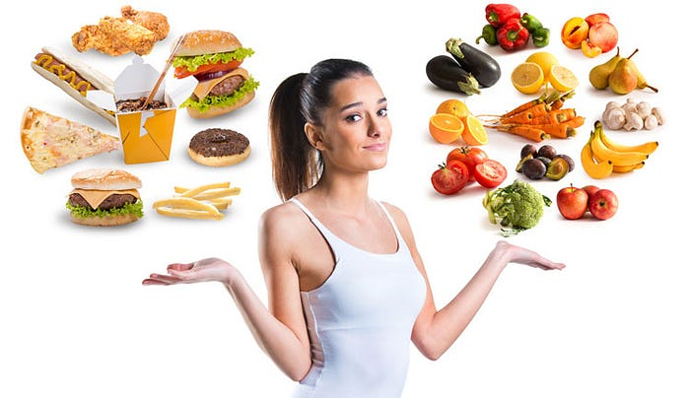
Food – Discussion 5
How do we action change?
Ultimately we have a choice about what we eat, however, we are reliant on the people and organisations that supply us with food to make sure we have the opportunity to make those choices.

Slide 15
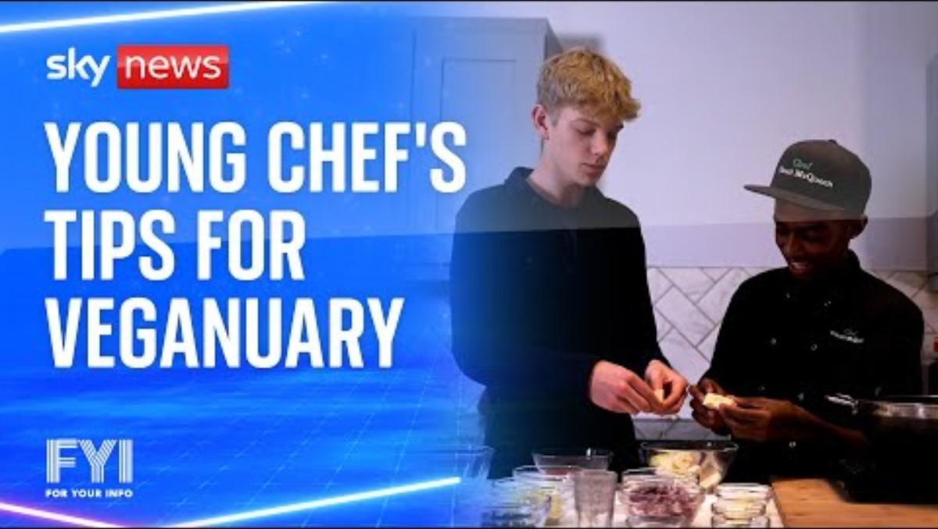
Food – Discussion 5
How do we action change?

Slide 16
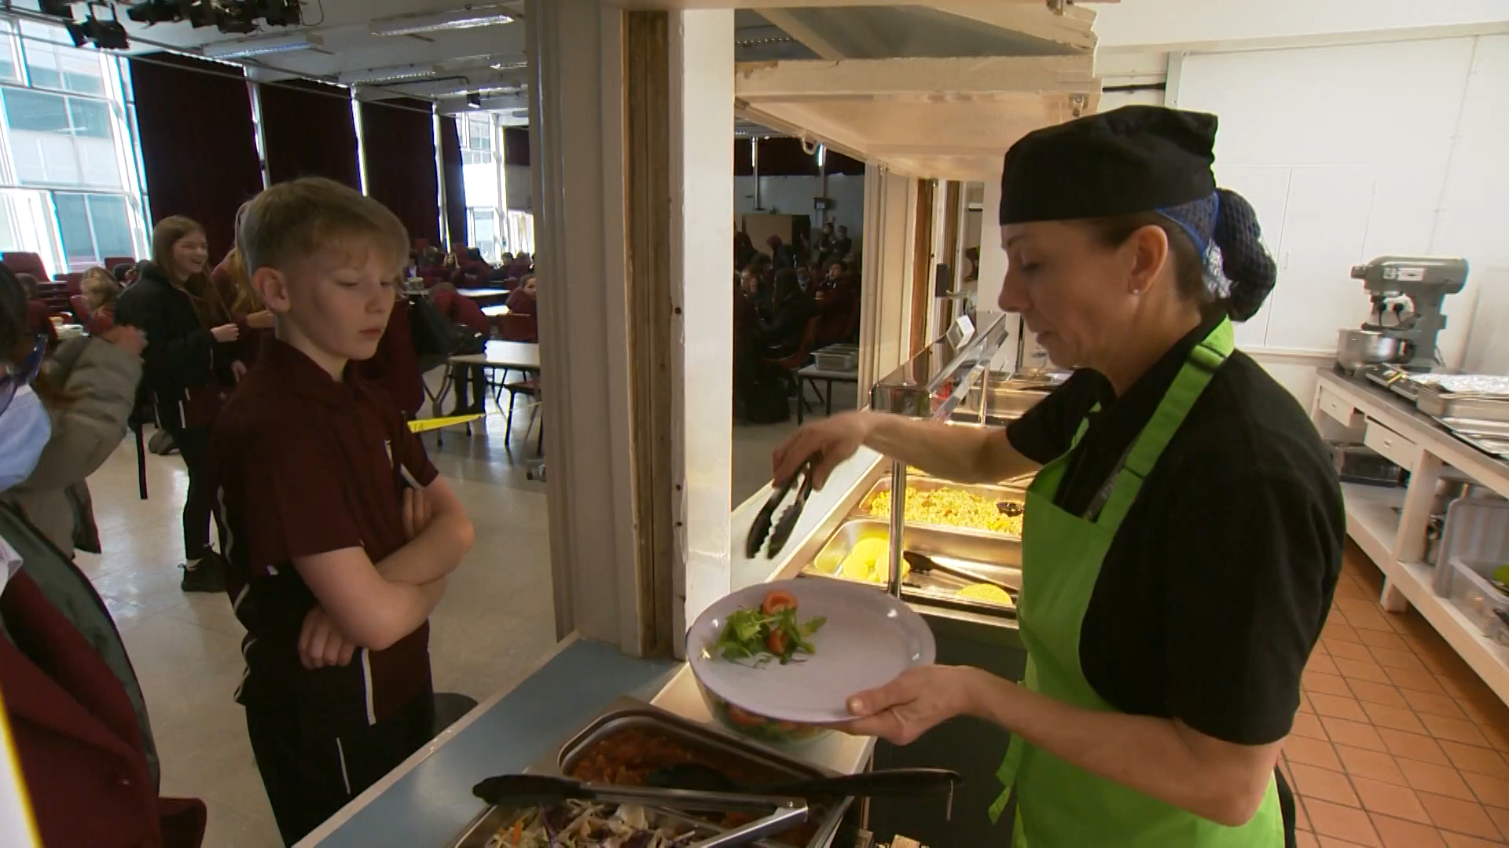
Food – Discussion 6
What changes can we make at our school?
This school took the initiative and offered students a tasty, low carbon, plant-based meal selection. Watch the video
Questions
What are your initial thoughts after watching the news clip?
Do you think this could work in our school? If not everything – which parts?
Would you try some of these foods if offered? Why not?
Click Here to find out about the school in Worthing that went to a plant-based kitchen

Slide 17


Food – Discussion 6
What changes can we make at our school?
Over the last few discussion sessions we have seen the environmental impact of food production and the health and environmental benefits of making certain choices around food.​
Click here to answer the 2 minute survey on food!

Slide 18
Food – Discussion 6
What changes can we make at our school?
Over the last few discussion sessions we have seen the environmental impact of food production and the health and environmental benefits of making certain choices around food.
The previous slide has the links to the Forms questionnaire that has these questions:
Which of these are important factors when choosing food at school? (healthiness, sustainability, price, taste, size)
Do you think our school should provide students with food that is healthy?
Do you think our school should provide students with food that has a low impact on the planet?
Do you think our school should reduce food packaging, containers and cutlery?
Do you see much food being wasted at school?
Do you think our school should recycle food waste?
Would you consider reducing your meat intake to improve your health?
Would you consider reducing your meat intake to reduce the impact on the planet?
What would encourage you to choose a vegetarian option? (Cheaper, tastier, bigger, low carbon label)
What vegetarian options would you like to see in the canteen? (If no time, jot down on paper)
Do you have any other ideas or comments about how we could make our school canteen more sustainable?

